Slide 1

N-Gram Language Models
CMSC 723: Computational Linguistics I ― Session #9
Jimmy Lin
The iSchool
University of Maryland
Wednesday, October 28, 2009

Slide 2
N-Gram Language Models
What?
LMs assign probabilities to sequences of tokens
Why?
Statistical machine translation
Speech recognition
Handwriting recognition
Predictive text input
How?
Based on previous word histories
n-gram = consecutive sequences of tokens
Notes:
What does modeling a language, say, English actually mean ?
Explain Noisy Channel Model for SMT to show the language model utility

Slide 3
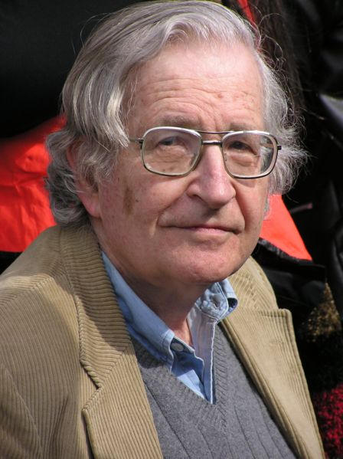
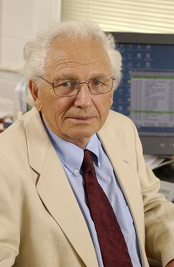
Huh?
Noam Chomsky
Fred Jelinek
But it must be recognized that the notion “probability of a sentence” is an entirely useless one, under any known interpretation of this term. (1969, p. 57)
Anytime a linguist leaves the group the recognition rate goes up. (1988)
Every time I fire a linguist…

Slide 4
N-Gram Language Models
N=1 (unigrams)
This is a sentence
Unigrams:
This,
is,
a,
sentence
Sentence of length s, how many unigrams?
Notes:
What are n-grams ? We already saw what they are sort of when we looked at NgramTaggers.

Slide 5
N-Gram Language Models
N=2 (bigrams)
This is a sentence
Bigrams:
This is,
is a,
a sentence
Sentence of length s, how many bigrams?
Notes:
What are n-grams ? We already saw what they are sort of when we looked at NgramTaggers.

Slide 6
N-Gram Language Models
N=3 (trigrams)
This is a sentence
Trigrams:
This is a,
is a sentence
Sentence of length s, how many trigrams?
Notes:
What are n-grams ? We already saw what they are sort of when we looked at NgramTaggers.

Slide 7

Computing Probabilities
[chain rule]
Is this practical?
No! Can’t keep track of all possible histories of all words!
Notes:
Sentence with T words - assign a probability to it

Slide 8
Approximating Probabilities
Basic idea: limit history to fixed number of words N
(Markov Assumption)
N=1: Unigram Language Model
Relation to HMMs?

Slide 9
Approximating Probabilities
Basic idea: limit history to fixed number of words N
(Markov Assumption)
N=2: Bigram Language Model
Relation to HMMs?
Notes:
Since we also want to include the first word in the bigram model, we need a dummy beginning of sentence marker <s>. We usually also have an end of sentence marker but for the sake of brevity, I don’t show that here.

Slide 10
Approximating Probabilities
Basic idea: limit history to fixed number of words N
(Markov Assumption)
N=3: Trigram Language Model
Relation to HMMs?

Slide 11
Building N-Gram Language Models
Use existing sentences to compute n-gram probability estimates (training)
Terminology:
N = total number of words in training data (tokens)
V = vocabulary size or number of unique words (types)
C(w₁,...,w_{k}) = frequency of n-gram w₁, ..., w_{k} in training data
P(w₁, ..., w_{k}) = probability estimate for n-gram w₁ ... w_{k}
P(w_{k}|w₁, ..., w_{k-1}) = conditional probability of producing w_{k} given the history w₁, ... w_{k-1}
What’s the vocabulary size?

Slide 12
Vocabulary Size: Heaps’ Law
Heaps’ Law: linear in log-log space
Vocabulary size grows unbounded!
M is vocabulary size
T is collection size (number of documents)
k and b are constants
Typically, k is between 30 and 100, b is between 0.4 and 0.6
Notes:
22

Slide 13
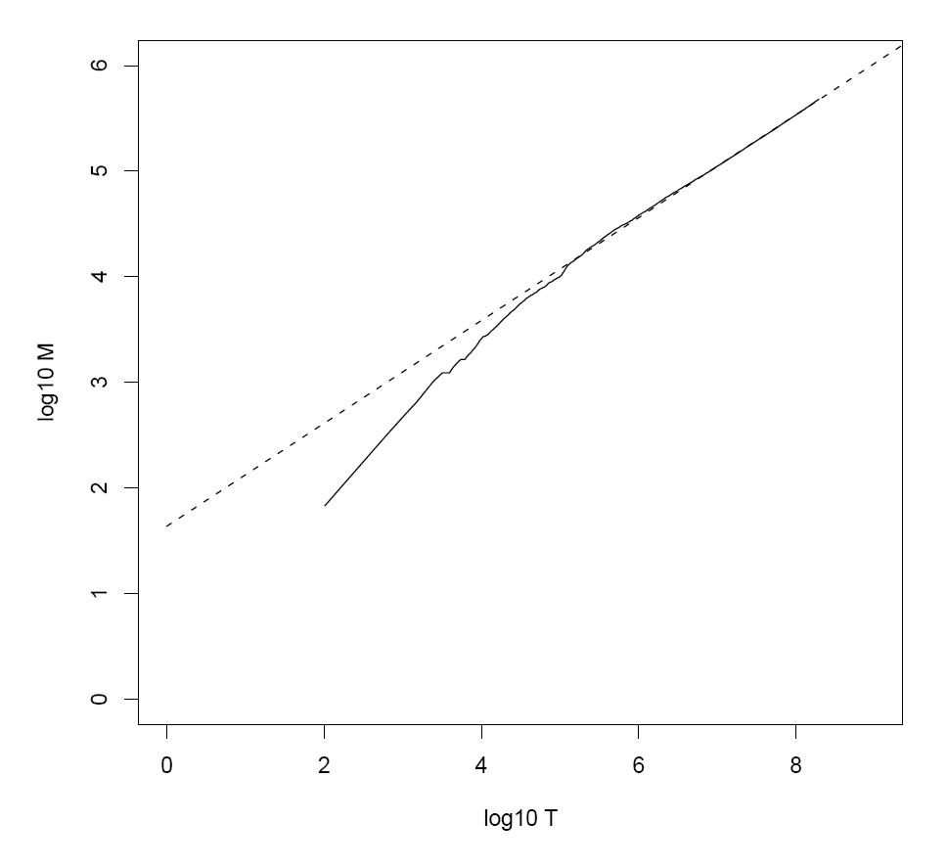
Heaps’ Law for RCV1
k = 44
b = 0.49
First 1,000,020 terms:
Predicted = 38,323
Actual = 38,365
Reuters-RCV1 collection: 806,791 newswire documents (Aug 20, 1996-August 19, 1997)
Manning, Raghavan, Schütze, Introduction to Information Retrieval (2008)

Slide 14



Building N-Gram Models
Start with what’s easiest!
Compute maximum likelihood estimates for individual n-gram probabilities
Unigram:
Bigram:
Uses relative frequencies as estimates
Maximizes the likelihood of the data given the model P(D|M)
Why not just substitute P(wi) ?
Notes:
N-gram probability estimates. Derive the conditional probability expression on board ! Given that the occurrence of an n-gram is a random variable with a binomial distribution i.e. each n-gram is independent of the next. Untrue: (a) n-grams are overlapping (b) content words tend to clump (used once, likely to get used again)

Slide 15
Example: Bigram Language Model
<s>
I am Sam Sam I am
I do not like green eggs and ham
</s>
<s>
</s>
<s>
</s>
Training Corpus
P( I | <s> ) = 2/3 = 0.67 P( Sam | <s> ) = 1/3 = 0.33
P( am | I ) = 2/3 = 0.67 P( do | I ) = 1/3 = 0.33
P( </s> | Sam )= 1/2 = 0.50 P( Sam | am) = 1/2 = 0.50
...
Bigram Probability Estimates
Note: We don’t ever cross sentence boundaries

Slide 16
Building N-Gram Models
Start with what’s easiest!
Compute maximum likelihood estimates for individual n-gram probabilities
Unigram:
Bigram:
Uses relative frequencies as estimates
Maximizes the likelihood of the data given the model P(D|M)
Let’s revisit this issue…
Why not just substitute P(wi) ?
Notes:
N-gram probability estimates. Derive the conditional probability expression on board ! Given that the occurrence of an n-gram is a random variable with a binomial distribution i.e. each n-gram is independent of the next. Untrue: (a) n-grams are overlapping (b) content words tend to clump (used once, likely to get used again)

Slide 17
More Context, More Work
Larger N = more context
Lexical co-occurrences
Local syntactic relations
More context is better?
Larger N = more complex model
For example, assume a vocabulary of 100,000
How many parameters for unigram LM? Bigram? Trigram?
Larger N has another more serious and familiar problem!

Slide 18
Data Sparsity
P( I | <s> ) = 2/3 = 0.67 P( Sam | <s> ) = 1/3 = 0.33
P( am | I ) = 2/3 = 0.67 P( do | I ) = 1/3 = 0.33
P( </s> | Sam )= 1/2 = 0.50 P( Sam | am) = 1/2 = 0.50
...
Bigram Probability Estimates
P(I like ham)
= P( I | <s> ) P( like | I ) P( ham | like ) P( </s> | ham )
= 0
Why?
Why is this bad?
Notes:
Why is the 0 bad ?

Slide 19
Data Sparsity
Serious problem in language modeling!
Becomes more severe as N increases
What’s the tradeoff?
Solution 1: Use larger training corpora
Can’t always work... Blame Zipf’s Law (Looong tail)
Solution 2: Assign non-zero probability to unseen n-grams
Known as smoothing
Notes:
Explain what Zipf’s law is and ask the students if they understand how it bears on this discussion.

Slide 20
Smoothing
Zeros are bad for any statistical estimator
Need better estimators because MLEs give us a lot of zeros
A distribution without zeros is “smoother”
The Robin Hood Philosophy: Take from the rich (seen n-grams) and give to the poor (unseen n-grams)
And thus also called discounting
Critical: make sure you still have a valid probability distribution!
Language modeling: theory vs. practice

Slide 21
Laplace’s Law
Simplest and oldest smoothing technique
Just add 1 to all n-gram counts including the unseen ones
So, what do the revised estimates look like?

Slide 22







Laplace’s Law: Probabilities
Unigrams
Bigrams
Careful, don’t confuse the N’s!
What if we don’t know V?
Notes:
You have to make sure that the joint is well-formed and understand how the conditional probability formula is derived.

Slide 23

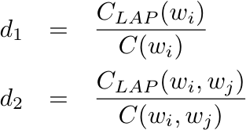
Laplace’s Law: Frequencies
Expected Frequency Estimates
Relative Discount

Slide 24
Laplace’s Law
Bayesian estimator with uniform priors
Moves too much mass over to unseen n-grams
What if we added a fraction of 1 instead?

Slide 25
Lidstone’s Law of Succession
Add 0 < γ < 1 to each count instead
The smaller γ is, the lower the mass moved to the unseen n-grams (0=no smoothing)
The case of γ = 0.5 is known as Jeffery-Perks Law or Expected Likelihood Estimation
How to find the right value of γ?

Slide 26

Good-Turing Estimator
Intuition: Use n-grams seen once to estimate n-grams never seen and so on
Compute N_{r} (frequency of frequency r)
N₀ is the number of items with count 0
N₁ is the number of items with count 1
…
Notes:
The conditional probability just uses the discounted bigram count as the numerator but the MLE count for the unigram.

Slide 27



Good-Turing Estimator
For each r, compute an expected frequency estimate (smoothed count)
Replace MLE counts of seen bigrams with the expected frequency estimates and use those for probabilities
Notes:
The conditional probability just uses the discounted bigram count as the numerator but the MLE count for the unigram.

Slide 28


Good-Turing Estimator
What about an unseen bigram?
Do we know N₀? Can we compute it for bigrams?
Notes:
Make sure it’s clear that PGT is the probability for each unseen bigram (not the total probability mass)

Slide 29
Good-Turing Estimator: Example
r | Nr
1 | 138741
2 | 25413
3 | 10531
4 | 5997
5 | 3565
6 | ...
N₀ =
(14585)² - 199252
C_{unseen} =
N₁ / N₀ = 0.00065
P_{unseen} =
N₁ /( N₀ N ) = 1.06 x 10⁻⁹
Note: Assumes mass is uniformly distributed
V = 14585
Seen bigrams =199252
C(person she) = 2
CGT(person she) = (2+1)(10531/25413) = 1.243
C(person) = 223
P(she|person) =CGT(person she)/223 = 0.0056

Slide 30
Good-Turing Estimator
For each r, compute an expected frequency estimate (smoothed count)
Replace MLE counts of seen bigrams with the expected frequency estimates and use those for probabilities
What if w_{i} isn’t observed?
Notes:
The conditional probability just uses the discounted bigram count as the numerator but the MLE count for the unigram.

Slide 31
Good-Turing Estimator
Can’t replace all MLE counts
What about r_{max}?
N_{r+1} = 0 for r = r_{max}
Solution 1: Only replace counts for r < k (~10)
Solution 2: Fit a curve S through the observed (r, N_{r}) values and use S(r) instead
For both solutions, remember to do what?
Bottom line: the Good-Turing estimator is not used by itself but in combination with other techniques

Slide 32
Combining Estimators
Better models come from:
Combining n-gram probability estimates from different models
Leveraging different sources of information for prediction
Three major combination techniques:
Simple Linear Interpolation of MLEs
Katz Backoff
Kneser-Ney Smoothing

Slide 33


Linear MLE Interpolation
Mix a trigram model with bigram and unigram models to offset sparsity
Mix = Weighted Linear Combination

Slide 34
Linear MLE Interpolation
λ_{i} are estimated on some held-out data set (not training, not test)
Estimation is usually done via an EM variant or other numerical algorithms (e.g. Powell)

Slide 35
Backoff Models
Consult different models in order depending on specificity (instead of all at the same time)
The most detailed model for current context first and, if that doesn’t work, back off to a lower model
Continue backing off until you reach a model that has some counts
Notes:
Make sure they understand why discounting is necessary !

Slide 36
Backoff Models
Important: need to incorporate discounting as an integral part of the algorithm… Why?
MLE estimates are well-formed…
But, if we back off to a lower order model without taking something from the higher order MLEs, we are adding extra mass!
Katz backoff
Starting point: GT estimator assumes uniform distribution over unseen events… can we do better?
Use lower order models!

Slide 37

Katz Backoff
Given a trigram “x y z”

Slide 38
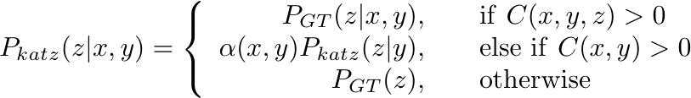
Katz Backoff (from textbook)
Given a trigram “x y z”
Typo?

Slide 39
Katz Backoff
Why use P_{GT} and not P_{MLE} directly ?
If we use P_{MLE} then we are adding extra probability mass when backing off!
Another way: Can’t save any probability mass for lower order models without discounting
Why the α’s?
To ensure that total mass from all lower order models sums exactly to what we got from the discounting
Notes:
So, basically you are discounting to get the p-mass for the lower order n-grams and then distributing it via the alpha’s

Slide 40
Kneser-Ney Smoothing
Observation:
Average Good-Turing discount for r ≥ 3 is largely constant over r
So, why not simply subtract a fixed discount D (≤1) from non-zero counts?
Absolute Discounting: discounted bigram model, back off to MLE unigram model
Kneser-Ney: Interpolate discounted model with a special “continuation” unigram model
Notes:
Save the work and just subtract a fixed value rather than by multiplying with a discount factor like in Laplace’s Law and Good-Turing discounting. This gives us absolute discounting.
Kneser-Ney extends this idea further and interpolates with a cleverly constructed unigram distribution rather than an MLE one.

Slide 41
Kneser-Ney Smoothing
Intuition
Lower order model important only when higher order model is sparse
Should be optimized to perform in such situations
Example
C(Los Angeles) = C(Angeles) = M; M is very large
“Angeles” always and only occurs after “Los”
Unigram MLE for “Angeles” will be high and a normal backoff algorithm will likely pick it in any context
It shouldn’t, because “Angeles” occurs with only a single context in the entire training data

Slide 42


Kneser-Ney Smoothing
Kneser-Ney: Interpolate discounted model with a special “continuation” unigram model
Based on appearance of unigrams in different contexts
Excellent performance, state of the art
Why interpolation, not backoff?
= number of different contexts w_{i} has appeared in

Slide 43
Explicitly Modeling OOV
Fix vocabulary at some reasonable number of words
During training:
Consider any words that don’t occur in this list as unknown or out of vocabulary (OOV) words
Replace all OOVs with the special word <UNK>
Treat <UNK> as any other word and count and estimate probabilities
During testing:
Replace unknown words with <UNK> and use LM
Test set characterized by OOV rate (percentage of OOVs)

Slide 44
Evaluating Language Models
Information theoretic criteria used
Most common: Perplexity assigned by the trained LM to a test set
Perplexity: How surprised are you on average by what comes next ?
If the LM is good at knowing what comes next in a sentence ⇒ Low perplexity (lower is better)
Relation to weighted average branching factor
Notes:
If it has good probability estimates -> makes good predictions -> knows what comes next

Slide 45
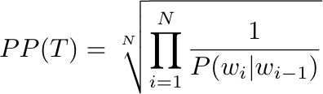
Computing Perplexity
Given testset W with words w₁, ...,w_{N}
Treat entire test set as one word sequence
Perplexity is defined as the probability of the entire test set normalized by the number of words
Using the probability chain rule and (say) a bigram LM, we can write this as
A lot easer to do with log probs!

Slide 46
Practical Evaluation
Use <s> and </s> both in probability computation
Count </s> but not <s> in N
Typical range of perplexities on English text is 50-1000
Closed vocabulary testing yields much lower perplexities
Testing across genres yields higher perplexities
Can only compare perplexities if the LMs use the same vocabulary
Order | Unigram | Bigram | Trigram
PP | 962 | 170 | 109
Training: N=38 million, V~20000, open vocabulary, Katz backoff where applicable
Test: 1.5 million words, same genre as training

Slide 47
Typical “State of the Art” LMs
Training
N = 10 billion words, V = 300k words
4-gram model with Kneser-Ney smoothing
Testing
25 million words, OOV rate 3.8%
Perplexity ~50

Slide 48
Take-Away Messages
LMs assign probabilities to sequences of tokens
N-gram language models: consider only limited histories
Data sparsity is an issue: smoothing to the rescue
Variations on a theme: different techniques for redistributing probability mass
Important: make sure you still have a valid probability distribution!

