Slide 1

INFM 603: Information Technology and Organizational Context
Session 3: JavaScript - Structured Programming
Jimmy Lin
The iSchool University of Maryland
Wednesday, February 12, 2014

Slide 2
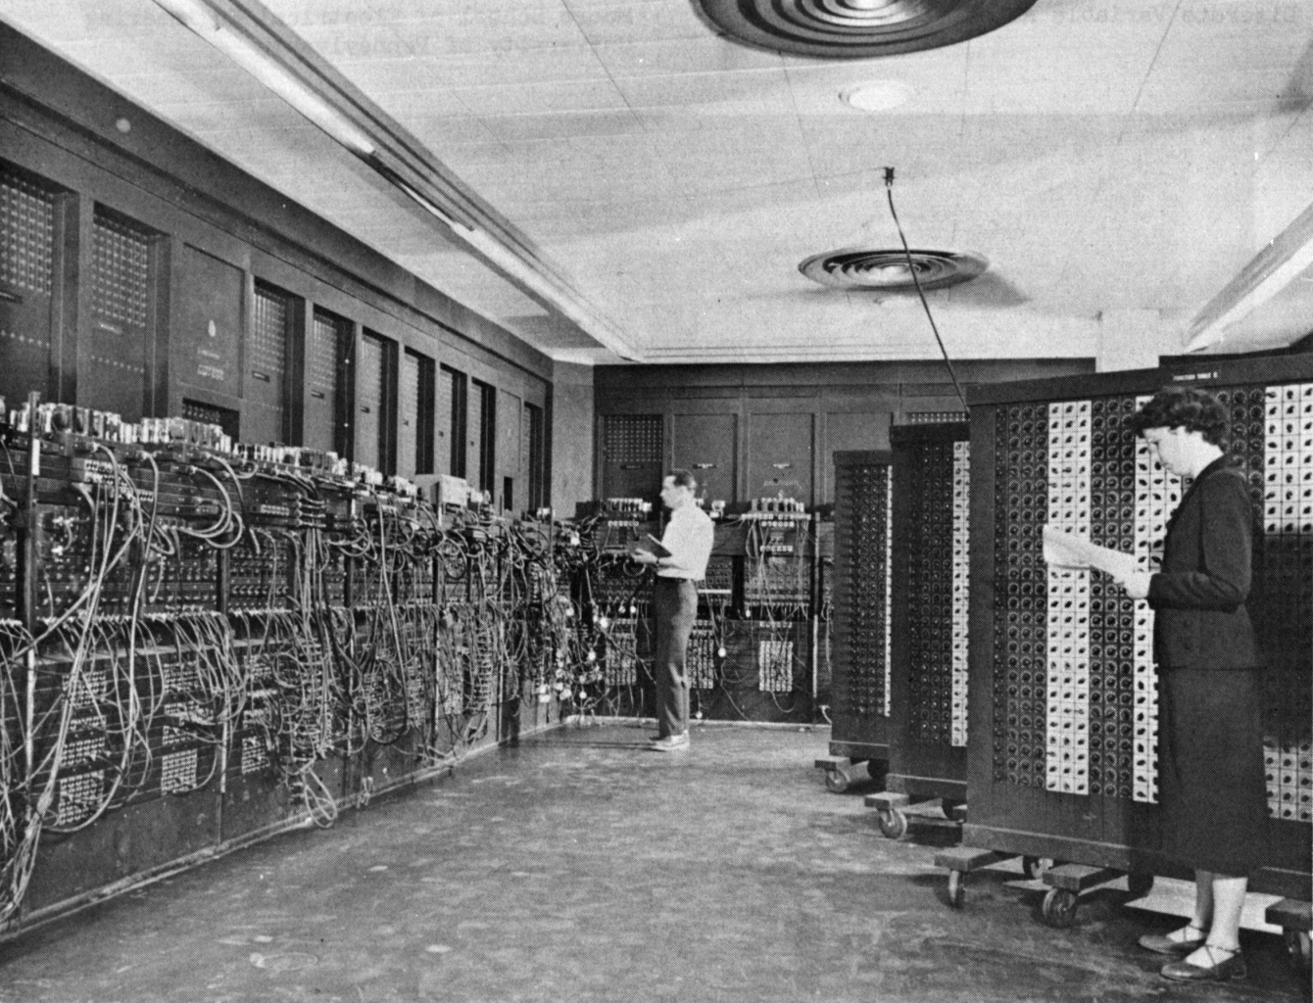
Source: Wikipedia

Slide 3
Types of Programming
Low-level languages
Directly specifies actions of the machine
Example: assembly language
High-level languages
Specifies machine instructions at a more abstract level
Compiler/interpreter translates instructions into machine actions
Example: JavaScript

Slide 4
What’s JavaScript?
Programming language for the web
Client-side, runs in the browser
Provides programmatic access to the HTML page in which it’s embedded (the DOM)
Enables richly-interactive websites!

Slide 5
What’s a Document?
Content
Structure
Appearance
Behavior

Slide 6
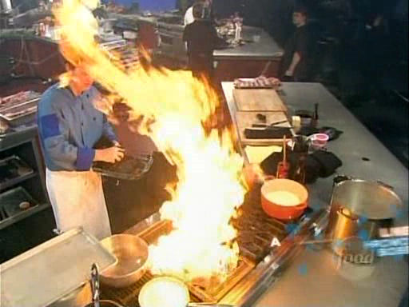
Programming… is a lot like cooking!
Source: Iron Chef America

Slide 7
Data Types and Variables
Data types = things that you can operate on
Boolean: true, false
Number: 5, 9, 3.1415926
String: “Hello World”
Variables hold values of a particular data type
Represented as symbols (e.g., x)
How should you name variables?
In JavaScript, var declares a variable
var b = true; create a boolean b and set it to true
var n = 1; create a number n and set it to 1
var s = “hello”; create a string s and set it to “hello”

Slide 8
Expressions & Statements
Things that you can do:
-x reverse the sign of x (negation)
6 + 5 add 6 and 5
2.1 * 3 multiply two values
“Hello” + “World” concatenate two strings
The simplest statements store results of expressions:
x = 5 set the value of x to be 5
x += y x = x + y
x *= 5 x = x * 5
x++ increase value of x by 1
In JavaScript, statements end with a semicolon (;)

Slide 9
Cooking Analogy
Data types are like?
Variables are like?
Statements are like?

Slide 10
Sequence of Instructions
Do
Something
Something Else
Third Thing
var a = 2;
var b = 3;
var c = a * b;

Slide 11
Where does the JavaScript go?
<!DOCTYPE html>
<html>
<head>
<meta charset=utf-8 />
<title>My Title</title>
<script>
…
</script>
<script src="code.js">
</script>
</head>
<body>
<script>
…
</script>
</body>
</html>
JavaScript in the header, processed before the page is loaded
JavaScript in an external file, processed before the page is loaded
JavaScript in the body, processed as the page is loaded

Slide 12
Temperature Conversion Demo
A few useful statements:
var t = prompt("message here", "default");
document.writeln("message here");
console.log("message here");
alert ("message here");
Tip: what if you want to have a quote inside a quote?
Your turn:
Convert the temperature now Celsius to Fahrenheit

Slide 13
Programming Tips
Details are everything!
Careful where you place that comma, semi-colon, etc.
Write a little bit of code at a time
Add a small new functionality, make sure it works, then move on
Don’t try to write a large program all at once
If it doesn’t work, revert back to previous version that worked
Debug by outputting the state of the program
Simulate what you think the program is doing
Print out the value of variables using document.writeln or console.log
Is the value what you expected?
Use the Chrome JavaScript console!

Slide 14
Controlling Execution
Conditional
Loops
Programming… is a lot like cooking!

Slide 15
Conditional
Condition
true
false
if (gender == "male") {
greeting = "It’s a boy!";
} else {
greeting = "It’s a girl!";
}
Do
Something
Something Else
Note, the text in red is part of the “template” of the conditional
Continue
Note the indentation...

Slide 16
Multiple if-else clauses
if ( expression ) {
…
} else if ( expression ) {
…
} else if ( expression ) {
…
} else {
…
}

Slide 17
Nested if-else clauses
if ( expression ) {
if ( expression ) {
…
} else {
…
}
} else if ( expression ) {
…
} else if ( expression ) {
…
} else {
…
}
Note this is where indentation become important…

Slide 18
Test Conditions: Boolean Expressions
x == y true if x and y are equal (note common gotcha!)
x != y true if x and y are not equal
x > y true if x is greater than y
x <= y true if x is smaller than or equal to y
x && y true if both x and y are true
x || y true if either x or y is true
!x true if x is false

Slide 19
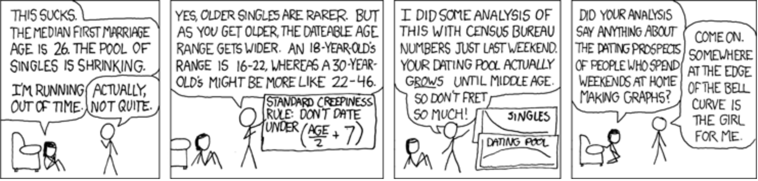

Slide 20
Creepy Guy Formula: Exercises
Add some error checking
Tip: x == ""
Tip: exit()
Add some age appropriate pictures

Slide 21
Loops
var n = 1;
while (n <= 10) {
document.writeln(n);
n++;
}
for (var n = 1; n <= 10; n++) {
document.writeln(n);
}
Condition
Continue
false
true
Do
Something
Note, the text in red is part of the “template” of the loop
FYI: Computer scientists like to start at zero…

Slide 22
Ice Cream Scoops: Exercises
What happens if there’s only one scoop?
Change from for loop to while loop
Alternate scoops of ice cream, chocolate and vanilla
Helpful tip: modulo (remainder) operation (%)
3%2 = 1, 4%2 = 0, 5%2 = 1
Randomize scoops of ice cream
To generate random number between 0 and 2: Math.floor((Math.random()*3));

