Slide 1

INFM 603: Information Technology and Organizational Context
Session 8: Ajax and Asynchronous Programming
Jimmy Lin
The iSchool University of Maryland
Wednesday, March 26, 2014

Slide 2
RideShare Exercise
Design a database to match drivers with passengers for ride sharing on long car trips:
Drivers post available seats; they want to know about interested passengers
Passengers come looking for rides: they want to know about available rides and can make reservations
These things happen in no particular order
To simplify, passengers don’t get to post “rides wanted” ads
Build a web application to accomplish the above

Slide 3
RideShare Exercise: Tasks
Design the tables you will need
First decide what information you need to keep track of
Then design tables to capture this information
Design SQL queries
What happens when a passenger comes looking for a ride?
What happens when a driver comes to find out who the passengers are?
Role play!

Slide 4
Tables
Ride: Ride ID, Driver ID, Origin, Destination, Date, Time, Available Seats
Passenger: Passenger ID, Name, Address, Phone Number
Driver: Driver ID, Name, Address, Phone Number
Booking: Ride ID, Passenger ID

Slide 5
Queries
Passenger searches for a ride:
Join: Ride, Driver
Where: Origin and Destination match request, Available Seats > 0
Select: Name, Phone Number
Passenger “books” a ride:
Assuming successful search above: decrease Available Seats by one
Insert row into Booking table with Ride ID and Passenger ID
Driver ready to go: Who are my passengers?
Join: Ride, Passenger, Booking
Where: (Driver) Name, Origin, and Date match
Select: (Passenger) Name, Phone Number

Slide 6
Demo
We’re going to build the RideShare web app…
Like, right now!

Slide 7
Slight Simplification
Ride table:
RideId
Driver (name)
Phone
Origin
Destination
Date
Seats
Booking table:
RideId
Passenger (name)
Phone

Slide 8
Today
More JavaScript!
Ajax
JSON
More PHP!

Slide 9
Synchronous vs. Asynchronous
Definitions
Synchronous: happening, existing, or arising at precisely the same time
Asynchronous: not synchronous
Communications
Synchronous
Asynchronous
Programming
Synchronous
Asynchronous

Slide 10
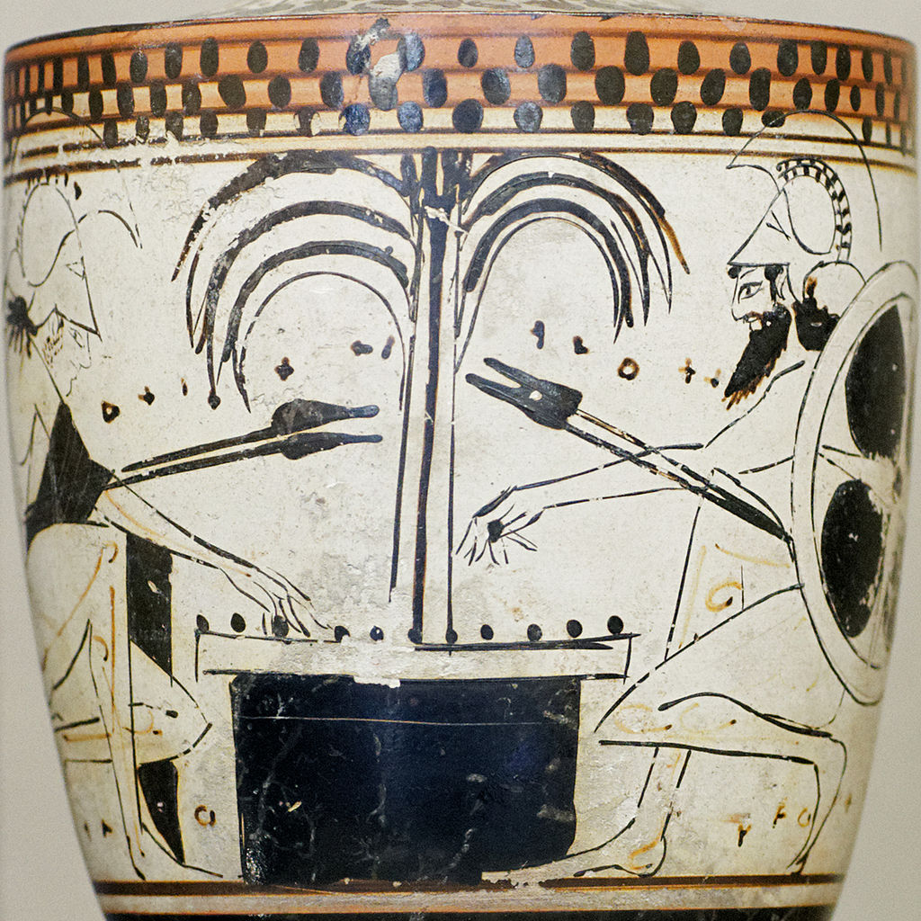
Ajax

Slide 11
What’s Ajax?
Asynchronous JavaScript and XML
The only thing you need to learn:
Get this URL
var url = "...";
var request = new XMLHttpRequest();
request.open("GET", url);
request.onload = function() {
if (request.status == 200) {
// Your code here
}
};
request.send(null);
Callback function

Slide 12

What’s at the URL?
A static file (e.g., JSON)
{
name: "Fido",
weight: 40, breed: "Mixed", loves: ["walks", "fetching balls"]
}

Slide 13
What’s at the URL?
An application programming interface (API)
How do we write APIs?
http://download.finance.yahoo.com/d/quotes.csv?s=GOOG&f=nsl1op
Think of this as a function call!
argument1=value&argument2=value...

Slide 14

Got it?
Source: The Matrix

