Slide 1

INFM 603: Information Technology and Organizational Context
Session 13: Developing and Managing Technology
Jimmy Lin
The iSchool University of Maryland
Wednesday, April 30, 2014

Slide 2
The Technology Lifecycle
How do you know what to build?
How do you actually build it?
How do you keep it running?
It’s about asking the right questions!

Slide 3
First Things First
What’s already there?
Do users actually want it?
Is technology even the right answer?
What’s the use context?
Technology is for solving problems!

Slide 4
How do you know what to build?
Ask your users
Watch them

Slide 5


Slide 6

So you’re going to build technology…

Slide 7

Major Decisions
Build vs. buy
In-house vs. out-source
Open source vs. proprietary
Best of breed vs. integrated solution
Pick your poison

Slide 8
Architecture Choices
Desktop software
Web app
Hosted in the cloud?
In-house datacenter?
Mobile app
Advantages and disadvantages to each!

Slide 9
Requirements
Functionality
Latency and throughput
Capacity
Reliability and resiliency
Flexibility
Development cost and time

Slide 10

There’s no free meal!

Slide 11
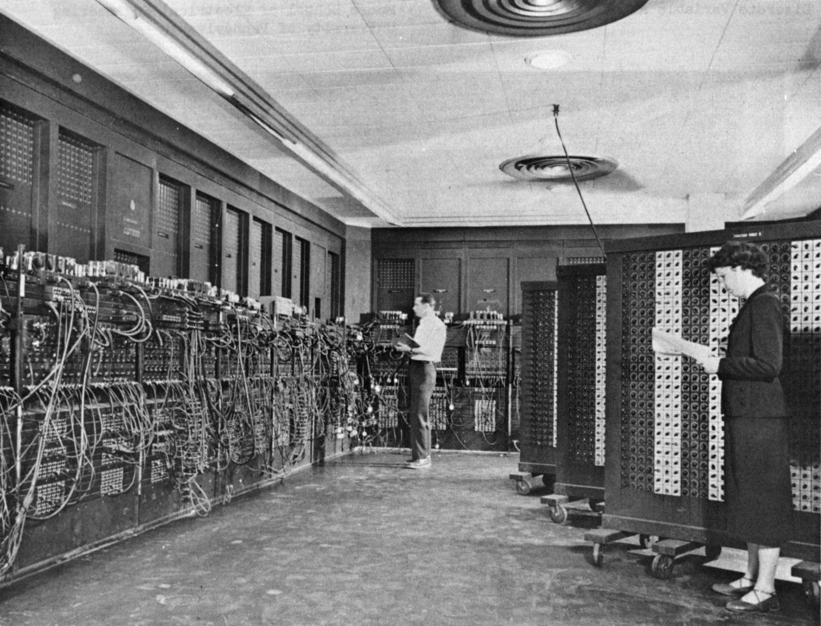
Software Development
Source: Wikipedia (ENIAC)

Slide 12
The Waterfall Model
Key idea: upfront investment in design
An hour of design can save a week of debugging!
Five stages:
Requirements: figure out what the software is supposed to do
Design: figure out how the software will accomplish the tasks
Implementation: actually build the software
Verification: makes sure that it works
Maintenance: makes sure that it keeps working

Slide 13

The Waterfall Model
Requirements
Design
Implementation
Verification
Maintenance

Slide 14
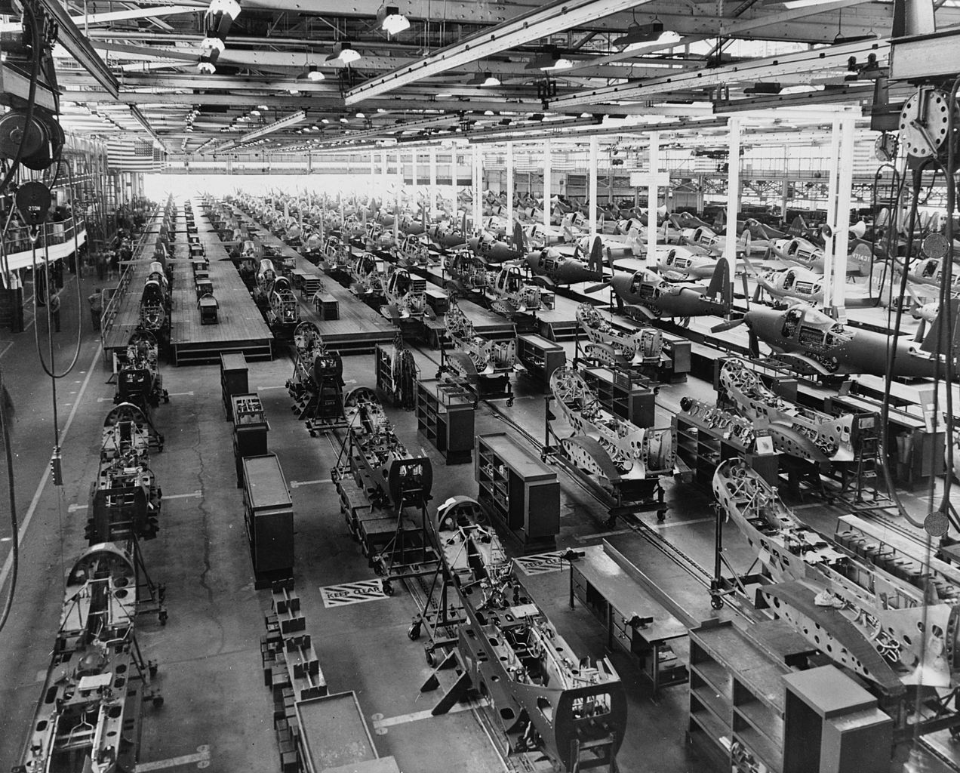

Slide 15
The Spiral Model
Build what you think you need
Perhaps using the waterfall model
Get a few users to help you debug it
First an “alpha” release, then a “beta” release
Release it as a product (version 1.0)
Make small changes as needed (1.1, 1.2, ….)
Save big changes for a major new release
Often based on a total redesign (2.0, 3.0, …)
Notes:
Barry Boehm 1988

Slide 16
The Spiral Model
2.3
1.2
0.5
1.1
2.2
1.0
2.1
2.0
3.0

Slide 17
Unpleasant Realities
The waterfall model doesn’t work well
Requirements usually incomplete or incorrect
The spiral model is expensive
Redesign leads to wasted effort

Slide 18
Prototyping
What’s the purpose of the prototype?
Meant to explore requirements, then be thrown away
An initial version of the software to be subsequently refined
Both are fine, as long as the goal is clear
Be aware, interfaces can be deceiving

Slide 19
SCRUM
An agile development methodology: the “fashion” today
As with any methodology…
Don’t blindly follow processes
Understand the rationale behind them
Adapt them to your context

Slide 20
Key Concepts
Roles:
Product owner: voice of the customer
Development team: small team software engineers
Scrum master: primary role as facilitator
User stories: short non-technical description of desired user functionality
“As a user, I want to be able to search for customers by their first and last names”
“As a site administrator, I should be able to subscribe multiple people to the mailing list at once”

Slide 21
Basic SCRUM Cycle
The sprint:
Basic unit of development
Fixed duration (typically one month)
End target is a working system (not a prototype)
Sprint planning meeting
Discussion between product owner and development team on what can be accomplished in the sprint
Sprint goals are owned by the development team

Slide 22
Standup Meetings
Short, periodic status meetings (often daily)
Three questions:
What have you been working on (since the last standup)?
What are you planning to work on next?
Any blockers?

Slide 23
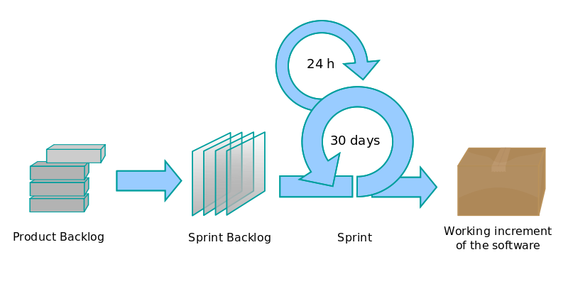
SCRUM

Slide 24
Advantages of SCRUM
Fundamentally iterative, recognizes that requirements change
Development team in charge of the sprint backlog
Favors self-organization rather than top-down control
Reprioritize in response to changing requirements and progress
Time-limited sprints ensure periodic delivery of new product increments
Allows opportunities to receive user feedback, change directions, etc.
Buzzword = velocity

Slide 25
Disadvantages
Can be chaotic
Dependent on a good SCRUM master to reconcile priorities
Requires dedication of team members
Slicing by “user stories” isn’t always feasible

Slide 26
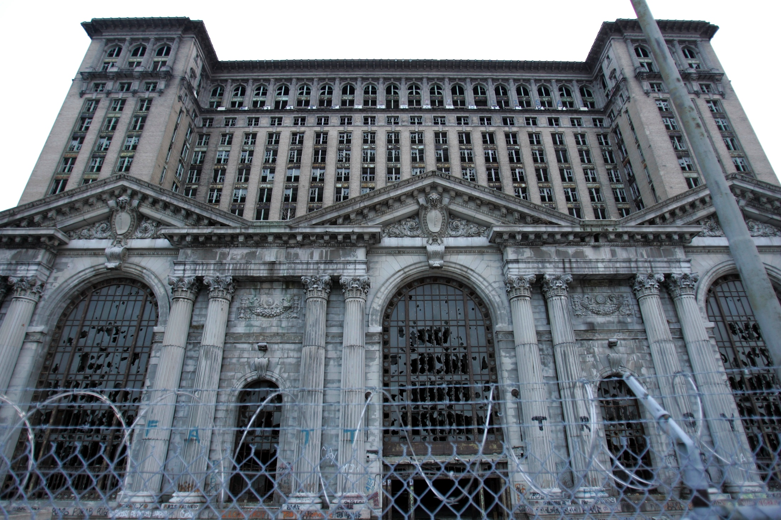
Keeping Technology Running

Slide 27
Management Issues
Operating costs
Staff time
Physical resources (space, cooling, power) or the cloud
Periodic maintenance
Equipment replacement
Retrospective conversion
Moving from “legacy systems”
Even converting electronic information is expensive!
Incremental improvements
Upgrade path?
Notes:
13

Slide 28
Management Issues
Usage information
Usage logs, audit trails, etc.
Collection, storage, as well as analysis
Training
Staff
Users
Privacy, security, access control
Backup and disaster recovery
Periodicity, storage location
The cloud doesn’t necessarily solve all the issues
Remember Murphy’s Law!
Notes:
13

Slide 29
TCO
“Total cost of ownership”
Hardware and software aren’t the only costs!
Other (hidden) costs: all the issues discussed above
Notes:
13

Slide 30
What is open source?
Proprietary vs. open source software
Open source used to be a crackpot idea:
Bill Gates on Linux (3/24/1999): “I don’t really think in the commercial market, we’ll see it in any significant way.”
MS 10-Q quarterly filing (1/31/2004): “The popularization of the open source movement continues to pose a significant challenge to the company’s business model”
Open source…
For tree hugging hippies?
Make love, not war?

Slide 31
Basic Definitions
What is a program?
What is source code?
What is object/executable code (binaries)?
An organized list of instructions that, when executed, causes the computer to behave in a predetermined manner. Like a recipe.
Program instructions in their original, human-readable form.
Program instructions in a form that can be directly executed by a computer. A compiler takes source code and generates executable code.

Slide 32
Proprietary Software
Distribution in machine-readable binaries only
Payment for a license
Grants certain usage rights
Restrictions on copying, further distribution, modification
Analogy: buying a car…
With the hood welded shut
That only you can drive
That you can’t change the rims on

Slide 33
Open Source Principles
Free distribution and redistribution
“Free as in speech, not as in beer”
Source code availability
Provisions for derived works
“The license may not restrict any party from selling or giving away the software as a component of an aggregate software distribution containing programs from several different sources. The license may not require royalty or other fee for such sale.”
“The program must include source code, and must allow distribution in source code as well as compiled form”.
“The license must allow modifications and derived works, and must allow them to be distributed under the same terms as the license of the original software.”

Slide 34
Open Source vs. Proprietary
Who gets the idea to develop the software?
Who actually develops the software?
How much does it cost?
Who can make changes?

Slide 35
Examples of Open Source Software
 | Proprietary | Open Source
Operating system | Windows | Linux
Office suite | Microsoft Office | OpenOffice
Image editor | Photoshop | GIMP
Web browser | Internet Explorer | Mozilla
Web server | IIS | Apache
Database | Oracle | MySQL

Slide 36
Open Source: Pros
Peer-reviewed code
Dynamic community
Iterative releases, rapid bug fixes
Released by engineers, not marketing people
No vendor lock-in
Simplified licensed management

Slide 37
Pros in Detail
Peer-reviewed code
Everyone gets to inspect the code
More eyes, fewer bugs
Dynamic community
Community consists of coders, testers, debuggers, users, etc.
Any person can have multiple roles
Both volunteers and paid by companies
Volunteers are highly-motivated

Slide 38
Pros in Detail
Iterative releases, rapid bug fixes
Anyone can fix bugs
Bugs rapidly fixed when found
Distribution of “patches”
Released by engineers, not marketing people
Stable versions ready only when they really are ready
Not dictated by marketing deadlines

Slide 39
Pros in Detail
No vendor lock-in
Lock in: dependence on a specific program from a specific vendor
Putting content in MS Word ties you to Microsoft forever
Open formats: can use a variety of systems
Simplified licensed management
Can install any number of copies
No risk of illegal copies or license audits
No anti-piracy measures (e.g. CD keys, product activation)
No need to pay for perpetual upgrades
Doesn’t eliminate software management, of course

Slide 40
Cons of Open Source
Dead-end software
Fragmentation
Developed by engineers, often for engineers
Community development model
Inability to point fingers

Slide 41
Cons in Detail
Dead-end software
Development depends on community dynamics: What happens when the community loses interest?
How is this different from the vendor dropping support for a product? At least the source code is available
Fragmentation
Code might “fork” into multiple versions: incompatibilities develop
In practice, rarely happens

Slide 42
Cons in Detail
Developed by engineers, often for engineers
My favorite “pet feature”
Engineers are not your typical users!
Community development model
Cannot simply dictate the development process
Must build consensus and support within the community
Inability to point fingers
Who do you call up and yell at when things go wrong?
Buy a support contract from a vendor!

Slide 43
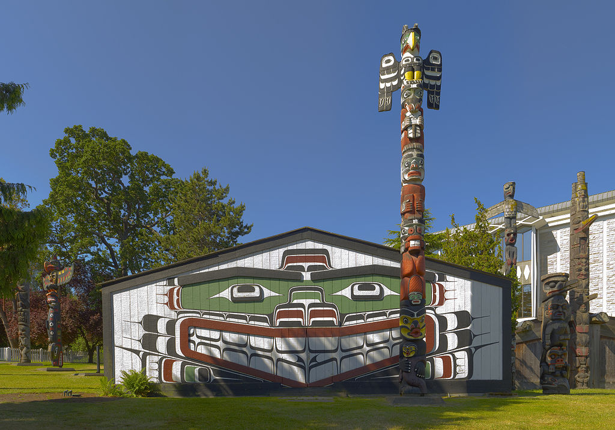

Slide 44
Open Source Business Models
Support Sellers
Loss Leader
Widget Frosting
Accessorizing
Give away the software, but sell distribution, branding, and after-sale service.
Give away the software as a loss-leader and market positioner for closed software.
If you’re in the hardware business, giving away software doesn’t hurt you and has it’s advantages. What are they?
Sell accessories: books, compatible hardware, complete systems with open-source software pre-installed, and merchandise (open-source T-shirts, coffee mugs, Linux penguin dolls, etc.).

Slide 45
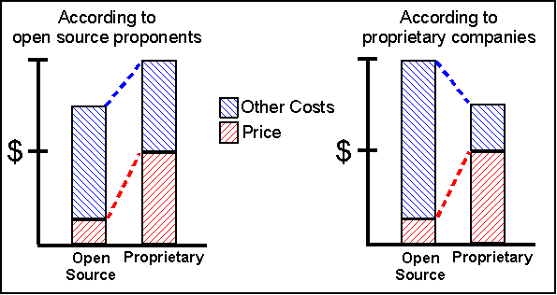
The TCO Debate

Slide 46
Is open source right for you?
Depends

Slide 47
Questions?

