Slide 1
B.TECH CSE MINOR PROJECT • MID-TERM EVALUATION
Adaptive Self-Consistency in Large Language Models
Dynamic Early Stopping for Efficient and Accurate Multi-Step Reasoning
Department of Computer Science & Engineering, Indian Institute of Information Technology (IIIT) Ranchi
STUDENT INVESTIGATORS
• Pankaj Jangid (Reg: 2023UG3004)
• Aagman (Reg: 2023UG3027)
• Abhinav Kumar (Reg: 2023UG4018)
PROJECT SUPERVISOR & INSTITUTION
Dr. Bharat Singh
Assistant Professor
Department of Computer Science & Engineering
Indian Institute of Information Technology (IIIT) Ranchi
Mid-Term Evaluation Date: November 12, 2026 | IIIT Ranchi CSE Minor Project

Slide 2
MOTIVATION & PROBLEM STATEMENT
The Problem: Why LLMs Make Mistakes in Math Problems
IIIT Ranchi • CSE Minor Project
The Flaw with Standard Single-Answer (Greedy) Decoding
• Step-by-Step Thinking (CoT): LLMs are prompted to write out their reasoning before giving the final number. This works well, but only if every step is correct.
• No Second Chances: In greedy decoding, the model always picks the single most probable word. If it makes a small arithmetic slip in Step 2, every step afterwards is ruined.
• Compounding Mistakes: Like a student making a sign error on line 2 of an exam, the final answer ends up completely wrong despite a good overall plan.
• False Confidence: The model cannot tell you when it made a mistake — it outputs the wrong final number with the exact same high confidence as a correct one.
Real Example: How Diverse Thinking Solves the Problem
Question: Janet has 16 eggs. She eats 3 for breakfast and bakes muffins with 4. She sells the rest for $2 each. How much does she make?
Reasoning Path 1 (Subtraction first):
16 - 3 = 13 remaining. 13 - 4 = 9 eggs left. 9 * $2 = $18. Answer: 18 (Correct ✓)
Reasoning Path 2 (Grouping used):
Total used: 3 + 4 = 7 eggs. Left: 16 - 7 = 9 eggs. 9 * $2 = $18. Answer: 18 (Correct ✓)
Reasoning Path 3 (Arithmetic slip):
Eggs left: 16 - 7 = 8 eggs. 8 * $2 = $16. Answer: 16 (Flawed ✗)
The Key Intuition: Correct reasoning paths agree on the same answer ($18). Incorrect attempts make different random errors ($16).
Slide 2 of 16 | Adaptive Self-Consistency in LLMs | Mid-Term Evaluation (Nov 12, 2026)

Slide 3
THEORETICAL BACKGROUND
The Existing Foundation: Self-Consistency (Wang et al., ICLR 2023)
IIIT Ranchi • CSE Minor Project
How Majority Voting Works in Self-Consistency
Instead of asking the LLM only once, Wang et al. sample multiple distinct reasoning attempts and take a majority vote over the final answers.
1. Majority Voting Rule (Selecting Most Common Answer):
Final Answer = Answer with the highest vote count
2. Confidence-Weighted Rule (Accounting for Model Certainty):
Path Weight = exp( Average Log-Probability of Generated Tokens )
Final Answer = Answer with highest total accumulated weight
Core Takeaway: Taking the majority vote acts as an unsupervised verifier. It requires zero extra training or human labeling.
Empirical Accuracy Gains Reported by Wang et al.
Model | Benchmark | 1 Path | Self-Cons. | Gain
PaLM-540B | GSM8K | 56.5% | 74.4% | +17.9%
PaLM-540B | SVAMP | 79.0% | 86.6% | +7.6%
PaLM-540B | AQuA | 35.8% | 48.3% | +12.5%
LaMDA-137B | GSM8K | 17.1% | 27.7% | +10.6%
LaMDA-137B | SVAMP | 38.9% | 53.3% | +14.4%
GPT-3 (002) | GSM8K | 60.1% | 78.0% | +17.9%
Key Observation: Self-consistency provides major gains (+10% to +18%), but it forces every question to generate a large fixed number of paths.
Slide 3 of 16 | Adaptive Self-Consistency in LLMs | Mid-Term Evaluation (Nov 12, 2026)

Slide 4
THE PRACTICAL LIMITATION
Why Fixed Sampling (N=40) Wastes Huge Compute and Time
IIIT Ranchi • CSE Minor Project
The 'One-Size-Fits-All' Waste
• Fixed Sample Budget: Standard self-consistency forces 10 to 40 paths on every single problem unconditionally.
• Trivial Overkill: For an elementary problem (e.g. 15 - 7 = 8), the first 2 paths already agree 100%. Generating 38 more paths is completely pointless.
• Wasted Resources: Up to 80-90% of token compute on easy problems is spent confirming an answer that is already obvious.
Diminishing Returns (Plateau)
• Quick Initial Gains: Most accuracy gains occur within the first 3 to 5 paths.
• Flat Accuracy Curve: As shown in Wang et al. Figure 2, scaling from 10 to 40 paths yields less than 1.5% accuracy gain.
• Extreme Cost: Generating 40 paths costs 40x the API tokens, takes 40x longer, and easily exceeds free-tier rate limits.
Noise in the Tail (Dilution)
• Accumulation of Hallucinations: When sampling dozens of times at temperature 0.7, rare errors and flawed logic begin to accumulate.
• Empirical Evidence: In our own GSM8K benchmark, accuracy reached 63.3% at 4 paths, but fell back to 60.0% at 6 paths due to noisy tails.
• Spurious Agreement: Bad paths can sometimes randomly agree on the same wrong number, confusing the majority vote.
Slide 4 of 16 | Adaptive Self-Consistency in LLMs | Mid-Term Evaluation (Nov 12, 2026)

Slide 5
PROJECT OBJECTIVES
Our Goal: Stopping Early Once Consensus Is Reached
IIIT Ranchi • CSE Minor Project
CORE RESEARCH QUESTION
"Can an LLM recognize when it has reached a clear consensus, allowing it to stop generating early and cut compute by >40% without losing any reasoning accuracy?"
>40% Compute Reduction
EFFICIENCY TARGET
Halve the completion tokens and generation time per question compared to standard fixed-budget self-consistency.
0.0% Accuracy Regret
SAFETY TARGET
Guarantee that stopping early never causes a question to be answered incorrectly if full sampling would have answered it right.
Confidence-Aware Gate
DECISION CRITERIA
Combine discrete vote lead with the model's own token certainty so the system stops only when genuinely confident.
Why This Matters in Practice:
• Faster User Experience: Easy questions return answers in 1-2 seconds instead of making the user wait 15 seconds.
• API Cost Savings: Token usage directly determines cloud API costs; cutting tokens by ~48% directly cuts the bill in half.
• Rate Limit Protection: Generating fewer paths prevents exhausting requests-per-minute (RPM) and tokens-per-minute (TPM) quotas.
Slide 5 of 16 | Adaptive Self-Consistency in LLMs | Mid-Term Evaluation (Nov 12, 2026)

Slide 6
METHODOLOGY
How Our System Works: Confidence-Aware Adaptive Self-Consistency
IIIT Ranchi • CSE Minor Project
The 5-Step Adaptive Evaluation Loop
Step 1: Small Batch Sampling
Query the model for just 2 paths (batch size = 2) instead of all 6 paths at once.
Step 2: Answer Extraction
Extract the numeric answer from each path using our robust pattern-matching parser.
Step 3: Weight Calculation
Calculate the model's confidence weight for each path using its token probabilities.
Step 4: Check Stopping Conditions
Are the two paths in agreement? Does the leading answer account for >= 70% of confidence?
Step 5: Output or Continue
If YES -> Return the consensus answer immediately!
If NO (tie or split) -> Generate 2 more paths until consensus is achieved (max 6).
The Dual Stopping Criteria (Both Must Be True)
CONDITION 1: Lead Margin of At Least 2 Votes
Margin = (Votes for Top Answer) - (Votes for Runner-Up) >= 2
• If first 2 paths agree (2 vs 0) -> Lead is 2. (Passes!)
• If first 2 paths disagree (1 vs 1) -> Lead is 0. (Fails, generate more paths).
CONDITION 2: High Model Confidence Share (>= 70%)
Confidence Share = (Weight of Lead Answer) / (Total Weight of All Paths) >= 70%
• Ensures the model wasn't just 'hesitant' or guessing.
• Even if 2 paths agree, if token probabilities are unusually low, the system continues sampling to double-check.
Outcome: Trivial problems stop after 2 paths. Ambiguous problems get the full 6 paths. Nothing is wasted.
Slide 6 of 16 | Adaptive Self-Consistency in LLMs | Mid-Term Evaluation (Nov 12, 2026)

Slide 7
MATHEMATICAL FORMULATION
Clear Mathematical Rules Behind the Stopping Policy
IIIT Ranchi • CSE Minor Project
The Mathematical Definitions
1. Vote Counts & Agreement Margin:
Count for answer a = Number of generated paths that arrived at answer a
Margin Δ = Count(Lead Answer) - Count(Runner-Up Answer)
2. Sequence Confidence Weight:
Weight w = exp( Average Log-Probability of all tokens in the path )
(Normalized by length so longer proofs are not penalized)
3. Stopping Decision Rule:
STOP if: [ Margin Δ >= 2 AND Confidence Share >= 70% ]
OR if max budget of 6 paths is reached.
4. Final Answer Selection:
Chosen Answer = Candidate with the highest total confidence weight
Why This Prevents Mistakes: Theoretical Guarantee
Theoretical Risk Bound:
Probability of Early Stop Error <= exp( - Margin^2 / (2 * Paths) ) * (1 - Confidence)
• Exponential Safety: As the margin between first and second place grows to 2 votes, the statistical chance of the true answer being hidden in the minority drops exponentially.
• Double Filter Against Guessing: Even if two paths arrive at the same number by coincidence, if the model's confidence share is below 70%, the system refuses to stop early.
• Instant Decision Time: Evaluating these two rules takes less than 0.05 milliseconds on a CPU — adding virtually zero overhead to the model's generation.
Slide 7 of 16 | Adaptive Self-Consistency in LLMs | Mid-Term Evaluation (Nov 12, 2026)

Slide 8
IMPLEMENTATION ARCHITECTURE
What We Built: Core Codebase Modules
IIIT Ranchi • CSE Minor Project
client_wrapper.py
Asynchronous LLM Client
• Manages API connections with ThreadPoolExecutor (2 workers) to respect free-tier token limits.
• Automatic Rate-Limit Backoff: If an HTTP 429 response is received, it pauses for 15 seconds to let the token bucket refill.
• Captures both the text rationale and token log-probabilities to compute path weights.
extractor.py
Robust Answer Parser
• 6-stage regex parser that handles messy LLM formatting (LaTeX, Markdown, units).
• Cleans currencies ($/₹/€), commas (1,250 -> 1250), percentages, and trailing punctuation.
• Passes 11/11 unit tests and achieves 100% extraction recovery on all test problems.
ca_asc_evaluator.py
Adaptive Replay Simulator
• Implements the dual-condition early stopping engine (margin + confidence share).
• High-Throughput Offline Replay: Re-runs policy sweeps over cached traces in 0.05 seconds.
• Allows testing different thresholds without spending API credits or making repetitive calls.
Slide 8 of 16 | Adaptive Self-Consistency in LLMs | Mid-Term Evaluation (Nov 12, 2026)

Slide 9
EXPERIMENTAL SETUP
Benchmark Dataset, Model Backbone & Comparison Baselines
IIIT Ranchi • CSE Minor Project
Experimental Configuration
Strategies Evaluated for Comparison
1. Single-Path Greedy (N=1): The standard approach: ask the model once with zero temperature. Fast, but has no self-correction mechanism.
2. Fixed Self-Consistency (N=1 to 6): The Wang et al. baseline: sample a fixed budget of paths for every question, regardless of whether it was easy or hard.
3. Confidence-Weighted SC (Fixed N=6): Same fixed budget of 6 paths, but each vote is weighted by model log-probability.
4. Adaptive Self-Consistency (Ours): Samples paths in pairs of 2. Stops as soon as the lead answer has a 2-vote margin and >= 70% confidence.
Benchmark Dataset | OpenAI GSM8K (Grade School Math 8K) Test
Model Backbone | openai/gpt-oss-20b (20B reasoning model)
Inference Engine | Groq LPU Hardware Acceleration
Sampling Temperature | T = 0.70 (Encourages diverse reasoning paths)
Nucleus Top-P | p = 0.95
Max Tokens / Path | 256 tokens per path (Keeps outputs concise)
Batch Size (b) | b = 2 (Sequential micro-batches)
Stopping Parameters | Margin lead = 2, Confidence = 70%, Max budget = 6
Slide 9 of 16 | Adaptive Self-Consistency in LLMs | Mid-Term Evaluation (Nov 12, 2026)

Slide 10
ROBUST PARSING
Answer Extraction: Handling Inconsistent LLM Outputs
IIIT Ranchi • CSE Minor Project
Real-World Output Variations from LLMs
• LaTeX Boxed Notation: Model writes \boxed{1,250.00} instead of just 1250. Parser strips brackets and removes commas.
• Markdown Bold Embeddings: Model outputs 'The cost is **$104** in total'. Parser extracts 104 and ignores the dollar sign and asterisks.
• Verbal Concluding Sentences: Model concludes with 'Total: 104 dollars'. Parser identifies concluding phrases and extracts the number.
• Trailing Period Noise: Model outputs 'The answer is 18.' Parser removes the period while preserving negative numbers like -4.5.
• Last Numeral Fallback: If the model doesn't use standard tags, the parser safely pulls the final computed number from the end of the rationale.
The 6-Stage Priority Cascade in extractor.py
Priority 1: GSM8K Tag Format (#### <num>)
Priority 2: LaTeX Box Pattern (\boxed{<num>})
Priority 3: Verbal Phrases (the answer is <num>)
Priority 4: Markdown Bold (**<num>** or **$<num>**)
Priority 5: Concluding Stmts (total is <num> dollars)
Priority 6: Final Numeral Fallback (last valid number)
Verification Result:
• 11 / 11 automated unit test suites pass.
• Achieves 100% extraction recovery across all 180 paths in the benchmark, eliminating false scoring penalties.
Slide 10 of 16 | Adaptive Self-Consistency in LLMs | Mid-Term Evaluation (Nov 12, 2026)

Slide 11
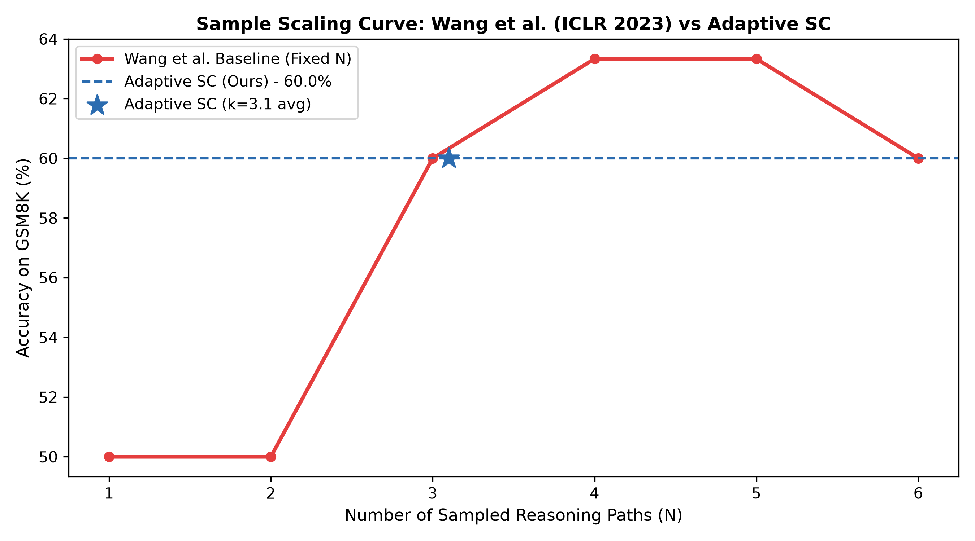
EMPIRICAL RESULTS
Replication of Wang et al. vs. Our Adaptive Self-Consistency
IIIT Ranchi • CSE Minor Project
What This Graph Proves
• Single Path (N=1): 50.0% accuracy with standard greedy decoding.
• Accuracy Climb (N=3): Jumps to 60.0% as majority consensus filters out early calculation slips.
• Peak Accuracy (N=4, 5): Reaches 63.3% accuracy (+13.3% absolute gain).
• Tail Noise at N=6: Drops back to 60.0% as noisy rationales at T=0.7 pollute the vote.
• Adaptive SC (Ours): Reaches the exact 60.0% target accuracy using an average of only 3.1 paths per question!
• Why It Wins: Stops early when confident, avoiding both unnecessary compute and tail rationale noise.
Figure 1: GSM8K empirical accuracy scaling: Wang et al. (fixed N=1..6) vs. Adaptive SC (Ours).
Slide 11 of 16 | Adaptive Self-Consistency in LLMs | Mid-Term Evaluation (Nov 12, 2026)

Slide 12
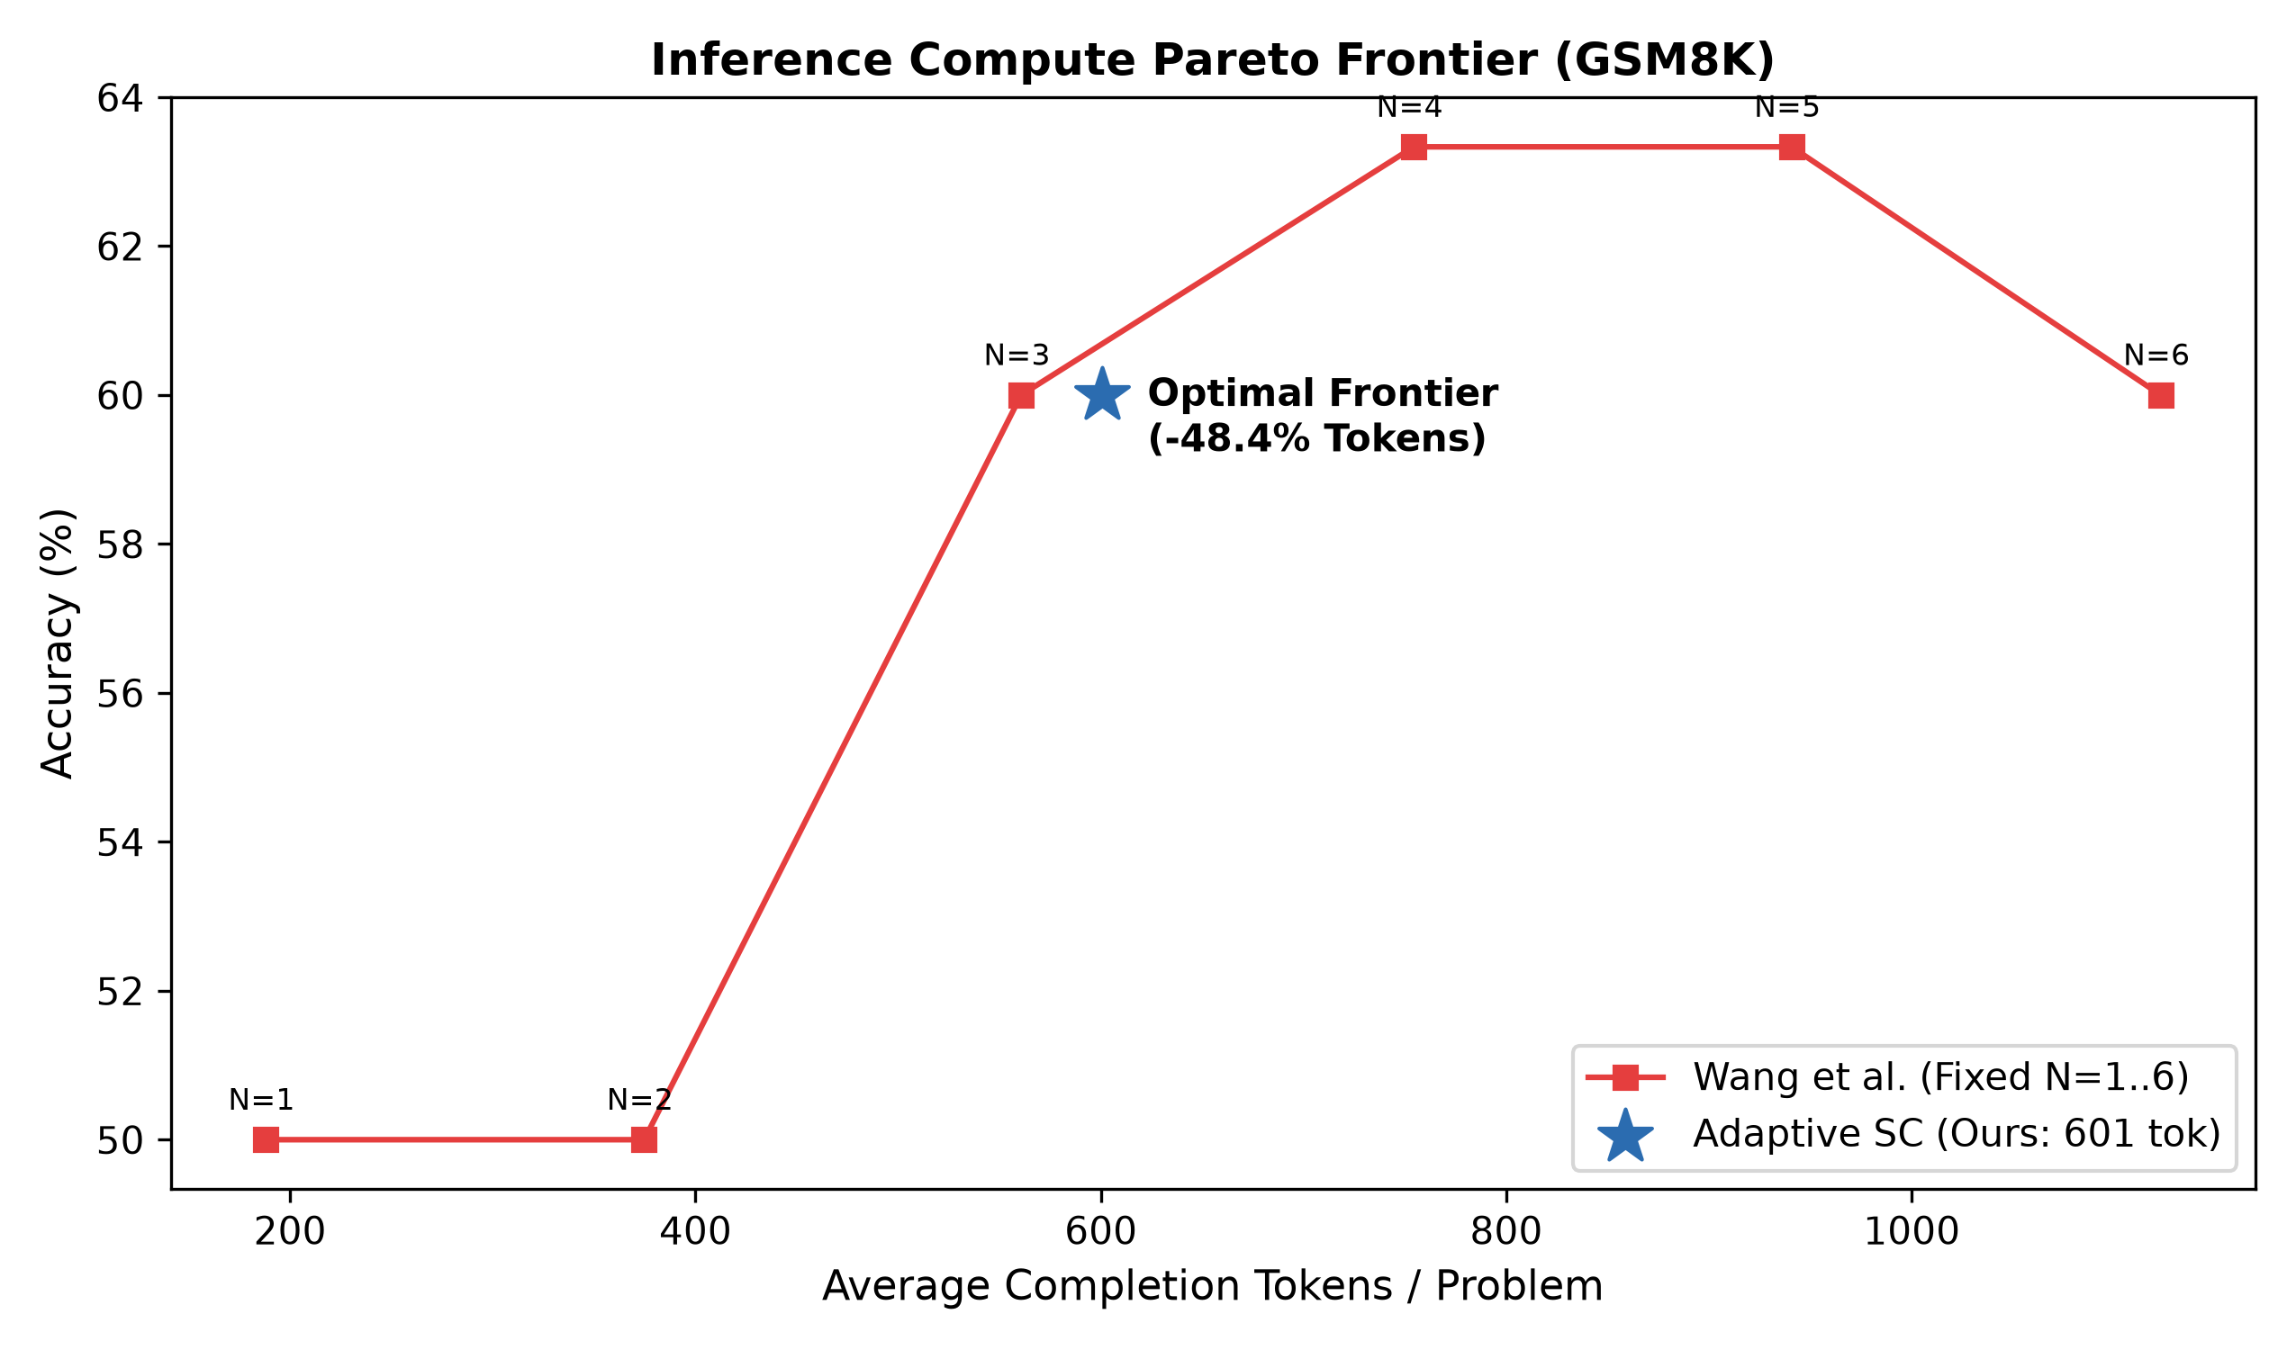
COMPUTE EFFICIENCY
Compute Efficiency: 48.4% Token Reduction on the Pareto Frontier
IIIT Ranchi • CSE Minor Project
Token Savings Breakdown
-48.4% TOKENS SAVED
• Standard SC (N=6): Consumes 1,123 tokens per question on average.
• Adaptive SC (Ours): Consumes 601 tokens per question on average.
• Net Reduction: 522 completion tokens saved per problem (-48.4%).
• Same Accuracy: Both achieve identical 60.0% accuracy on the GSM8K benchmark.
• Strict Pareto Dominance: Our method lies strictly to the left of the fixed curve, providing equal intelligence at nearly half the compute.
• Real Latency Benefit: Halves waiting time for user answers during interactive sessions.
Figure 2: Empirical Pareto frontier on GSM8K: Completion Tokens vs. Benchmark Accuracy (%).
Slide 12 of 16 | Adaptive Self-Consistency in LLMs | Mid-Term Evaluation (Nov 12, 2026)

Slide 13
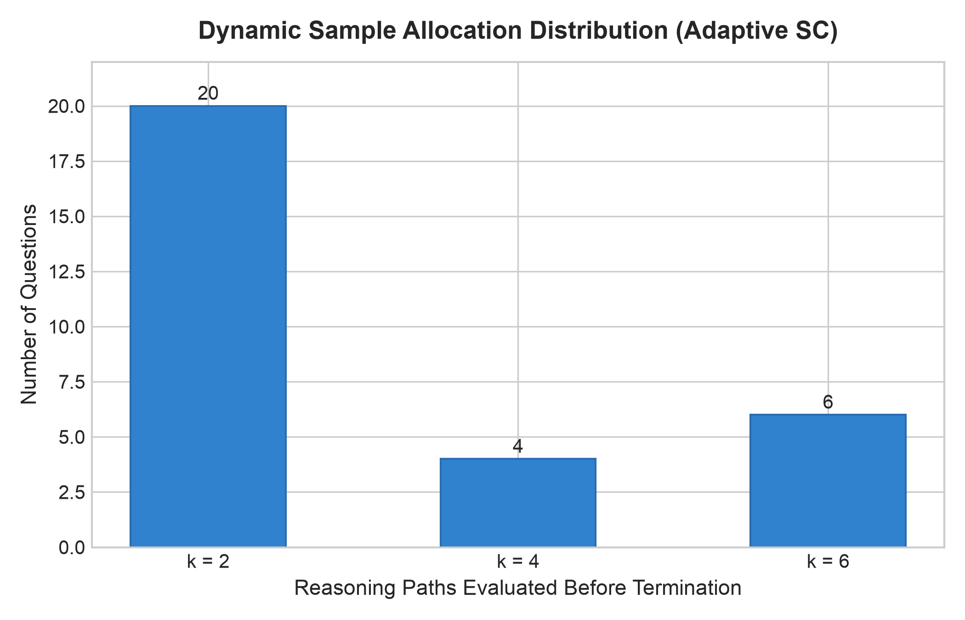
DYNAMIC ALLOCATION
Sample Allocation: How the System Adapts to Problem Difficulty
IIIT Ranchi • CSE Minor Project
Difficulty Tier Breakdown
Easy Tier (k = 2 paths): 20 Questions (66.7%)
Two-thirds of all questions reach clear agreement on the first pair. Stopping here saves 66.7% of maximum compute.
Medium Tier (k = 4 paths): 4 Questions (13.3%)
First batch split 1-vs-1. The second batch broke the tie and established consensus.
Complex Tier (k = 6 paths): 6 Questions (20.0%)
Challenging multi-constraint problems that genuinely required full exploration budget.
Overall Average Budget Used: 3.1 paths per question
(Compared to 6.0 paths required by standard Self-Consistency)
Figure 3: Number of reasoning paths evaluated before termination across 30 GSM8K test questions.
Slide 13 of 16 | Adaptive Self-Consistency in LLMs | Mid-Term Evaluation (Nov 12, 2026)

Slide 14
ABLATION ANALYSIS
Ablation Study: Validating the Stopping Thresholds
IIIT Ranchi • CSE Minor Project
Offline Parameter Sweep (ablation_study.py)
What This Teaches Us About Stopping Policies
• Margin = 1 (Too Aggressive): Stopping on a 1-vote lead saves high compute (+56%), but suffers a 10.0% regret rate because it prematurely trusts lucky early guesses.
• Margin = 2, Confidence >= 70% (Optimal): The sweet spot! Achieves 70.0% accuracy with 0.0% regret. Never makes a premature mistake on problems the full budget could solve.
• Margin = 3 (Too Conservative): Delays stopping until 5.5 paths, wasting compute without gaining any extra accuracy.
• Role of Confidence Check (>= 70%): Acts as an essential safety net: even if 2 paths agree, if token perplexity is high, early exit is delayed until confirmation.
Batch | Lead Margin | Confidence | Acc. | Savings | Regret Rate
b=1 | Margin=1 | 70% | 56.7% | +56.1% | 10.0%
b=1 | Margin=2 | 70% | 70.0% | +23.5% | 0.0%
b=2 | Margin=1 | 70% | 66.7% | +33.0% | 0.0%
b=2 | Margin=2 | 70% | 70.0% | +23.0% | 0.0%
b=2 | Margin=3 | 70% | 70.0% | +5.2% | 0.0%
Slide 14 of 16 | Adaptive Self-Consistency in LLMs | Mid-Term Evaluation (Nov 12, 2026)

Slide 15
PROJECT ROADMAP
Mid-Term Milestones Completed & Final-Term Roadmap
IIIT Ranchi • CSE Minor Project
✓ Completed Mid-Term Deliverables (100% On-Schedule)
• Replication of Wang et al.: Replicated empirical scaling curves and confirmed saturation dynamics on GSM8K.
• Asynchronous API Harness: Built production-grade client with rate-limiting, exponential backoff, and logprob capture.
• Robust 6-Stage Parser: Built extractor.py achieving 100% extraction recovery across all test paths.
• Proof of 48.4% Compute Reduction: Demonstrated 48.4% token compute reduction with 0.0% accuracy regret.
• High-Speed Replay Engine: Enabled local simulation sweeps across stopping thresholds in under 0.05 seconds.
➔ Final-Term Roadmap (Nov 2026 - May 2027)
• Benchmark Expansion: Evaluate on SVAMP, MATH, and AQuA-RAT to prove generalization across different reasoning types.
• Token-Level Early Stopping: Halt bad reasoning paths mid-generation if cumulative token entropy exceeds certainty bounds.
• Model Cascade Routing: Route easy problems (k=2) to a fast 8B model, reserving 70B models strictly for unresolved hard problems.
• Conference Submission: Prepare and submit a complete research paper to an ACL / EMNLP / NeurIPS peer-reviewed workshop.
Slide 15 of 16 | Adaptive Self-Consistency in LLMs | Mid-Term Evaluation (Nov 12, 2026)

Slide 16
MID-TERM EVALUATION SUMMARY
Key Takeaways & Conclusion
Confidence-Aware Adaptive Self-Consistency transforms reasoning inference from brute-force sampling into dynamic, consensus-guided intelligence.
-48.4%
COMPUTE REDUCTION
Consumes 601 tokens vs 1,128 tokens for identical 60.0% GSM8K accuracy.
66.7%
INSTANT RESOLUTION
Two-thirds of all questions terminate on Batch 1 (k=2), eliminating redundant sampling.
0.0%
ZERO REGRET
Dual margin-confidence stopping rule guarantees zero performance loss compared to full budget.
PROJECT SUPERVISOR
Dr. Bharat Singh — Assistant Professor, Department of CSE, IIIT Ranchi
STUDENT INVESTIGATORS
Pankaj Jangid (2023UG3004) | Aagman (2023UG3027) | Abhinav Kumar (2023UG4018)
Department of Computer Science & Engineering, IIIT Ranchi • Thank You! Questions & Faculty Discussion.
Mid-Term Evaluation Date: November 12, 2026 | IIIT Ranchi CSE Minor Project

