Slide 1
Simutech Project 2022
Computations in thermodynamics
&
Heat transfer devices
MENTOR – PARIKSHIT GHOSH MENTEE- ABHINAV KUMAR(200016)

Slide 2

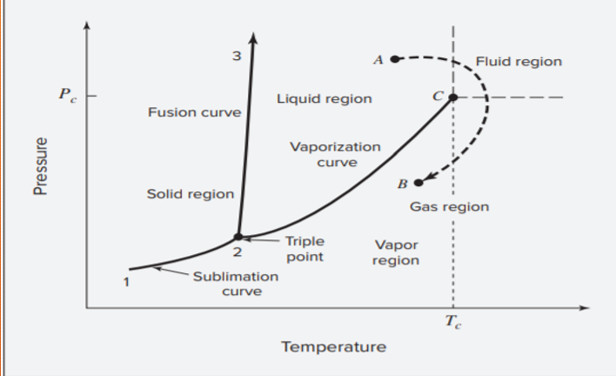
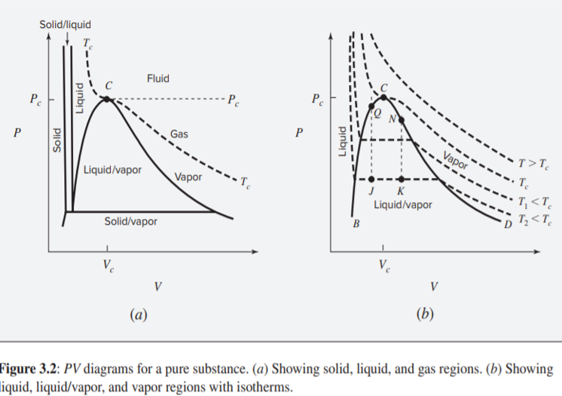
PT Curve for pure Substance.
Topics Discussed in WEEK 1
VOLUMETRIC PROPERTIES OF FLUIDS
PV DIAGRAM AND CRITICAL BEHAVIOUR

Slide 3
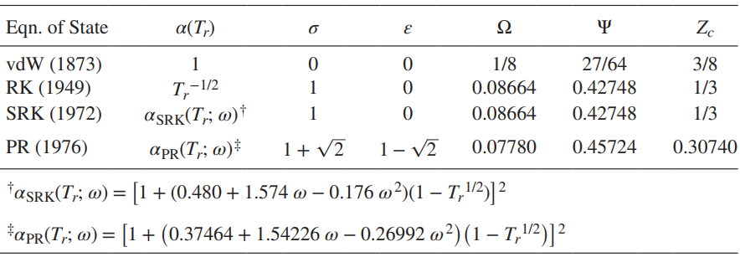
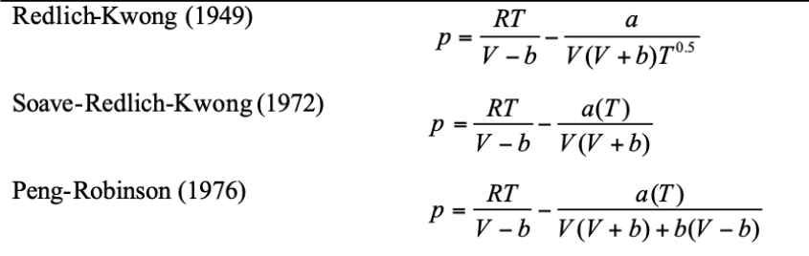





PARAMTERS FOR EQUATION OF STATE VARIOUS EQUATION OF STATES GENERIC CUBIC EQUATION OF STATE VIRIAL EQUATION OF STATE

Slide 4
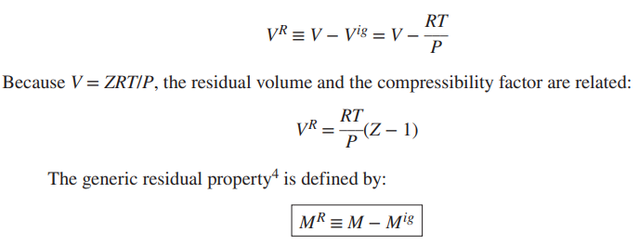





TOPICS DISCUSSED IN WEEK 2
RESIDUAL PROPERTIES AND FUNCTION
DEPARTURE FUNCTION
M and Mig are the actual and the ideal-gas-state values of the thermodynamic property M at the same temperature and pressure

Slide 5





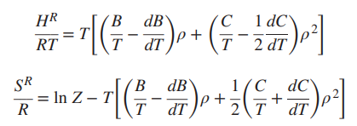
RESIDUAL PROPERTIES FROM THE VIRIAL EOS
For
ENTHALPY , ENTROPY AND GIBBS ENERGY
Put the value of Z-1 in the expression of residual property of Gibbs Free Energy , Enthalpy, Entropy

Slide 6


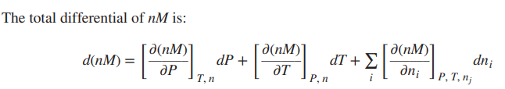






TOPICS DISCUSSED IN WEEK 3 & 4
Partial molar property is sometimes called a response function, it is a measure of the response of total property nM to the addition of an infinitesimal amount of species i to a finite amount of solution, at constant T and P.
MOLAR VOLUME USING DEPARTURE FUNCTION FOR DIFFERNET CUBIC EOS
PARTIAL PROPERTIES FOR BINARY SOLUTIONS

Slide 7


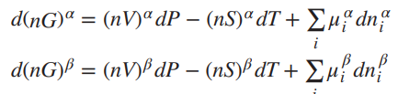





GIBBS/DUHEM EQUATION:
This equation represents a general criterion for chemical-reaction equilibrium in a single-phase closed PVT system.
hence,
Thus, multiple phases at the same T and P are in equilibrium when the chemical potential of each species is the same in all phases.
GIBBS-DUHEM EQUATION
CHEMICAL POTENTIAL & EQUILIBRIUM

Slide 8









TOPICS DISCUSSED IN WEEK 5
The fugacity of pure species i,
The dimensionless ratio fi/P has been defined as another new property, the fugacity coefficient, given by symbol ϕi.
The fugacity of pure species i, may be written for species i as a saturated vapor and as a saturated liquid at the same temperature.
for two phases α and β of a pure species coexisting at equilibrium ..
Therefore,
For a pure species, coexisting liquid and vapor phases are in equilibrium when they have the same temperature, pressure, and fugacity
FUGACITY FOR PURE SPECIES
VAPOR LIQUID EQUILIBRIUM FOR PURE SPECIES
EXCESS PROOPERTY & ACTIVITY COEFFICIENT

Slide 9

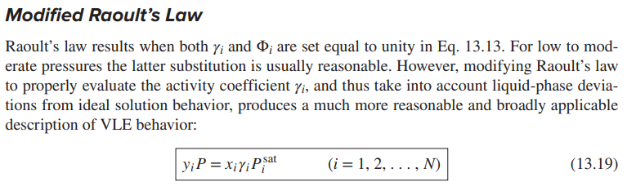
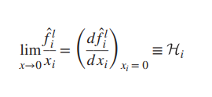


An excess property ME is defined as the difference between the actual property value of a solution and the value it would have as an ideal solution at the same temperature, pressure, and composition.
EXCESS PROPERTY & ACTIVITY COEFFICIENT
MODIFIED RAOULT’S LAW
HENRY’S LAW
VAN LAAR EQUATION &
WILSON EQUATION

Slide 10
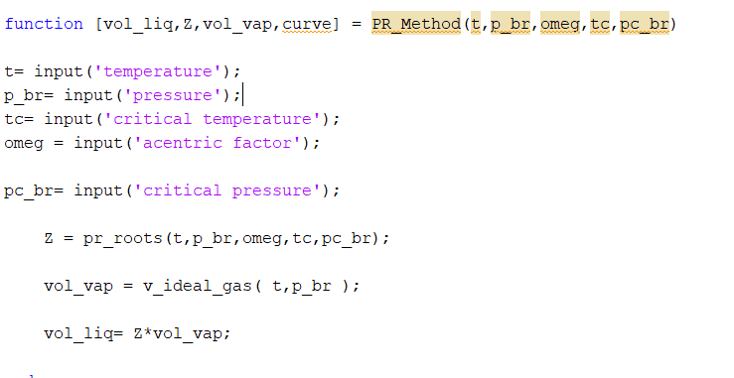
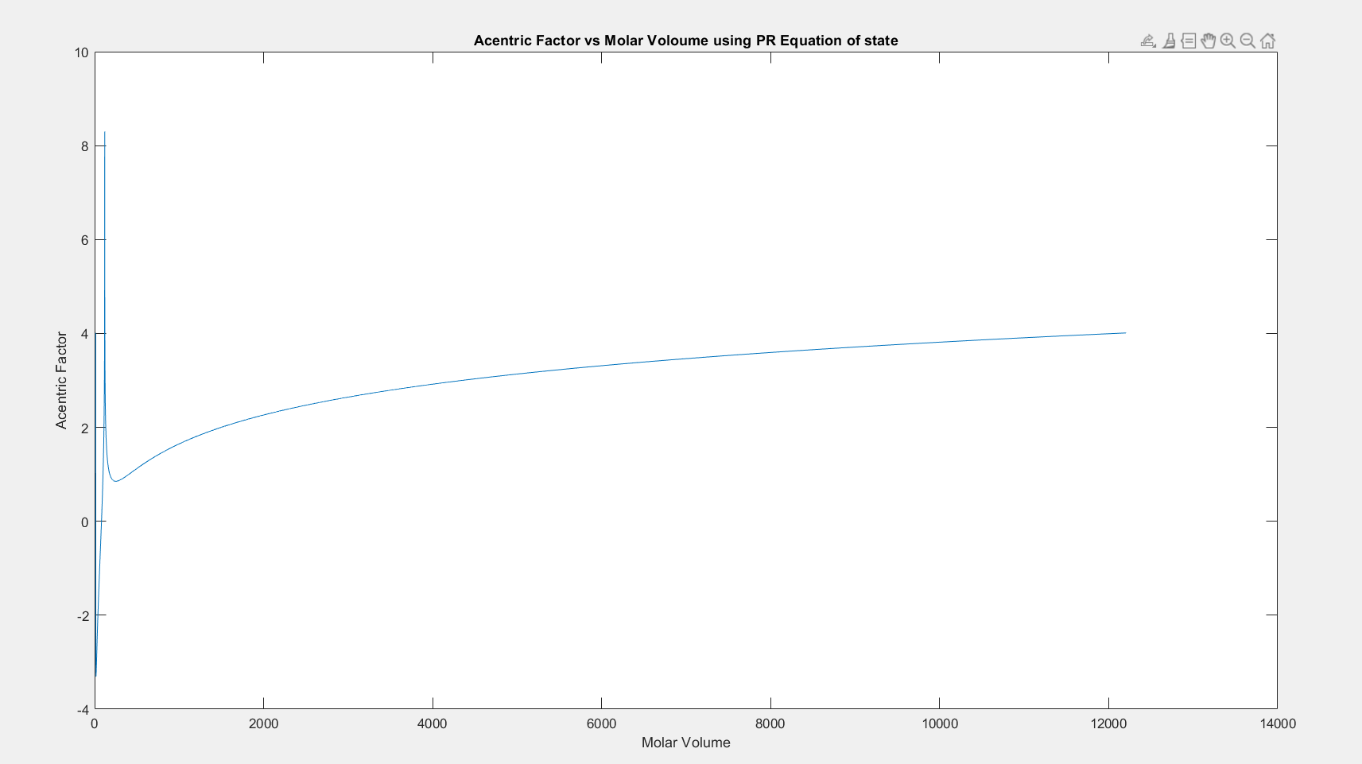
PROBLEM STATEMENT 1
Calculated molar volumes of saturated vapor and liquid for different species.
Different functions for All cubic equation of state
(vdw, SRK,PR,RK)
Saturated vapor vs acentric factor curve

Slide 11
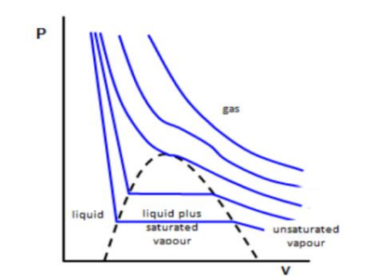
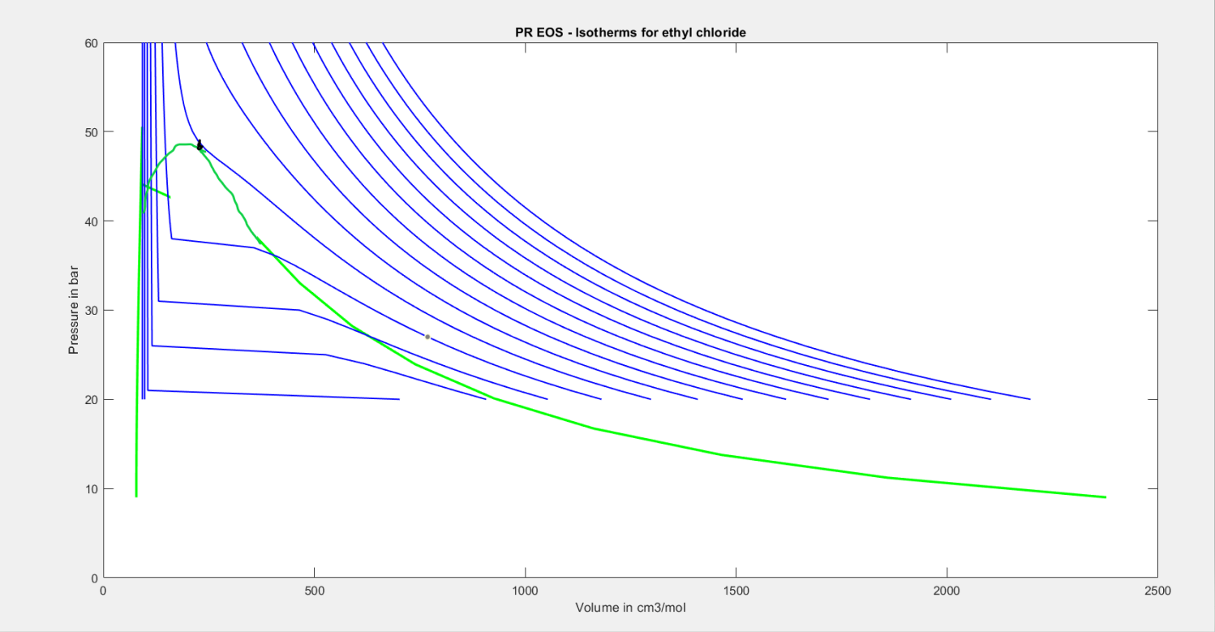
PROBLEM STATEMENT 2
PLOTTED PV CURVE FOR PR EQUATION OF STATE
SYSTEM – C2H5CL
OBSERVED APPROXIMATED DOME SHAPED CURVE

