Slide 1
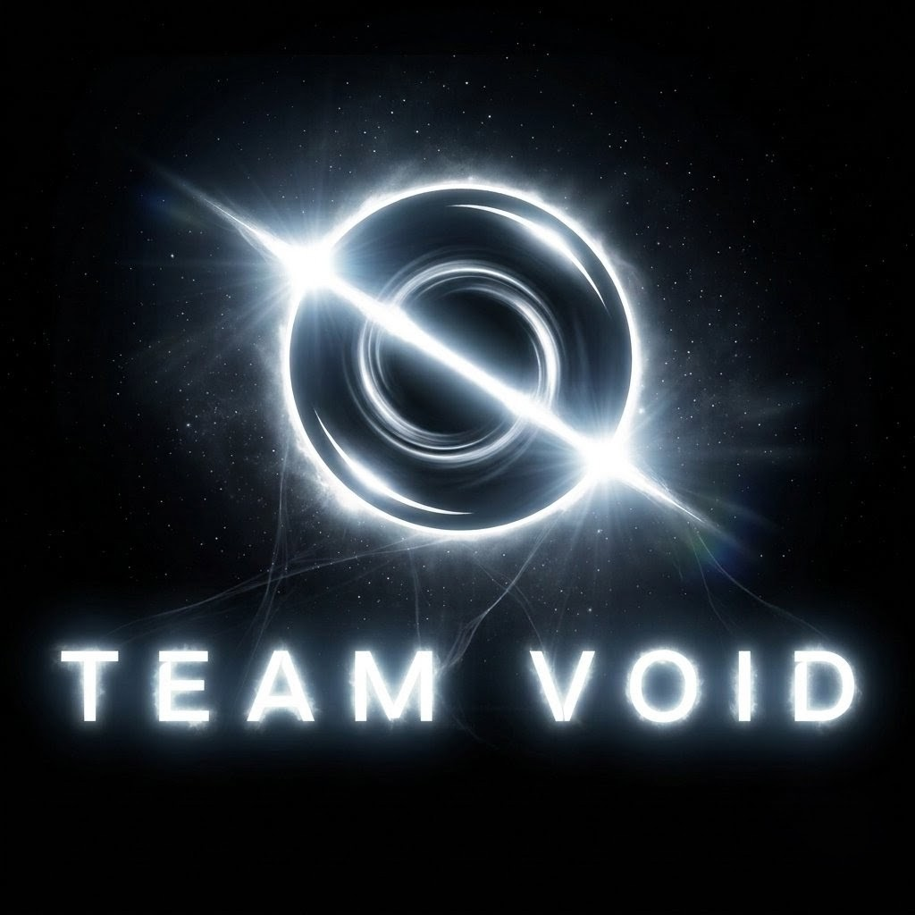

SMART INDIA HACKATHON 2026
Problem Statement ID – SIH26189
Problem Statement Title- AI-Powered Criminal Network Analysis System
Theme- Software: Blockchain & Cybersecurity (Ministry of Home Affairs)
PS Category- Software
Team ID-
Team Name – Team Void

Slide 2
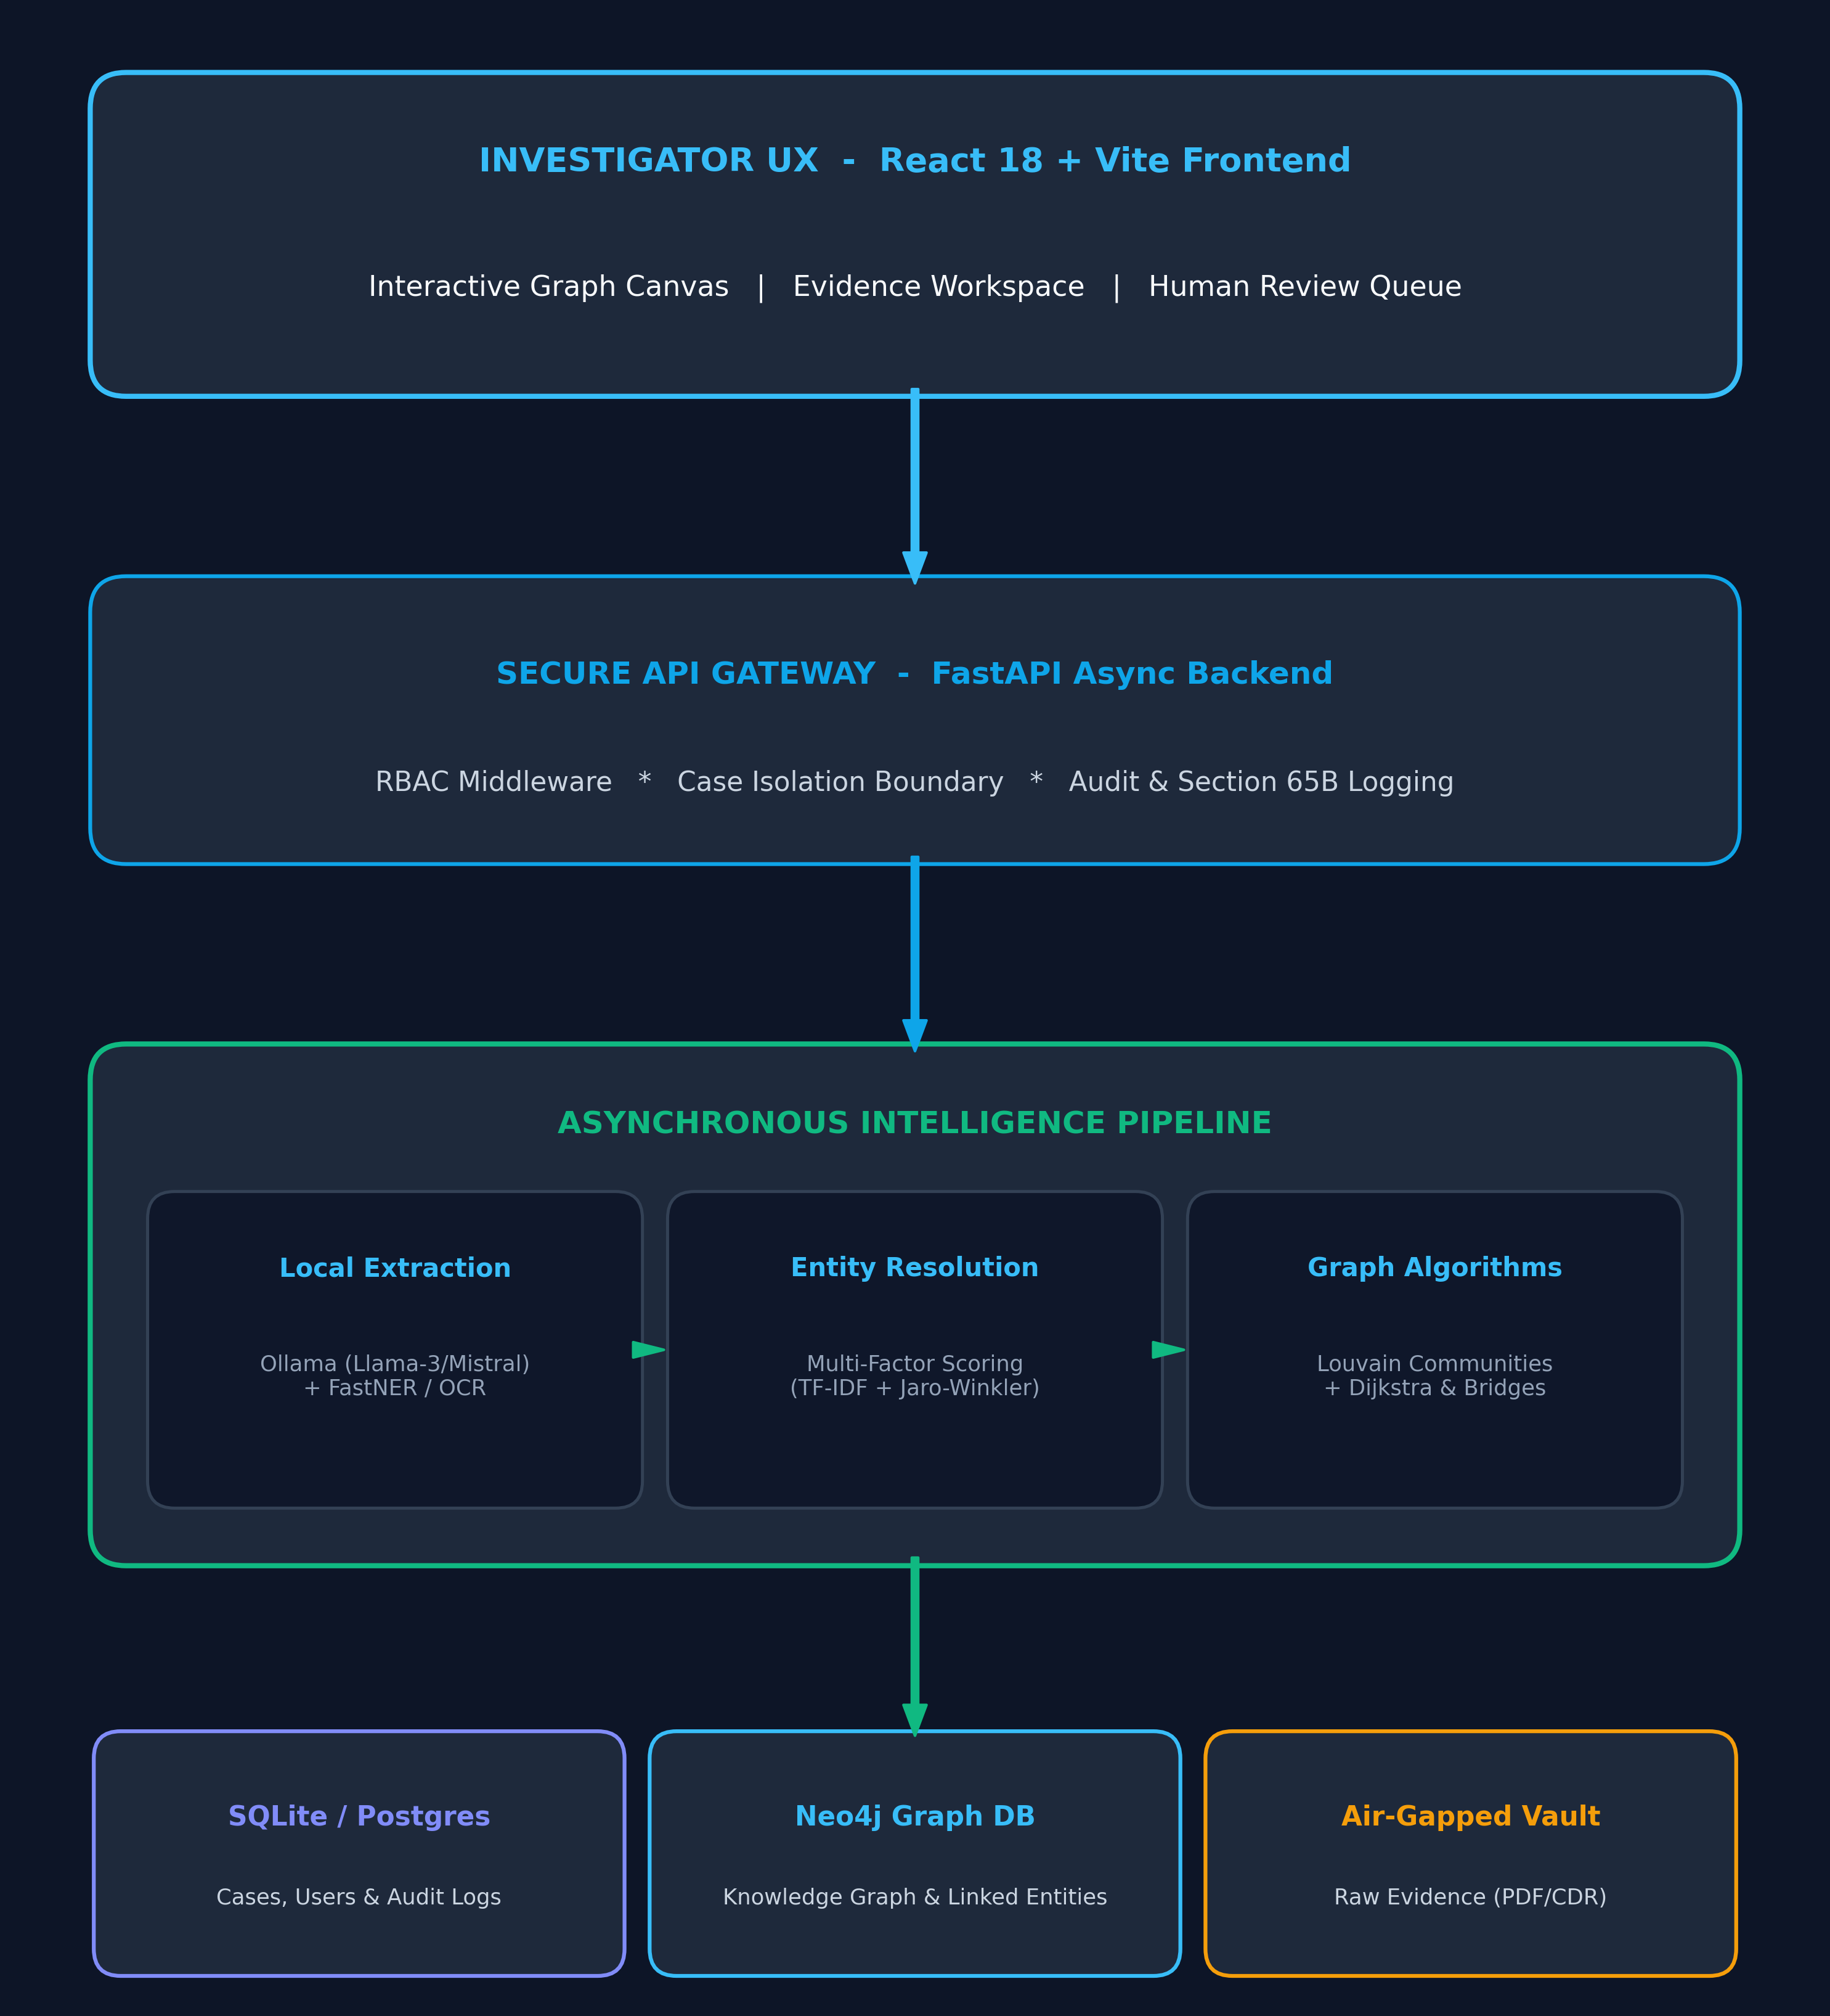
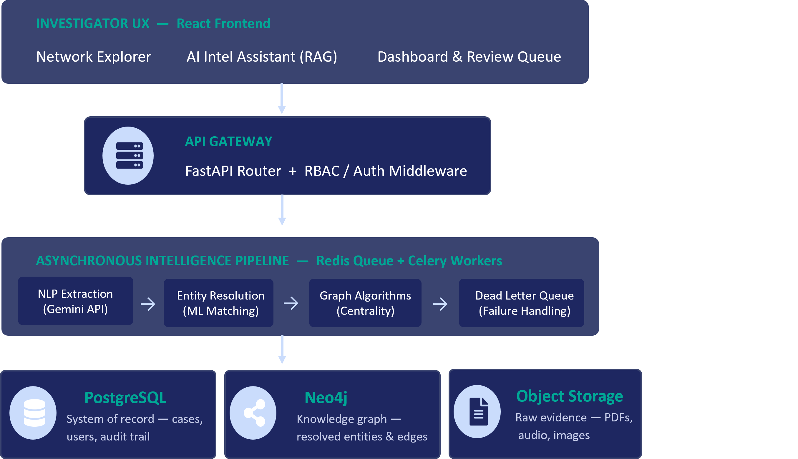
VEILLE
(Multisource Intelligence Fusion for Criminal Networks)
★ Innovation
PROPOSED SOLUTION
1
PROBLEM EXISTING
Data Fragmentation: FIRs, CDRs, financial records & surveillance reports sit in incompatible, disconnected silos.
Multisource Fusion Engine: NLP extraction + entity resolution across FIRs, CDRs, financial & surveillance data.
Manual Correlation: Investigators hand-draw link charts, missing connections buried across sources.
5-Layer Confidence Model: Every entity/edge scored L1-L5, ending in an auditable investigation_priority.
Evidence-Grounded RAG: Every AI answer cites its exact source evidence — never a black box.
No Evidence Trust: “Graph-DB + LLM” tools give no confidence scoring, provenance, or auditability.
Human-in-the-Loop Queue: AI-suggested merges & links stay “candidate” until an investigator confirms.
UVP (UNIQUE VALUE PROPOSITION)
No Guilt/Risk Scores: Replaces subjective “risk scores” with an ethically-bounded investigation_priority metric.
Full Evidence Provenance: Every graph edge traces back to a hash-verified source document.
Case-Isolated by Design: RBAC + case_id scoping means Case A data can never leak into Case B.
Workflow

Slide 3
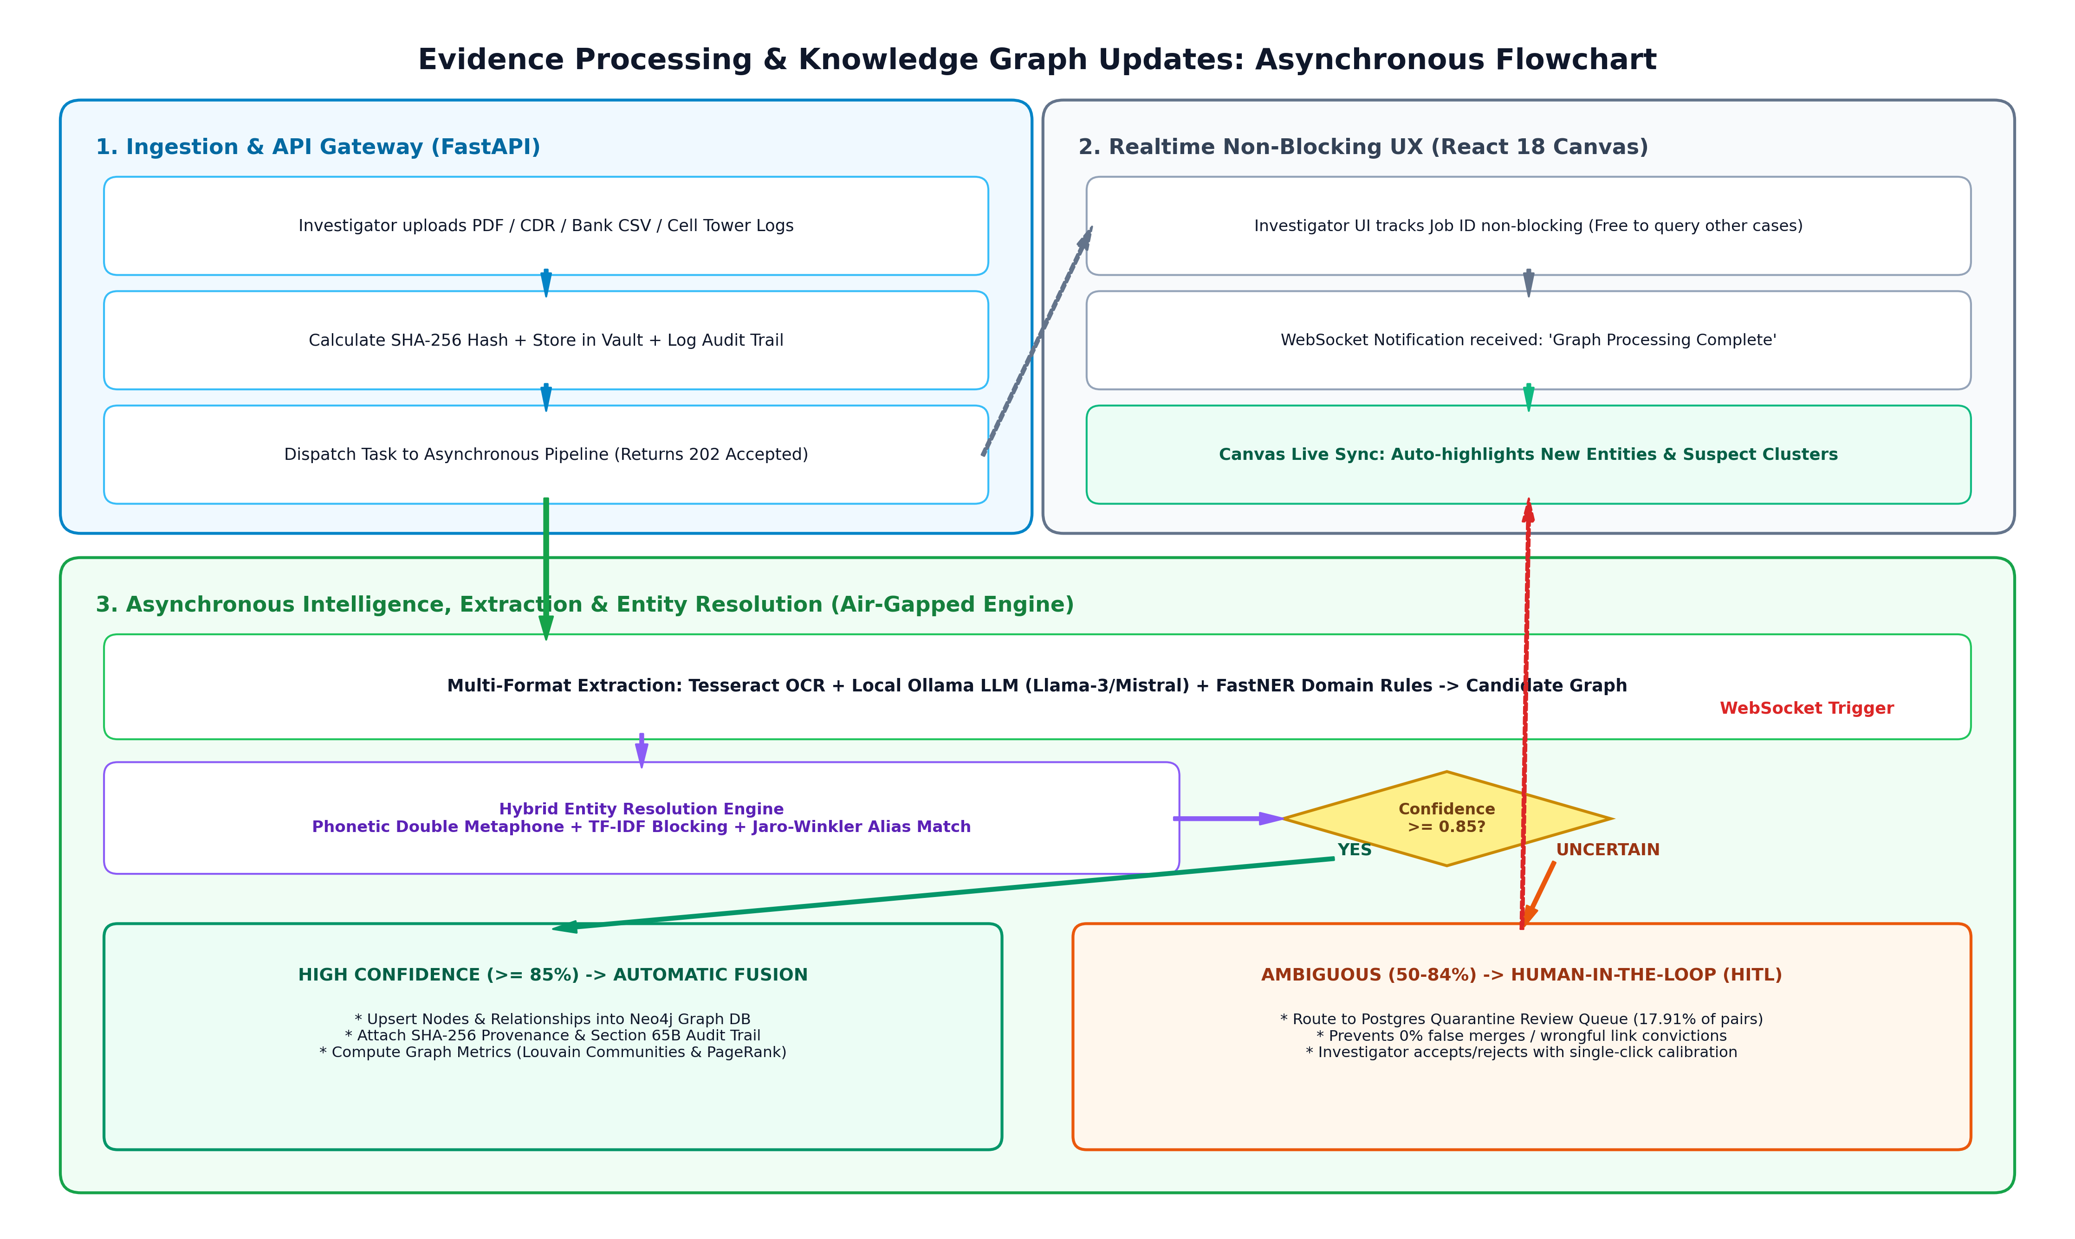
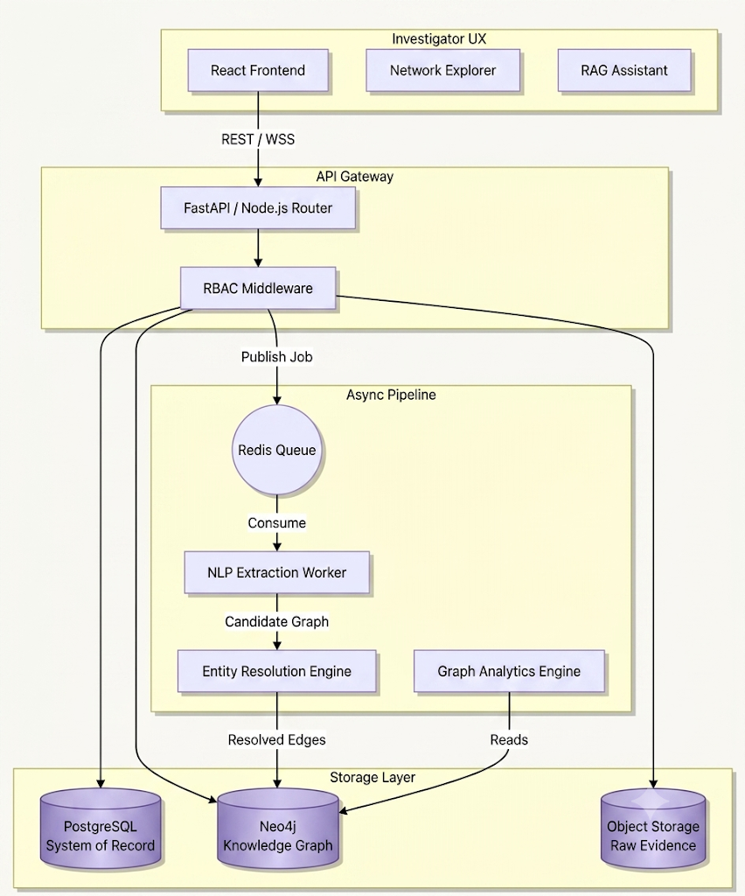
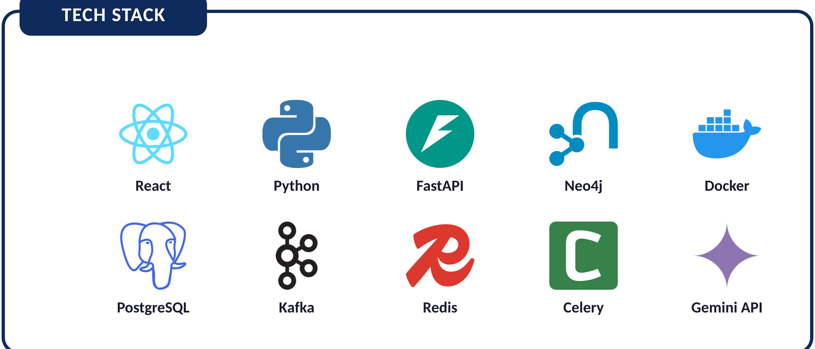
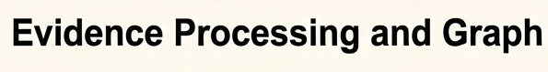
TECHNICAL APPROACH
3
2
System Architecture

Slide 4
FEASIBILITY AND VIABILITY
FEASIBILITY
VIABILITY
Technical: Modular, proven stack — FastAPI, React, Neo4j, Celery; hybrid AI limits reliance on any single fragile component.
Policy Fit: Aligns directly with MHA's CCTNS mission — 15,000+ police stations already interconnected nationally.
Data Compliance: Canonical ontology + evidence provenance align with CCTNS, already live across 97%+ of Indian police stations.
Adoption Pull: National IPC investigation rate sits near 72%; VEILLE targets cases stalled by fragmentation, not absent data.
Innovation: 5-Layer confidence model culminating in investigation_priority — avoids subjective “risk scores” by design.
Deployment Path: State police units → paramilitary/defense intelligence → compliance-grade audit layer for allied agencies.
Operational: Outbox Pattern keeps Postgres ↔ Neo4j in sync; async Celery pipeline decouples slow AI from the live UI.
Cost to Adopt: Sits downstream of data investigators already generate — no new hardware or data-collection burden.
Economic: Built on open-source infra (Postgres, Neo4j, Redis, Kafka) — no proprietary licensing lock-in.
Retention: RAG assistant + review queue make it a daily investigative tool, not a one-time dashboard demo.
TECHNICAL CHALLENGES
BUSINESS / USER CHALLENGES
Risk: Neo4j ↔ Postgres desync under async writes, risking orphaned or duplicate graph nodes.
Risk: Investigators may distrust AI-suggested links in a legal-evidentiary setting.
Mitigation: Outbox Pattern with idempotency keys — replaying an event twice still yields exactly one graph node.
Mitigation: Every inferred edge stays “candidate” until human-reviewed; ethical guardrails hardcoded to build judiciary-level trust.

Slide 5







IMPACT AND BENEFITS
Investigative Efficiency:
Cuts hours of manual link-chart drawing to minutes of automated, evidence-linked graph reconstruction.
Feature
Generic Tools
VEILLE
Automated NLP Extraction
Evidentiary Integrity:
Every relationship is hash-traceable to its source document — defensible for judicial scrutiny.
Entity Resolution (Aliases)
5-Layer Confidence Scoring
Evidence Provenance
Civil Liberties Safeguard:
Hardcoded ethical guardrails protect against algorithmic overreach in an MHA-sponsored system.
Human Review Queue
No Guilt / Risk Scores
Case Isolation (RBAC)
National Scale Fit:
Designed to sit downstream of CCTNS's already-digitized FIR data across 97%+ of police stations.
RAG Assistant w/ Citations
WHAT THIS MEANS ON THE GROUND
Minutes, not Hours
Court-Defensible
Trust by Design
Ready for Scale
From raw FIR upload to a resolved, queryable network
Every claim traces to hash-verified source evidence
No guilt scores — human review gates every decision
Plugs into CCTNS data investigators already generate

Slide 6
RESEARCH AND REFERENCES
CCTNS (Crime & Criminal Tracking Network & Systems) connects 15,000+ police stations under NCRB, with 97%+ digitally equipped — digitalpolice.gov.in
2. National average IPC charge-sheeting rate stands near 72%, varying sharply by state — confirming fragmentation, not data scarcity, is the bottleneck.
3. Link analysis is an established investigative discipline (node-and-edge relationship mapping) that VEILLE automates and scores end-to-end.
SOLUTIONS ALREADY EXIST
OUR SOLUTION STANDS OUT
Enterprise link-analysis suites (Palantir Gotham, IBM i2 Analyst's Notebook) and generic “Neo4j + LLM query” stacks exist — but are complex, costly, and not built for Indian FIR/CDR formats or MHA-grade ethical constraints.
Automated Fusion: not just visualization — gets clean data into the graph in the first place.
Evidence-Grounded: every AI answer is cited back to its source document.
Ethically Hardcoded: no guilt/risk scores, human review always in the loop.
AVAILABLE TOOLS: Palantir Gotham · IBM i2 Analyst's Notebook · Generic Neo4j + LLM stacks
India-Built: native to FIR/CDR formats and MHA-grade case isolation.
PROJECT RESOURCES
Demo Video :
Prototype : Figma / repo

