Slide 1
CHAT
BOT
Let’s Learn more about what all can CarEx do for you.
Let’s go!

Slide 2
What is a chatbot
Why Chat-Bots
Methodology used to build the chatbot
Our future Goals
Conclusion
1
2
3
4
5

Slide 3
What is a
Chatbot
A chatbot is a computer program that simulates and processes human conversation (either written or spoken), allowing humans to interact with digital devices as if they were communicating with a real person.
1

Slide 4
Why Chatbots ?
Chatbots allow businesses to connect with customers in a personal way without the expense of human representatives. For example, many of the questions or issues customers have are common and easily answered. That’s why companies create FAQs and troubleshooting guides. Chatbots provide a personal alternative to a written FAQ or guide and can even triage questions, including handing off a customer issue to a live person if the issue becomes too complex for the chatbot to resolve. Chatbots have become popular as a time and money saver for businesses and an added convenience for customers.
2

Slide 5

Introducing CarEx
An expert chatbot in guiding about the globally wide industry of cars and automobiles, taking you from basic to advance levels.
Work by: Abhinav Rawat

Slide 6
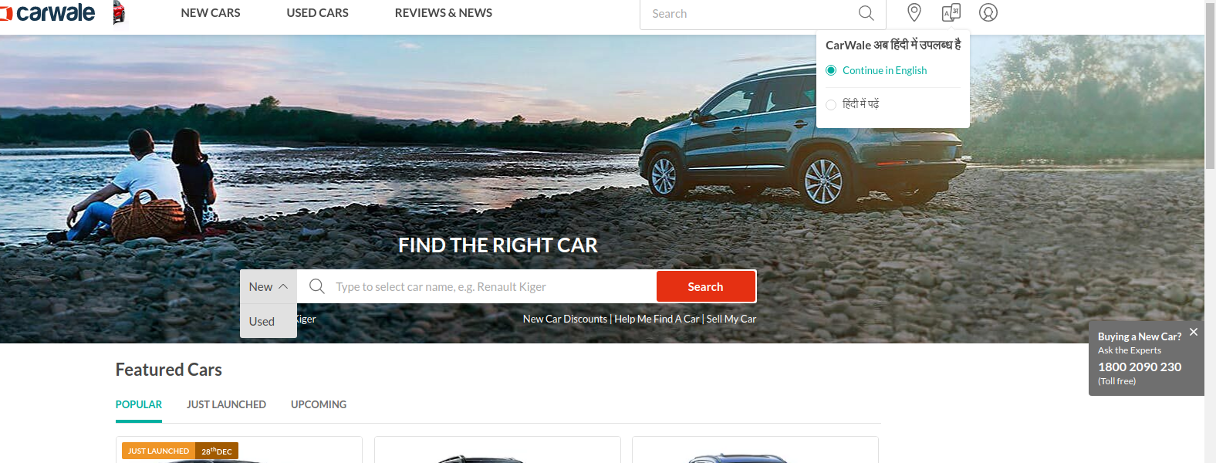
Idea Behind Introducing CarEx
Here in this famous Website as we can see there are no chatbots used. They are guiding their customers using a human expert.

Slide 7
Methodology
Used
Driven by AI, automated rules, natural-language processing (NLP), and machine learning (ML), chatbots process data to deliver responses to requests of all kinds.
3

Slide 8
Data Driven
Data-Driven and predictive(conversational) chatbots.Theyare often referred to as virtual assistants or digital assistants, and they are much more sophisticated, interactive, and personalized than task-oriented chatbots. These chatbots are contextually aware and leverage natural-language understanding (NLU), NLP, and ML to learn as they go. They apply predictive intelligence and analytics to enable personalization based on user profiles and past user behavior. Digital assistants can learn a user’s preferences over time, provide recommendations, and even anticipate needs. In addition to monitoring data and intent, they can initiate conversations. Apple’s Siri and Amazon’s Alexa are examples of consumer-oriented, data-driven, predictive chatbots.
Task-Oriented
Task-oriented (declarative) chatbots are single-purpose programs that focus on performing one function. Using rules, NLP, and very little ML, they generate automated but conversational responses to user inquiries. Interactions with these chatbots are highly specific and structured and are most applicable to support and service functions—think robust, interactive FAQs. Task-oriented chatbots can handle common questions, such as queries about hours of business or simple transactions that don’t involve a variety of variables. Though they do use NLP so end users can experience them in a conversational way, their capabilities are fairly basic. These are currently the most commonly used chatbots.
Chatbots

Slide 9
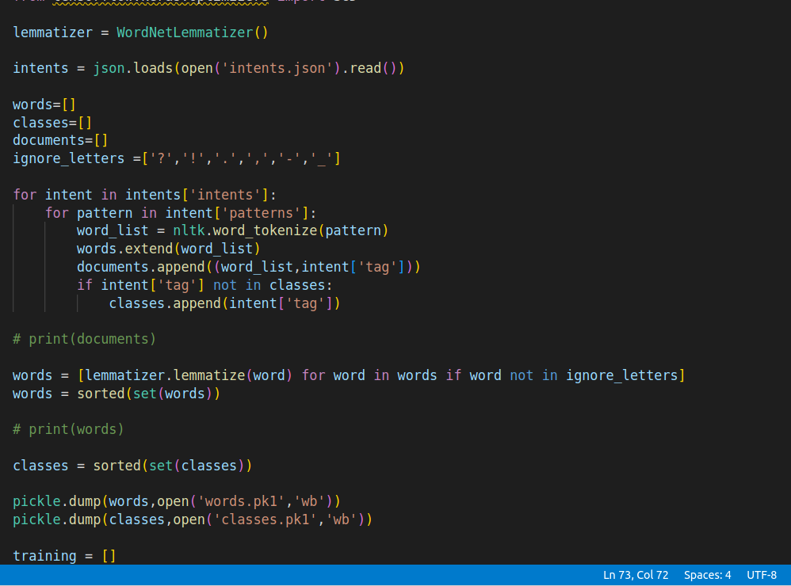
Methodology
We have used Natual Language processing often abbreivated as NLP in the process to build our Chatbot CarEx.NLP enables the computer to acquire meaning from inputs given by users. It is a branch of informatics, mathematical linguistics, machine learning, and artificial intelligence.
NLP uses a pattern called Lemmatization to identify word variations and determine the root of a word in natural language.Lemmatization is a text normalisation technique used for Natural Language Processing (NLP). It can convert any word's inflections to the base root form. This allows us to categorise words with similar meanings, no matter how they are spelled.
A machine learning model is a file that has been trained to recognize certain types of patterns. You train a model over a set of data, providing it an algorithm that it can use to reason over and learn from those data.
In this chatbot we have used a sequential model and the techniques of neural networks ans deep learning in order to train our model.

Slide 10
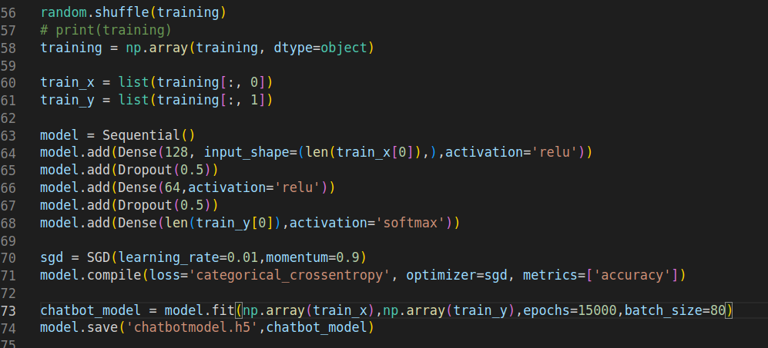
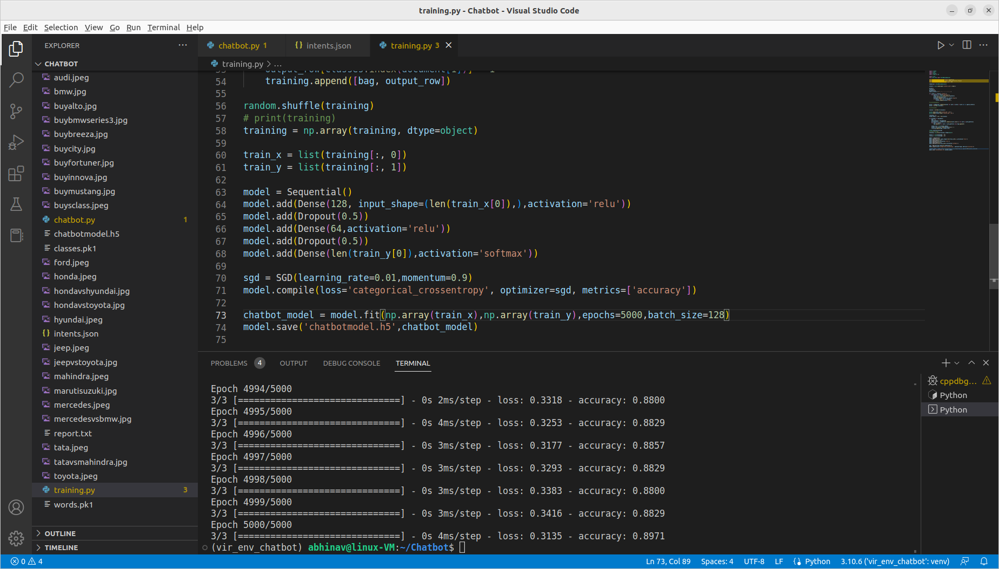
Methodology
A machine learning model is a file that has been trained to recognize certain types of patterns. You train a model over a set of data, providing it an algorithm that it can use to reason over and learn from those data.
In this chatbot we have used a sequential model and the techniques of neural networks and deep learning in order to train our model.
For the current dataset, our model, after it’s training achieved an accuracy of approx 90%.

Slide 11
Intergration
Chatbot
Looking forward to integrate with a web-app using flask at the backend end and ReactJs at the frontend.
A 100% ready to use chatbot for customer interaction with great interactivity
Will be thriving to achieve more accuracy in the near future
More optimized and increased dataset with help of automatic data retrival from internet
Accuracy
Dataset

Slide 12
THANK YOU

