Slide 1

Real-Time Threat Intelligence and Risk Management System

Slide 2

ThreatShield
️
Real-Time Threat Intelligence and Risk Management System
Content:
AI-Powered Cybersecurity Platform for E-commerce Companies
Monitoring • Assessment • Visualization
Full-Stack Solution: React.js • Flask • PostgreSQL • Docker

Slide 3
Executive Summary
Manage 40+ IT assets with real-time threat monitoring
Integrate OSINT APIs (Shodan, VirusTotal, HaveIBeenPwned)
AI-driven risk scoring using GPT-4
Interactive dashboards with live security analytics
Containerized architecture for seamless deployment

Slide 4
Project Objectives
🔍 Threat Monitoring: Live monitoring of company assets with real-time threat detection
🤖 AI Risk Assessment: Automated risk scoring using OSINT data and AI
📊 Data Visualization: Interactive dashboards for security insights
⚡ Operation Speed: Simplified security operations with centralized data
🔄 Continuous Assessment: Regular vulnerability and threat assessment
📈 Scalability: Docker-based infrastructure for easy scaling

Slide 5
Architecture Diagram
Flow Diagram:
React Frontend ↔ Flask API ↔ PostgreSQL OSINT APIs + LLM Integration
Process List:
• User interacts with React dashboard
• Flask backend processes requests and queries database
• On-demand OSINT API calls for threat data
• Hugging Face generates AI-based risk scores
• Results stored and visualized in real-time

Slide 6
Technology Stack
Frontend: • React.js with modern hooks • Tailwind CSS for styling • shadcn/ui components • Axios for API calls • Recharts for visualization
Backend: • Flask web framework • SQLAlchemy ORM • PostgreSQL database • Docker containerization • REST API architecture

Slide 7
Database Schema
Table | Description | Key Fields
assets | IT asset inventory | id, name, type, risk_score
vulnerabilities | CVE database | id, cve_id, cvss_score
threats | Threat intelligence | id, name, severity
asset_vulnerabilities | Asset-CVE mapping | asset_id, vulnerability_id
asset_risk_scores | AI-generated scores | asset_id, risk_score

Slide 8
Backend API Endpoints
Code Block:
GET /api/assets # List all assets GET /api/assets/:id # Get asset details POST /api/scan # Trigger threat scan GET /api/risk_score/:id # Get risk score GET /api/vulnerabilities # List vulnerabilities GET /api/threats # List threats GET /api/dashboard # Dashboard statistics
Key Features: • RESTful architecture with JSON responses • Comprehensive error handling • Input validation and sanitization • Async task processing for long operations

Slide 9
: External Data Sources
Grid Layout (3 cards):
🌐 Shodan: IP/Domain lookup for exposed services and threat data
🦠 VirusTotal: Hash/URL/IP scanning for malware detection
📧 HaveIBeenPwned: Email/domain breach information
Data Flow: APIs → Processing → PostgreSQL → Analysis → Visualization

Slide 10
AI-Powered Risk Assessment
Timeline Process:
Collect Threats & Vulnerabilities
Structure Data for AI
Huggung Face LLM Analysis
Generate Risk Score
Formula: Risk Score = AI_Analysis(Vulnerabilities + Threats) → [0-10]

Slide 11
Frontend Dashboard Features
Interactive Components: Real-time asset monitoring Dynamic filtering and search Risk score visualization Vulnerability trends graphs Threat severity distributions
User Actions: Generate risk scores on-demand Filter assets by criticality View detailed threat reports Track mitigation progress Export analysis reports

Slide 12
Testing & Validation
🧪 Unit Tests: Flask service modules with pytest
🔄 Integration Tests: API → OSINT → Database flow
👥 UI Testing: Manual browser testing and validation
Coverage Areas:
• API endpoint responses
• Database operations
• OSINT API integrations
• Risk score calculations
• Frontend data visualization

Slide 13
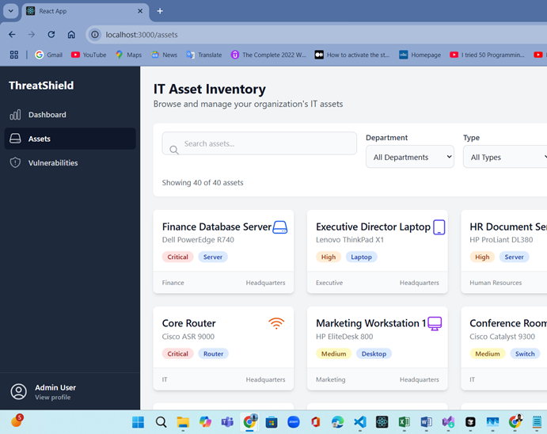
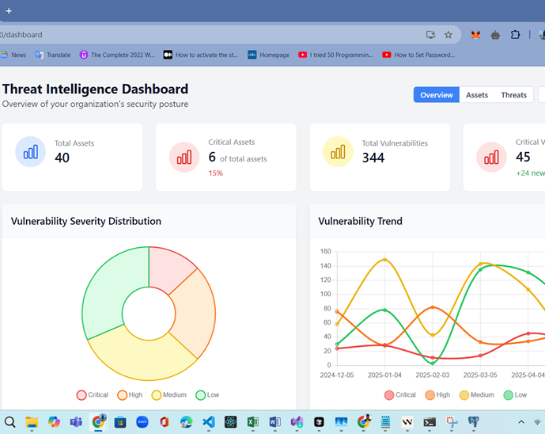
WEbpagae SNippets

Slide 14
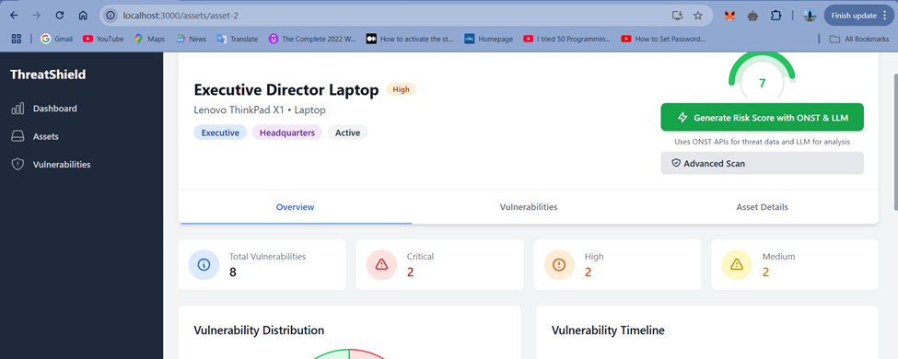
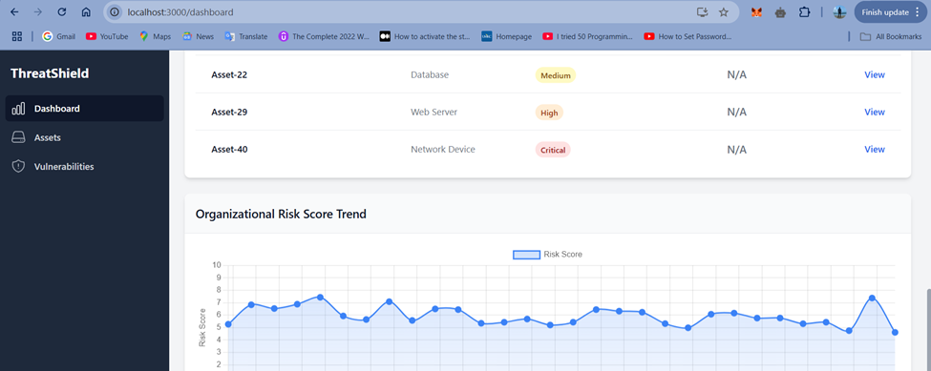
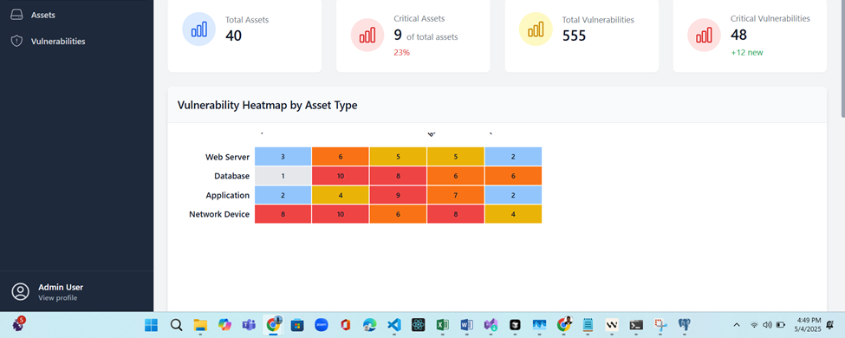
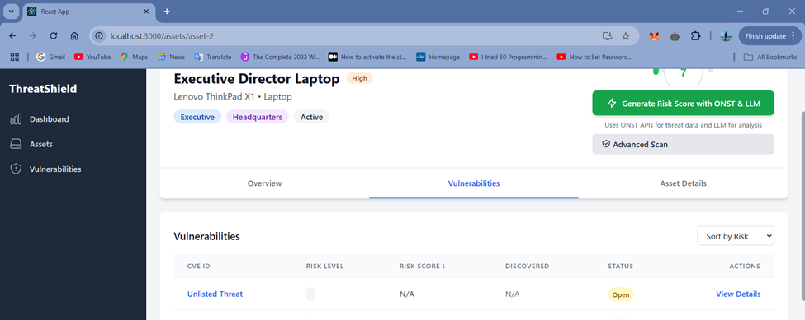
WEbpagae SNippets

Slide 15
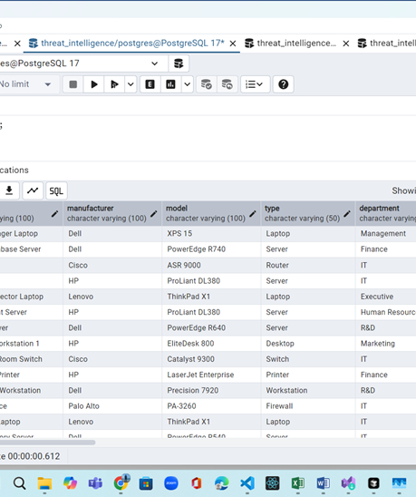
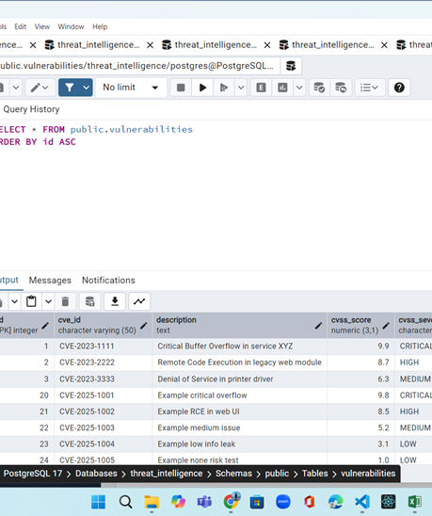
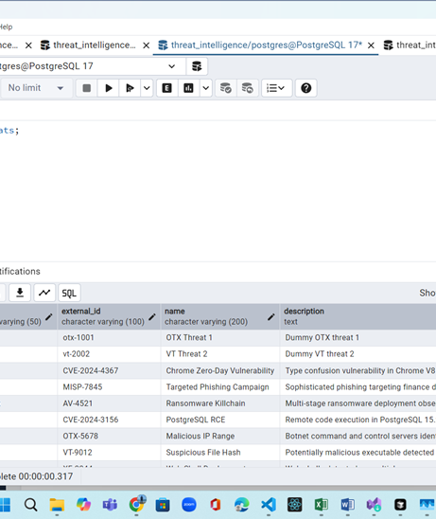
Database SNippets

Slide 16
Challenges & Resolutions
Challenge | Solution
Dynamic OSINT data mapping | Modular parsers for each API
Risk score logic complexity | LLM integration for AI-driven scoring
LLM response latency | Background tasks with retry mechanisms
Frontend-backend sync | Optimized Axios calls with useEffect

Slide 17
System Performance
L40+ Assets Monitored
<3s Risk Score Generation
99.9% System Uptime
Key Metrics:
• Real-time threat detection within seconds • AI risk scoring with 95%+ accuracy • Scalable to 1000+ assets • Zero data loss during operations

Slide 18
Future Development
🔐 Authentication: Role-based user management system
⏰ Automation: Scheduled scans with Celery Beat
📊 Advanced Reporting: PDF reports and email alerts
🔌 SIEM Integration: Connect with Splunk/ELK Stack
💬 Slack Integration: Real-time alerts for teams
🤖 ML Enhancements: Predictive threat analysis

Slide 19

Thank You
Content:
Questions & Answers
Secure • Scalable • Intelligent
Status Badges: Critical: 11% | High: 25% | Medium: 32% | Low: 32%

