Slide 1


DNL : Do Not Leak
ECSE205L - Spring 2020
Abhinav Robinson E18CSE006
Ashok Kumar E18CSE029
Bhavya Batra E18CSE035
Srishti Verma E18CSE181

Slide 2

Contents
Our Big Idea
The Problem Statement
Solution
Statistical Data
The Concept
Our Product

Slide 3

Introduction
Data Leakage is a common issue faced by today’s always-online user.
When we transfer private data from on system to another, there is always a possibility of the data getting stolen via transmission.
This poses a serious threat to the end user and the companies using the Internet.

Slide 4
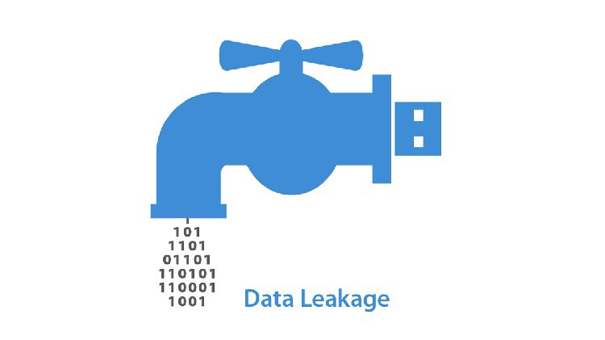
Problem
In course of Business, there is a lot of data generated. Over the internet, during transmission there may be security risks involved in form of a Data Leak, protection of which is important!

Slide 5
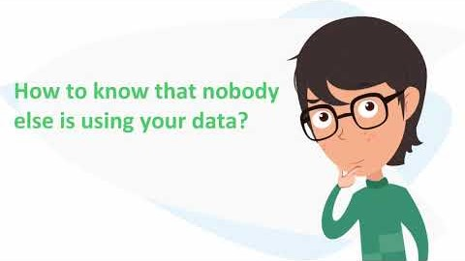

Slide 6
Solution
> IDENTIFY CRITICAL DATA.
> MONITOR ACCESS AND ACTIVITY.
> ENCRYPT THE FILES.
> ENDPOINT SECURITY.

Slide 7

Software Requirements
Mask all data sent/received by the user.
Identify attempted attacks.
User Friendly UI.
Work on Mobile and PC.
Use Jargon-Free Language.
FREE to B2C and earn from B2B, whose data it will protect.

Slide 8
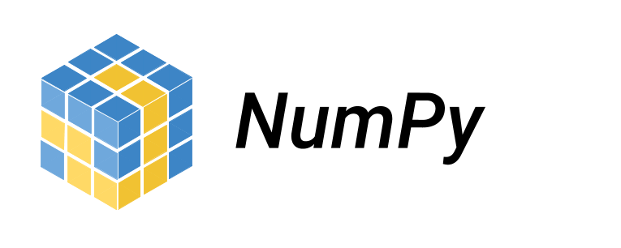




Tech/Resources utilized
Python/Java
Numpy
Django
Git
MongoDB/MySQL/Firebase
HTML Web Template
A .jsp setup.

Slide 9
Feedback
“With the growing age of rapid communication, your initiative to ensure safety of my data is appreciable and I hope you all make it a success.” ~Abhimanyu
"If it works the [the team] told me then it will really be a nice app, I would love have it in my phone“ ~Nikhil

Slide 10
Thank You! ☺

