Slide 1
IBM Hack Challenge
Team – We Are Groot

Slide 2
Problem statement 2 - Solution
Identification of User Query on Stack Overflow Using Semantic Search
Stack Overflow is a question and answer site for professional and enthusiast programmers. It's built and run by the community of developer, as part of the Stack Exchange network of Q&A sites. A lot of content is present in form of stack overflow questions and answers, various studies point that developers face problems while development life cycles and they ask questions on stack overflow which gets answered by fellow developers across the globe.
In order for a new developer to understand a concept or solve an issue, it is very difficult to identify the problems. It involves domain experts in form of experienced software developers. The information present is overwhelming and at times can be too much to handle for a budding developer.

Slide 3



Members:
P R Rahul Hebbar
Nipun Haldar
K Kesava

Slide 4
Role of Team Members
P R Rahul Hebbar – Code optimization; Presentation, Video Editing and Documentation.
Nipun Haldar – integration of frontend and backend by flask.
K Kesava - Use of NLTK, Test cases, audio, features like upvotes, probability.

Slide 5
Technologies, Platforms, API’s used.
Flask – web framework (for static file serving and computation)
Stack Overflow API – To get the questions and their links related to the tags

Slide 6
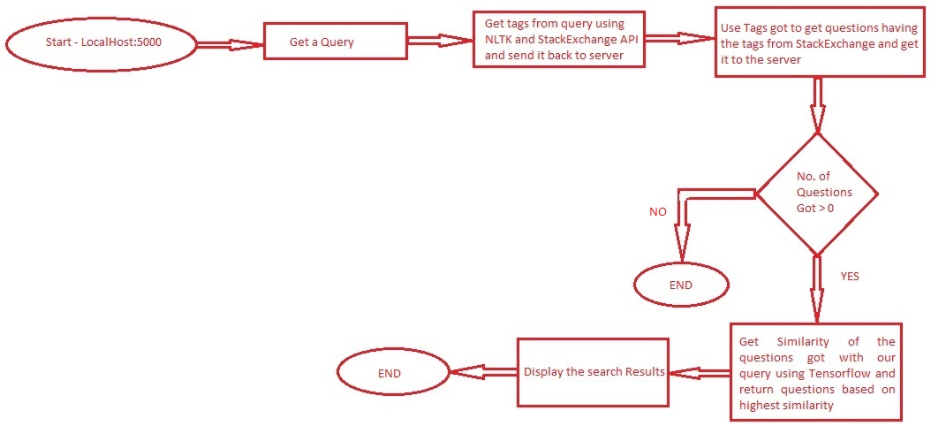
Flow Chart

Slide 7
Tools used for UI
React.js - The frontend framework
A JavaScript library for building user interfaces. React makes it painless to create interactive UIs. Design simple views for each state in your application, and React will efficiently update and render just the right components when your data changes.

