Slide 1
Internship
IoT Bootcamp
conducted by
Tek Certify Training Solutions PVT.LTD
11th September 2022 to 29th October 2022

Slide 2
Team Members
Abhinav Sandru (1601-20-733-090)
Tanish Rohil Gali (1601-20-733-056)
Vishnu Sathwik Rebally (1601-20-733-060)

Slide 3
Problem Statement
Smart Mining Gear
Work clothing that has sensors embedded in it to securely transmit data to managers about hazardous conditions and the workers’ physical conditions, improving safety overall

Slide 4
Sensors Used
Temperature and Humidity Sensor
Smoke Sensor
Photo Sensor
Sound
Temperature Sensor is a sensor that outputs temperature in Celsius.
Humidity Sensor detects humidity level in the air.
Detects presence of smoke.
A sensor that detects light within the container where the sensor is placed.
Detect environment and device sounds and calculate dB.

Slide 5
INTERFACES USED
Cisco Packet Tracer
000webhost
Arduino IDE
TinkerCAD
NODE MCU
MySQL
Web Hosting platform
Network Simulation tool
IDE for NodeMCU
For arduino simulation
Micro controller
Database

Slide 6
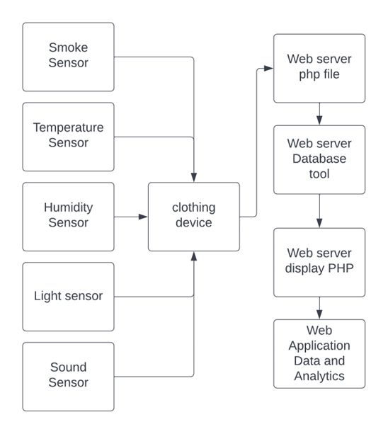
Data Flow
In the system

Slide 7
CISCO PACKET TRACER SIMULATION

Slide 8
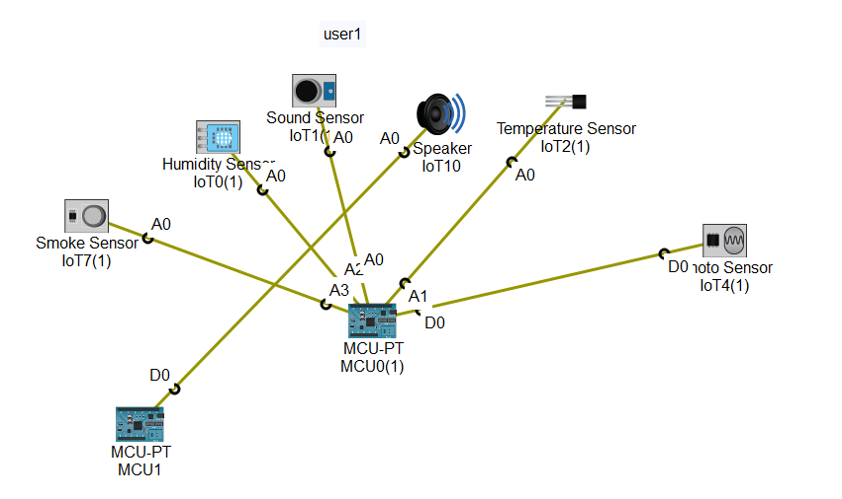
USER -1 connection

Slide 9
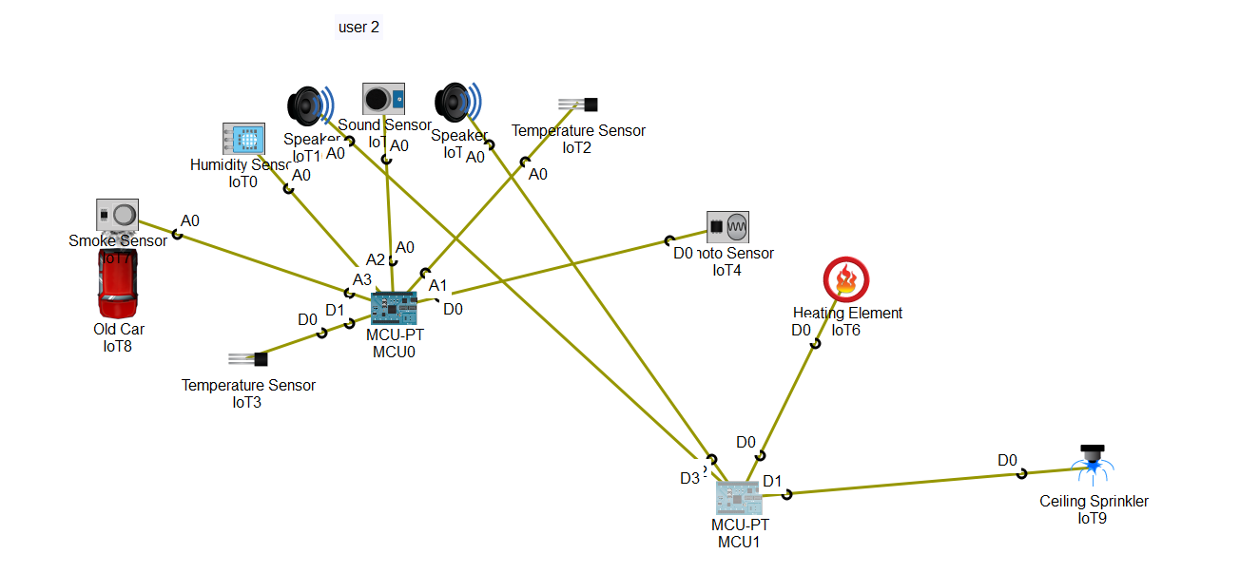
USER -2 connection

Slide 10
Data from sensor through Database

Slide 11
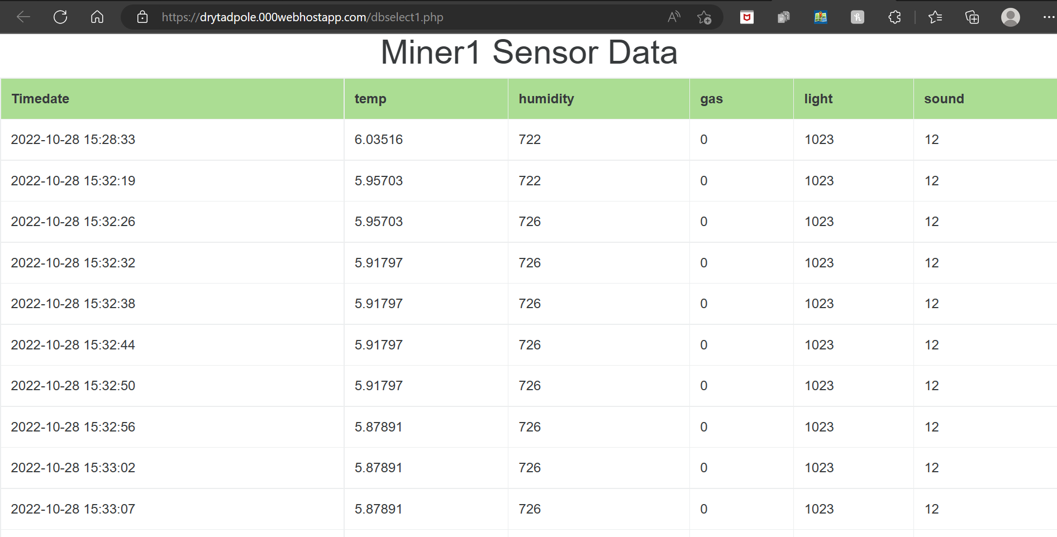

Slide 12
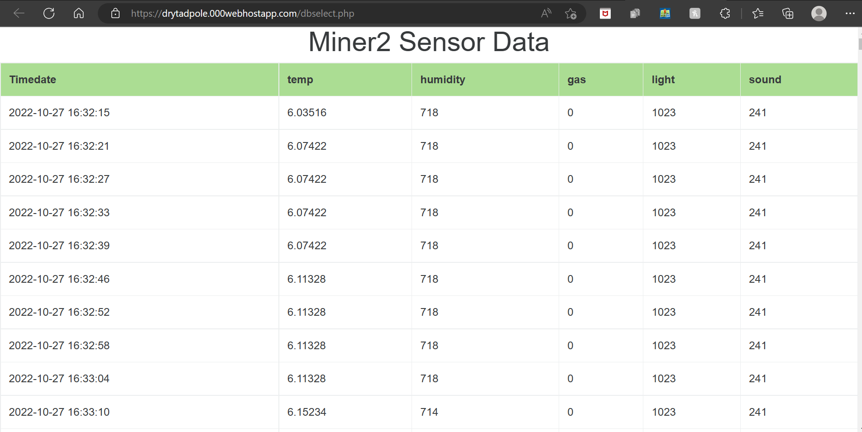

Slide 13
Data Analytics

Slide 14
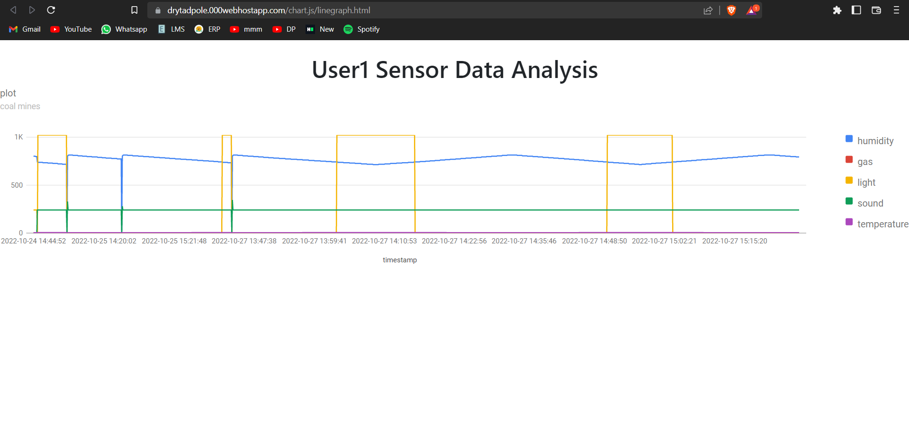

Slide 15
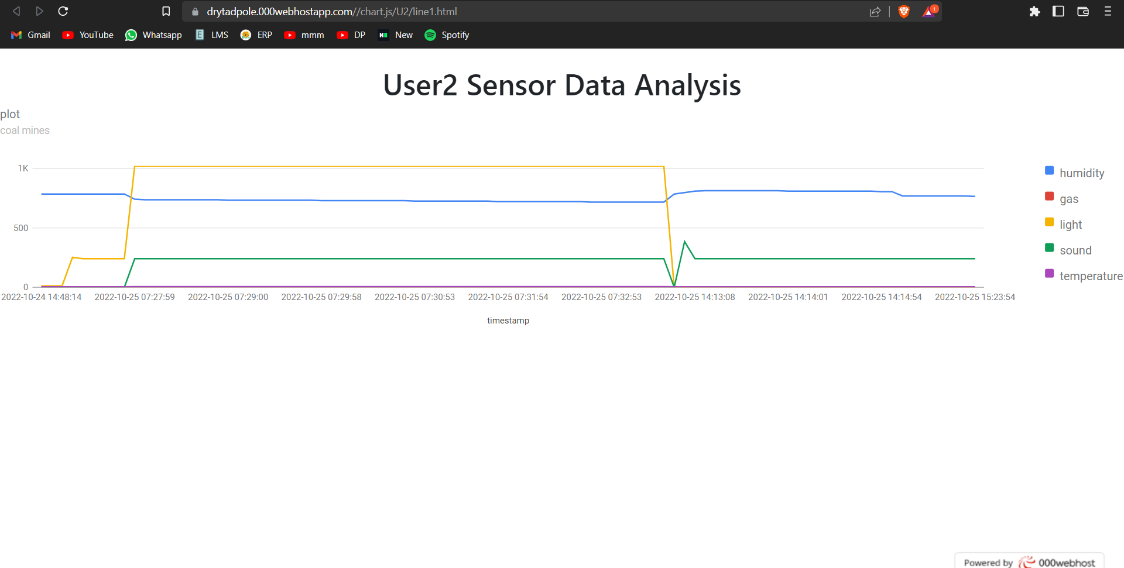

Slide 16
Manager/administrator
portal

Slide 17
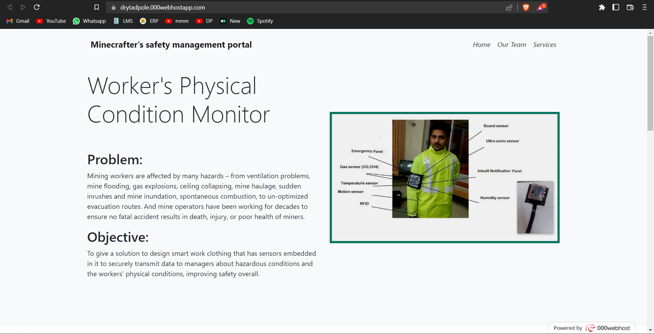

Slide 18
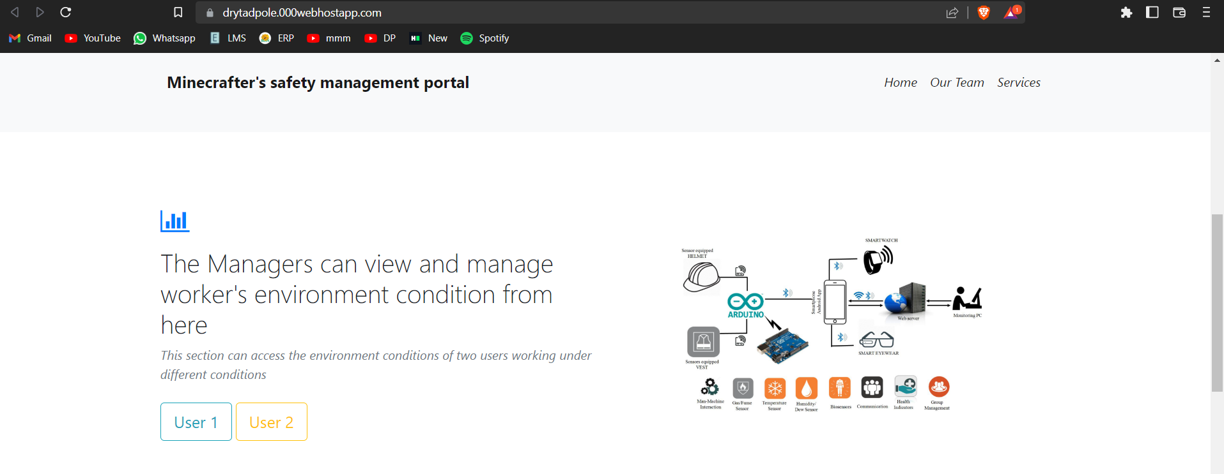
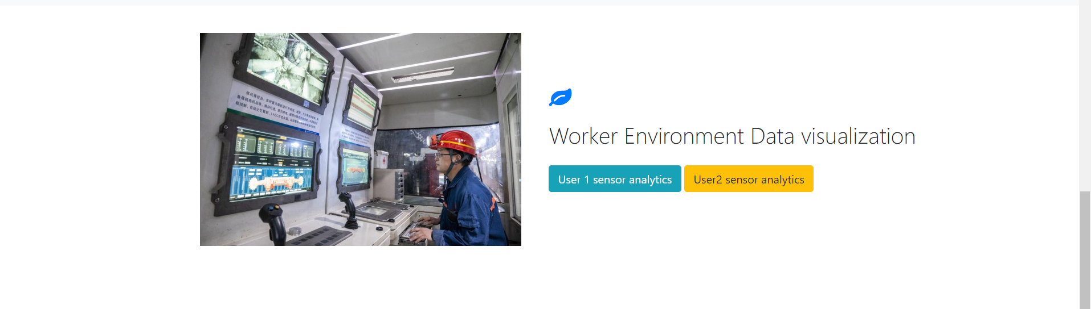

Slide 19
Conclusion
When working in mines especially in coal mines, there are lot of factors that affect the human health conditions, these effect involves the presence of hazardous gas, temperature, oxygen level depth of mine etc. lot of accidents have already been reported in such work. Rescue teams spend lot of money and time to recover the affected person from the accidental site. To overcome this problem, a system has been introduced which collects and monitor gases in realtime and sends data to the authorities for further use. Hence proposed embedded system dully designed for coal miners providing the essential parameters in order to be in contact with all miners & get to know about their the environmental conditions i.e. availability of hazardous gas, and various life threatening issue inside the mine.

Slide 20
Future Scope
The system should track the health parameters of the workers such as the heart rate , blood oxygen levels
The system should be able to predict the dangers in advance using ML algorithms and notify the manager
The proposed system can be extended to other areas of application such as sewage monitoring ,construction sites,industrial corridors etc

Slide 21
Thank You

