Slide 1
MINOR PROJECT
Self Balancing Robot
Saumitra Nashikkar SMCE2160
Abhinav Singh S207030
Anish Bhat SCETSY100

Slide 2
PROBLEM STATEMENT
Two Wheeled Self Balancing Robot is a foremost research topic in the area of robotics and control engineering. The principle of operation behind a self balancing robot is an inverted pendulum concept. The major focus in this paper is the hardware development of a two wheeled self balancing robot for an application to carry objects from one place to another. The modeling of the self balancing robot is done in terms of the inverted pendulum.

Slide 3
INTRODUCTION
The research in the field of self-balancing robot has gained momentum in the field of robotics and control engineering. The basic working principle behind the self-balancing robot is an inverted pendulum concept.
Two wheeled self-balancing robot requires just two points of contact with the floor surface. The unique stability control that is required to keep the robot balanced differentiates it from ordinary robots.
The basic idea of a self-balancing robot is similar to the inverted pendulum model in the control theory. It has many advantages such as small size, low cost, flexibility.

Slide 4
PROCESS
Literature , Market & Competitor Survey
Basic overview of the design and concepts
Structure of the robot
Deciding Components
Working on the circuit
Final Design

Slide 5
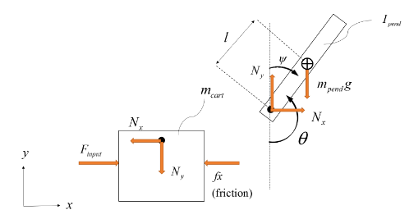
Physics
Physics behind the working of a self balancing robot is similar to that of an inverted pendulum. It is fashioned as a rigid rod fastened by a frictionless joint to a rigid cart moving in one direction. To simplify the equations the wheelbase can be compared to a cart sliding on a frictionless surface.
Where m(cart) and m(pend) represent the cart’s and pendulum’s weight respectively. Parameter, l, is the distance to the pendulum’s center of mass, θ the angle between the pendulum and the vertical axis as seen in Figure. The parameter, f is a friction parameter. Rewriting the equations as transfer functions gives us:

Slide 6
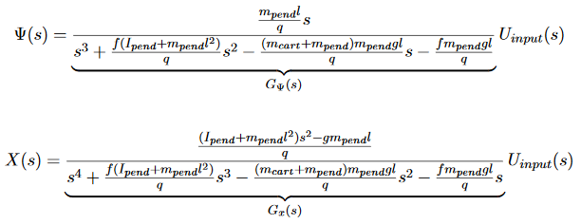
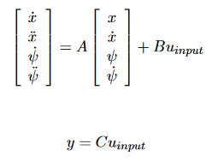
Where Ψ represents the angle deviation, see and X is the position of the cart. The upper case letters mark the transformation from the time domain to the Laplace domain. It is concluded that for all positive values of the parameters l, I(pend), m(cart), m(pend) and g the system in itself is unstable since it has a pole in the right half plane. This arrangement is viable, since an inverted pendulum is intuitively unstable.The differential equations are linearised. According to Glad and Ljung, the system can then also be described in State Space form with the states being ̇x, ̈x, ̇ψ and ̈ψ.

Slide 7
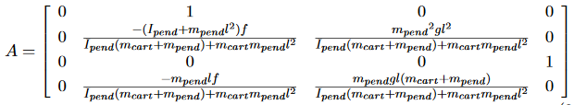
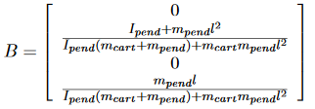


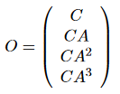
Where Uinput is the control effort in time domain. The system matrices A, B and C given by:
The system is controllable if the matrix S, defined as
has full rank. Likewise, the system is observable if the matrix O has full rank, where O is defined as
The rank of S and O confirms that the system is controllable and observable for any positive value of l, Ipend, mcart, mpend and g.

Slide 8
DESIGN METHODOLOGY
The self balancing robot gets balanced on a pair of wheels having the required grip providing sufficient friction. For maintaining the vertical axis, inclination angle must be measured as well as controlling the motors to move forward and backward.
We will be using MPU6050 which is a type of variable capacitive micro electromechanical system and is highly sensitive. It will act as a combination of accelerometer as well as a gyroscope. These sensors will produce an output which will get subtracted from the desired value to produce an error.
This error will be fed to the Arduino which will try to reduce the error to the smallest value possible and accordingly the motors will be driven.

Slide 9
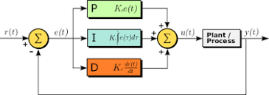
PID Controller
Input to the controller is error form the system. Here the error will be the deviation or tilting of the robot to one side.
It simply calculates the angular measurement of the robot and makes the motors move in the same direction to stop the falling of the robot.
The Integral term will find the average of past errors and this term has an important role in reducing the steady state errors. The Derivative component will handle the overshoots and reduces the robot vibrations of the robot.
The Arduino and IMU will together work as the PID.

Slide 10
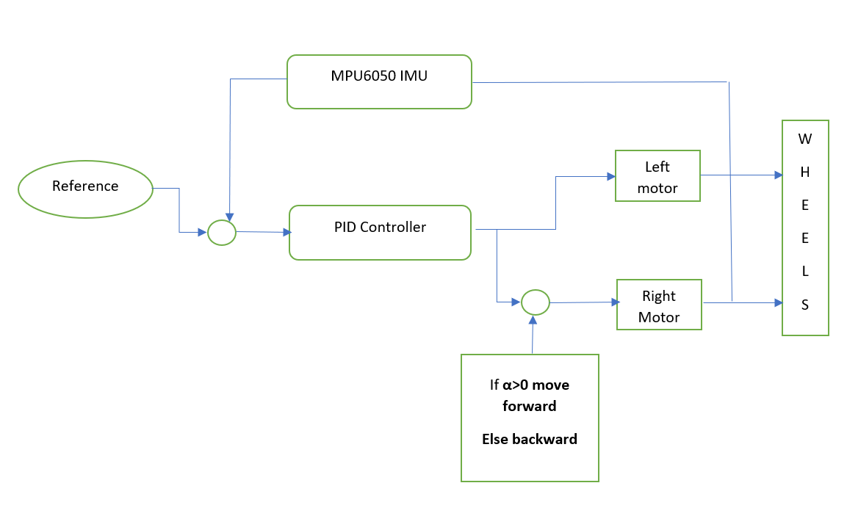
Block Diagram

Slide 11
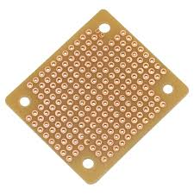
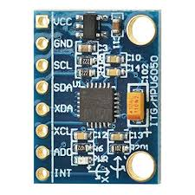
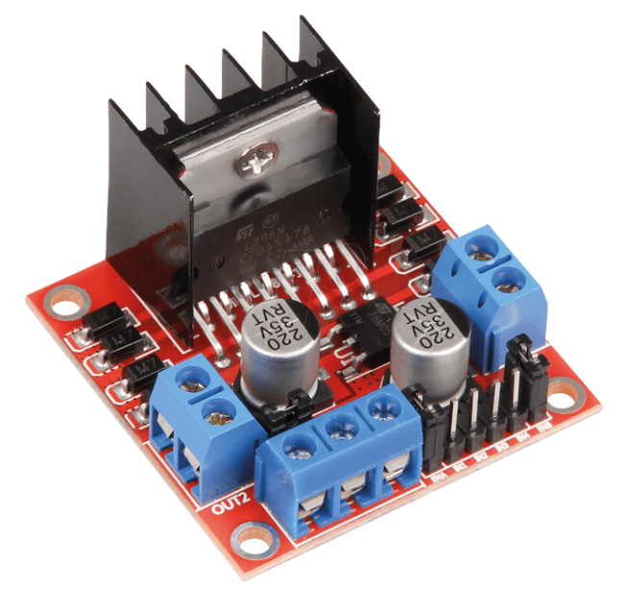
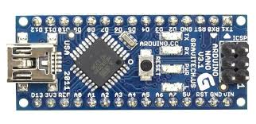
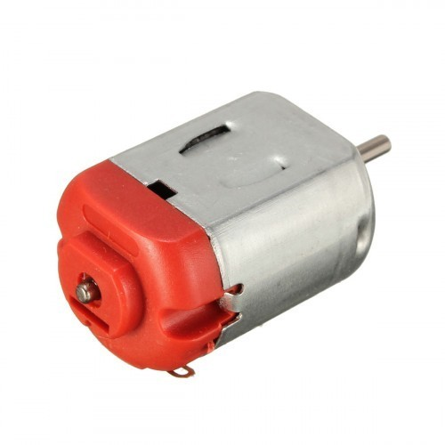
Components
Toy Motors - 4.5 V to 9V, 250mA, RPM = 200(approx.)
Motor Driver - L298N
Arduino Nano
6-axis IMU (ADXL 345 accelerometer ,ITG 3200 gyroscope , Sparkfun 6 DOF IMU sensor board, MPU 6050.)
Batteries
Wood or Plastic for the structure of the robot.
Perfboard

Slide 12
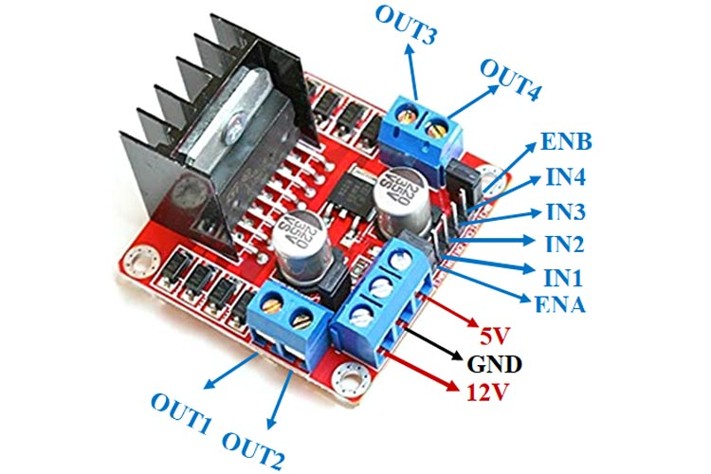
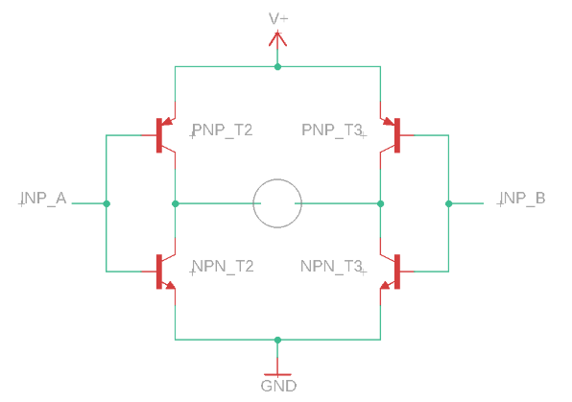
Motor Driver
Instead of using a separate voltage regulator we will be using the L298N motor driver to run the motors.
It will also be used for controlling the directions in which the motor rotate.
The OUT (1,2,3&4 ) are connected to the motors, 3 power module pins on the front , 4 pins (IN1,IN2 ,IN3 & IN4) to control the direction of the motor.
IN1 and 1N3 are used to control the rotate the motors in clockwise direction and IN2 and IN4 are used to rotated the motors in anti-clockwise direction.
The 2 enable pins are used to control the speed of the motor.

Slide 13
Arduino NANO and IMU
ARDUINO Nano
The Arduino Nano is a small, complete, and breadboard-friendly board based on the ATmega328P.
It is the cheapest option available in the market.
Has the same features as that of Arduino UNO but smaller in size and used for comfortable prototyping.
MPU6050
It is the most accurate and reliable sensor which has both accelerometer and gyroscope integrated on a single chip.
Gyroscope is used for measuring the rotational velocity and accelerometer is used to determine gravitational acceleration along the 3 axes.

Slide 14
IMU Interfacing with Arduino
Header files used are wire.h, MPU6050.h and stepper.h .
Declare one variable for each of these header files in the setup function. Also, declare 6 variables of 16 bit integer data type for acceleration and gyroscope (ax,ay,az,gx,gy,gz).
Initiate the wire library. Use the ‘attach’ function of the stepper library for providing the pin which will allow the Arduino to give the input to the motor through the pin.
Initialize the sensor and test its connection.
In the loop function, use the ‘getmotion6’ function from the MPU library to receive the output from the sensor i.e the values of all the 6 variables of acceleration and gyroscope.
Map each of these variables with the help of ‘map’ function which is intended to change one range of values to other range of values.
Use the ‘write’ to provide the mapped output to the motor for moving it.

Slide 15
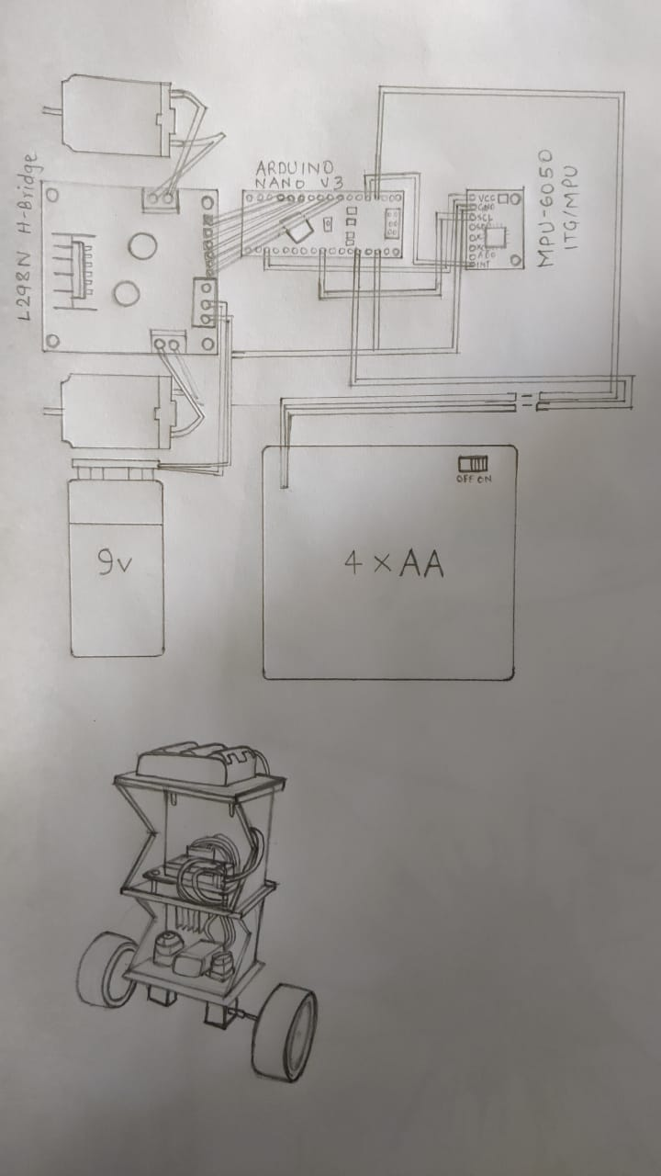
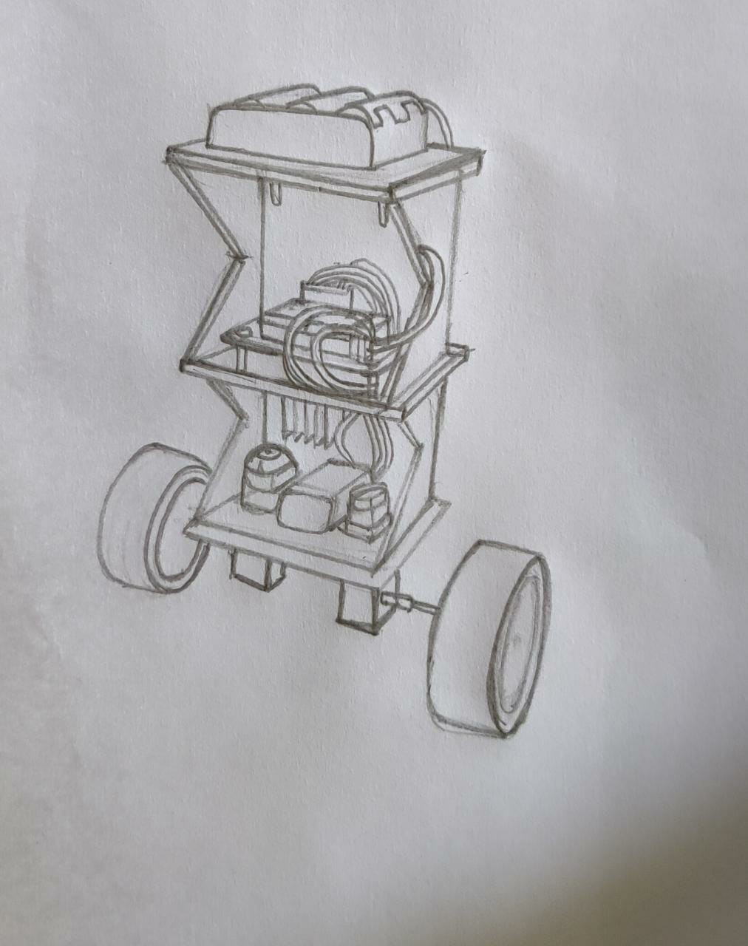
Diagrams
Materials used: Plastic/3D printed material

Slide 16
FUTURE SCOPE & APPLICATIONS
A metal Detector can be added to the robot so that it can be brought into use for land mine detection.
A scaled up and modified version based on the same concept can be used in vehicles that are made for handicapped people.
Can be used for the purpose of carrying objects from one place to another.

Slide 17
REFERENCES
https://components101.com/modules/l293n-motor-driver-module
https://www.makeuseof.com/tag/cheapest-arduino-nano/
https://components101.com/sensors/mpu6050-module
Ji-Hyun Park,Baek-Kyu Cho et al. Development of a self-balancing robot with a control moment gyroscope. International Journal of Advanced Robotic Systems[Online] March 2018
Aja Mariam Johnson, Nasar A et al. Design and development of a two wheeled self balancing robot for an application of object carrying. International Journal of Engineering Research and Technology(IJERT) Vol. 6 Issue 07 July 2017
A.K.M Ashfaque Shakil Shaon, Subrata Bhowmik, Bikash Kumar Bhawmick, Priya Das and Nipu Kumar Das et al. Design and Implementation of a Self-Balancing Robot. International Conference on Mechanical Engineering and Renewable Energy 2017[ICMERE2017-PI-294] December 2017

Slide 18
THANK YOU

