Slide 1
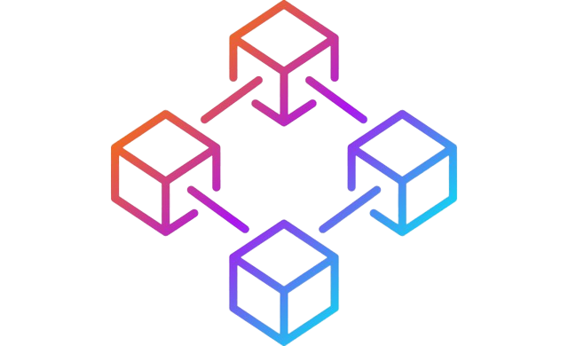
Blockchain E-commerce Website

Slide 2
Introduction
Blockchain in simple terms is a peer-to-peer protocol that allows people to interact directly with each other, rather than going through a third party. It aims to make transactions trustless, secure, and accessible.
Most eCommerce websites face functional or operational issues such as slow transactions, trust, digital data ownership, and policies. Blockchain technology can help an eCommerce business to gain confidence in online payments. With the cryptocurrency in place, you can introduce a secure, accurate, and quick payment method to your business.
BlockBuy is a blockchain based eCommerce Marketplace where the users can trade items in a trustless and secure way. With blockchain-driven technology, you will not need any third-party influence for transactions. You can have accurate, faster, and transparent transactions with a complete record stored for future use.
GitHub Repository: https://github.com/AbhinavXT/BlockBuy-Ecommerce
Deployed Website: https://block-buy-ecommerce.vercel.app/

Slide 3
When applied in building eCommerce sites blockchain will help in:
- Revamping payment methods.
- Only the buyer and seller control the operations. Hence, no third party can manipulate the transactions. No one can devalue or inflate the currencies.
- Furthermore, cryptocurrencies don’t reveal the identities of the parties. However, the transactions are still transparent, and the details are stored in the decentralized ledger.
- Increasing Security
- Blockchain does not exhibit any party’s identity. It does not ask a consumer to provide their sensitive data. Instead, it authorizes the consumer to transfer funds from his wallet to a recipient without additional information.

Slide 4
- Reducing cost
- When you manage the supply chain with the help of blockchain, you will automatically see reduced costs incurred earlier. For example, automation will eliminate intermediaries and reduce fraud and other threats such as product duplication.
- Making a more transparent marketplace.
- Introducing blockchain technology can work positively for you. Due to its decentralized nature, any wrongdoings can be tracked instantly. Also, all stakeholders can see who is doing it.

Slide 5
Tech Stack
Frontend
JavaScript
Javascript is a programming language that is one of the core technologies of the World Wide Web, alongside HTML and CSS. Over 97% of websites use JavaScript on the client side for web page behavior, often incorporating third-party libraries.
In this project Javascript is used on frontend for creating different functions for rendering data on pages,

Slide 6
Next.js(React)
Next.js is an open-source web development framework built on top of Node.js enabling React based web applications functionalities such as server-side rendering.
It brings Next JS users three main advantages:
Rich user experience (easier and faster)
Outstanding performance (also easier and faster)
Automatic Routing through pages
Great server-side rendering
In this project Next.js is used with tailwindcss to create and design entire UI of the website.

Slide 7
CSS and Design
TailwindCSS
A utility-first CSS framework packed with classes that can be composed to build any design, directly in your markup.
Some advantages of using TailwindCSS are:
Easy to implement
Responsiveness
Faster to implement designs
In this project TailwindCSS is used to design different components like navbar, footer, buttons and forms

Slide 8
Blockchain
Solidity
Solidity is an object-oriented programming language for implementing smart contracts on various blockchain platforms, most notably, the Ethereum blockchain. Programs in Solidity run on Ethereum Virtual Machine.
In this project solidity is used to develop smart contracts for items and marketplace. These smart contracts will help in recording and querying data from the blockchain.

Slide 9
Hardhat
Hardhat is a development environment to compile, deploy, test, and debug your Ethereum software. It helps developers manage and automate recurring tasks in the process of building smart contracts and dApps, as well as easily introducing more functionality around this workflow. This means compiling, running and testing smart contracts at the very core.
In this project Hardhat is used to create and run scripts for testing and deploying smart contracts to ethereum.

Slide 10
Other technologies used
Git
A free and open source distributed version control system. It tracks changes in any set of files, usually used for coordinating work among programmers. Used with Github for implementing version control in this project.
VSCode
Code editor made by Microsoft for Windows, Linux and macOS. Used as the primary code editor in the project.
Vercel
A hosting service for deploying the website. Used to host the project website

Slide 11
Hardware and Software Requirements
To use the deployed website you will need:
A system with latest version of windows, linux distribution or macOS.
A web browser. Brave 1.33 or Chrome 103 preferred.
MetaMask extension installed in browser.
Test ether on Rinkeby network.
To run the project locally you need:
Git
Node JS (everything was installed and tested under v15.12.0)
A source-code editor.
A Browser with the MetaMask extension installed.
Test Ether on the Rinkeby network.

Slide 12
Roadmap
1. Discuss the scope and functionality of a blockchain e-commerce website and assign roles to team members.
2. Creating, testing and deploying smart contracts to perform transactions on the blockchain with the basic functions of buying and selling tokens being demonstrable.
3. Building a react frontend for the eCommerce website using React(Next.js) and TailwindCSS.
4. Adding and testing blockchain functionality on the frontend side using ethers.js with React.
5. Building unit tests for testing front-end integrations with a blockchain.
6. Adding documentation about the project in the github repository.
7. Deploying the website on a hosting service.

Slide 13
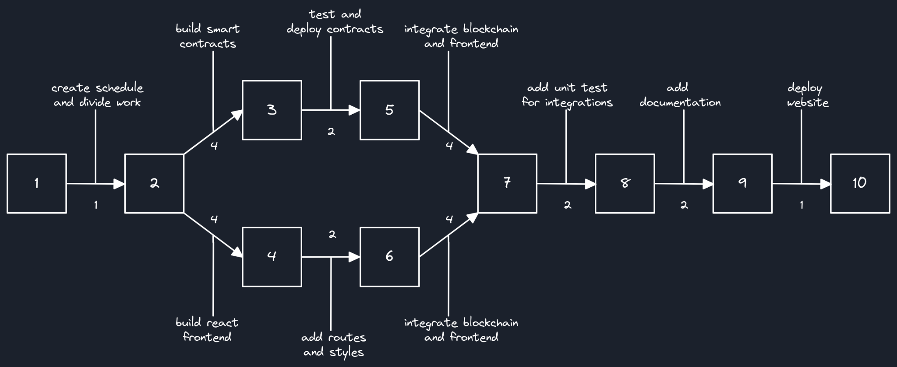
PERT Chart

Slide 14
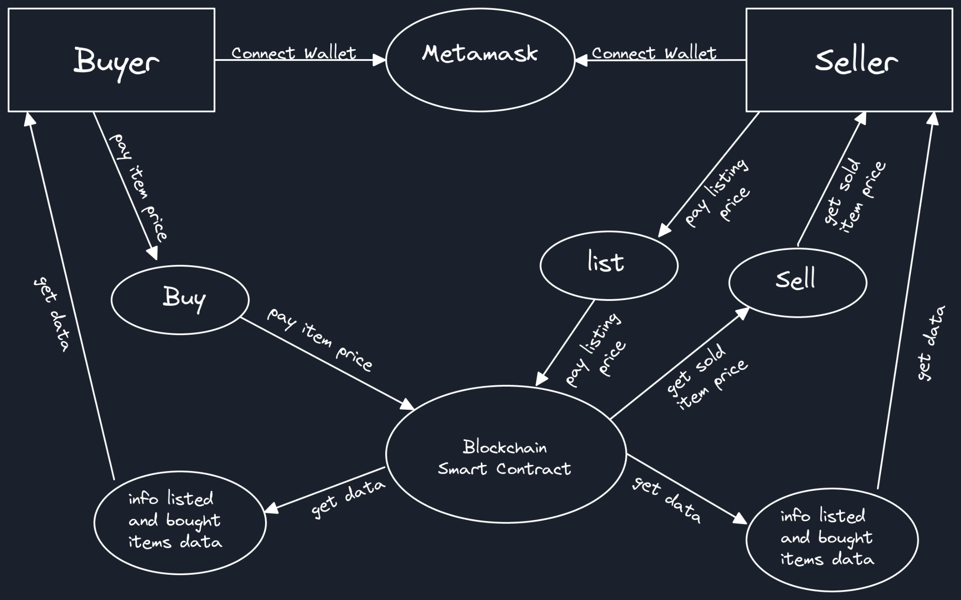
Level-1 Data Flow Diagram

Slide 15
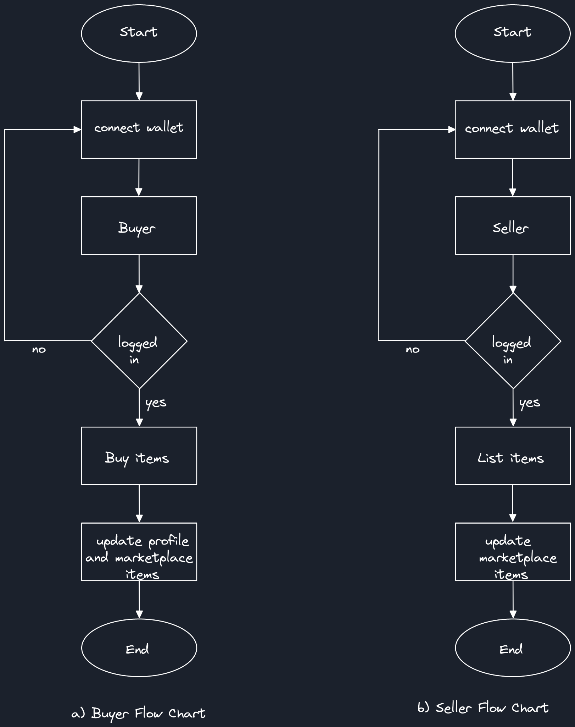
Flow Charts

Slide 16
Thank You

