Slide 1

AI-Driven Plant Disease Detection
TEAM: G131
Project Title: Vriksha Rakshak
Team Members:
Name Of The Members
Respective Roll Numbers
ALLENKI JASHWANTH
23BD1A0509
MD OZAIR
23BD1A054H
MOHAMMED SHAHRUKH SIDDIQUI
23BD1A054Q
AVANAGANTI ABHINAVA REDDY
23BD1A0565
SIRIKONDA SANDEEP RAO
23BD1A056X
YAKKATI GUNAVARDHAN
23BD1A057V
VEGESNA KRISHNA TEJA
23BD1A05K2

Slide 2
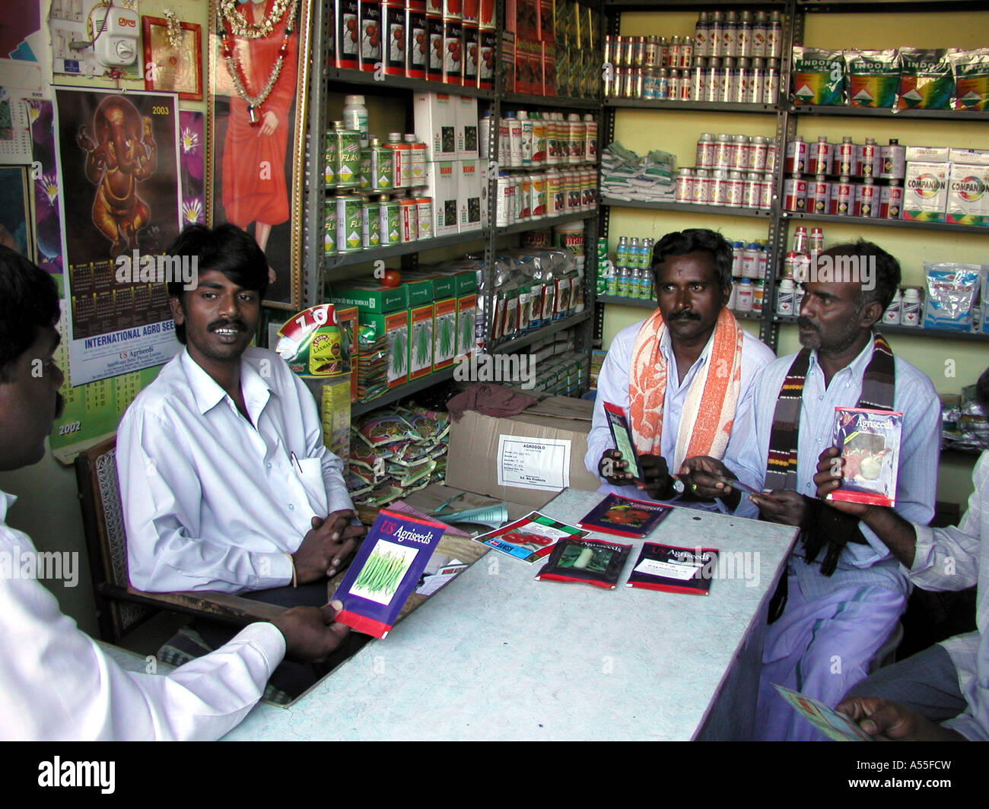
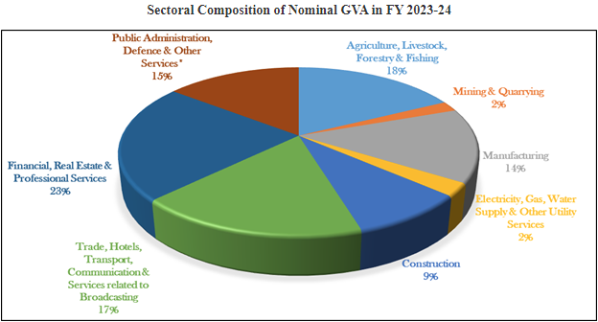
G131
PROBLEM STATEMENT:
About 55% of population is dependent on agriculture as their primary source of income
contributing 18% of GDP.
Crop losses in our country vary from 10-35% annually mostly due to Pests and Diseases. This ongoing issue threatens agricultural productivity and food security.
Majority of the farmers fail to Cure Diseased Plants as they are not able to properly diagnose and treat the Plants and lack of timely precautions.

Slide 3
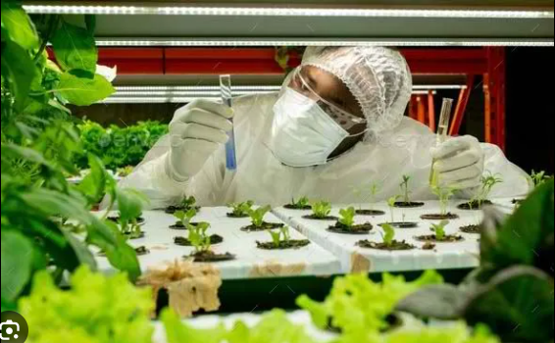

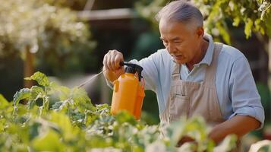
G131
TARGET USERS:
Our Target Users (Stake Holders) are:
Input Suppliers.
Agricultural Scientist and Pathology Students.
Farmers.

Slide 4
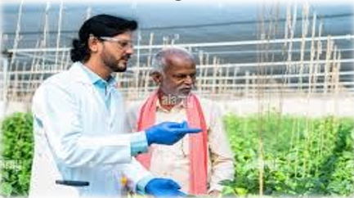
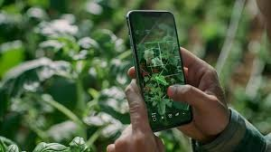
G131
OUR SOLUTION:
Detailed Diagnosis Report based on the Leaf image provided.
Disease Analysis
Discovering new Diseases for R&D
Timely Alerts:
Automated Alerts based on Disease Analysis
Manual Alerts by Researchers or Agro Scientist
Blogs and FAQ pages for farmer engagement.
Building a bridge between Agricultural Scientist and Farmer

Slide 5
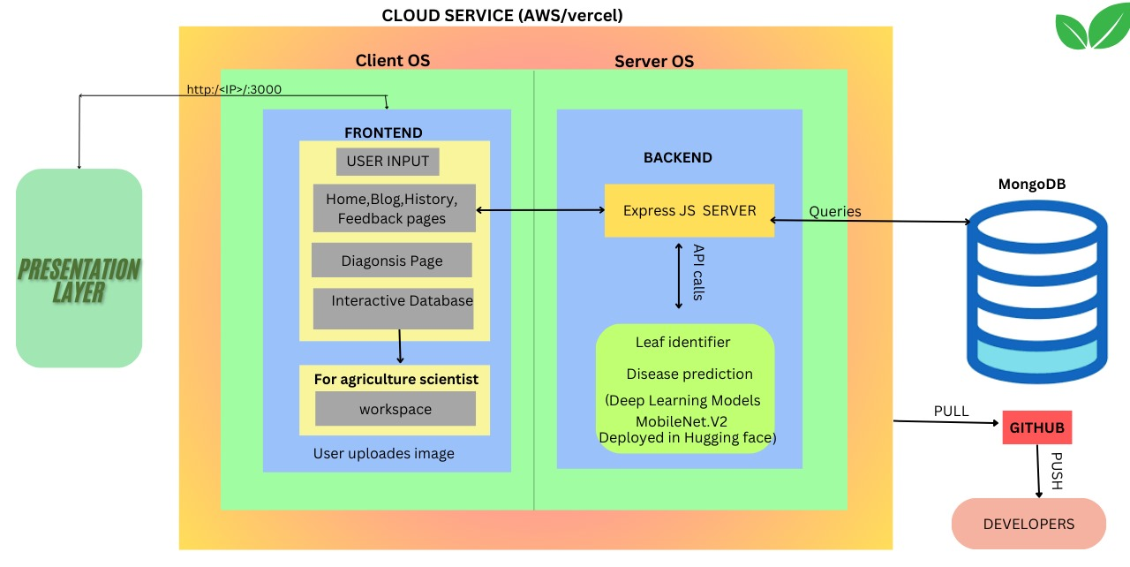
G131
SYSTEM ARCHITECTURE:
Frontend:
React-based interface for seamless interaction.
Features like diagnosis, history, blogs, and analytics.
Backend :
API-driven architecture with Express.js.
AI models hosted on Hugging Face for plant disease detection.
Database:
MongoDB for managing user data, feedback, and diagnosis history.

Slide 6
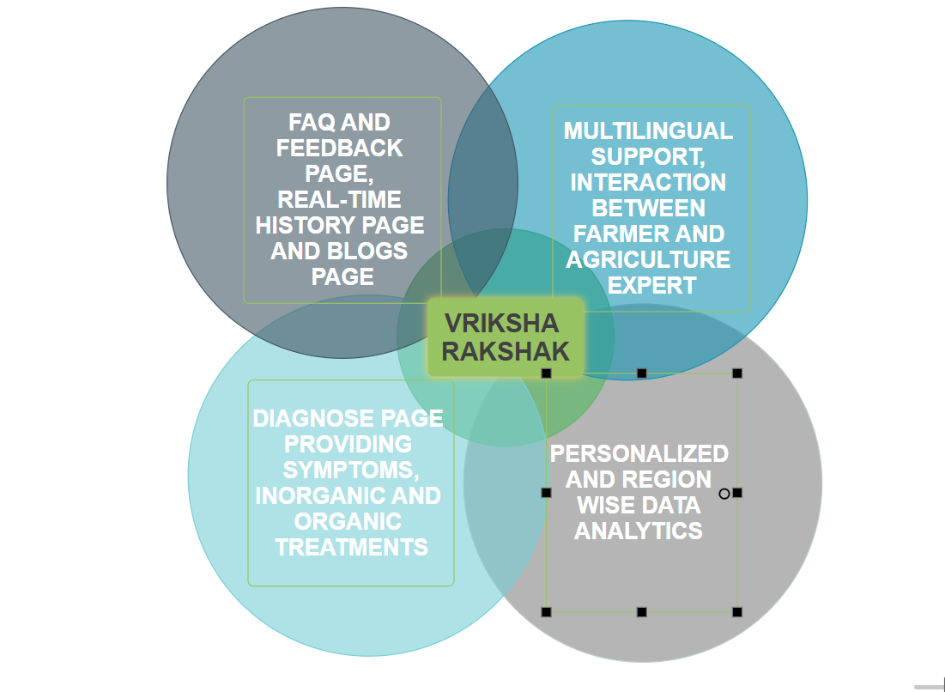
G131
UNIQUE FEATURES
FILLING THE GAPS
Farmer-Agriculture Expert Connection.
Timely Alerts:
Automated Alerts based on Disease Analysis
Manual Alerts by Researchers or Agro Scientist
Insights - personal , location, alerts based on disease count.
Notifications for corrected diagnoses and alerts.
Blogs and FAQs for continuous farmer engagement.
Multilingual support for diverse users.
Responsive Design: Fully optimized for devices as small as 300px.
Weather
Diagnosis page - not a leaf , report, choose a image from phone
Camera Feature for taking photo via mobile
History page
Workspace: cases to solve , location alert
Dark Mode
Mail sent to users in that location

Slide 7
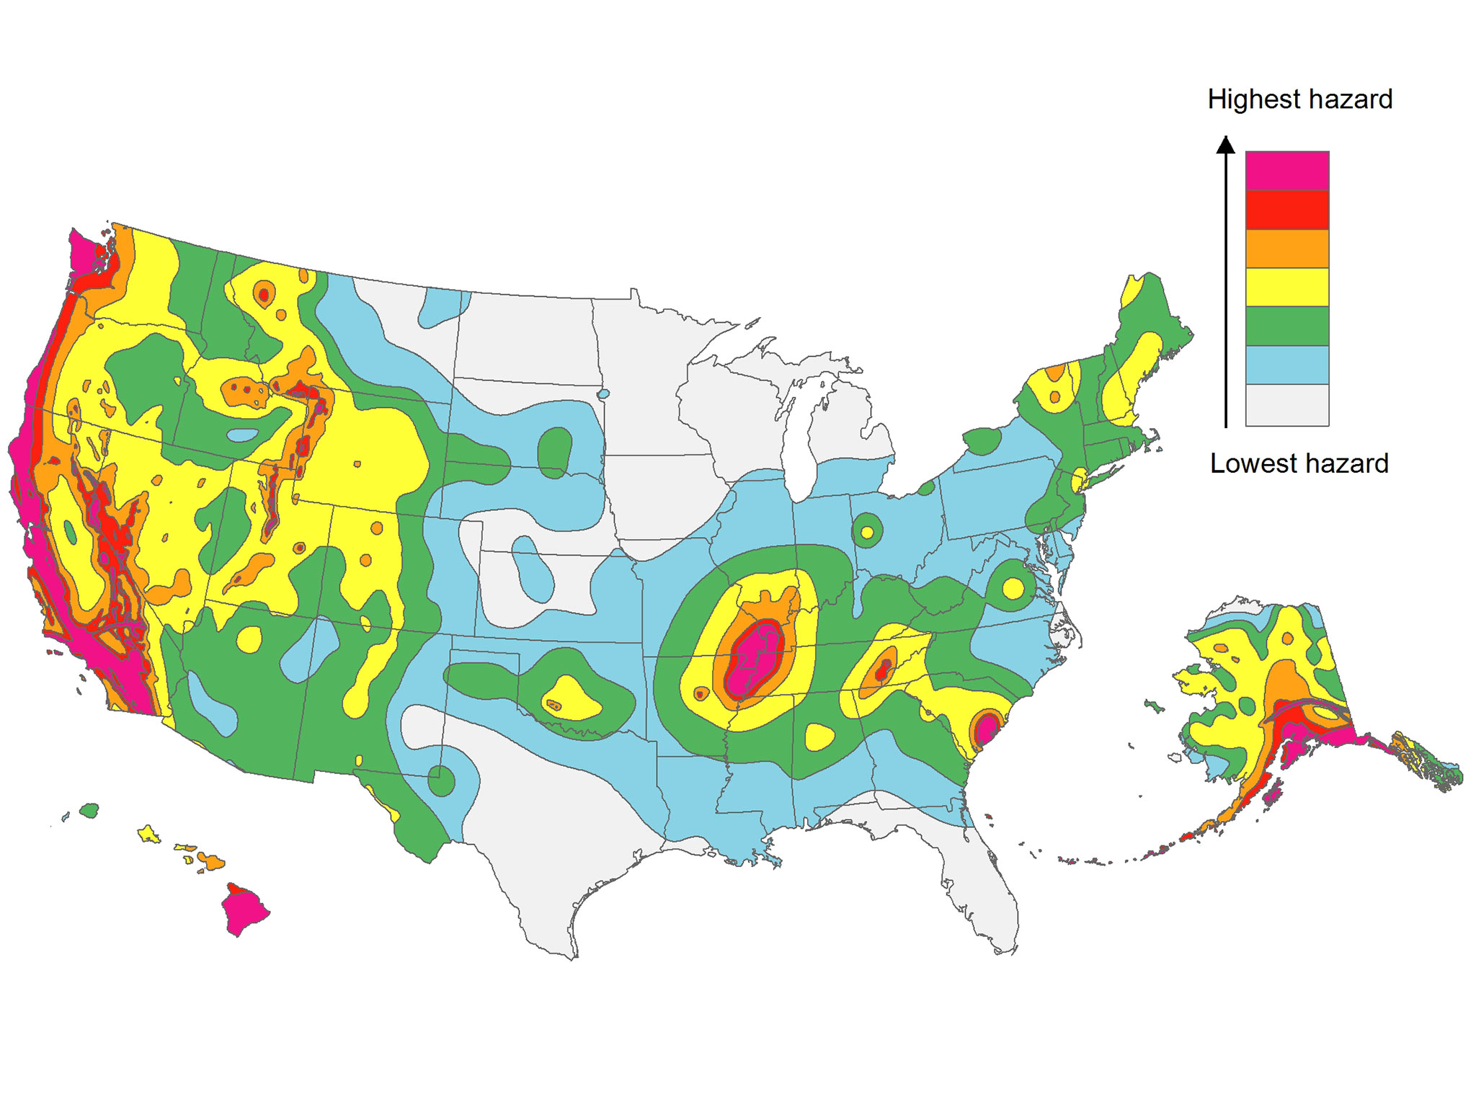
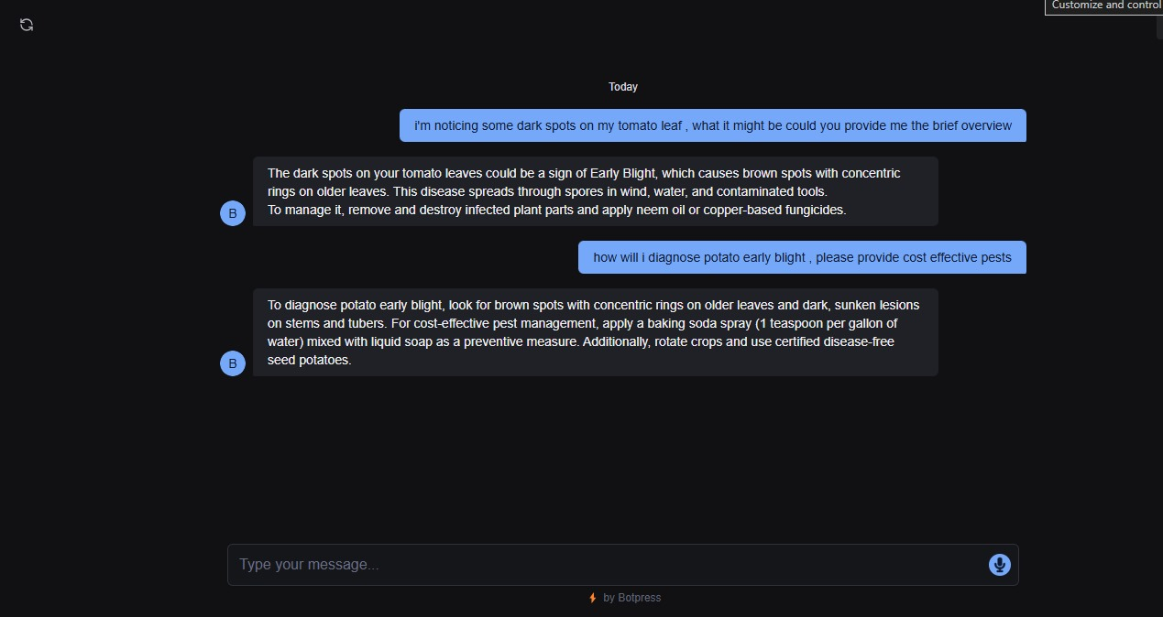
G131
POTENTIAL UPGRADATIONS:
Complete deployment.
Expand crop and disease coverage.
Chat bot for quick doubt solving and recommendations.
Dynamic training of model and increasing accuracy of model.
Integrating google maps with Location Analysis

Slide 8
G131
RESEARCH AND REFERENCES
https://pib.gov.in/PressReleseDetailm.aspx?PRID=1939473#:~:text=The%20Union%20Home%20Minister%20and,in%20agriculture%20and%20allied%20activities.
https://www.indiabudget.gov.in/economicsurvey/doc/echapter.pdf
https://sansad.in/getFile/loksabhaquestions/annex/15/AU2146.pdf?source=pqals
https://www.statista.com/outlook/cmo/diy-hardware-store/lawn-garden/india
https://www.preventionweb.net/news/annual-crop-loss-147-million-kg-due-pest-attacks-tea-research-body
https://adex.org.in/harvesting-tomorrow-with-farm-forensics-ai-revolutionizing-plant-disease-detection-in-agriculture/
https://huggingface.co/ozair23/mobilenet_v2_1.0_224-finetuned-plantdisease
https://www.kaggle.com/datasets/abdallahalidev/plantvillage-dataset

Slide 9
Thank You!

