Slide 1


Developing Secure Solutions for Cyber Physical System in Healthcare Applications
SHRI RAMDEOBABA COLLEGE OF ENGINEERING AND MANAGEMENT, NAGPUR
Department of Information Technology
Session: 2025-26
Project Seminar on
By
Abhinav Anpan(16)
Atharva Bomle(26)
Devansh Dhopte(29)
Om Telrandhe(40)
Parth Wankar(43)
Semester : VI
Under the guidance of
Dr. Rakesh Kadu
Assistant Professor, IT Department RCOEM, Nagpur

Slide 2
Content
Introduction
Past Implementation & Work
Current Progress
Work - Flow
Project Timeline

Slide 3
Introduction
A cyber-physical system refers to a system that integrates physical processes with computation in a manner that enables real-time processing and interaction with the environment. A smartwatch can therefore be referred to as a form of CPS by integrating sensors, software, and connectivity that connects to the health environment in order to monitor and respond in real time.
Smartwatch as our prototype for CPS:
Considering a smartwatch as the first CPS prototype in this project for real-time health monitoring and data gathering demonstrates how CPS can improve personal health management.
Health Data Collected:
Heart Rate
Blood Oxygen Level (SpO2)
Sleep Patterns
Steps and Physical Activity
Stress Levels

Slide 4
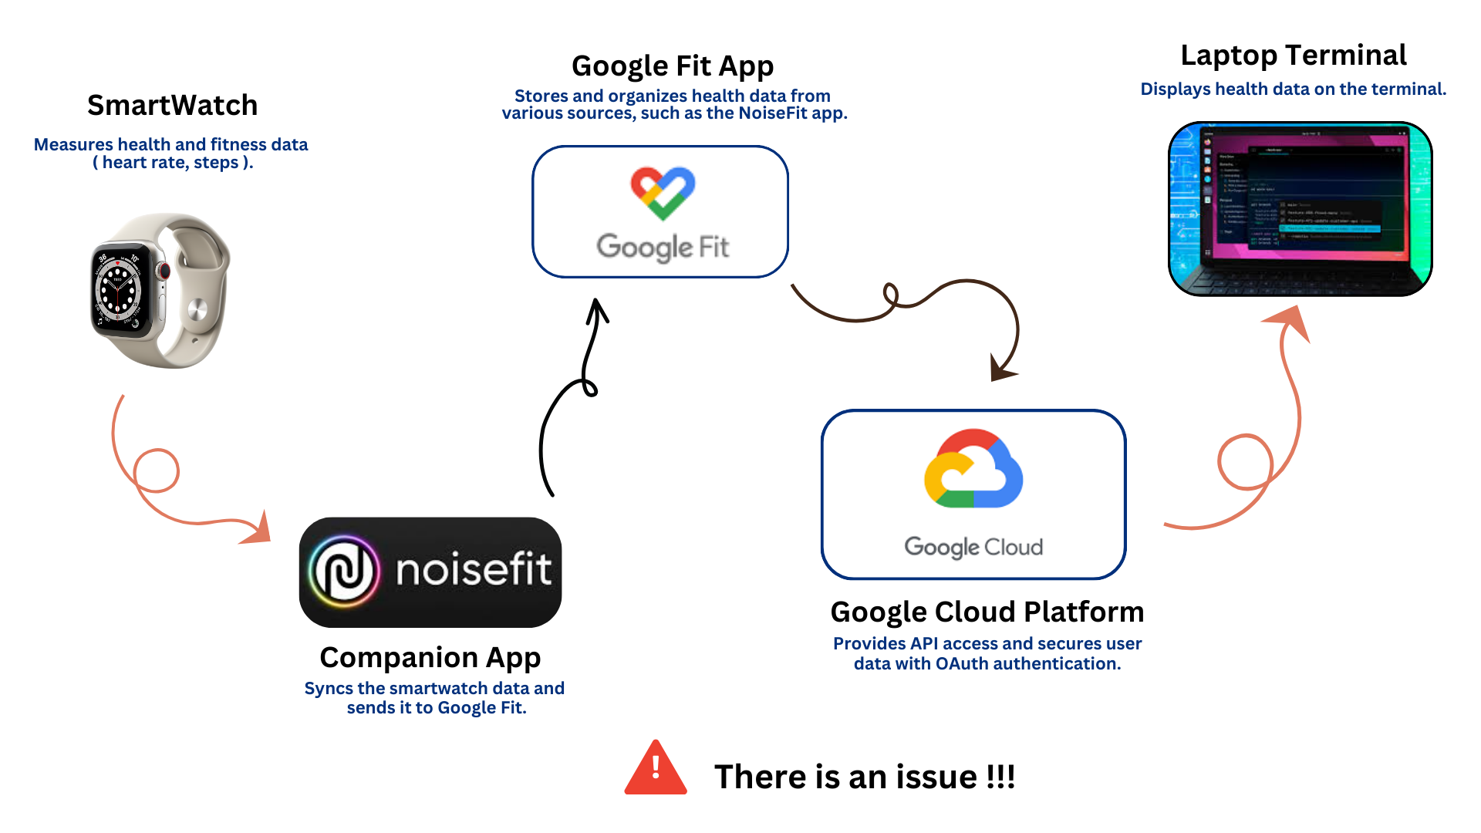
Past Implementations & Work

Slide 5
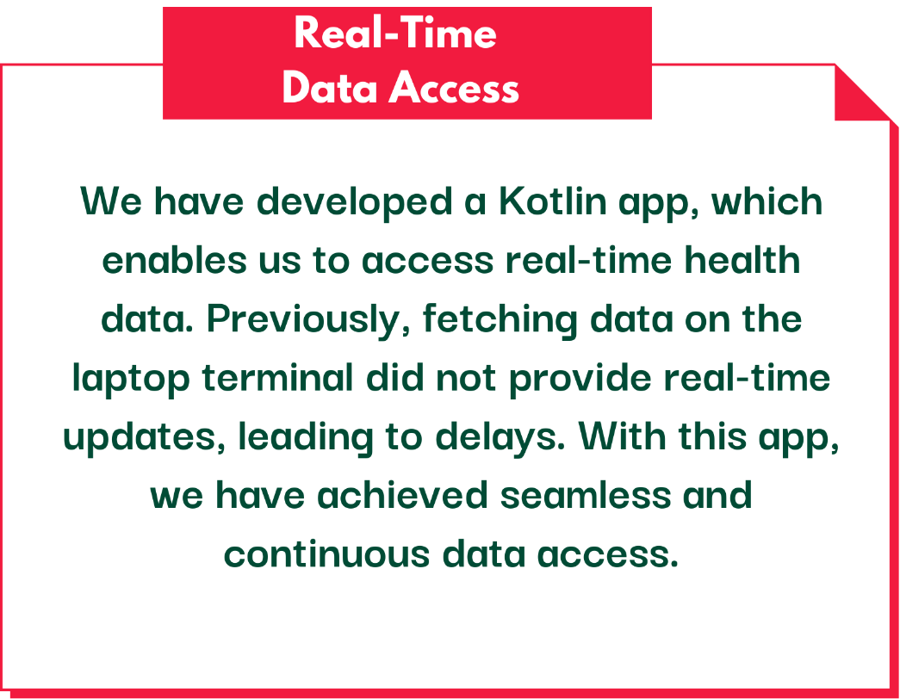
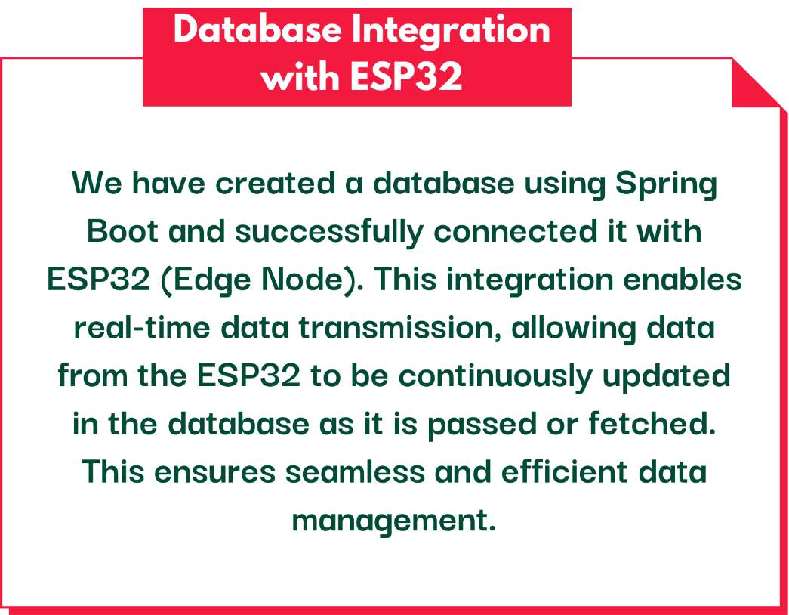
Current Progress

Slide 6

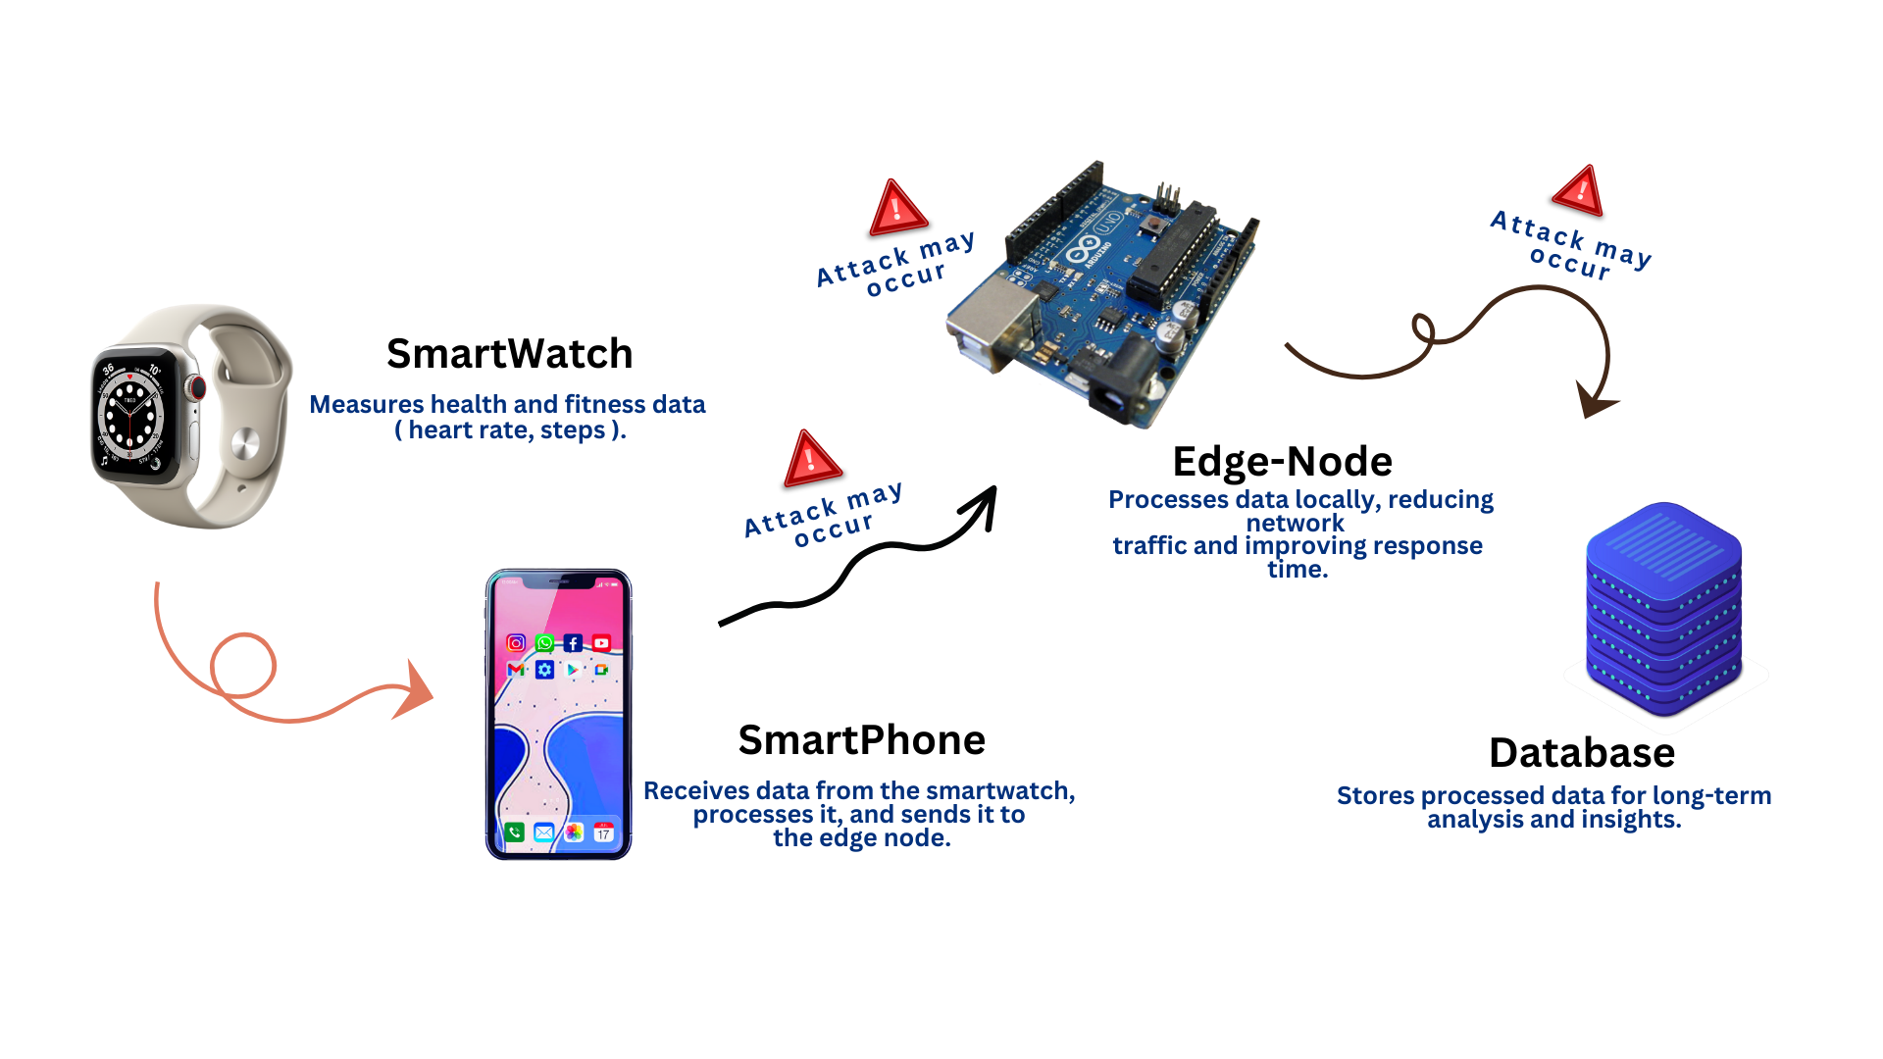

Slide 7
Timeline
🔹 Integration of Kotlin App with ESP32 We need to connect our Kotlin app with ESP32 to establish a seamless data flow.
Real-time data → Kotlin App → ESP32 → Database.
🔹 Cybersecurity Testing & Protection Conducting a dummy cyber attack to identify potential vulnerabilities that could compromise or harm the data. After identifying the risks, we will implement protective mechanisms to secure the data flow.

Slide 8
THANK YOU!

