Slide 1


Designing Secure Solutions for Cyber Physical System in Healthcare Applications
SHRI RAMDEOBABA COLLEGE OF ENGINEERING AND MANAGEMENT, NAGPUR
Department of Information Technology
Session: 2024-25
Project Seminar on
By
Abhinav Anpan(16)
Atharva Bomle(26)
Devansh Dhopte(29)
Om Telrandhe(40)
Parth Wankar(43)
Semester : VI
Under the guidance of
Dr. Rakesh Kadu
Assistant Professor, IT Department RCOEM, Nagpur

Slide 2
Content
Introduction
Past Implementation & Work
Current Progress
Work - Flow
Project Timeline

Slide 3
Introduction
A cyber-physical system refers to a system that integrates physical processes with computation in a manner that enables real-time processing and interaction with the environment. A smartwatch can therefore be referred to as a form of CPS by integrating sensors, software, and connectivity that connects to the health environment in order to monitor and respond in real time.
Smartwatch as our prototype for CPS:
Considering a smartwatch as the first CPS prototype in this project for real-time health monitoring and data gathering demonstrates how CPS can improve personal health management.
Health Data Collected:
Heart Rate
Steps and Physical Activity
Blood Oxygen Level (SpO2)
Sleep Patterns
Stress Levels

Slide 4
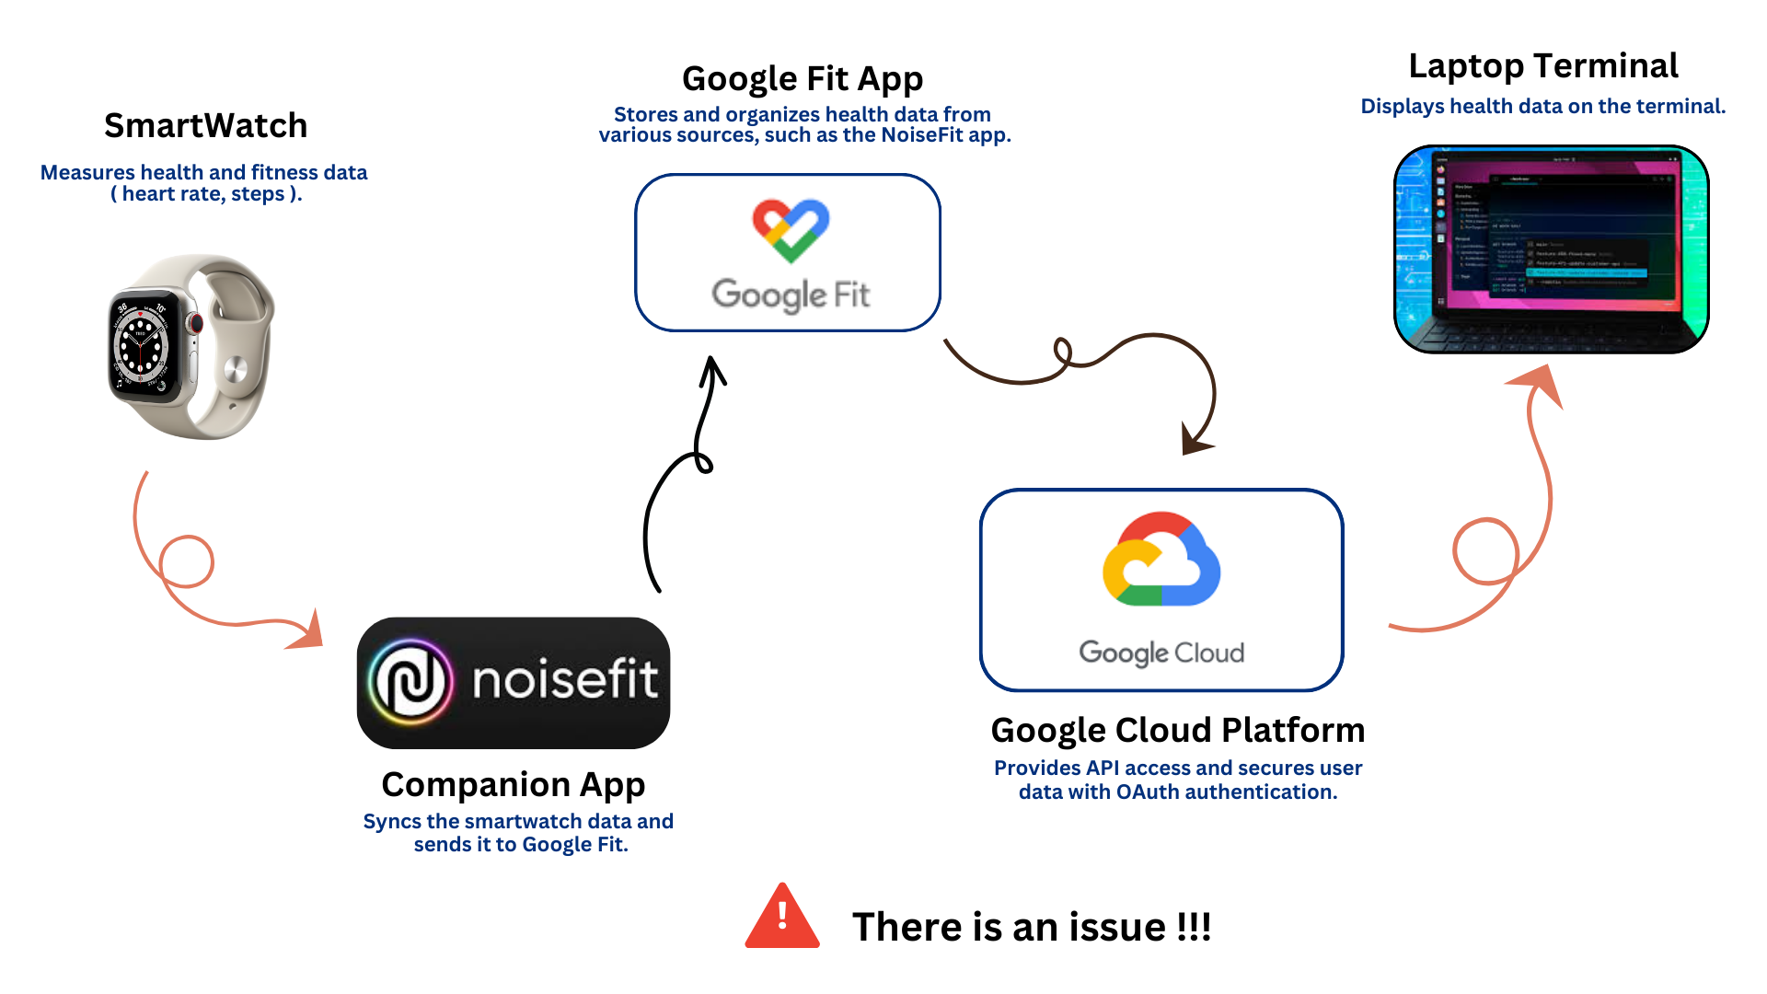
Past Implementations & Work

Slide 5
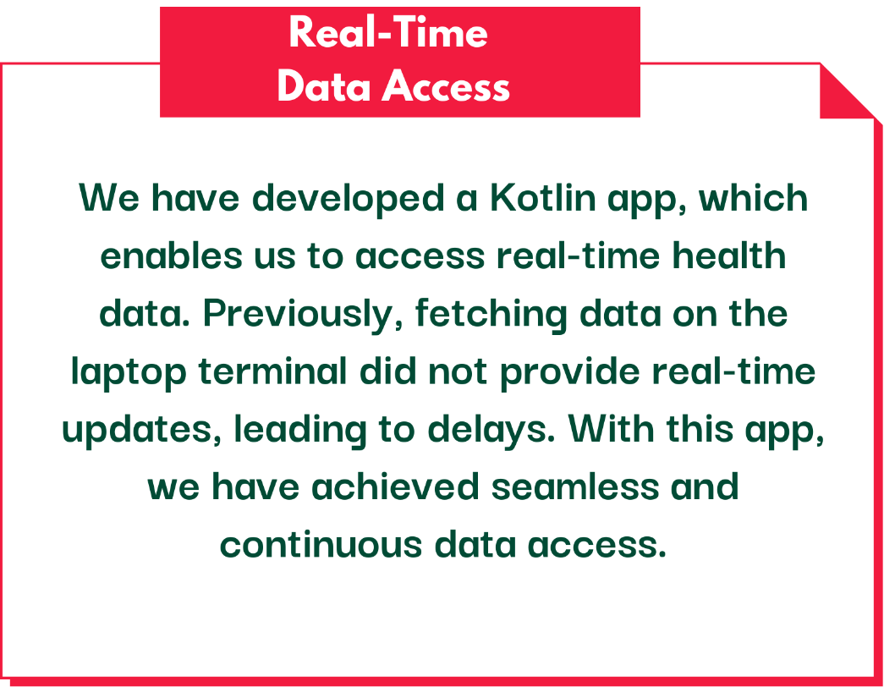
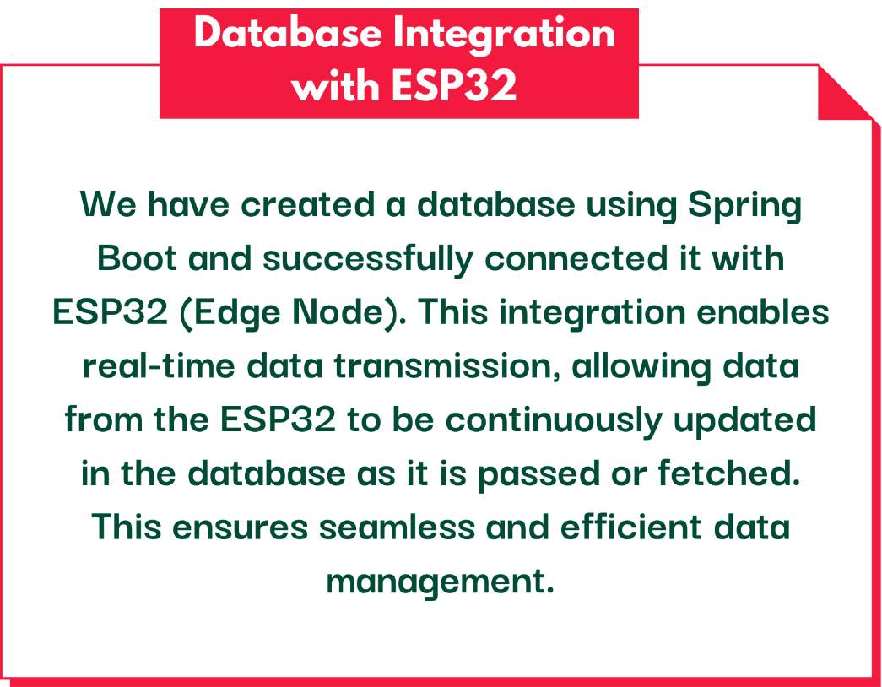
Past Implementations & Work

Slide 6
Kotlin app fetches heart rate from Google Fit
Current Progress
To establish real-time data sync between the Kotlin app and the ESP32, we explored two effective methods:
🌐 HTTP-Based Sync (Same Wi-Fi Network)
→ Flow:
Kotlin app fetches heart rate from Google Fit
Sends data via HTTP GET to ESP32
ESP32 forwards data to Spring Boot API via HTTP POST
Spring Boot stores in PostgreSQL.
🌐 MQTT-Based Sync (Broker-Based)
→ Flow:
Kotlin app fetches heart rate from Google Fit
Publishes data to MQTT Broker.
ESP32 subscribes to topic and receives data
ESP32 forwards it to Spring Boot API
Data stored in PostgreSQL DB

Slide 7

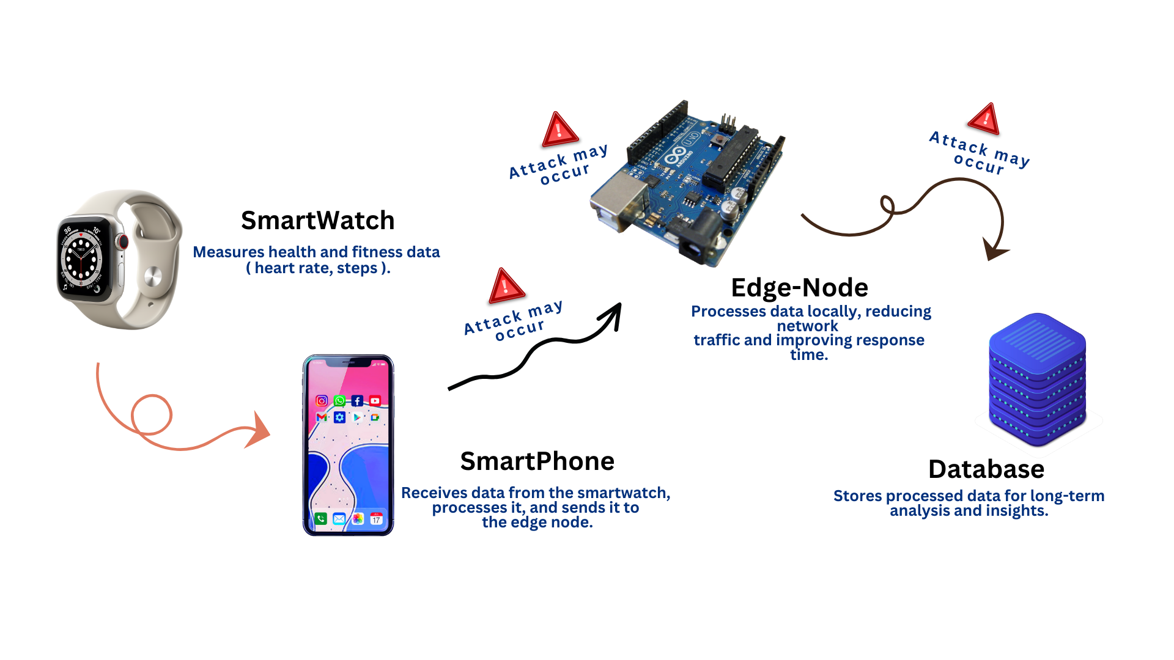

Slide 8
Timeline
🔹 Integration of Kotlin App with ESP32 We need to connect our Kotlin app with ESP32 to establish a seamless data flow.
Real-time data → Kotlin App → ESP32 → Database.
🔹 Cybersecurity Testing & Protection Conducting a dummy cyber attack to identify potential vulnerabilities that could compromise or harm the data. After identifying the risks, we will implement protective mechanisms to secure the data flow.

Slide 9
THANK YOU!

