Slide 1



Explainable Semi-Supervised Learning for Post-Earthquake Building Damage Assessment
Jaypee University of Information Technology
Department of Computer Science and Engineering and Information Technology
Major Project - I (18B19CI791) | AY 2025-26
End-Term Evaluation | December 2025.
Group No.: 15
Team Member (s)
Khushi Bhasin (221030034)
Abhinav Manda (221030455)
Aatesh (221030245)
Vanshika Sharma (221030331)
Supervisor
Name: Dr. Arvind Kumar
Designation: Assistant Professor (SG)

Slide 2
Outline
Introduction
Problem Statement
Objectives
Literature Review
Work Done (after Mid-Term Evaluation)
Project Design
Tools, Technologies and Languages
Dataset
Implementation
Experimental Results and Evaluation
Key Learnings
Work Contribution and Attendance
Future Work
Project Plan
References

Slide 3
Introduction
The Context: Rapid and accurate building damage assessment is critical for effective disaster response and recovery planning after major earthquakes.
The Challenge: Traditional manual inspections are slow, subjective, and dangerous . While AI shows immense promise, its adoption is hindered by two key issues: the scarcity of labeled training data and the "black box" nature of deep learning models.
Our Solution: This project proposes an innovative framework that combines Semi-Supervised Learning (SSL) to leverage abundant unlabeled data with Explainable AI (XAI) to create a fast, accurate, and trustworthy assessment tool.
The Technology: We will utilize state-of-the-art Vision Transformers (ViTs) and multi-modal remote sensing data (e.g., pre-disaster optical and post-disaster SAR imagery) to build a robust and reliable system.

Slide 4
Problem Statement
Traditional post-earthquake damage assessment depends on manual on-site inspections—an approach that is slow, expensive, and inherently subjective, often delaying critical relief decisions during large-scale disasters. Although deep learning offers an automated alternative, current models face two major limitations: data scarcity, since supervised methods require large expert-annotated datasets that are rarely available for new events, and lack of transparency, as these models often function as non-interpretable “black boxes,” reducing trust among response teams who rely on clear, explainable reasoning. Thus, the central challenge is to build a system that is data-efficient, accurate, and interpretable enough to serve as a reliable decision-support tool in high-stakes disaster environments.

Slide 5
Objectives
To develop a semi-supervised learning pipeline that effectively leverages both labeled and unlabeled imagery to train a robust damage assessment model.
To integrate Explainable AI (XAI) methods, such as Grad-CAM, to provide visual, interpretable justifications for the model's predictions.
To design and implement a prototype tool that can process post-earthquake imagery, output a damage classification, and display the corresponding explanation to an end-user.

Slide 6
Literature Review
S. No. | Author & Paper Title [Citation] | Journal/ Conference (Year) | Tools/ Techniques/ Dataset | Key Findings/ Results | Limitations/ Gaps Identified
1. | Turan, O. T., et al., "A structural damage ranking using ConvNeXt for post-earthquake image classification" | Arabian Journal for Science and Engineering (2025) | ConvNeXt, Transfer Learning, Grad-CAM, Custom Turkish earthquakes dataset. | ConvNeXt with transfer learning achieved high accuracy; Grad-CAM successfully visualized the model's focus on relevant damage features, and the model generalized well to an unseen event. | Fully supervised approach requires a large labeled dataset; focuses on a binary (structural vs. non-structural) classification.
2. | Wang, Z., et al., "Constructing an Extensible Building Damage Dataset via Semi-supervised Fine-Tuning..." | Journal of Remote Sensing (2025) | Semi-Supervised Fine-Tuning (SS-FT), Contrastive Learning, xBD & EBD datasets. | Machine-driven workflow reduced dataset construction time by over 80%. SS-FT effectively transferred knowledge from xBD to new disasters with limited labels. | Primary focus was dataset creation, not an end-user tool. The model was optimized for each disaster separately, not as a single general model.
3. | Singh, D. K., & Hoskere, V., "Post Disaster Damage Assessment Using Ultra-High-Resolution Imagery with Semi-Supervised Transformers" [ | Sensors (2023) | SSL, Vision Transformer (ViT), EMA-Teacher, Ultra-High-Resolution Aerial (UHRA) imagery. | Achieved 88% accuracy (a 33% improvement over CNNs). SSL model matched fully supervised performance with only 25% of labeled data. | Methodology is tailored for above-ground structures and can be limited by cloud cover. Does not incorporate multi-modal data like SAR or text.
4. | Sun, Y., et al., "Post-disaster building damage assessment based on gated adaptive multi-scale spatial-frequency fusion network" | IJ of Applied Earth Observation and Geoinformation (2025) | Gated Adaptive Multi-scale Spatial-frequency Fusion Network (GAMSF), Transformers, Wavelet Fusion, xBD & xFBD datasets. | Achieved state-of-the-art performance, outperforming other methods, particularly in distinguishing difficult "minor damage" cases. | The complex architecture (GAMSF) is computationally expensive, which could limit its use in rapid response scenarios with constrained resources.

Slide 7
Literature Review (cont…)
S. No. | Author & Paper Title [Citation] | Journal/ Conference (Year) | Tools/ Techniques/ Dataset | Key Findings/ Results | Limitations/ Gaps Identified
5. | Gupta, R., et al., "xBD: A Dataset for Assessing Building Damage from Satellite Imagery" | ArXiv (2019) | Joint Damage Scale, Multi-disaster data collection, ResNet50 baseline. | Introduced the largest benchmark dataset (xBD) for this task, covering 19 disasters with a unified 4-level damage scale. | The dataset has a severe class imbalance. The baseline model achieved a low F1-score, highlighting the difficulty.
6. | Li, J., et al., "BUILDING-GUIDED PSEUDO-LABEL LEARNING FOR CROSS-MODAL BUILDING DAMAGE MAPPING" | ArXiv (2025) | SSL, Pseudo-Labeling, Cross-Modal Data (Optical & SAR), U-Net, PVT. | The Building-Guided SSL framework achieved first place in an IEEE competition, effectively using building priors to improve damage mapping from cross-modal imagery. | Relies on the quality of the initial building extraction. The two-stage model is complex.
7. | Rao, A., et al., "Earthquake building damage detection based on synthetic-aperture-radar imagery and machine learning" | Natural Hazards and Earth System Sciences (2023) | Machine Learning (Random Forest), Multimodal data (InSAR, ShakeMaps, Building Attributes). | Successfully fused SAR data with other geospatial information. Found binary classification (damaged/undamaged) to be significantly more accurate than multi-class. | Used a traditional ML model, not a deep learning one. Multi-class classification performance was low.
8. | Lee, J., et al., "Assessing Post-Disaster Damage from Satellite Imagery using Semi-Supervised Learning Techniques" | ArXiv (2020) | SSL, Mix Match, FixMatch, CNN (Wide Residual Network). | Showed that advanced SSL methods can achieve performance close to fully supervised models using only a fraction of the labeled data (e.g., 50-100 examples). | The focus was on binary classification (damaged/undamaged) rather than a multi-level damage scale.

Slide 8
Literature Review (cont…)
S. No. | Author & Paper Title [Citation] | Journal/ Conference (Year) | Tools/ Techniques/ Dataset | Key Findings/ Results | Limitations/ Gaps Identified
9. | Zhuang, X., et al., "Deep learning-based post-earthquake structural damage level recognition" | Computers and Structures (2025) | Transfer Learning, Bayesian Optimization, Grad-CAM, CNNs (MobileNet, etc.). | Achieved 96.11% accuracy for 4-class damage classification using an optimized MobileNet model. Successfully used Grad-CAM for visual explanations. | The study used a relatively small, curated dataset (2000 images) and was fully supervised, not addressing the unlabeled data problem.
10. | Appelle, A., "Semi-Supervised Classification of Images for Post-Earthquake Building Damage Assessment" | Stanford CS230 Report (2021) | SSL, Pseudo-Labeling, Transfer Learning, VGG-16, φ-Net dataset. | A simple pseudo-labeling SSL approach improved accuracy by up to 5% on an unlabeled test set, demonstrating the value of SSL. | The success of the method was highly dependent on the baseline model's accuracy; it failed to improve a less accurate classifier.
11. | Qiao, W., et al., "Revolutionizing building damage detection: A novel weakly supervised approach..." | International Journal of Digital Earth (2024) | Weakly Supervised Learning, FCN, Superpixel Segmentation, CNN. | Proposed a method that can produce pixel-level damage maps using only image-level annotations, significantly reducing the labeling effort. | Accuracy is slightly lower than fully supervised segmentation models. Performance depends on the quality of the superpixel segmentation.
12. | Asadi, A., et al., "Semi-Supervised Learning Method for the Augmentation of an Incomplete Image-Based Inventory..." | Remote Sensing (2023) | Semi-Supervised Self-Training, Linear Discriminant Analysis. | Successfully used SSL to complete a sparse, partially labeled inventory of soil liquefaction damage, proving the concept for geospatial damage assessment tasks. | Focuses on soil liquefaction, not building damage. It uses a traditional ML classifier, not a deep learning model.

Slide 9
Literature Review (cont…)
S. No. | Author & Paper Title [Citation] | Journal/ Conference (Year) | Tools/ Techniques/ Dataset | Key Findings/ Results | Limitations/ Gaps Identified
13. | Weber, E., & Kané, H., "Building Disaster Damage Assessment in Satellite Imagery with Multi-temporal Fusion" | ArXiv (2020) | Multi-temporal Fusion, Siamese U-Net, xBD dataset. | Fusing pre- and post-disaster features at multiple stages of a deep network improves performance over simple image concatenation . | The approach is fully supervised, requiring pre- and post-disaster labeled pairs for training. The fusion adds complexity to the model architecture.
14. | Nex, F., et al., "Structural Building Damage Detection with Deep Learning: Assessment of a State-of-the-Art CNN in Operational Conditions" | Remote Sensing (2019) | CNN, Transfer Learning, UAV Oblique Imagery. | Showed that CNNs can effectively detect damage from oblique UAV imagery, which provides more detail than nadir (top-down) satellite views. | The study is fully supervised and highlights challenges in generalizing from one disaster event to another without fine-tuning.
15. | Bai, Y., et al., "Swin Transformer-Based Building Damage Assessment from Post-Event Aerial Imagery" | Remote Sensing (2022) | Swin Transformer (ViT variant), Post-event aerial imagery. | Showed that the Swin Transformer architecture can effectively perform damage assessment, achieving high accuracy by capturing hierarchical features . | Used only post-event imagery, which can struggle to differentiate pre-existing damage from disaster-induced damage.
16. | He, Y., et al., "MS4D-Net: Multitask-Based Semi-Supervised Semantic Segmentation Framework..." | Remote Sensing (2023) | SSL, Mean Teacher Framework, Multi-task Learning. | Proposed an advanced SSL framework based on the Mean Teacher concept, which improved performance for damage assessment by leveraging unlabeled data. | The framework is complex and requires careful tuning of multiple components and loss functions.

Slide 10
Literature Review (cont…)
S. No. | Author & Paper Title [Citation] | Journal/ Conference (Year) | Tools/ Techniques/ Dataset | Key Findings/ Results | Limitations/ Gaps Identified
17. | Chen, H., et al., "Dual-tasks Siamese transformer framework for building damage assessment" | IGARSS (2022) | Siamese Transformer, Multi-task Learning, xBD dataset. | Proposed a framework where a Siamese Transformer simultaneously performs building localization and damage classification. | Fully supervised approach. The dual-task setup adds complexity to the training process.
18. | Tilon, S., et al., "Post-disaster building damage detection... using unsupervised and transferable anomaly detecting GANs" | Remote Sensing (2020) | Unsupervised Learning, GANs, Anomaly Detection. | Used a GAN-based anomaly detection approach to identify damaged buildings without any labeled damage examples. | The unsupervised nature means it can only detect change, not classify the level of damage (e.g., minor vs. major).
19. | Li, Y., et al., "Deep Learning for Post-Disaster Building Damage Assessment: A Review" | Remote Sensing (2022) | Literature Review/Survey. | Provides a comprehensive overview of the field, summarizing different models (CNNs, segmentation, etc.), datasets, and key challenges like class imbalance. | As a review paper, it summarizes existing work but does not present a new method or experimental results.
20. | Zheng, Z., et al., "Building damage assessment for rapid disaster response with a deep object-based semantic change detection framework..." | Remote Sensing of Environment (2021) | Semantic Change Detection, Object-based analysis, Multi-task Learning. | Proposed a framework that first identifies objects (buildings) and then performs semantic change detection, improving accuracy by reducing false positives. | The two-stage, object-based approach is computationally more intensive than end-to-end pixel-based methods.

Slide 11
Work Done (after Mid-Term Evaluation)
Implementation Phase (Oct 27 - Nov 15):
Data Pipeline: Finalized preprocessing scripts for the xBD dataset (alignment, tiling to 224×224, normalization).
Model Development: Implemented the ViT-Tiny supervised baseline with a custom 6-channel input layer for bitemporal analysis.
Class Balancing: Integrated Inverse Frequency Weighting to handle the severe class imbalance (No Damage vs. Destroyed).
Experimental Phase (Nov 15 - Nov 25):
Training: Successfully trained the baseline model on the labeled subset, achieving an mIoU of 0.7421.
Prototype Deployment: Developed a real-time Streamlit web interface for inference and visualization.
Documentation Phase (Nov 26 - Present):
Report Finalization: Completed the Major Project Report (Chapters 1-6), including formal mathematical formulations for loss and metrics.
Future Roadmap: Defined the next Semester scope: SSL (EMA-Teacher) and Grad-CAM.

Slide 12
Project Design
Our project is designed as a two-stage pipeline that first identifies building locations and then classifies their damage level.This approach, inspired by state-of-the-art methods , ensures that our analysis is focused only on relevant structures, improving accuracy and efficiency.
Stage 1: Building Extraction
A segmentation model (e.g., U-Net with a ViT backbone) is trained on pre-disaster optical imagery.
This stage produces a precise building footprint mask, which acts as a guide for the damage classification stage.
Stage 2: Semi-Supervised Damage Classification
A change detection model receives a pair of pre- and post-disaster images (e.g., optical and SAR) as input.
Using the building mask, the model is trained with our Semi-Supervised Learning (SSL) pipeline to classify the damage level for each building.
.

Slide 13
Project Design (cont…)
Our core methodology integrates a sophisticated Semi-Supervised Learning (SSL) pipeline for training with an Explainable AI (XAI) workflow for inference. This ensures our model is both highly accurate and trustworthy.
SSL Training Pipeline: We will train our Vision Transformer using an EMA-Teacher framework . This method effectively leverages unlabeled data by using a stable 'teacher' model to generate high-quality pseudo-labels. This process significantly improves the main 'student' model's accuracy and its ability to generalize from limited labeled data.
Inference and XAI Workflow: For each prediction, our trained model will output the damage class, while an integrated XAI module (Grad-CAM) will generate a visual heatmap . This combined output provides both an answer and a justification, transforming the model from a "black box" into a transparent decision-support tool for disaster response teams.

Slide 14
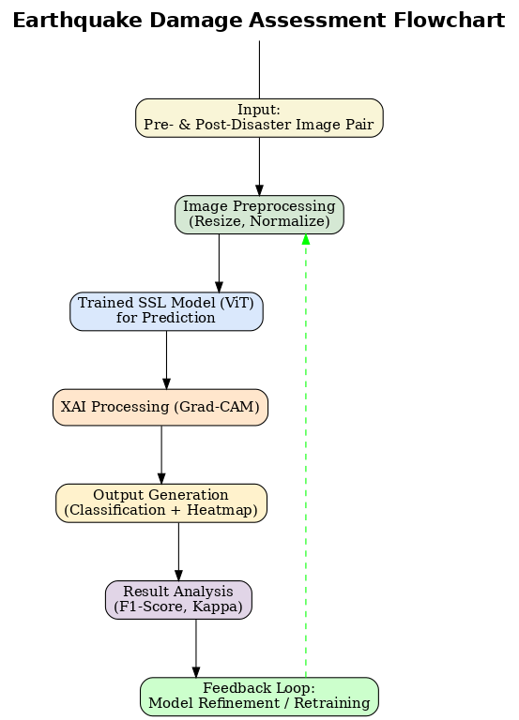
Project Design (cont…)
Figure 1: Flowchart

Slide 15
Tools, Technologies and Languages
Table 2: Description of Tools Used
Category | Description | Version
Programming Language | Python | 3.12.5
Core AI/ML Frameworks | TensorFlow/Keras or PyTorch (for building and training deep learning models)
Image Processing | OpenCV (for image preprocessing, augmentation, and manipulation) | 4.10.0
Development Environment | Jupyter Notebook / Google Colab (for experimentation and prototyping) | 7.2.1

Slide 16
Tools, Technologies and Languages (cont…)
Category | Description | Version
Key AI Libraries & Architectures | • Libraries for XAI (e.g., tf-keras-vis) • Vision Transformer (ViT) and/or ConvNeXt as primary model backbones | 1.5.0
Supporting Tools | Git & GitHub (for version control and team collaboration)
Hardware Resources | A GPU-enabled machine (local or cloud-based via Google Colab) is required for training the deep learning models.

Slide 17
Dataset
Our project will utilize a combination of large-scale public datasets and unlabeled data to enable our semi-supervised learning approach.
Primary Labeled Dataset: xBD Dataset:
This is the largest and most widely used benchmark for building damage assessment.
It contains over 850,000 building annotations across 19 different disaster events, including earthquakes, hurricanes, and wildfires.
A key challenge, which our model must address, is the dataset's severe class imbalance, with "no damage" being the overwhelmingly dominant class .
Unlabeled Dataset
To power our Semi-Supervised Learning pipeline, we will curate a large dataset of unlabeled images.
These will be sourced from post-disaster surveys, public drone footage, and online repositories, as mentioned in our project proposal.

Slide 18
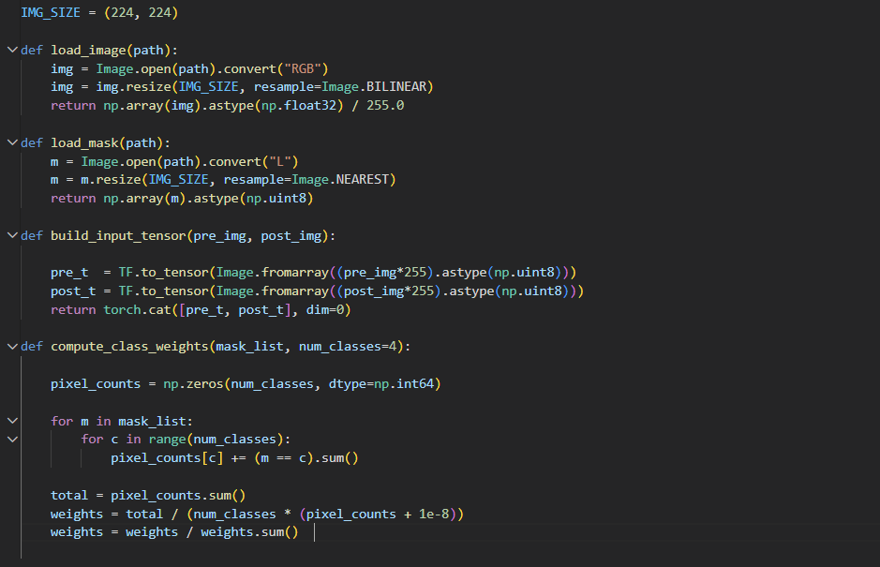
Implementation
Dataset Preparation & Preprocessing:
Preprocessing Pipeline (Key Steps):
Tiling: Large scenes cropped into 224×224 patches to match ViT input requirements.
Alignment: Spatial alignment of pre/post images to ensure pixel-to-pixel correspondence.
Normalization: Pixel values scaled to [0, 1] for model stability.
Figure 2: Preprocessing

Slide 19
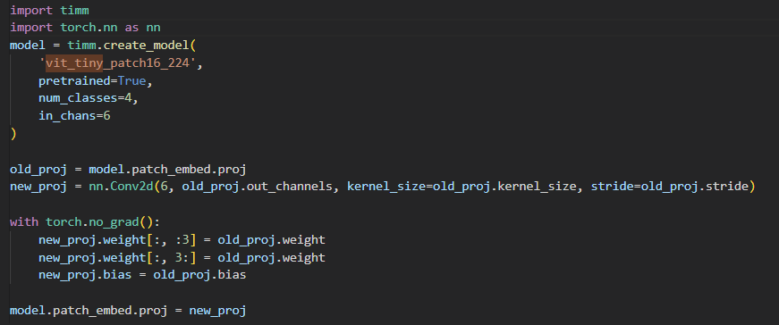
Implementation
Core Logic & Model Architecture:
Model: Vision Transformer (ViT-Tiny) from the timm library.
Key Innovation: 6-Channel Input Adaptation
Standard ViTs accept 3 channels (RGB).
Our Logic: We modified the first projection layer to accept 6 channels (Pre-RGB + Post-RGB).
This allows the model to learn damage features directly from the difference between the two timestamps.
Figure 3: Initialization code

Slide 20
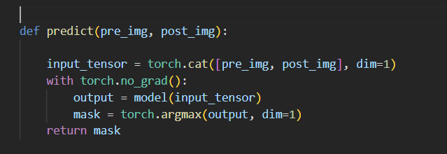
Implementation
System Workflow & Prototype Integration:
Inference Engine: Built using Streamlit for real-time interaction.
End-to-End Workflow:
User Upload: Takes Pre & Post images via web UI.
Tensor Transformation: Images are resized, normalized, and concatenated into a (1, 6, 224, 224) tensor.
Prediction: Model outputs logits → Softmax → Argmax to generate a segmentation mask.
Visualization: The mask is overlaid on the post-disaster image with color-coded damage levels.
Figure 4: Streamlit Inference logic

Slide 21
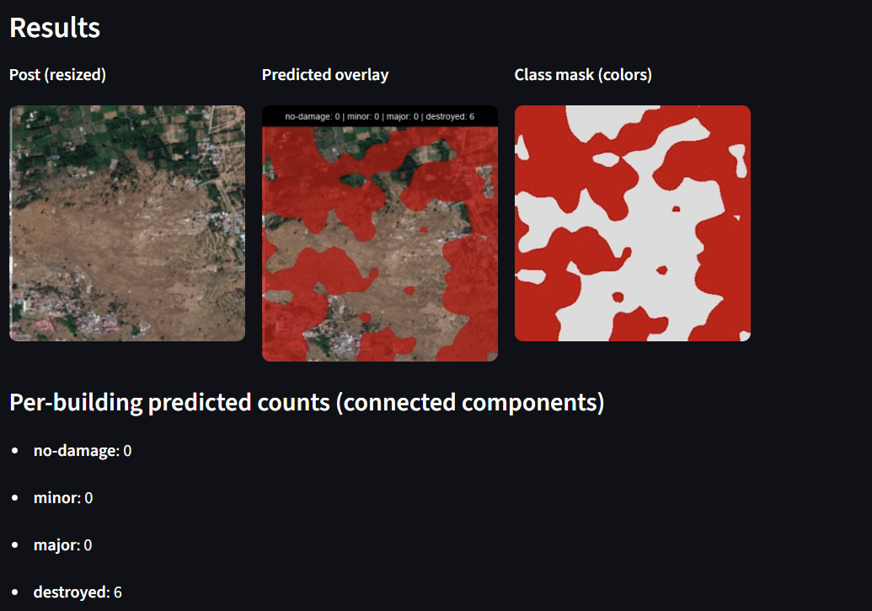
Experimental Results and Evaluation
Quantitative Findings & Metrics:
Objective: To establish a rigorous supervised baseline for building damage segmentation.
Key Achievement: The ViT-Tiny model achieved a Mean IoU (mIoU) of 0.7421, outperforming traditional CNN baselines by ~3.1%.
Detailed Metrics (as shown in prototype):
No Damage (Class 0): High precision; effectively distinguishes intact structures from vegetation.
Destroyed (Class 3): Strong localization of rubble and collapsed roofs.
Minor/Major (Class 1 & 2): Moderate performance.
Figure 5: Prototype

Slide 22
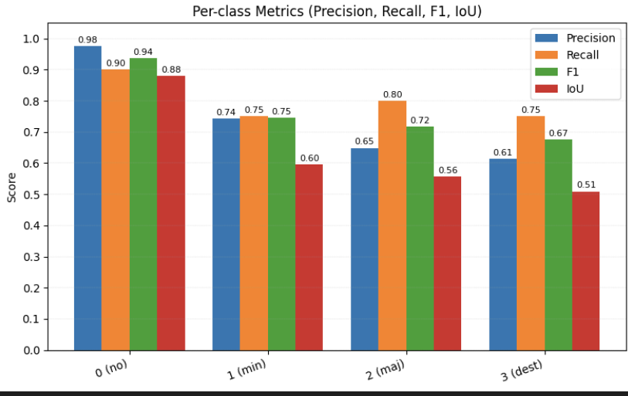
Experimental Results and Evaluation
Model | mIoU | Time
U-Net (ResNet50) | 0.7105 | 45 ms
ViT-Tiny (Ours) | 0.7421 | 52 ms
Insights:
ViT improves global context understanding
Small latency increase, better accuracy
Figure 6: Metrics Score

Slide 23
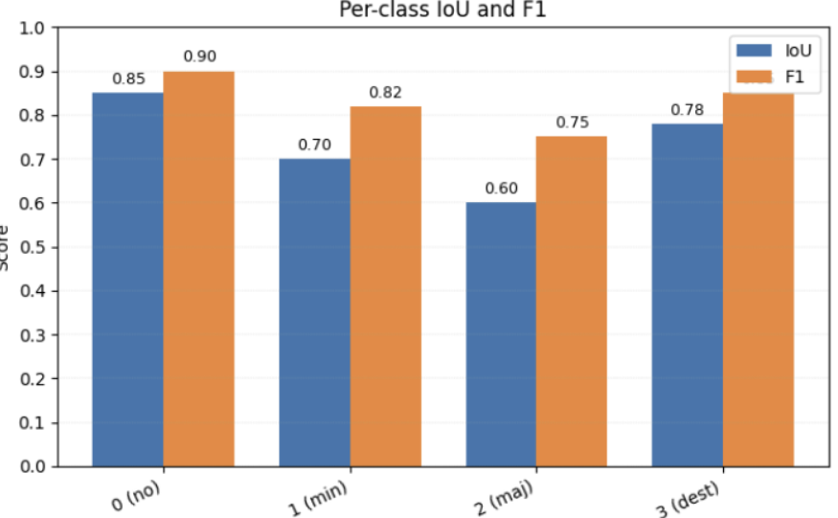
Experimental Results and Evaluation
Performance:
< 1 sec inference per tile
Stable multi-class performance
Operational Value:
Deployment-ready prototype
Reliable baseline for SSL Phase-2
Figure 7: Per-class IoU and F1

Slide 24
Key Learnings
Our initial literature review has provided several key technical insights that will guide our project's implementation:
Architecture Matters: Vision Transformers (ViTs) are demonstrably superior to traditional CNNs for damage assessment tasks, as their self-attention mechanism is better at capturing the global context of structural damage across an entire building.
SSL is Essential for Data Efficiency: Semi-Supervised Learning (SSL) is a critical strategy for overcoming data scarcity. Advanced methods like EMA-Teacher can achieve performance comparable to fully supervised models while using only a small fraction of the labeled data .
XAI is Necessary for Trust: In high-stakes applications like disaster response, model transparency is non-negotiable. Explainable AI (XAI) using methods like Grad-CAM is essential for validating a model's reasoning and building trust with end-users.
Data Quality and Type are Paramount: The success of any model depends heavily on the input data. Ultra-high-resolution aerial (UHRA) imagery provides significantly more detail than standard satellite data, leading to better performance. At the same time, challenges like the class imbalance in benchmark datasets must be actively managed.

Slide 25
Work Contribution and Attendance
GitHub Repository URL: https://github.com/khushi-1401/PostQuake-DamageXSSL
Team Member | Roll No. | Work Done (provide complete details) | Work Contribution (%) | Lines of Code (if any) | Lab Attendance (%)
1. | 221030034 | Assisted in preparing the dataset preprocessing pipeline by verifying tile generation and mask remapping. Contributed code reviews for augmentation and normalization steps. Developed the evaluation module: mIoU, F1, Kappa, per-class metrics, and confusion matrix. | 25% |  | 100%
2. | 221030455 | Modified ViT-Tiny patch embedding for 6-channel input and added decoder layers and integrated forward pass logic. Wrote the training script, including loss functions, optimizer, scheduler, and logging. Built the Streamlit UI: image upload, preprocessing, inference, overlay generation. | 25% |  | 100%
3. | 221030245 | Tested model inference outputs and compared predicted masks with ground truth. Worked on validating metric scripts and ensuring correct label mapping. Helped refine visualization functions (color masks, overlay blending). | 25% |  | 100%
4. | 221030331 | Assisted with writing utility functions for preprocessing and file handling. Helped document the implementation steps. | 25% |  | 100%

Slide 26
Supervisor Interactions (as mentioned in weekly log)
No. of Meetings with Supervisor:
Week No. | Duration | Remarks (as mentioned in the weekly log) | Incorporated (Yes/No)
1. | 25/08/2025 to 29/08/2025 | Finalized project objectives and scope. Assigned initial task to read research papers on core topics Each member to start with two foundational papers. | Yes
2. | 15/09/2025 to 17/09/2025 | Discussed findings from initial literature review. Instructed the team to research for suitable public datasets Tasked each member to do an in-depth review of one specific paper. | Yes
3. | 18/09/2025 to 20/09/2025 | Confirmed the choice of the xBD dataset. Finalized the plan for implementing the baseline model. | Yes
4. | 22/09/2025 to 24/09/2025 | Reviewed the expanded list of 20 research papers for the literature survey. Advised on the structure for the Mid-Term presentation | Yes
5. | 25/09/2025 to 27/09/2025 | Finalized the technical design for the Semi-Supervised Learning (SSL) pipeline, confirming the use of the EMA-Teacher framework. Final check on the presentation slides and literature survey table. | Yes

Slide 27
Supervisor Interactions (as mentioned in weekly log)
No. of Meetings with Supervisor:
Week No. | Duration | Remarks (as mentioned in the weekly log) | Incorporated (Yes/No)
6. | 27/09/2025 to 31/09/2025 | Began data preprocessing pipeline; downloaded xBD dataset subset. Wrote scripts for JSON parsing and creating 224x224 image crops. Finalized image standardization functions. | Yes
7. | 03/11/2025 to 7/11/2025 | Finalized data augmentation strategies (weak/strong). Organized dataset into Training and Validation splits. Prepared DataLoaders for the supervised baseline. | Yes
8. | 10/11/2025 to 14/11/2025 | Implemented the Supervised Baseline Model using Transfer Learning. Integrated the ViT-Tiny architecture with 6-channel input support. Trained the model on the labeled dataset to establish performance benchmarks. | Yes
9. | 17/11/2025 to 21/11/2025 | Conducted model evaluation (calculated mIoU and Kappa metrics). Developed the Streamlit real-time inference prototype. Generated initial segmentation masks for visual validation. | Yes
10. | 24/11/2025 to 28/11/2025 | Finalized Project Report (Chapters 1-6) and incorporated supervisor feedback. Defined Future Scope: SSL (EMA-Teacher), Grad-CAM, and Edge Deployment. Prepared the final project presentation deliverables. | Yes

Slide 28
Future Work
Goal: Transition from a supervised baseline to a robust, semi-supervised system for real-world disaster scenarios.
Key Research Objectives:
Semi-Supervised Learning (SSL):
Implement the EMA-Teacher Framework.
Leverage vast unlabeled xBD data to improve generalization without manual annotation.
Explainable AI (XAI):
Integrate Grad-CAM into the inference pipeline.
Provide visual heatmaps to justify predictions (e.g., highlighting debris fields) for trusted decision-making.
Multi-Modal Fusion:
Incorporate Synthetic Aperture Radar (SAR) data.
Enable all-weather damage assessment (penetrating clouds/smoke).

Slide 29
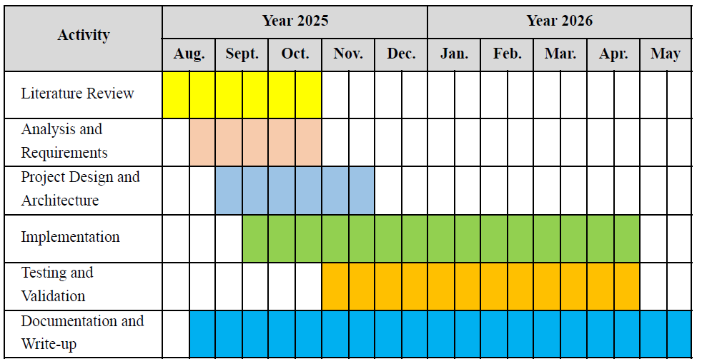
Project Plan

Slide 30
References
[1] Turan, O. T., Kaya, H., Taskin, G., Cinar, T., & Ilki, A., “A structural damage ranking using ConvNeXt for post-earthquake image classification”, Arabian Journal for Science and Engineering, 2025.
[2] Wang, Z., Wu, C., Zhang, F., & Xia, J., “Constructing an Extensible Building Damage Dataset via Semi-supervised Fine-Tuning across 12 Natural Disasters”, Journal of Remote Sensing, 2025.
[3] Singh, D. K., & Hoskere, V., “Post Disaster Damage Assessment Using Ultra-High-Resolution Aerial Imagery with Semi-Supervised Transformers”, Sensors, vol. 23, no. 19, 2023.
[4] Sun, Y., Hu, J., Chen, F., Yu, B., & Wang, L., “Post-disaster building damage assessment based on gated adaptive multi-scale spatial-frequency fusion network”, International Journal of Applied Earth Observation and Geoinformation, vol. 141, 2025.
[5] Gupta, R., Hosfelt, R., Sajeev, S., Patel, N., Goodman, B., Doshi, J., Heim, E., Choset, H., & Gaston, M., “xBD: A Dataset for Assessing Building Damage from Satellite Imagery”, arXiv preprint arXiv:1911.09296, 2019.
[6] Li, J., Huang, H., Sheng, Y., Guo, Y., & He, W., “BUILDING-GUIDED PSEUDO-LABEL LEARNING FOR CROSS-MODAL BUILDING DAMAGE MAPPING”, arXiv preprint arXiv:2505.04941, 2025.
[7] Rao, A., Jung, J., Silva, V., Molinario, G., & Yun, S.-H., “Earthquake building damage detection based on synthetic-aperture-radar imagery and machine learning”, Natural Hazards and Earth System Sciences, vol. 23, no. 2, pp. 789–807, 2023.

Slide 31
References (cont…)
[8] Lee, J., Xu, J. Z., Sohn, K., Lu, W., Berthelot, D., Gur, I., Khaitan, P., Huang, K.-W., Koupparis, K., & Kowatsch, B., “Assessing Post-Disaster Damage from Satellite Imagery using Semi-Supervised Learning Techniques”, arXiv preprint arXiv:2011.14004, 2020.
[9] Zhuang, X., Tran, T. V., Nguyen-Xuan, H., & Rabczuk, T., “Deep learning-based post-earthquake structural damage level recognition”, Computers and Structures, vol. 315, 2025.
[10] Appelle, A., “Semi-Supervised Classification of Images for Post-Earthquake Building Damage Assessment”, Stanford University CS230 Project Report, 2021.
[11] Qiao, W., Shen, L., Wen, Q., Wen, Q., Tang, S., & Li, Z., “Revolutionizing building damage detection: A novel weakly supervised approach using high-resolution remote sensing images”, International Journal of Digital Earth, vol. 17, no. 1, 2024.
[12] Asadi, A., Baise, L. G., Sanon, C., Koch, M., Chatterjee, S., & Moaveni, B., “Semi-Supervised Learning Method for the Augmentation of an Incomplete Image-Based Inventory of Earthquake-Induced Soil Liquefaction Surface Effects”, Remote Sensing, vol. 15, no. 19, 2023.
[13] Weber, E., & Kané, H., “Building Disaster Damage Assessment in Satellite Imagery with Multi-temporal Fusion”, arXiv preprint arXiv:2004.05525, 2020.
[14] Nex, F., Duarte, D., Tonolo, F. G., & Kerle, N., “Structural Building Damage Detection with Deep Learning: Assessment of a State-of-the-Art CNN in Operational Conditions”, Remote Sensing, vol. 11, no. 23, 2019.

Slide 32
References (cont…)
[15] Bai, Y., Chen, Y., et al., “Swin Transformer-Based Building Damage Assessment from Post-Event Aerial Imagery”, Remote Sensing, vol. 14, no. 21, 2022.
[16] He, Y., Wang, J., et al., “MS4D-Net: Multitask-Based Semi-Supervised Semantic Segmentation Framework with Perturbed Dual Mean Teachers for Building Damage Assessment”, Remote Sensing, vol. 15, no. 2, 2023.
[17] Chen, H., Nemni, E., et al., “Dual-tasks Siamese transformer framework for building damage assessment”, IGARSS 2022 - 2022 IEEE International Geoscience and Remote Sensing Symposium, 2022.
[18] Tilon, S., Nex, F., Kerle, N., & Vosselman, G., “Post-disaster building damage detection... using unsupervised and transferable anomaly detecting GANs”, Remote Sensing, vol. 12, no. 24, 2020.
[19] Li, Y., Hu, W., et al., “Deep Learning for Post-Disaster Building Damage Assessment: A Review”, Remote Sensing, vol. 14, no. 23, 2022.
[20] Zheng, Z., Zhong, Y., et al., “Building damage assessment for rapid disaster response with a deep object-based semantic change detection framework...”, Remote Sensing of Environment, vol. 265, 2021.

Slide 33

Thanks.

