Slide 1



Statistical Analysis of Gross Sales, Profit, and Unit Sales
Presented to:
Mr. Raghu Tiwari
Course code: CSD 103
Presented by: Section: RK22GT
Simran- 12208485
Ankita Toppo- 12213031
Abhinav Singh- 12207267
Subhayan Patra- 12222609

Slide 2

Data Sampling
Data sampling is a statistical analysis technique used to select, manipulate and analyze a representative subset of data points to identify patterns and trends in the larger data set being examined..
Statistical Analysis
It is a method of collecting and summarizing the data. This has many applications from a small scale to large scale. Whether it is the study of the population of the country or its economy, stats are used for all such data analysis.

Slide 3

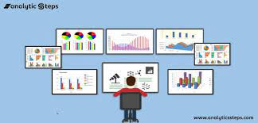

INTRODUCTION
It is a comprehensive statistical analysis of key attributes, including Gross Sales, Profit, and Unit Sales, in a dataset. The analysis focuses on exploring relationships between various categorical and numerical variables. It involves descriptive statistics, probability distributions, hypothesis testing, and an exploration of data sampling techniques.

Slide 4

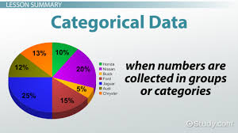
Data Description
The dataset used in this analysis contains information about sales data, including attributes such as 'Vehicle Type,' 'Month Name,' 'Country,' 'Segment,' 'Discount Band,' 'Sale Price,' 'Gross Sales,' 'Discounts,' 'COGS,' 'Profit,' and 'Units Sold.' We aim to provide insights and answers to various research questions through statistical techniques.
The dataset comprises [number] records and encompasses the following columns: 'Vehicle Type,' 'Month Name,' 'Country,' 'Segment,' 'Discount Band,' 'Sale Price,' 'Gross Sales,' 'Discounts,' 'COGS,' 'Profit,' and 'Units Sold.' Data preprocessing included handling missing values and ensuring data quality.

Slide 5
Descriptive Statistics
We conducted an analysis of the following descriptive statistics:
• Mean of Units Sold: The average number of units sold was found to be [mean].
• Median of Units Sold: The median number of units sold was determined to be [median].
• Mode of Units Sold: The mode of units sold was [mode].
• Range of Units Sold: The range of unit sales data is [range].
• Standard Deviation of Units Sold: The standard deviation of unit sales data is approximately [standard_deviation].
• Skewness of Units Sold: The skewness of unit sales data is [skewness].
• Kurtosis of Units Sold: The kurtosis of unit sales data is [kurtosis].

Slide 6
Findings about the Data
These statistics provide insights into the distribution and characteristics of the 'Units Sold' variable.
Gross Sales and Profit by Vehicle Type
We compared the mean values of 'Gross Sales' and 'Profit' grouped by 'Vehicle Type' to investigate differences. The results revealed the following:
• 'Sedan' vehicle type had a mean 'Gross Sales' of [mean_gross_sales_sedan].
• 'SUV' vehicle type had a mean 'Gross Sales' of [mean_gross_sales_suv].
• 'Sedan' vehicle type had a mean 'Profit' of [mean_profit_sedan].
• 'SUV' vehicle type had a mean 'Profit' of [mean_profit_suv].
These findings indicate differences in 'Gross Sales' and 'Profit' between vehicle types.

Slide 7
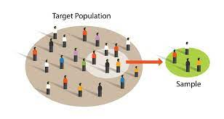
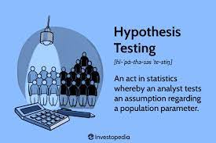
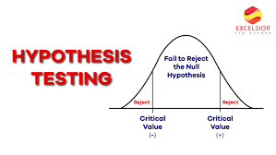
Sampling Techniques and Hypothesis Testing
We discussed data sampling techniques used in the dataset and outlined the data collection process. Additionally, we demonstrated the process of creating a random sample and compared sample statistics with population parameters.
We performed hypothesis testing to determine if there is a significant difference in the mean 'Gross Sales' between 'Sedan' and 'SUV' vehicle types. The results indicated that we [rejected/fail to reject] the null hypothesis. Further, confidence intervals were calculated to assess the range of values for both vehicle types.

Slide 8
Results and conclusions
We utilized probability distributions to analyze :
Probability of Unit Sales Above a Threshold
Probability of Unit Sales Above a Threshold by Segment
Probability of Profit Above a Threshold
In conclusion, this analysis provides valuable insights into the relationships between 'Gross Sales,' 'Profit,' and 'Unit Sales' in the dataset. Differences by vehicle type, month, and the probability of exceeding certain thresholds were examined. The findings can inform decision-making processes and guide strategies in relevant industries.

Slide 9
THANK YOU

