Slide 1



PlotTwist
A Creative Plot Generation Framework with Small Language Models
Abhinav Thorat
Ravi Kolla
Jyotin Goel
Madhav Kataria
Niranjan Pedanekar
User Engagement Research, Sony Research India
I · THE PLEDGE
II · THE TURN
III · THE PRESTIGE
Notes:
PlotTwist, from Sony Research India. The talk follows the three acts of The Prestige: the pledge (the task), the turn (what makes it hard and how PlotTwist restructures it), and the prestige (what it achieves).

Slide 2

PLOTTWIST
02
ACT I
The Pledge
The task, and the standard it is held to.
Notes:
Act I, the Pledge: the ordinary-looking task. A short premise has to become a full plot, and we need a clear standard for what a good plot is.

Slide 3
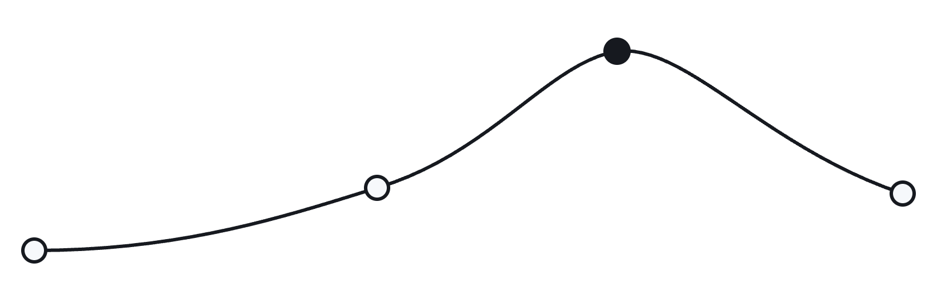

I
THE PLEDGE
03
A premise must expand into a full narrative arc
Climax
PREMISE
“A romantic comedy set in the modern tech startup era”
Development
Resolution
Setup
Isn't this just text generation?
SUMMARIZATION · QA
Local Context
PLOT GENERATION
Long-Horizon
Notes:
Writers constantly turn a concise premise into a narrative outline. The premise gives minimal guidance, yet has to expand into a causally connected sequence: setup, development, climax, resolution. Early motivations must align with later decisions, tonal shifts must feel earned, pacing must sustain engagement. Unlike summarization or QA, local context is not enough.

Slide 4
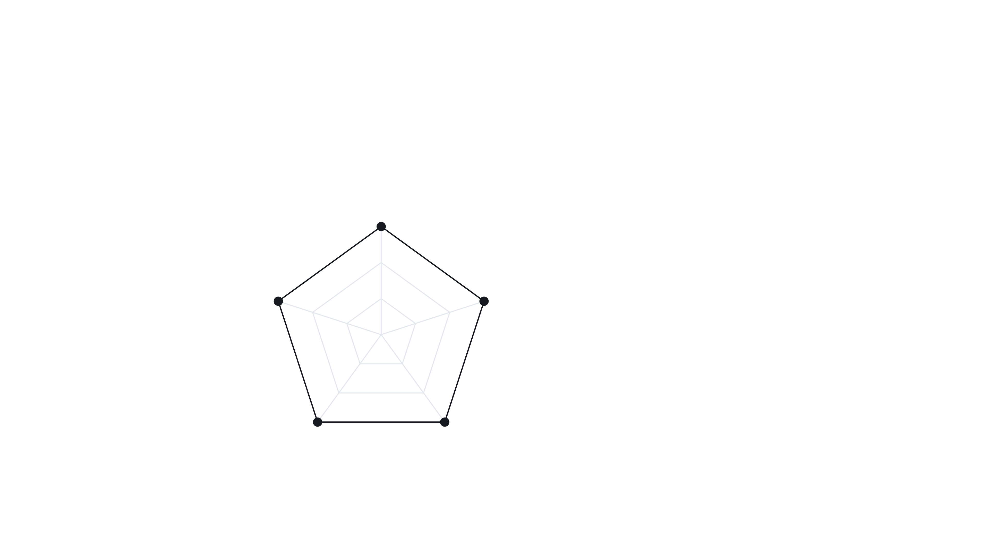






I
THE PLEDGE
04
Five dimensions define plot quality
Narrative Coherence
Structural
Emotional Turning Points
Character Development
How do you score a story?
Affective
NQDs
Character
Tone Consistency
Pacing
Stylistic
Temporal
Notes:
Quality is judged along five Narrative Quality Dimensions. Together they cover structural, temporal, stylistic, character-centric and affective aspects while keeping the evaluation space compact. These five dimensions recur through every component of PlotTwist.

Slide 5

PLOTTWIST
05
ACT II
The Turn
Why the task is hard, and how PlotTwist restructures it.
Notes:
Act II, the Turn: the complications, and the change in approach PlotTwist makes in response.

Slide 6


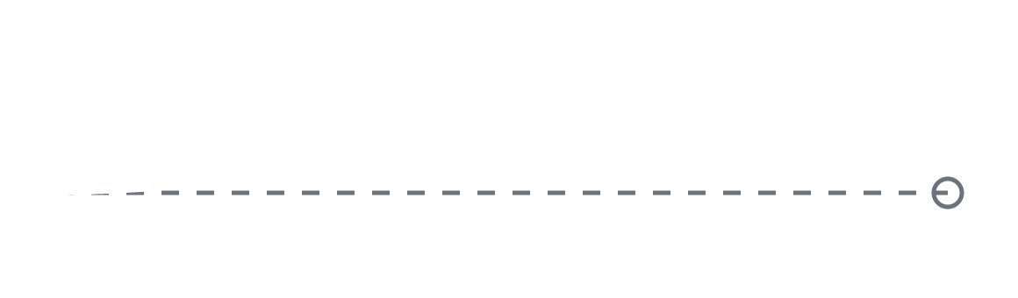





II
THE TURN
06
Aligning at scale is costly; LLM judges are biased
01 · GENERATION
02 · EVALUATION
Frontier Alignment
LLM-as-a-Judge
Computationally Prohibitive
Systematic Biases
Narrative Drift
Same-Family Preference
Positivity Bias
Why not just use a bigger model?
Intended Arc
Limited Expert Agreement
Verbosity Bias
Scale ≠ Long-Horizon Coherence
+ Correlated Errors Across Models
Notes:
Two obstacles. Generation: task-specific alignment beats general-purpose models, but aligning frontier-scale models is computationally prohibitive, and scale alone does not fix long-horizon coherence. Evaluation: LLM judges show positivity bias, same-family preference, verbosity bias and limited agreement with experts, and their errors are correlated across models.

Slide 7









II
THE TURN
07
PlotTwist externalizes structure instead of scaling
BEFORE
Reward
Explicit Signal
One Monolithic LLM
EXTERNALIZE
Generator
3B Active
Quality Learned Implicitly
Jury
Independent
RESEARCH QUESTION
Can ≤ 3B-active SLMs match frontier LLMs?
Notes:
The paper's hypothesis: the key lies not in model scale, but in externalizing narrative structure into explicit evaluative and training signals. Rather than asking one monolithic model to learn every aspect of narrative quality implicitly through token prediction, PlotTwist decomposes the problem into specialized components, trading model capacity for structured workflow design. The research question: can SLMs, meaning at most 3B active parameters per token, match frontier LLMs with the right scaffolding?

Slide 8



II
THE TURN
08
Three modules divide the work
TRAINING
POST-HOC EVALUATION
01 REWARD
02 GENERATOR
03 JURY
Aspect Rating Reward Model
Ranks
Mixture-of-Experts Plot Generator
Plots
Agentic Evaluation Module
Qwen-3-32B · SFT
Qwen-3-30B-A3B · DPO
5 Jurors · 1 Judge
INFERENCE
Premise
→
Generator
→
Plot
1 Model · 1 Pass
Notes:
Three modules. The Aspect Rating Reward Model scores plots on the five NQDs. Its rankings produce preference pairs for DPO on the MoE generator. The Agentic Evaluation module sits outside the training pipeline and assesses outputs post hoc. Colors stay fixed from here: purple for the reward model, blue for the generator, green for the jury.

Slide 9
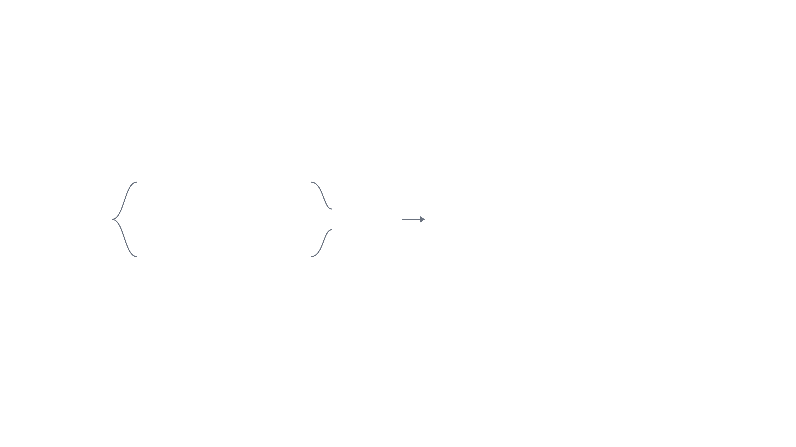



II
THE TURN
09
Paired prompts counter rater positivity bias
01 REWARD
r⁺
Strengths Only
5 Raters
Σ
Plot
r⁺ − r⁻
Reward Model
Why ask for the positives and negatives separately?
r⁻
Weaknesses Only
5 Raters
5,000 MovieLens Plots
→
5 NQDs × 2 Prompts × 5 Raters
→
SFT Qwen-3-32B · CE + Huber
Notes:
No dataset has aspect-level plot ratings, so PlotTwist builds one. 5,000 MovieLens films, plots from Wikipedia, at most 4,000 words. IMDb ratings are used only for curation and stratification, not training. Five LLMs each rate every aspect twice: once considering only positives, once only negatives. The final rating sums the differences. This mitigates LLM positivity bias. Qwen-3-32B, 4-bit, is then fine-tuned with cross-entropy plus a Huber loss on the ratings.

Slide 10

II
THE TURN
10
DPO aligns a 3B-active generator on 160 pairs
02 GENERATOR
5,000 Premises
Qwen-3-30B-A3B
Base MoE + 3 Frontier LLMs Write Plots
DPO
Reward Model Scores Each Plot
3B / 30B Active
Keep: Frontier Best · > 8 · Δ ≥ 0.5
Only 160 pairs?
DPO Only · No SFT
160 Pairs
Notes:
Premises are generated for each of the 5,000 plots with Gemma-27B. The base MoE and three frontier models write plots for each premise, and the reward model scores them. A sample is kept only if a frontier model has the highest reward, above 8, by a margin of at least 0.5. That leaves 160 high-confidence preference pairs. DPO is then run on Qwen-3-30B-A3B: 30B total parameters, 3B active per token. SFT is skipped because the base model already follows instructions well.

Slide 11





II
THE TURN
11
A cross-family jury evaluates plots independently
03 JURY
1 · 5 JURORS
OpenAI
Google
Mistral
2 · DELIBERATE
3 · JUDGE
Plot
NVIDIA
Gap ≥ 2 Points
Llama · 6th Family
Zhipu
Who judges the judges?
10 Criteria / NQD
94–99% Verified
Each 0–1 · Summed to 10
Evidence Quoted Verbatim
Notes:
The jury is independent of training. Five open-weight jurors from five families, none of them Qwen, score each plot on every NQD. Disagreements of two points or more go through two rounds of structured deliberation, then a held-out sixth-family judge, Llama-3.3-70B. Neither step changes the conclusions, so results report the independent first-round panel. Each NQD has a ten-criterion rubric, and every criterion score must quote a verbatim span from the plot.

Slide 12

PLOTTWIST
12
ACT III
The Prestige
What a model with 3B active parameters achieves.
Notes:
Act III, the Prestige: first, do the evaluators themselves hold up; then, how PlotTwist compares with eleven baselines.

Slide 13


III
THE PRESTIGE
13
Both evaluators separate classics from Razzies
101 Greatest Screenplays (GSAT) vs Razzie Winners · 1,000 Balanced Runs
Razzie
GSAT
01 REWARD
7.21
8.28
+1.07
Reward Model
[0.96, 1.19]
Can they tell a classic from a Razzie?
03 JURY
6.58
8.33
+1.75
Cross-Family Jury
[1.66, 1.85]
6
7
8
9
Δ · 95% CI
GSAT Higher in 100% of Runs · All 5 NQDs
Notes:
Before trusting the scores, both evaluators are tested on known-good and known-bad plots: 94 from the 101 Greatest Screenplays of All Time, 37 Razzie winners. The Razzie set is fixed and an equal GSAT sample is drawn over 1,000 runs. Reward model: 8.28 vs 7.21, a gap of +1.07. Jury: 8.33 vs 6.58, +1.75. GSAT wins in 100% of runs, on all five NQDs, with large effect sizes.

Slide 14

III
THE PRESTIGE
14
The jurors agree on rankings more than on scores
SCHEMATIC · SAME ORDER, DIFFERENT LENIENCY
SCORE AGREEMENT
J1
0.41 → 0.64
J2
Krippendorff's α · Recentered
J3
J4
RANK AGREEMENT
0.98
Are five judges really five?
J5
Lower Score
Higher Score →
Kendall's W
≈ 1.3 Effective Judges of 5
Correlated Judgments
No Same-Family Cells · Same Ranking
113 Specifications · Same Ranking
Notes:
How reliable is the jury itself? Raw inter-juror agreement is moderate, Krippendorff's alpha 0.41, but that mostly reflects calibration: jurors differ in leniency, not in ordering. Gwet's AC2 is 0.89, recentering raises alpha to 0.64, and system rankings are highly consistent: mean pairwise Spearman 0.97, Kendall's W 0.98. Because judgments are correlated, the panel counts as roughly 1.3 effective independent judges, not five, which is why the per-judge and leave-one-judge-out analyses carry the evidential weight. Same-family judges inflate scores by 0.82, but PlotTwist does not benefit: its corrected same-family inflation is negative. The ranking holds across all 113 analysis specifications.

Slide 15

III
THE PRESTIGE
15
PlotTwist wins against ten of eleven baselines
Paired Win Rate · 160 Premises · 95% CI · Ties = 0.5
Claude Sonnet 4
Inconclusive · p = 0.13
0.563
MEAN JURY SCORE
Agents' Room
0.734
8.36
PlotTwist
GPT-4.1
0.906
Gemini 2.0 Flash
0.938
Claude Sonnet 4
8.35
Qwen-3-32B
0.987
Near-Tie in Mean → Win Rate Is Primary
Qwen-2.5-14B
0.950
Mistral Small 24B
0.994
DeepSeek-R1-14B
0.994
Llama-3.3-70B
0.988
WizardLM-30B
0.994
Phi-4 Mini
0.994
0.4
0.5
0.6
0.8
1.0
Notes:
The pre-specified primary endpoint is per-premise paired win rate over 160 held-out premises, ties counted as 0.5, with bootstrap CIs and Holm-corrected sign tests. PlotTwist wins at least 0.95 against every open-weight baseline, 0.94 against Gemini 2.0 Flash, 0.91 against GPT-4.1, 0.73 against Agents' Room, all significant. Against Claude Sonnet 4 the result is inconclusive: 0.56, CI crossing parity, p = 0.13. We only claim PlotTwist is competitive with it. Ablations: the dense Qwen3-32B scores 7.90 with about ten times the active parameters; DPO alone lifts the base MoE from 8.03 to 8.81 on the development evaluator.

Slide 16
III
THE PRESTIGE
16
Neither scale nor paradigm explains the gains
Overall Mean Score · Axis 7–9
SCALE
PARADIGM
ALIGNMENT
vs Larger and Similar-Size Models
vs a Multi-Agent Writers’ Room
Same MoE, Before and After DPO
Qwen-2.5-14B
7.62
Agents' Room
8.25
Qwen-3-30B-A3B Base
8.03
Qwen3-32B (Dense)
7.90
PlotTwist
8.36
+ DPO on 160 Pairs
8.81
PlotTwist
8.36
1 Model · 1 Pass · Win Rate 0.73
+0.78 · Development Evaluator, Not the Jury
≈ 1/10 Active Parameters · Win Rate 0.99
Notes:
Ablations. The gains are not attributable to scale, architecture or generation paradigm. PlotTwist outperforms similarly sized instruction-tuned models (Qwen2.5-14B 7.62, DeepSeek-R1-14B 7.60) and the dense Qwen3-32B (7.90) with about one-tenth the active parameters per token, win rate 0.99. It beats the multi-agent Agents' Room, 8.36 vs 8.25, win rate 0.73, with a single model and a single inference pass. Isolating preference optimization: the base Qwen-3-30B-A3B goes from 8.03 to 8.81 after DPO on 160 pairs. Note that last comparison uses the single-judge development evaluator, not the jury.

Slide 17
III
THE PRESTIGE
17
Gains grow as source quality drops
Gain over Source Plot · 40 Films per IMDb Stratum
+1.28
+0.98
+0.65
Doesn't it just inflate every score?
EXCELLENT
+0.31
Light Touch · Pacing Unchanged
LOW
Excellent
Good
Mid
Low
Beats Original on ≥ 97.5% of Films
> 8
7–8
6–7
≤ 6
Refine
Restructure
Notes:
Quality-stratified analysis. 160 films in four IMDb strata, 40 each. A premise is derived from each source plot, PlotTwist generates a plot, and the jury compares original and generated pairs. The improvement grows monotonically as source quality drops: +0.31, +0.65, +0.98, +1.28. For Excellent films pacing is unchanged within uncertainty, while in the Low stratum generated plots beat their originals on at least 97.5% of films on every NQD. PlotTwist adapts the size of its intervention rather than uniformly inflating scores.

Slide 18





III
THE PRESTIGE
18
3B active parameters, competitive with the frontier
Structured, preference-based alignment is a resource-efficient approach to high-quality creative plot generation.
01 REWARD
02 GENERATOR
03 JURY
Positive–Negative Aspect Ratings
3B-Active MoE · DPO · 160 Pairs
Cross-Family, Evidence-Grounded
LIMITS
LLM Judges, Not Experts
English Synopses
Claude Comparison Open
Notes:
The prestige. A model with 3B active parameters, aligned with structure rather than scale, beats ten of eleven baselines and is competitive with Claude Sonnet 4. The paper's conclusion: structured, preference-based alignment is a resource-efficient approach to high-quality creative plot generation. Limitations: LLM judges rather than expert readers, English synopsis-style plots only, and the Claude Sonnet 4 comparison is unresolved at 160 premises.

Slide 19

PLOTTWIST
19
CURTAIN CALL
Any questions?
Notes:
Open the floor for questions.

Slide 20

PlotTwist
A Creative Plot Generation Framework with Small Language Models
Visit here to know more about our work
Abhinav Thorat
Ravi Kolla
Jyotin Goel
Madhav Kataria
Niranjan Pedanekar
User Engagement Research, Sony Research India
Notes:
Thank you. Scan the code to visit the project page.

