Slide 1
WOXSEN UNIVERSITY | SCHOOL OF TECHNOLOGY
REVIEW 1 — PROJECT PROPOSAL & CONCEPTUAL MODELING
Cinema Screening and Ticket Booking System
Review 1: Problem Statement, Operational Scope & Conceptual ER Architecture
Student: G. Abhinav | Roll No: WU0102089 | Section: AIML Rhinos (Batch 2025–2029)
Course: Database Management Systems (DBMS) — PBL Activity | Faculty Guide: Prof. Sahithi
Program: B.Tech in Computer Science and Engineering (AI & ML) | Academic Year: 2026–2027

Slide 2
CONTEXT & MOTIVATION
Multiplex Operational Challenges & The Need for an RDBMS
Legacy Operational Vulnerabilities
Proposed RDBMS Architecture
• Concurrency Collisions: Unsynchronized file or manual records allow simultaneous reservation of identical chairs, causing customer disputes.
• Auditorium Overlaps: Consecutive shows scheduled without cleaning/turnaround buffers cause screen runtime collisions.
• Concession Inventory Leaks: Food and beverage sales managed independently from ticket counters risk inventory shortages and negative stock.
• Unregulated Refunds: Cancellation records lack cumulative refund ceilings, allowing financial leakage exceeding paid amounts.
• Unified Relational Engine: Centralizes theaters, auditoriums, film schedules, seating layouts, concessions, and financial ledgers.
• ACID Transaction Isolation: Atomic multi-row booking locks seats exclusively during checkout, completely eliminating double-booking.
• Declarative & Trigger Logic: Enforces a mandatory 15-minute turnaround buffer between shows and caps cumulative refunds at database level.
• Integrated Analytics: Automates real-time business intelligence for show occupancy, box office gross, and screen load.
DBMS PBL Activity | Review 1: Proposal & Conceptual Modeling | G. Abhinav (WU0102089)

Slide 3
SYSTEM BOUNDARIES
Core Project Objectives & Functional Scope
Core Objectives
Functional Inclusions
System Exclusions
• Formal Conceptual Model: Formulate 15 interconnected entities with verified participation and cardinalities.
• Normalization up to 3NF: Eliminate data redundancy and update anomalies via functional dependency analysis.
• Enforce Integrity Rules: Guard double-booking, 15-min turnaround buffer, and refund limits in SQL DDL & triggers.
• Interactive Prototype: Construct an operational Python application with CLI workflows and visual seat matrices.
• Multi-Theater Support: Model multiple cinema branches, multi-format auditoriums (IMAX, 4DX, Standard), and tiered seating.
• Cryptographic Ticketing: Issue verified e-tickets with unique serial numbers and SHA-256 digital security barcode hashes.
• F&B Inventory Sync: Automatic live decrementing of concession stock upon confirmed customer orders.
• Cancellation Workflow: Pre-showtime booking cancellation retaining 10% fee and enforcing policy refund limits.
• Physical Turnstiles: Hardware gate integration excluded; simulated via digital barcode cryptographic hashes.
• Live Merchant Gateway: External banking APIs simulated via validated transaction reference hashes.
• Buffer Standard: Standardizes mandatory cleaning turnaround buffer at exactly 15 minutes between shows.
DBMS PBL Activity | Review 1: Proposal & Conceptual Modeling | G. Abhinav (WU0102089)

Slide 4
ENTITY ARCHITECTURE
15 Interconnected Relational Entities Across 3 Functional Domains
Theater & Catalog Subsystem
Ticketing & Reservation Subsystem
Concessions & Policy Subsystem
• CINEMAS: Stores multiplex location, address, total screens, contact phone, and strictly unique email.
• SCREENS: Auditoriums with projection format (IMAX 3D, 4DX, Standard) and capacity specifications.
• SEATS: Physical chairs with tier classifications (Silver, Gold, Platinum) and base tier pricing.
• MOVIES: Film catalog capturing runtime duration (> 0), certification rating (U, UA, A, R), and spoken languages.
• CUSTOMERS: Registered patron profiles with unique email address credentials and phone contact.
• SCREENINGS: Scheduled showtime slots with runtime validity checks and 15-min turnaround buffers.
• BOOKINGS: Master reservation header tracking total price, booking time, and lifecycle status.
• BOOKED_SEATS: Seat allocation junction enforcing single occupancy per screening via unique index.
• TICKETS: Issued digital e-tickets bearing unique serial numbers and SHA-256 barcode hashes.
• PAYMENTS: Financial ledger capturing payment methods (UPI, Card, Cash) and gateway hashes.
• CONCESSION_ITEMS: Menu catalog tracking category, unit price, and live inventory stock (DEFAULT 0).
• ORDERS: Concession purchase order header linked to customers and optional movie bookings.
• ORDER_ITEMS: Order line items enforcing strictly positive purchase quantity (quantity > 0).
• CANCELLATIONS: Audit record capturing booking voidance justification and 10% administrative fee retention.
• REFUNDS: Monetary disbursements constrained by cumulative original payment ceilings.
DBMS PBL Activity | Review 1: Proposal & Conceptual Modeling | G. Abhinav (WU0102089)

Slide 5
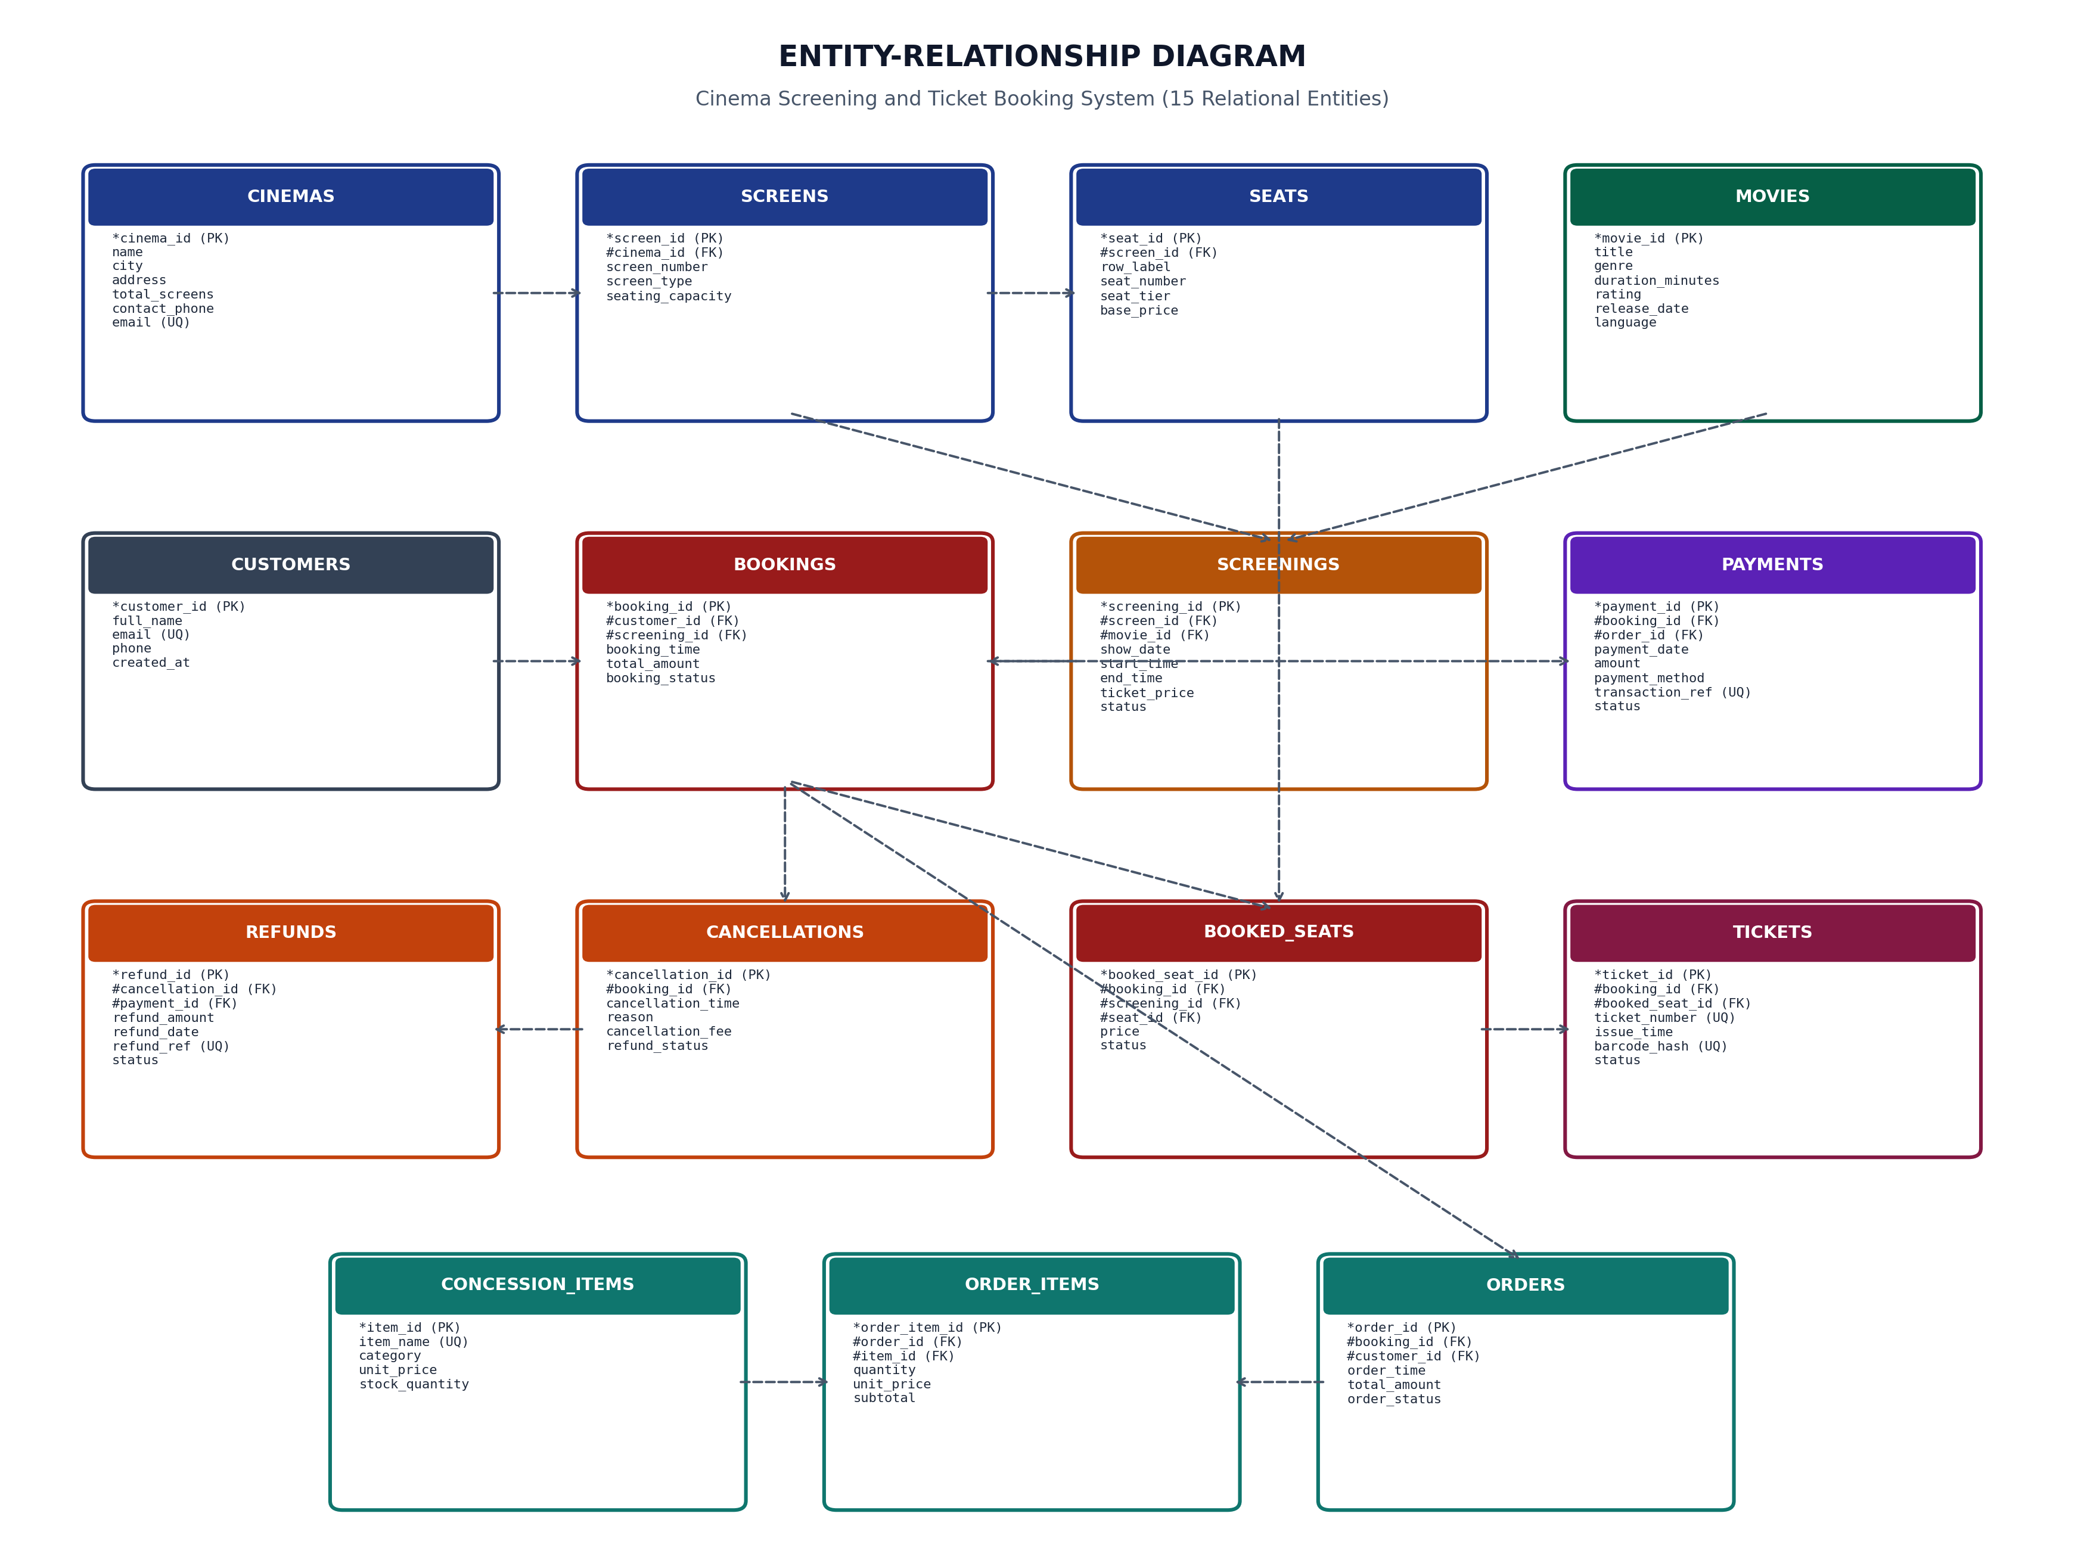
CONCEPTUAL MODELING
Entity-Relationship Diagram (15 Relational Entities & Relationships)
DBMS PBL Activity | Review 1: Proposal & Conceptual Modeling | G. Abhinav (WU0102089)

Slide 6
REVIEW 1 ACCOMPLISHMENTS
Project Milestones Achieved & Readiness for Logical Design
Conceptual Model Complete
Core Business Rules Formalized
Readiness for Review 2
• 15 Core Entities: Comprehensive modeling of all physical, transactional, and audit entities.
• Verified Cardinalities: Established 1:N theater-to-screen, 1:N screen-to-seat, 1:1 seat-to-ticket, and 1:1 booking-to-cancellation links.
• Zero Ambiguity: All primary keys, foreign keys, and unique domain constraints identified.
• Zero Double-Booking: Defined partial unique index requirement on active seat bookings.
• 15-Min Turnaround Buffer: Formulated time overlap condition preventing auditorium schedule collisions.
• Inventory Safeguards: Specified automatic inventory decrement and positive stock constraints.
• Refund Ceilings: Established rule that cumulative refunds cannot exceed payment amount.
• Relational Mapping: Ready to transform conceptual ER entities into formal 3NF relational tables.
• Functional Dependencies: All determinant-dependent attribute mappings documented for normalization.
• SQL DDL Formulation: Full ANSI-SQL schema with tables, triggers, and analytical views prepared.
DBMS PBL Activity | Review 1: Proposal & Conceptual Modeling | G. Abhinav (WU0102089)

Slide 7
THANK YOU
Review 1 Completed: Conceptual Model and ER Architecture Formulated.
Questions & Faculty Evaluation | Prof. Sahithi, School of Technology

