Slide 1
WOXSEN UNIVERSITY | SCHOOL OF TECHNOLOGY
REVIEW 3 — FINAL WORKING PROTOTYPE & IMPLEMENTATION
Cinema Screening and Ticket Booking System
Review 3: Final Working Prototype, Live Demo, Testing Suite & Executive Reports
Student: G. Abhinav | Roll No: WU0102089 | Section: AIML Rhinos (Batch 2025–2029)
Course: Database Management Systems (DBMS) — PBL Activity | Faculty Guide: Prof. Sahithi
Program: B.Tech in Computer Science and Engineering (AI & ML) | Academic Year: 2026–2027

Slide 2
SYSTEM ARCHITECTURE
Three-Tier Software Architecture & Integrated Tech Stack
Presentation Tier (CLI)
Application Logic Tier (Python)
Persistence Tier (SQLite RDBMS)
• Interactive Terminal Interface: Terminal console offering 9 interactive operational choices with colored status cues.
• Dynamic 2D Seat Matrix: Real-time visual auditorium seat matrix displaying seat numbers, tiers, and availability.
• Cross-Platform Launchers: Provided run_app.bat (Windows 1-click launcher) and run_app.sh (Linux/macOS terminal script).
• Standard PEP 249 DB-API: Standard library sqlite3 connector using parameterized SQL queries to prevent SQL injection.
• Cryptographic Generator: Python hashlib producing verifiable SHA-256 digital security ticket hashes.
• Transaction Controller: Coordinates multi-table ACID transaction boundaries across reservations and orders.
• ANSI SQL Relational Engine: Zero-configuration embedded database enforcing foreign keys, check constraints, and triggers.
• Self-Healing Database: Auto-initializes schema and populates seed data if database is missing or empty.
• Pre-Compiled Views: 6 optimized SQL reporting views computing live occupancy, box office, and net revenue.
DBMS PBL Activity | Review 3: Final Working Prototype & Demo | G. Abhinav (WU0102089)

Slide 3
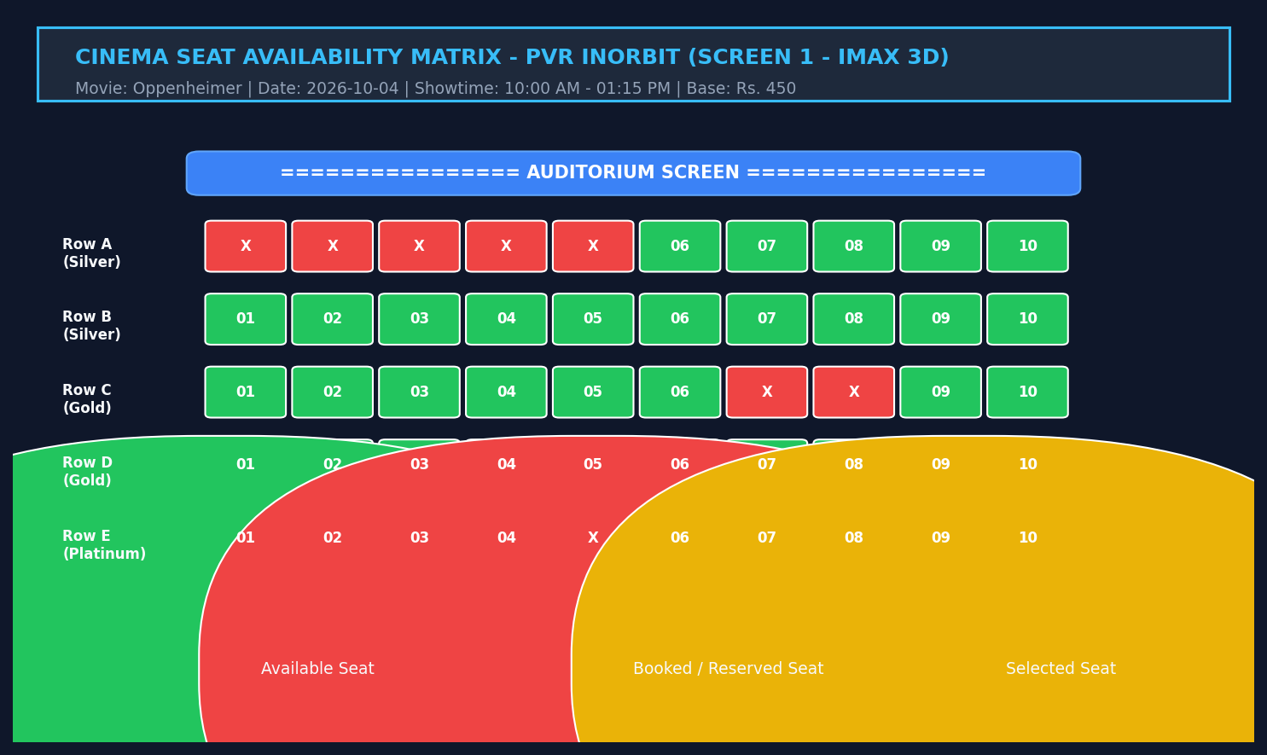
OPERATIONAL WORKFLOW 1
Master Show Catalog & Live 2D Auditorium Seating Matrix
Show Scheduling & Visual Seat Map
• Real-Time Catalog (Option 1): Queries screenings joined with cinemas, screens, and movies, showing format, date, time, and price.
• Non-Overlapping Schedules: Guaranteed collision-free showtimes enforced by the 15-minute turnaround buffer trigger.
• Visual 2D Seat Matrix (Option 2): Renders rows A through E with Silver (Rs.300), Gold (Rs.400), and Platinum (Rs.550) pricing.
• Instant Occupancy State: Displays [04] [05] for free seats and [X] for reserved seats dynamically queried from booked_seats.
DBMS PBL Activity | Review 3: Final Working Prototype & Demo | G. Abhinav (WU0102089)

Slide 4
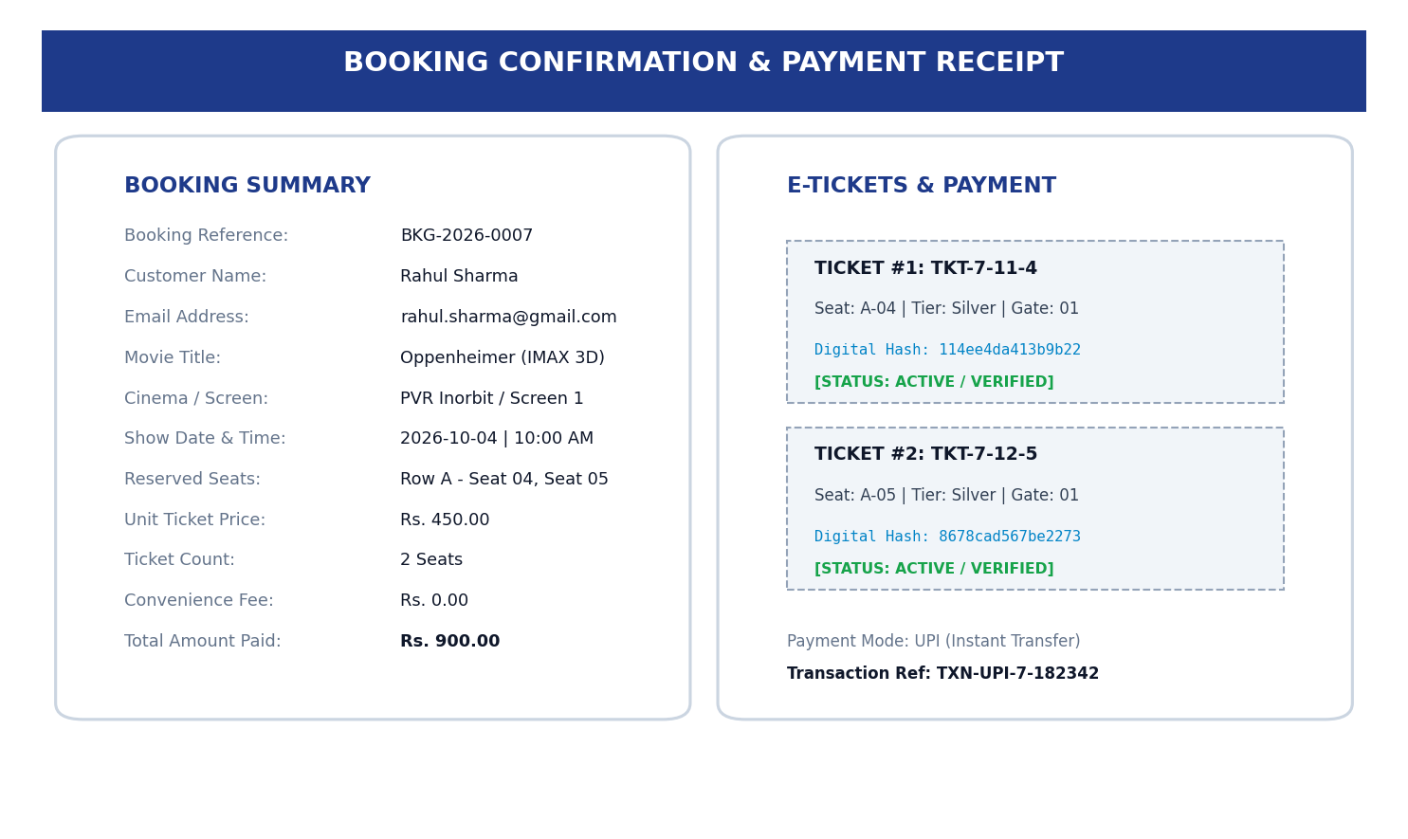
OPERATIONAL WORKFLOW 2
ACID Multi-Seat Booking Engine & Cryptographic E-Ticket Issuance
Atomic Booking & E-Ticket Security
• Multi-Seat Reservation (Option 3): User enters seat IDs (e.g. 15, 16); system checks collision against partial unique index.
• ACID Transaction Isolation: BEGIN TRANSACTION encapsulates booking header, seat rows, tickets, and payment ledger.
• Cryptographic Digital Hashing: Generates unique ticket numbers and 16-character SHA-256 digital hashes for turnstile validation.
• Payment Ledger Settlement: Records financial receipt across UPI, Credit/Debit Card, Net Banking, or Cash atomically.
DBMS PBL Activity | Review 3: Final Working Prototype & Demo | G. Abhinav (WU0102089)

Slide 5
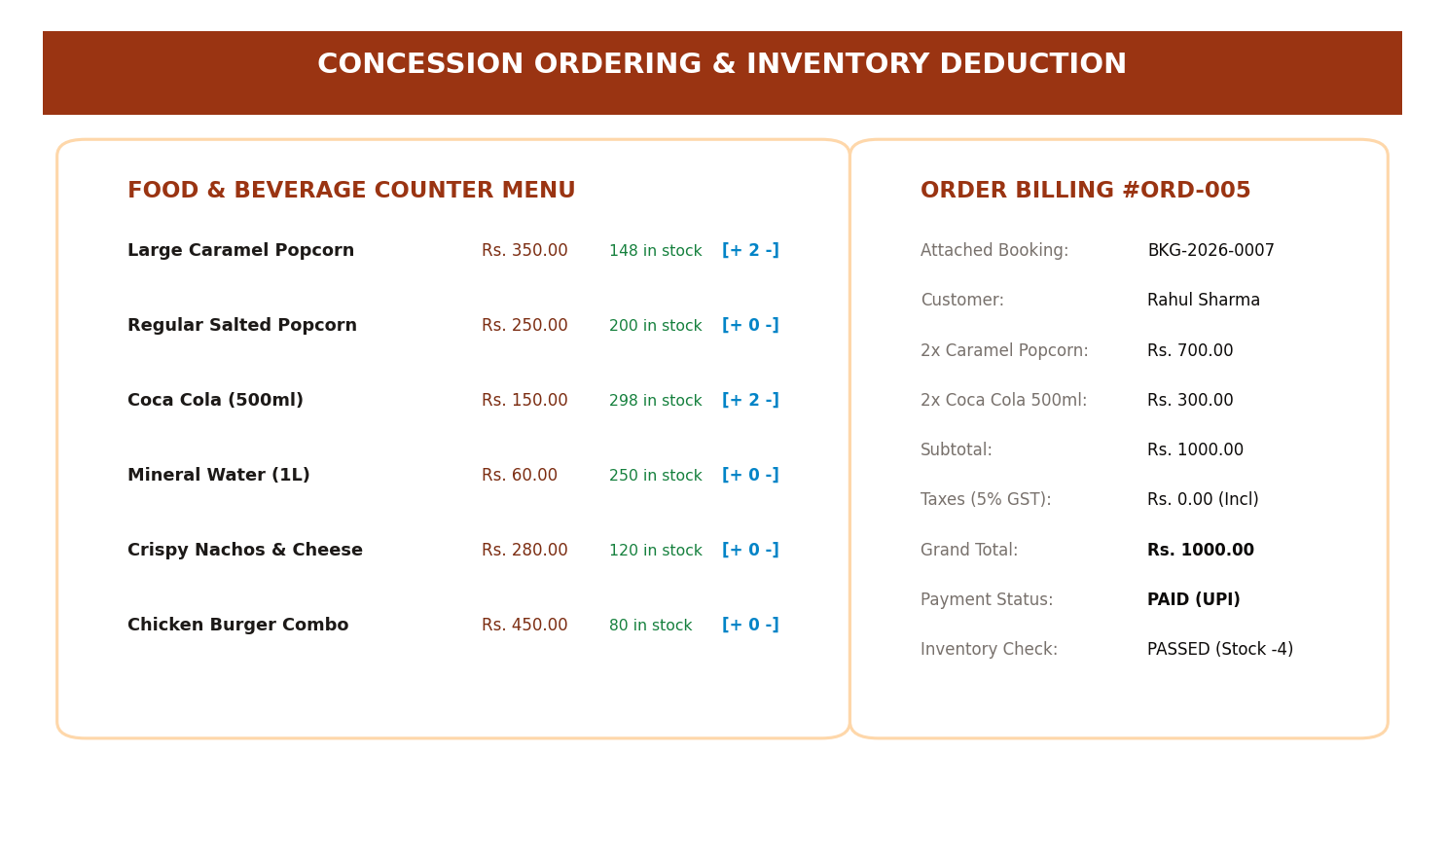
OPERATIONAL WORKFLOW 3
Concession Inventory Management & Policy-Compliant Cancellations
Retail & Cancellation Safeguards
• Live Stock Verification (Option 4): Validates snack inventory (Large Popcorn, Nachos, Coca Cola) prior to purchase confirmation.
• Automatic Stock Depletion: Atomically decrements stock_quantity upon order placement, preventing warehouse overselling.
• Pre-Showtime Cancellation (Option 5): Enforces that bookings can only be cancelled prior to movie screening commencement.
• 10% Administrative Fee & Limits: Retains 10% fee and disburses 90% refund, strictly governed by cumulative payment ceilings.
DBMS PBL Activity | Review 3: Final Working Prototype & Demo | G. Abhinav (WU0102089)

Slide 6
QUALITY ASSURANCE
Rigorous Verification: 10 Positive & Negative Test Cases (100% Pass)
Functional Workflow Tests (TC 01–05)
Integrity Constraint Tests (TC 06–10)
• TC-01 Show Scheduling: PASSED — Valid screening inserted into database; unique ID generated.
• TC-02 Overlap Rejection: PASSED — Trigger intercepts collision within 15-min turnaround buffer.
• TC-03 Seat Matrix Display: PASSED — Displays visual rows A–E with accurate occupancy symbols.
• TC-04 Double-Booking Lock: PASSED — Unique index aborts duplicate seat booking with transaction rollback.
• TC-05 Atomic Booking & Pay: PASSED — Booking header, 2 seats, 2 tickets, and payment committed atomically.
• TC-06 Concession Depletion: PASSED — Ordering 2x Popcorn decrements live stock from 150 to 148.
• TC-07 Negative Quantity Check: PASSED — CHECK constraint rejects quantity = -2 with rollback.
• TC-08 Refund Overflow Check: PASSED — Trigger rejects refund exceeding original payment.
• TC-09 Cancellation Execution: PASSED — Seats released; 10% fee retained; refund reference generated.
• TC-10 Executive Analytics: PASSED — Net operating revenue accurately computed across all theaters.
DBMS PBL Activity | Review 3: Final Working Prototype & Demo | G. Abhinav (WU0102089)

Slide 7
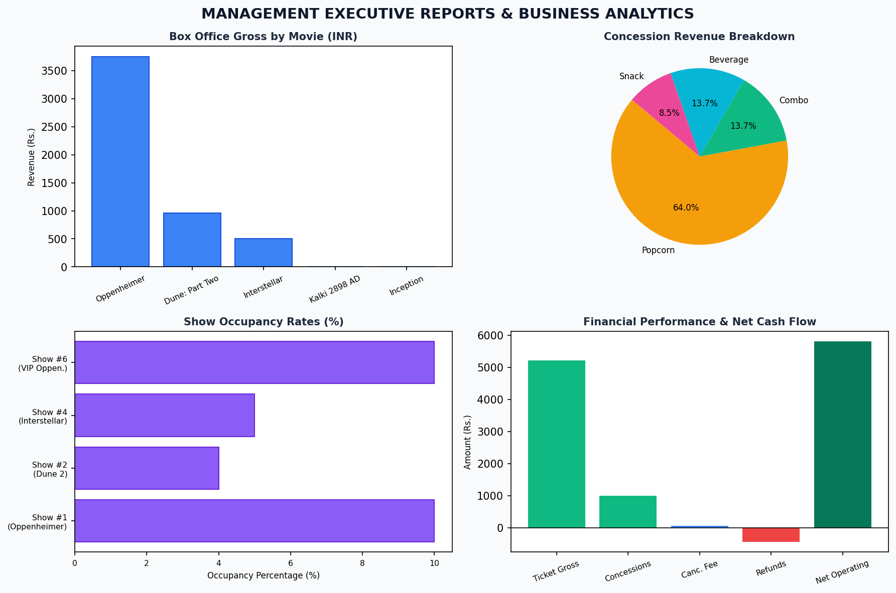
BUSINESS INTELLIGENCE
Executive Reporting Dashboards Powered by 6 Relational Views
Real-Time Executive Analytics
• View 1: Show Occupancy: Calculates booked seats, available capacity, and occupancy percentage per screening.
• View 2: Box Office Performance: Tracks tickets sold and cumulative gross ticket revenue per movie title.
• View 3: Screen Utilization: Computes total operational runtime hours and average screen capacity load.
• View 4: Concession Summary: Breaks down total units sold, remaining warehouse stock, and gross revenue by item.
• View 6: Net Operating Revenue: Computes Net Revenue = (Ticket Gross + Concessions + Retained Fees) - Refunds Disbursed.
DBMS PBL Activity | Review 3: Final Working Prototype & Demo | G. Abhinav (WU0102089)

Slide 8
ACADEMIC CONCLUSION
Project Achievements, Academic Takeaways & Future Roadmap
Key Academic Takeaways
Future Engineering Roadmap
• Rigorous Relational Design: Successfully translated complex multiplex workflows into 15 normalized 3NF entities.
• Database-Level Integrity: Proved that core business rules must be guarded by triggers and constraints rather than UI alone.
• Production Transaction Skills: Gained deep hands-on mastery of ACID transaction boundaries in Python with DB-API.
• Zero Error Verification: Achieved 100% test pass rate across positive and negative testing vectors.
• Dynamic Surge Pricing: Integrate machine learning demand forecasting to dynamically adjust prices by occupancy velocity.
• Distributed Cloud Scalability: Migrate to PostgreSQL with PgBouncer connection pooling and Redis seat locking for web scale.
• Live Payment Webhooks: Integrate production payment gateway webhooks (Razorpay / Stripe) for automated payment clearing.
• Mobile QR Code Scanning: Build mobile cashier app scanning SHA-256 e-ticket QR codes at physical turnstiles.
DBMS PBL Activity | Review 3: Final Working Prototype & Demo | G. Abhinav (WU0102089)

Slide 9
THANK YOU
Cinema Screening and Ticket Booking System Successfully Implemented.
Questions & Faculty Evaluation | Prof. Sahithi, School of Technology

