Slide 1


SEOUL RENTAL BIKE ANALYSIS
TEAM DATAHOLICS

Slide 2
DESCRIPTION
The given data is a record of rental bike usage in the city of Seoul for two consecutive years 2017 and 2018. Its also delves into various factors such as seasons, hours of the day, snowfall, rainfall, temperatures and humidity.
This data can be useful for rental bike businesses to predict the hours of supply demand.
Furthermore, the dataset is instrumental for optimizing last-mile connectivity in regions characterized by narrower passages, such as hillside terrains, thereby contributing to enhanced urban mobility.

Slide 3
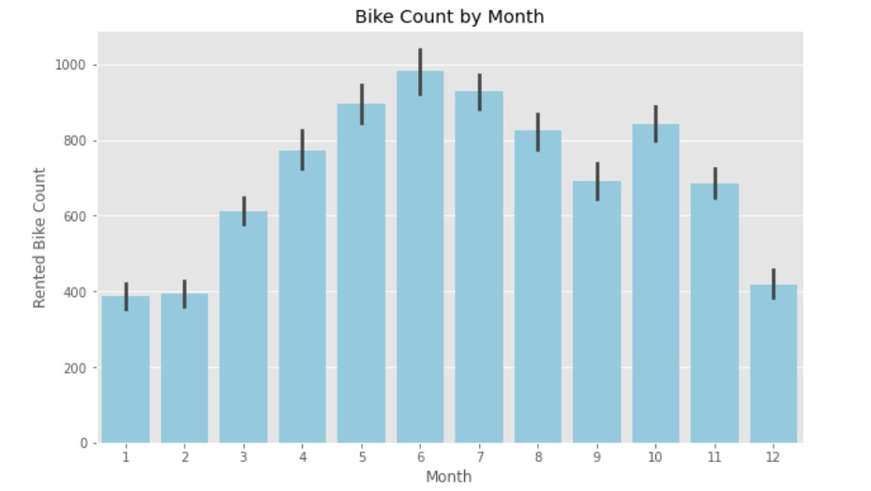
MONTHLY ANALYSIS
it is observed that the highest no of bike rentals is recorded in the month of june followed by july
and the lowest rentals are recorded during the months of january and february
Inference

Slide 4
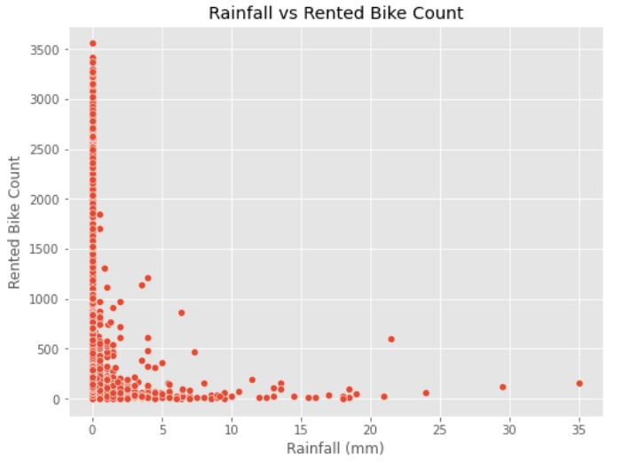
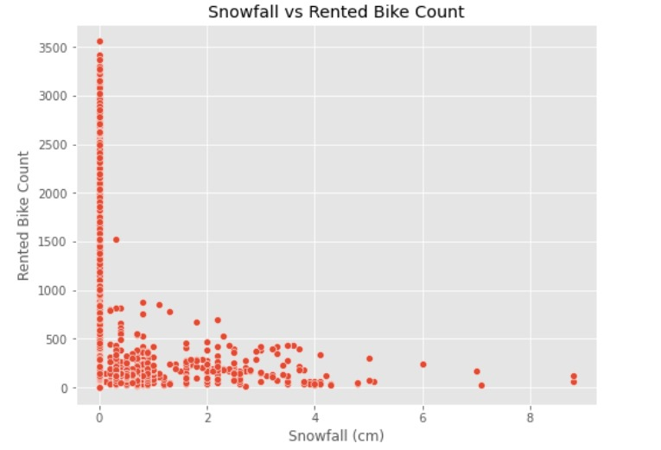
OBSRVATIONS BASED ON SNOWFALL AND RAINFALL
it is observed that the highest no of bike rentals is recorded in the month of june followed by july
and the lowest rentals are recorded during the months of january and february
Inference

Slide 5
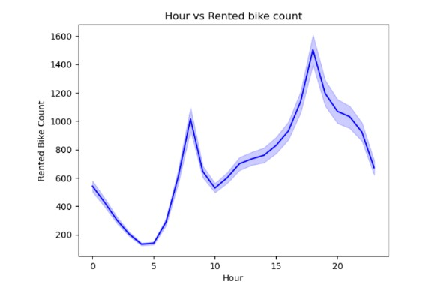
HOURLY RENTAL ANALYSIS
Inference
Tthe most preferred hours for biking are observed to be in the later parts of the day. 6pm is the hour of highest activity. Early mornings are the period of lowest activity.

Slide 6
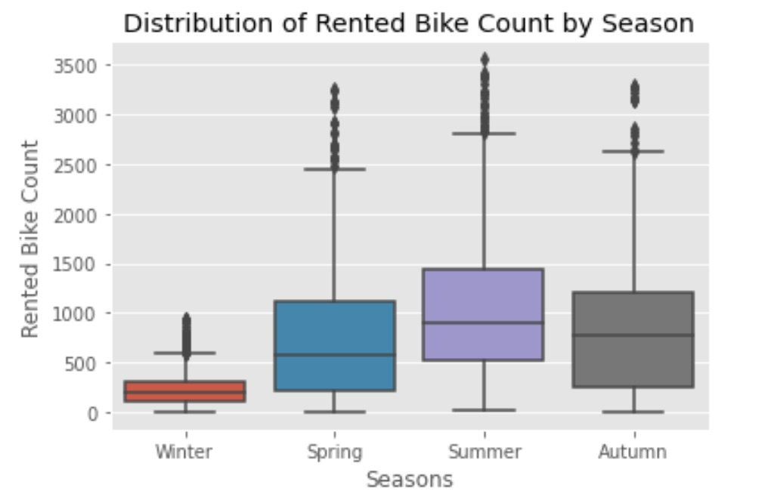
ANALYSIS BASED ON SEASONS
Inference
Summer accounts for the most no of rentals followed by autumn. Winter is the least preferred season

Slide 7
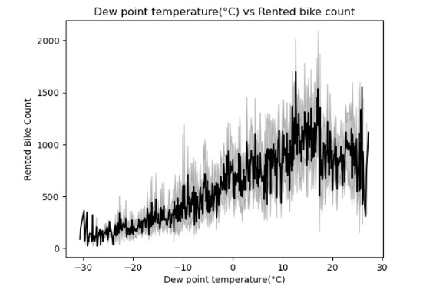
ANALYSIS BASED ON DEW TEMPERATURE
Inference
Bikers prefer dew temperatures around 10-20 Celsius the most

Slide 8
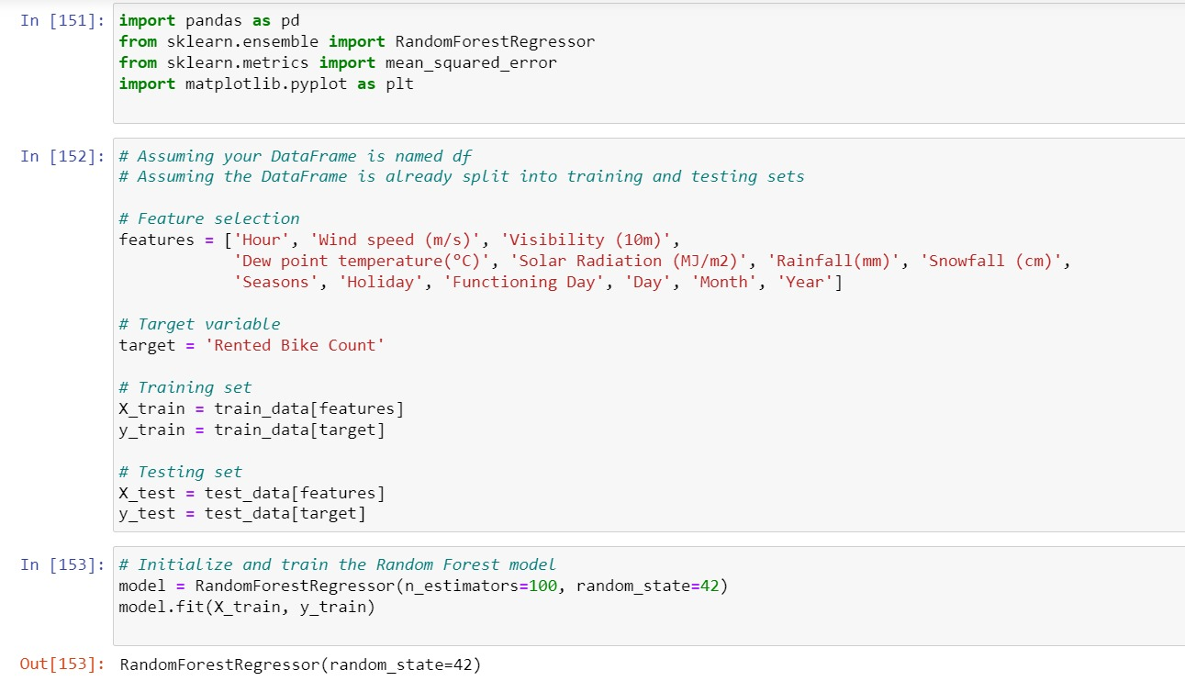
MODEL PREDICTION USING RANDOM TREE REGRESSOR

Slide 9
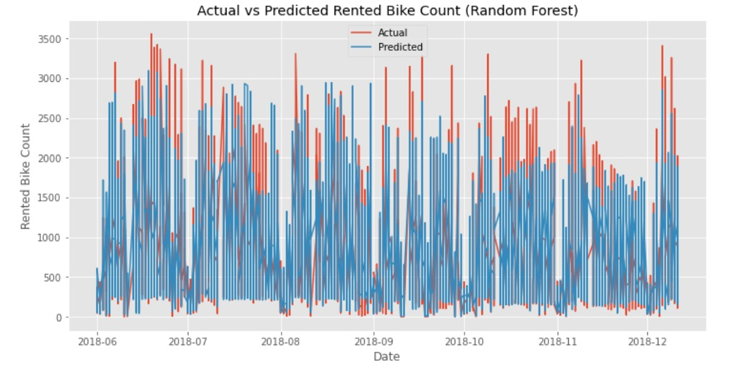
MODEL PREDICTION USING RANDOM TREE REGRESSOR

Slide 10
THANK YOU

