Slide 1
TCS iON INDUSTRY PROJECT · AIP 135
A Neural Network Approach to
Analyse Customer Metrics
& Predict Buying Trends
Abhinav M (31250837)
F.Y M.Sc – Statistics Data Science
Under Mentorship of Dr. Raeesa Bashir
Vishwakarma University, Pune · AY 2025–26

Slide 2
Introduction & Problem Statement
Background
Our Solution
Retail industry generates vast customer data, yet most businesses still rely on outdated rule-based segmentation.
AI and Machine Learning now enable intelligent, scalable customer behaviour prediction — offering a decisive competitive edge.
Build an MLP Neural Network using PySpark to classify customers as:
🟢 High Spender
🟡 Medium Spender
🔴 Low Spender
Enabling targeted marketing, personalised offers, and optimised inventory planning.
Problem Statement
Difficulty identifying High-Value customers accurately
Inefficient marketing budget allocation
Unclear which attributes drive buying behaviour
Promotions failing to deliver expected ROI

Slide 3
Project Objectives
Design & implement an MLP Neural Network using PySpark MLlib for multi-class spending level classification
Perform in-depth EDA to uncover hidden patterns between customer metrics and purchasing behaviour
01
02
Identify most influential features through feature engineering and model evaluation
Evaluate model using Accuracy, F1 Score, Weighted Precision & Recall
03
04
Demonstrate model deployment with real-time inference on new customer data
Derive actionable business insights and strategic recommendations for retail organizations
05
06

Slide 4
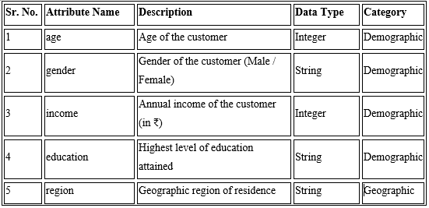
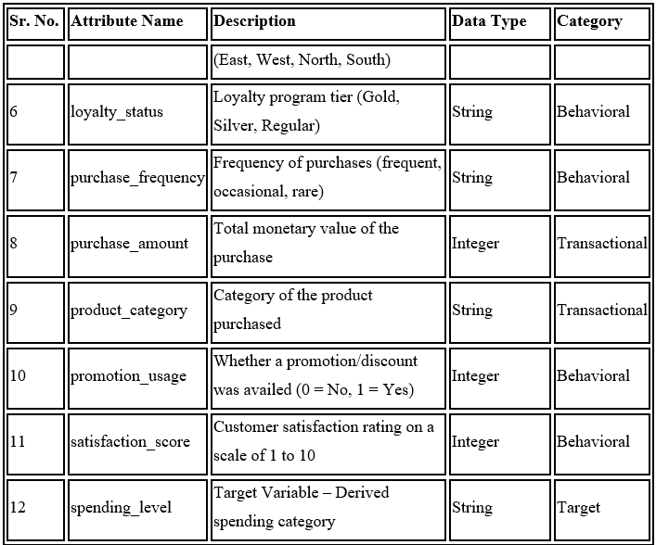
Dataset Description
100,000
11
3
Kaggle
Total Records
Feature Columns
Target Classes
Data Source

Slide 5
EDA — Class Distribution & Demographic Insights
49.15%
Largest segment — 49,149 customers
Medium Spender
25.82%
25,817 high-value customers
High Spender
25.03%
25,034 budget customers
Low Spender
Key Insight:
The dataset is moderately balanced with no extreme class dominance. Income and gender individually show weak separation between spending tiers — confirming that multi-feature neural network modelling is essential.

Slide 6
EDA — Product Trends & Regional Revenue
Regional Revenue Contribution
East
₹289.2M
31.2% of total
West
₹288.0M
31.1% of total
South
₹193.7M
20.9% of total
North
~₹155M
16.8% of total
Key Insight:
Electronics leads in volume (30,027 purchases) but Beauty & Food lead in avg revenue per sale (₹9,721 & ₹9,670). East & West regions drive ~62% of total revenue.

Slide 7
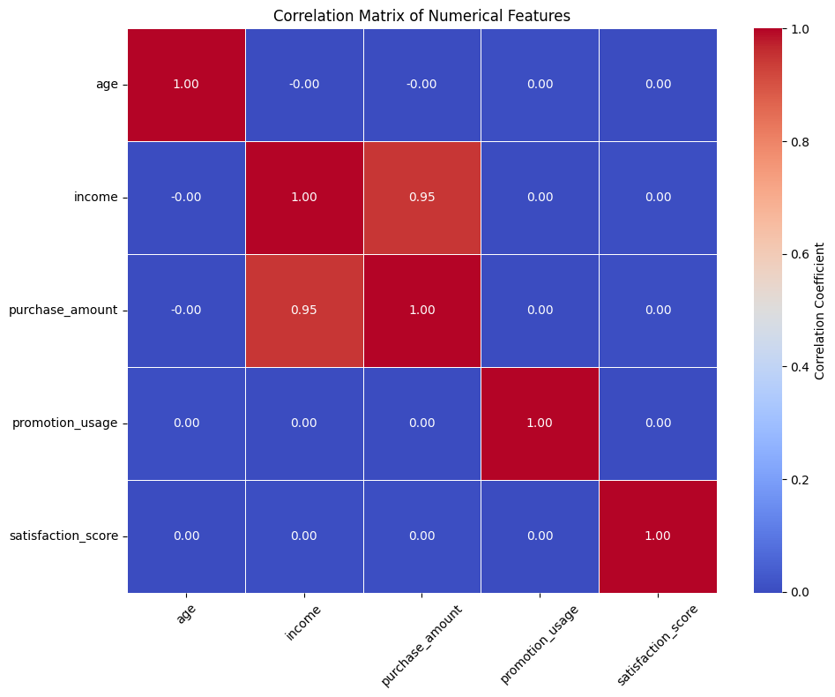
EDA — Feature Correlation & Scatter Analysis
Income vs Purchase
Age vs Purchase
All spending tiers spread uniformly — income is NOT a clean separator
No age-based clustering — age alone is a weak predictor
Satisfaction vs Purchase
Promotion vs Purchase
Flat distribution confirms correlation = 0.0034 (negligible)
Both promo & non-promo buyers appear at all spending tiers
Correlation Matrix — Numerical Features
Scatter Analysis Summary
Key Insight:
Near-zero correlations confirm no single feature drives spending level — a multi-dimensional, non-linear model like MLP is the correct choice.

Slide 8
Methodology & Feature Engineering
1
2
3
4
5
6
Data
Ingestion
Cleaning
& EDA
Feature
Engineering
Feature
Scaling
Model
Training
Evaluation
& Deploy
CSV → PySpark DataFrame
100,000 records
0 nulls · Drop id · Derive target variable
StringIndexer → OneHotEncoder → VectorAssembler
StandardScaler applied to all 27 features
MLP Classifier · 80/20 split · seed=42
Accuracy · F1 · Precision · Recall · Inference
Feature Engineering Details
Categorical (6 cols): gender, education, region, loyalty_status, purchase_frequency, product_category → StringIndexer + OneHotEncoder
Numerical (4 cols):
age, income, promotion_usage, satisfaction_score → retained as-is
Final Feature Vector:
27 dimensions via VectorAssembler → StandardScaler normalization

Slide 9
Model Architecture — Multilayer Perceptron
27
128
64
32
3
neurons
neurons
neurons
neurons
neurons
Input Layer
Hidden Layer 1
Hidden Layer 2
Hidden Layer 3
Output Layer
Features
ReLU
ReLU
ReLU
Softmax
Training Configuration
200
0.05
256
80% / 20%
42
StandardScaler
Max Iterations
Learning Rate
Block Size
Train / Test Split
Random Seed
Feature Scaling
Architecture: [ 27 → 128 → 64 → 32 → 3 ]

Slide 10
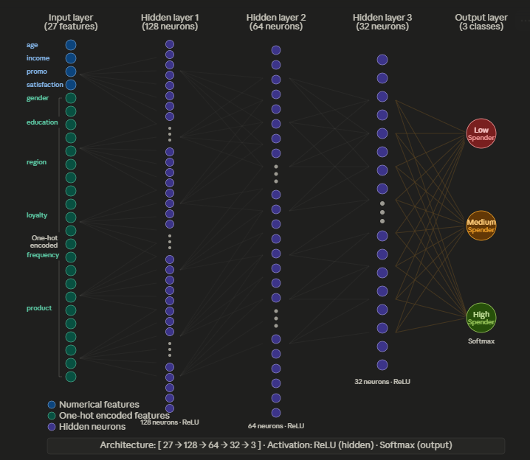
Model Architecture — Multilayer Perceptron

Slide 11
Hyperparameter Tuning & Experimentation
Exp 1 50.46%
[27, 64, 32, 3] | No Scaling
Baseline model — random-level performance
Exp 2 50.46%
[27, 128, 64, 32, 3] | No Scaling
Deeper network — no improvement without scaling
Exp 3 ✓ 85.94%
[27, 128, 64, 32, 3] | StandardScaler
Scaling applied — dramatic breakthrough!
🚀 Feature Scaling (StandardScaler) alone improved accuracy from 50.46% → 85.94% — a 35.5 percentage point jump!

Slide 12
Final Model Results
85.94%
85.99%
86.02%
85.94%
Test Accuracy
F1 Score
Weighted Precision
Weighted Recall
Confusion Matrix Insights
High Spenders correctly identified with strong precision
Medium Spenders — largest class — well classified
Low Spenders show balanced precision & recall
Model shows no bias toward any single class
Consistency between Precision & Recall confirms robust generalization
The model demonstrates strong generalization capability — consistent metrics confirm suitability for real-world deployment

Slide 13
Key Business Insights
🛒 Electronics Dominates
💄 Beauty & Food = High Value
🗺️ East & West Lead Revenue
30,027 purchases — top category by volume. Inventory & promotions should prioritise this segment.
Despite lower volume, Beauty (₹9,721) & Food (₹9,670) generate highest avg revenue per sale.
Together contribute ~62% of total revenue. South region has untapped growth potential.
🎯 Promotions Need Re-targeting
🏅 Loyalty Tier Needs Rethink
😊 Satisfaction ≠ Spending
Average spend difference: only ₹12 between promo vs no-promo. Blanket campaigns deliver poor ROI.
Regular customers (₹9,640 avg) marginally outspend Gold (₹9,621). Loyalty programme needs recalibration.
Correlation = 0.0034. Satisfaction alone does not drive revenue — multi-factor targeting is required.
These insights, combined with MLP predictions, enable targeted marketing, optimised promotions, and personalised customer experiences.

Slide 14
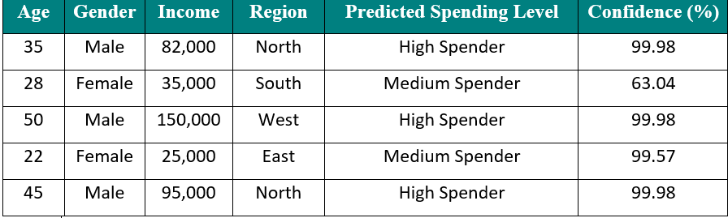
Model Deployment & Inference
1
2
3
4
Model Saved
Model Loaded
New Customers
Predictions
Trained MLP saved to disk using Spark's native format for reuse without retraining
Saved model reloaded and pipeline reconstructed for inference on new data
5 synthetic customer profiles created with realistic demographics & behaviour
Model outputs: Predicted spending class + probability distribution per class
Sample Inference Results (5 New Customers)

Slide 15
Conclusion & Future Scope
Conclusion
Future Scope
MLP Neural Network achieved 85.94% accuracy classifying customers into Low, Medium, and High Spenders
Feature Scaling (StandardScaler) was the single most impactful improvement — lifting accuracy by 35.5pp
End-to-end PySpark pipeline proven scalable for 100,000+ records
EDA and Business Intelligence reveal actionable segmentation insights beyond model predictions
Deployed model successfully generates predictions with class-level probability confidence on new data
Incorporate time-based purchase patterns and customer interaction history for richer feature sets
Explore RNN / LSTM architectures for sequential purchase behaviour modelling
Implement automated hyperparameter tuning and cross-validation
Integrate with CRM systems for real-time personalized customer engagement
Deploy as a REST API / web service for live business use
This project demonstrates a complete end-to-end AI pipeline — from raw retail data to deployed intelligence.

Slide 16
Thank You
Questions & Discussion
85.94%
85.99%
100K
27
Accuracy
F1 Score
Records
Features
Abhinav M · 31250837 · TCS iON AIP 135 · Vishwakarma University, Pune · AY 2025–26

