Slide 1
Does Timing Matter?
Temporal signals and time-robustness in AI detection of mental-health risk from Reddit posts
Group 2 · COMP 8790 Topics in Applied AI · Phase I
Notes:
Introduce the team and the question. One sentence: we tested whether a claim in a recent paper, that adding posting time helps classify mental-health posts, holds up.

Slide 2
A paper says timing helps. We checked.
The claim
Our question
0.7222
0.7376
Do posting-time features improve classification over a strong text-only model?
How much does each method lose when trained on earlier posts and tested on later ones?
text only
text + time
Weighted F1 from one run of a BiLSTM. No transformer baseline, no released code.
Notes:
Anchor paper: Saeed and Ahmed 2025. They add hour, weekday and month to a BiLSTM and report weighted F1 0.7222 to 0.7376. One run, no strong baseline, no code. Our question has two parts: does timing help against a strong text model, and what is lost when a model trained on earlier posts is tested on later ones.

Slide 3
The data, and what we removed first
701,787
1
Subreddit mentions
r/depression, "this sub" removed
2
Cross-posts
raw Reddit posts
same text under two labels dropped
3
Duplicates
483,715
exact and near copies dropped
4
Stratified sample
clean posts, 2021 to 2022
by class and month, 60k per replicate
5
Fit on train only
vectoriser, scaler, tuning
Notes:
701,787 Kaggle posts from six subreddits. We removed things that let a model read the label instead of learning language: mentions of the subreddit name, texts that appear under two labels, and duplicates. The Kaggle file has no author column, so same-user leakage can only be checked on the Zenodo data.

Slide 4
Do leakage removal and stratification matter?
Leakage control (macro F1, 5 replicates)
Sampling (scored on a common test set)
Variant | Reported | On clean posts
full cleaning | 0.620 | 0.620
keep duplicates and cross-posts | 0.621 | 0.621
keep subreddit mentions | 0.624 | 0.624
no leakage control | 0.620 | 0.619
Sample | Macro F1
class balanced | 0.607
label x month stratified | 0.623
plain random | 0.624
Both are cheap insurance, not score boosters. Leakage is rare here (about 3% of posts), so scores barely move (0.620 to 0.624, within noise). Stratified and plain random samples match at 20k posts, and a class-balanced sample scores lower on the real class mix.
Notes:
We measured both with the TF-IDF model on 20,000 posts and 5 replicates. Leakage: reported score on its own test set versus score on posts that are clean by every criterion. Stratification: all samples scored on one common reference test set drawn at random from the full clean data.

Slide 5
Three methods, same data and splits
A
B
C
TF-IDF + logistic regression
MentalRoBERTa
BiLSTM + cross-modal attention
Counts words and word pairs. Fast, a strong baseline.
Pretrained on mental-health Reddit, fine-tuned on our data (Colab GPU).
The anchor paper's model, rebuilt from its equations.
Each trained text-only and text + time, on a random split and on a later-period test (Aug to Nov 2022). Five replicates, paired bootstrap intervals.
Notes:
A is the classical baseline, B is the strong pretrained model, C is the anchor paper's model rebuilt from its equations because no code was released. Every model is trained with text only and with text plus time so the only difference is the time features.

Slide 6
Better text model helps. Timing does not.
Gain from time
A -0.015
95% CI -0.018 to -0.013
B -0.002
95% CI -0.005 to 0.001
C +0.006
95% CI 0.002 to 0.010
Notes:
Macro F1 on the later-period test, text only versus text plus time. The step from A to B is about four points. The step from adding time is under one point in every case.

Slide 7
Does timing help? Almost never
Model | Random split | Same-size random | Later period
A TF-IDF + LR | +0.001 [-0.001, 0.003] | -0.003 [-0.006, -0.000] | -0.015 [-0.018, -0.013]
B MentalRoBERTa | not run | +0.000 [-0.003, 0.003] | -0.002 [-0.005, 0.001]
C BiLSTM | -0.001 [-0.005, 0.004] | +0.005 [0.001, 0.009] | +0.006 [0.002, 0.010]
Change in macro F1 from adding time features, 95% bootstrap interval. Shaded orange = significantly worse, green = significantly better.
Time alone predicts at chance level (0.15 vs 0.145 random guess).
Notes:
Change in macro F1 when time features are added, with a 95 percent paired bootstrap interval. Orange is a significant drop. The only significant gains are for the weak BiLSTM and they are about half a point. The anchor paper's 0.015 gain is not reproduced. Time alone scores at chance, 0.15 against a random guess of 0.145.

Slide 8
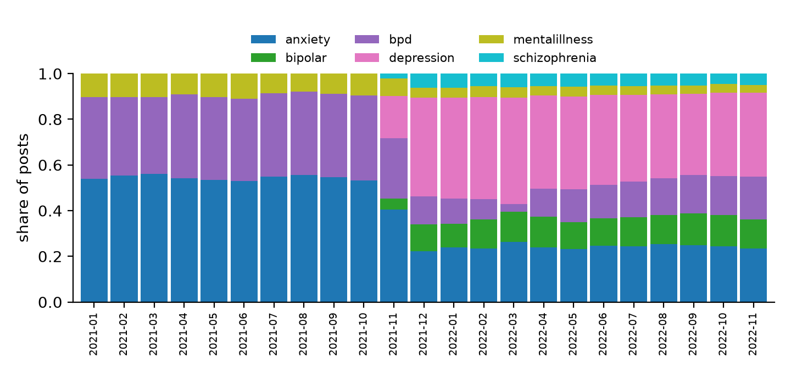
Later posts cost nothing
Later vs same-size random
A -0.001
95% CI -0.007 to 0.006, includes 0
B +0.008
95% CI -0.001 to 0.017, includes 0
C -0.001
Three classes only exist from Nov 2021
95% CI -0.007 to 0.005, includes 0
The paper's 2021 to 2022 split is confounded: Method A with time falls to 0.25, and to 0.54 without month and day.
Notes:
Training on Nov 2021 to Jun 2022 and testing on Aug to Nov 2022 scores the same as a random split of the same size. The shift effect is about minus 0.001 with an interval of roughly plus or minus 0.007. The anchor paper's 2021 to 2022 split is confounded: depression, bipolar and schizophrenia posts essentially start in Nov 2021 in this file, so that split measures a collection change, not language drift.

Slide 9
What we found
1
Timing is not a reliable signal.
No gain for the strongest models, a small loss for TF-IDF under shift.
2
Model choice matters more.
A pretrained mental-health model beats TF-IDF by about four points.
3
Later posts are not harder here.
Within Nov 2021 to Nov 2022, no measurable drop.
4
The paper's split is confounded.
Class mix changes with the collection date.
Notes:
Be honest about limits on this slide: labels are subreddits not diagnoses, condition names stay in the text, no author column in the Kaggle file, our BiLSTM is a rebuild, the valid shift window is only nine months, Method B uses a 20k subsample.

Slide 10
Limits, and what comes next
Limits
Next: Phase II
Labels are subreddits, not diagnoses
Condition names stay in the text
No author column, same-user leakage unchecked on Kaggle
Method C is our rebuild, B uses a 20k subsample
Shift window is about nine months
Moderator triage assistant using the strongest text model
Explanations for each flag
Ethics and safety report
A human always makes the final call
Notes:
Limits are on the left. Phase II is a moderator triage assistant that uses the best model, with an ethics plan. Xing Liao leads the interface, explanations and ethics report.

