Slide 1
Botnet detection using neural networks
- ABHINAY BIR ( P24CS016 )

Slide 2
What is Botnet?
Definition: are malware-controlled networks that exploit unknown or unpatched vulnerabilities in Android devices.
These botnets:
Secretly infect Android devices
Can steal data, send spam, or perform DDoS attacks
Are hard to detect using traditional methods

Slide 3
Problem Statement
Android devices are widely used across domains like banking, healthcare, and entertainment.
The open-source nature of Android makes it a major target for attackers.
Android botnets pose a significant threat by allowing remote control for malicious activities.
Botnets are difficult to detect as they involve new, unseen attack patterns.
Traditional detection methods are not effective against these evolving threats.
There is a need for a robust neural network-based solution that can detect zero-day Android botnets using permission-based features.

Slide 4
Dataset Overview
Total Samples: 3,458 Android applications
Benign Apps: 1,729
Botnet Apps: 1,729
Features: 455 permission-based features extracted from each app's manifest file
Label: Each sample is labeled as either benign or botnet
This balanced dataset provides a solid foundation for training and evaluating machine learning models, particularly in distinguishing between benign applications and those infected with botnets.

Slide 5
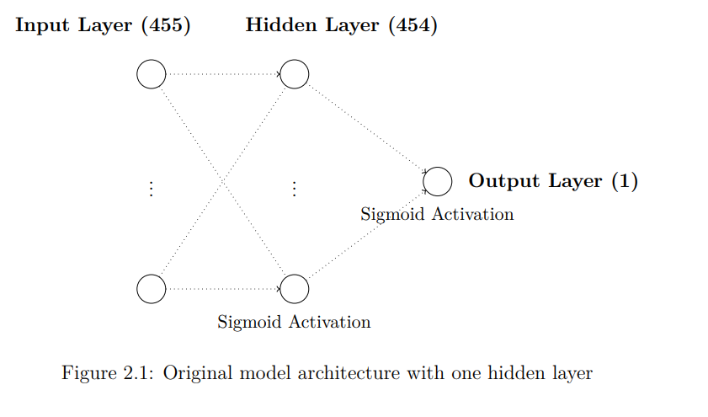
Implementation of Original Architecture

Slide 6
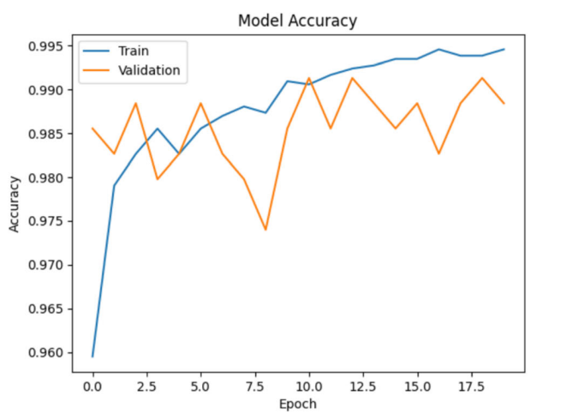
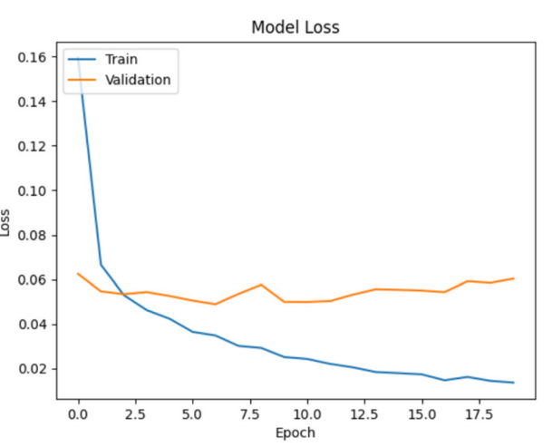
Training and Validation Curve ( mentioned in the paper)
n

Slide 7
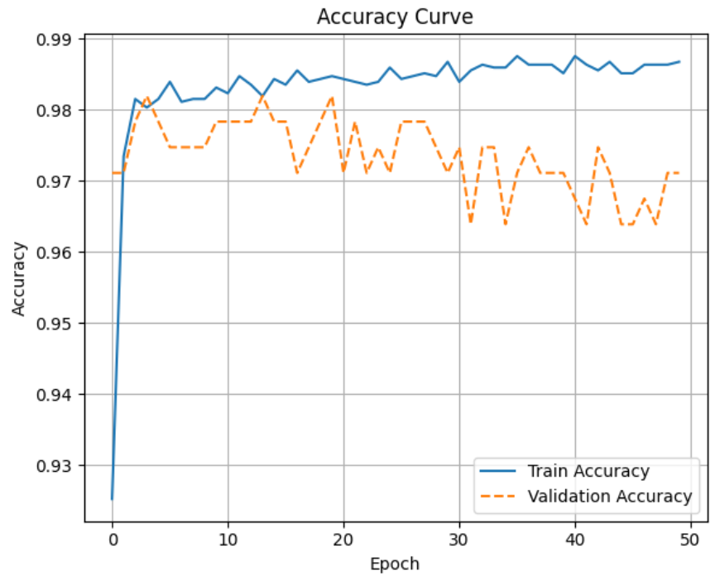
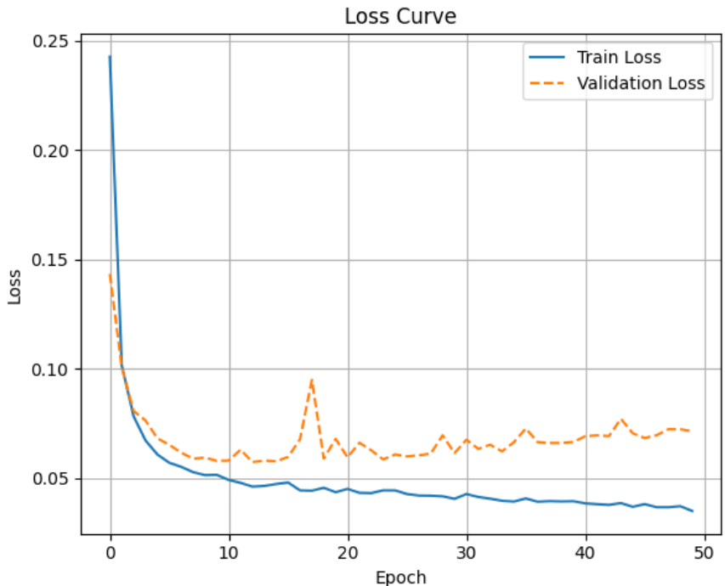
Training and Validation Curve (of implemented original mode, accuracy = 97.54%)
n

Slide 8
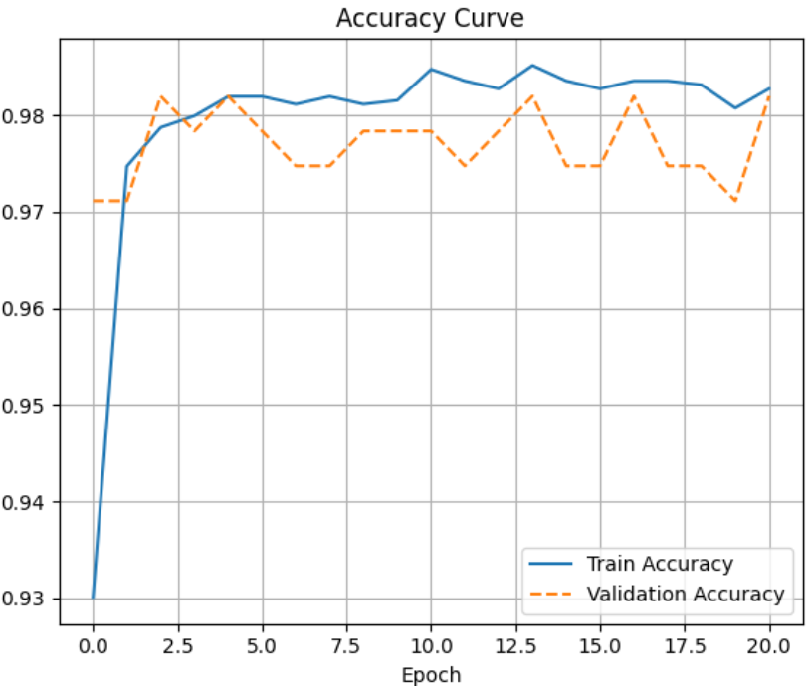
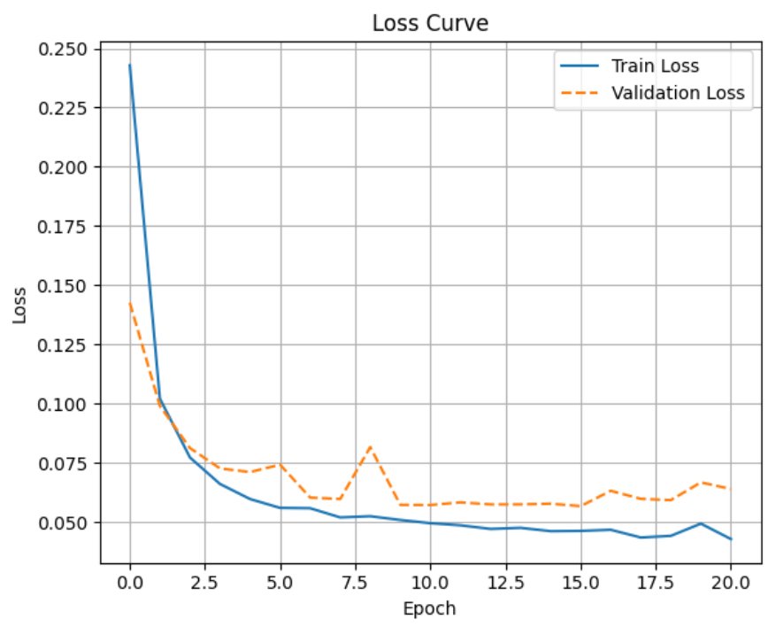
Overfitting Avoidance Techniques: Early Stopping (Test Accuracy : 97.69%)
n

Slide 9
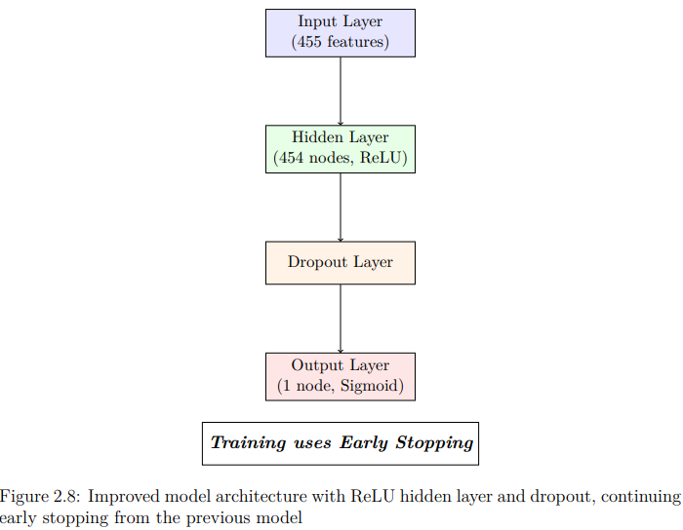
Overfitting Avoidance Technique: Adding a Dropout Layer

Slide 10
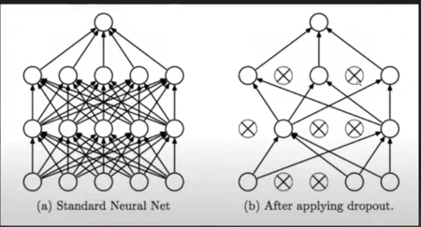

Slide 11
Experimenting with different values of p i.e dropout ratio p = 0.5 i.e 50% of nodes will be dropped

Slide 12
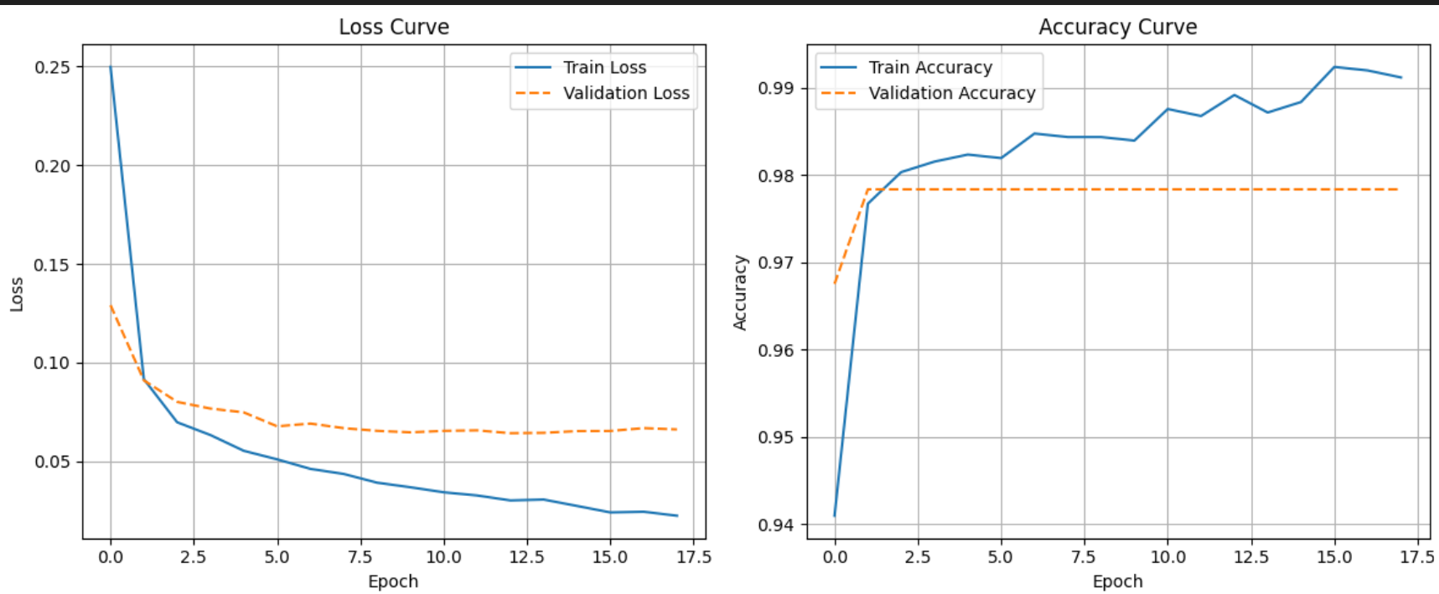
For p = 0.5
Test Accuracy: 97.83%

Slide 13
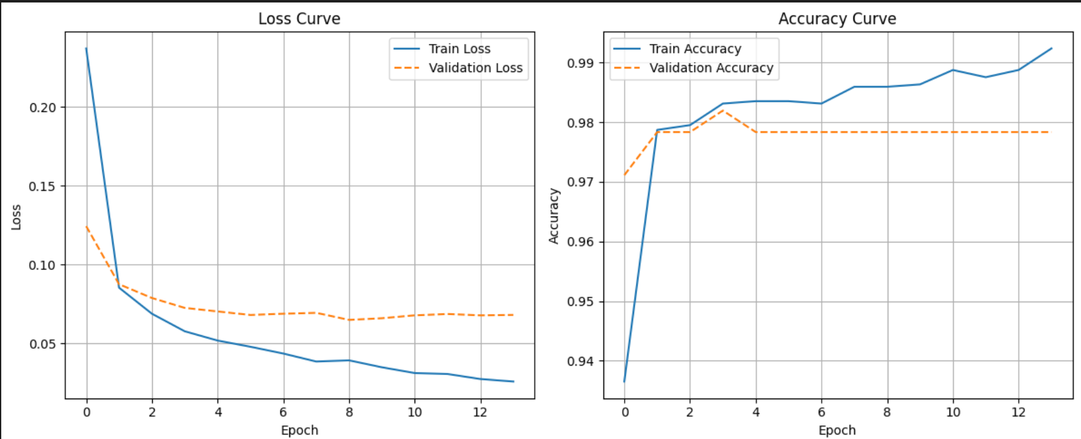
For p = 0.4 ( most optimum value of p)
Test Accuracy: 97.98%

Slide 14
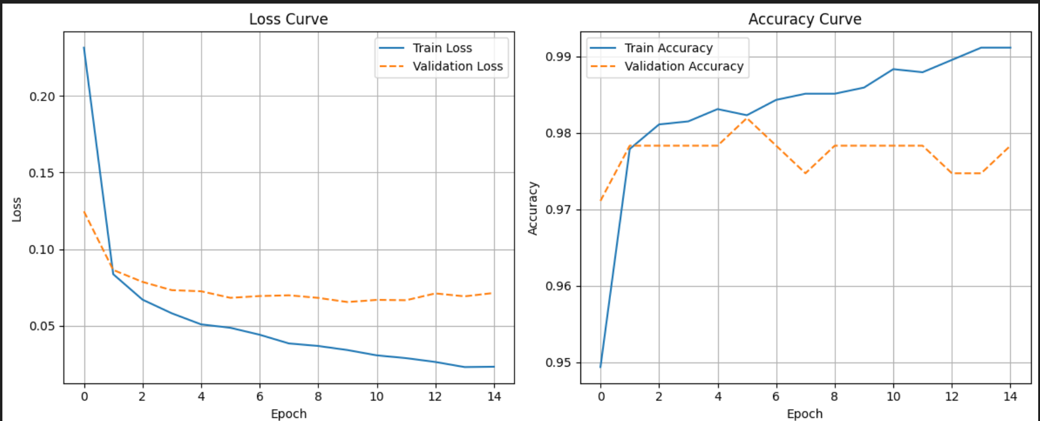
For p = 0.3
Test Accuracy: 97.98%

Slide 15
For p = 0.3
Test Accuracy: 97.98%

Slide 16
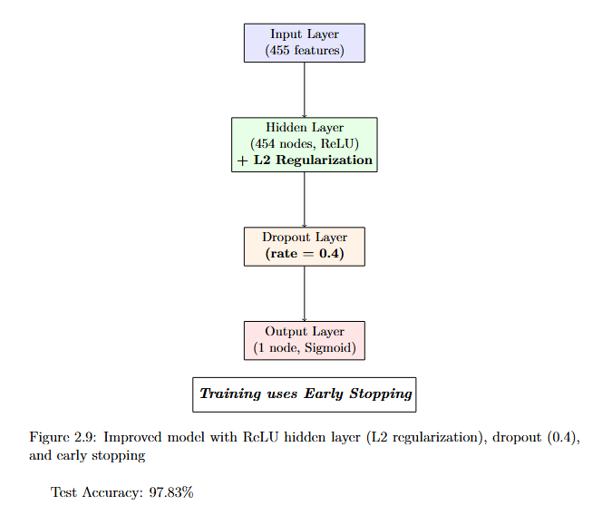
Overfitting Avoidance Technique: L2 Regularization

Slide 17
Improved Generalization: Batch Normalization

Slide 18
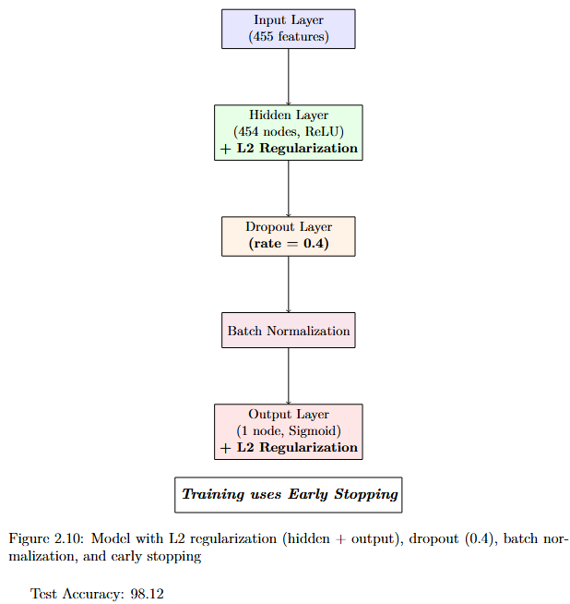

Slide 19
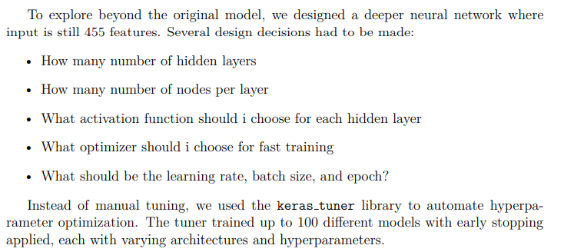
Custom Deep Neural Network using Keras Tuner

Slide 20
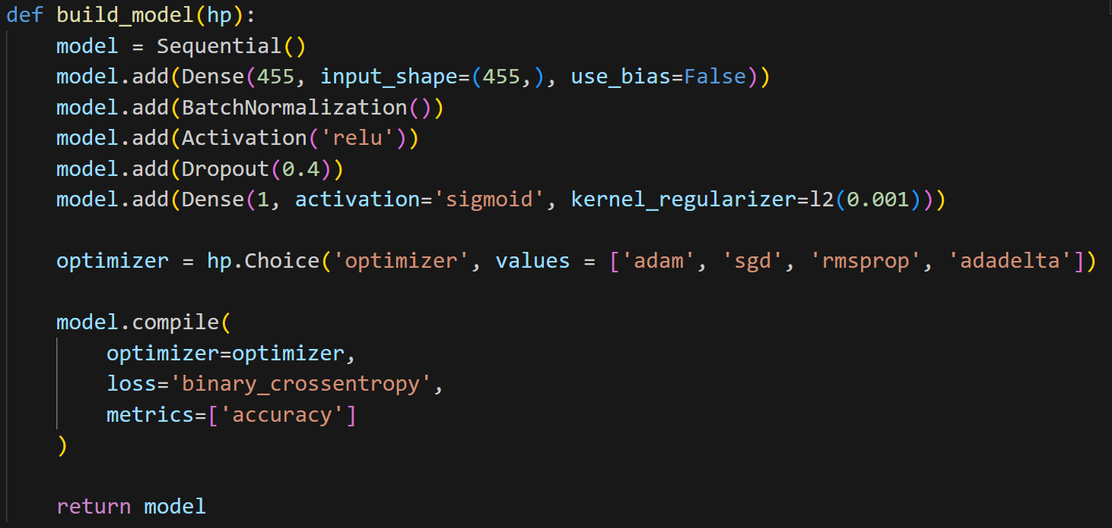
Custom Deep Neural Network using Keras Tuner

Slide 21
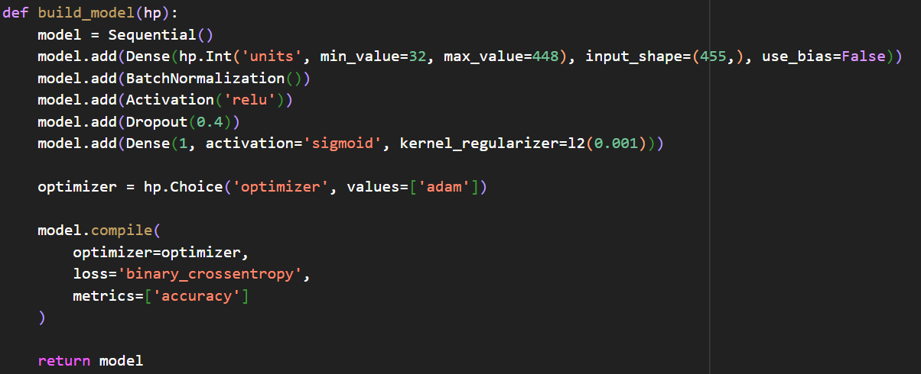
Custom Deep Neural Network using Keras Tuner

Slide 22
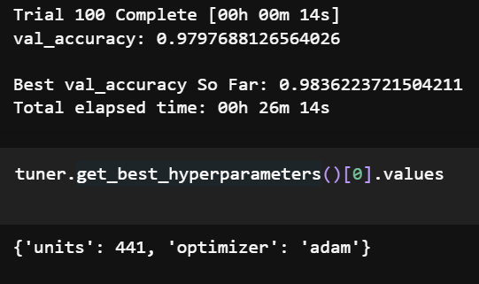
Custom Deep Neural Network using Keras Tuner

Slide 23
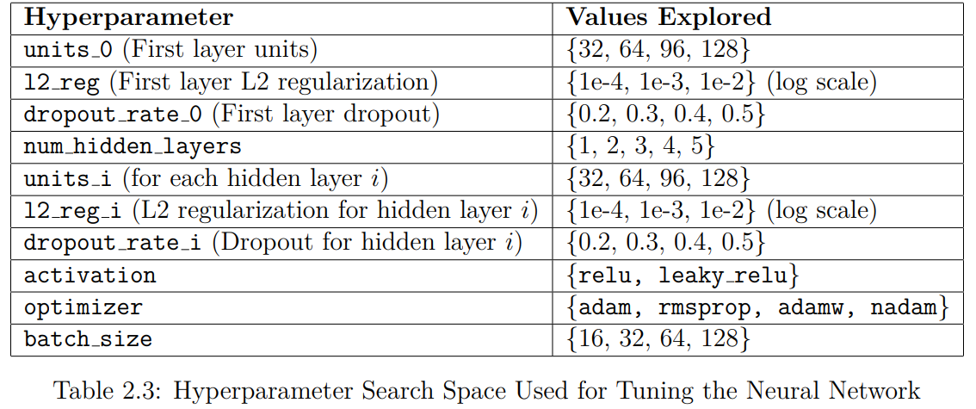
Custom Deep Neural Network using Keras Tuner

Slide 24
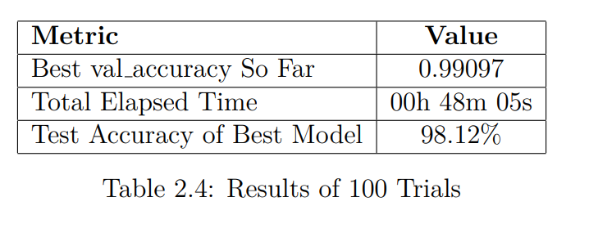
Custom Deep Neural Network using Keras Tuner

Slide 25
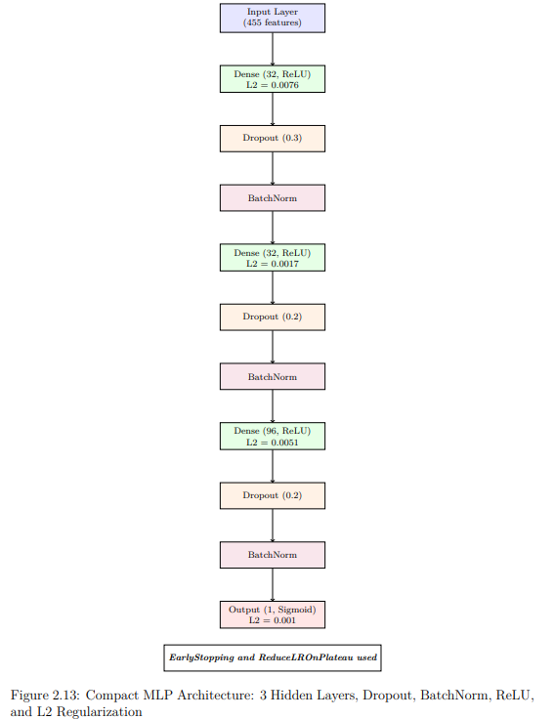

Slide 26
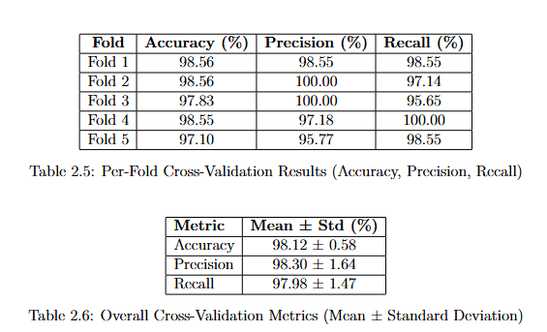

Slide 27
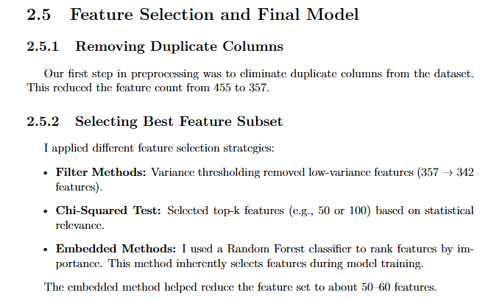

Slide 28
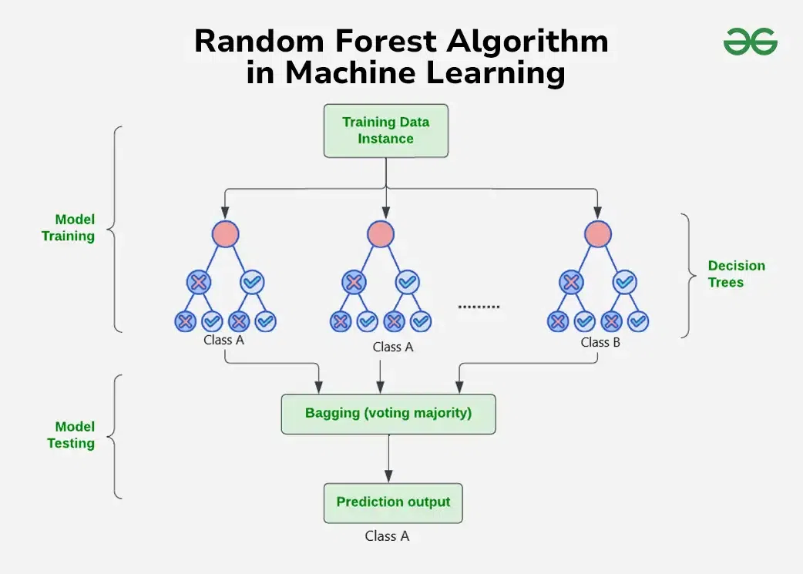

Slide 29
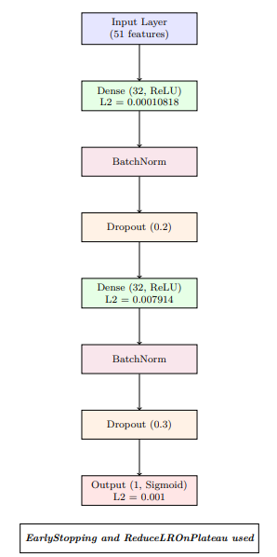

Slide 30
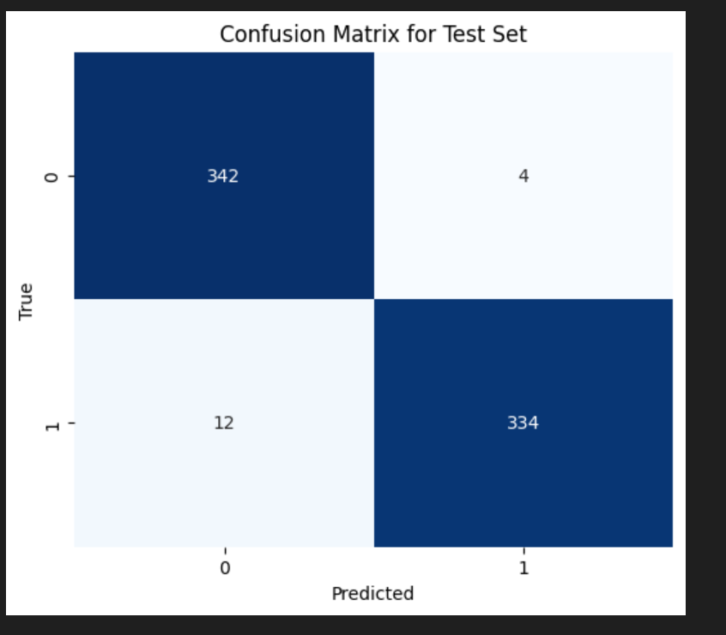

Slide 31
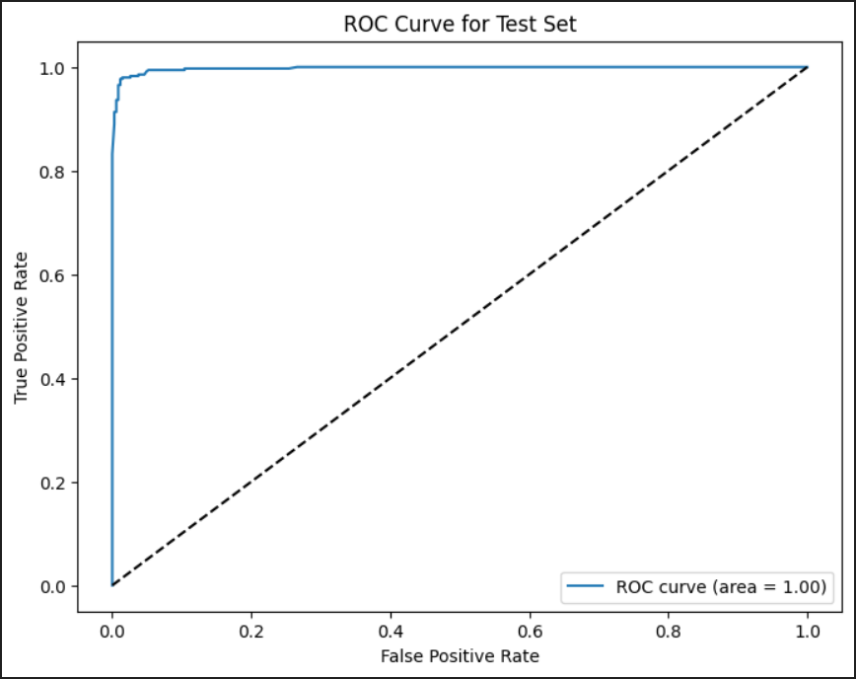

Slide 32
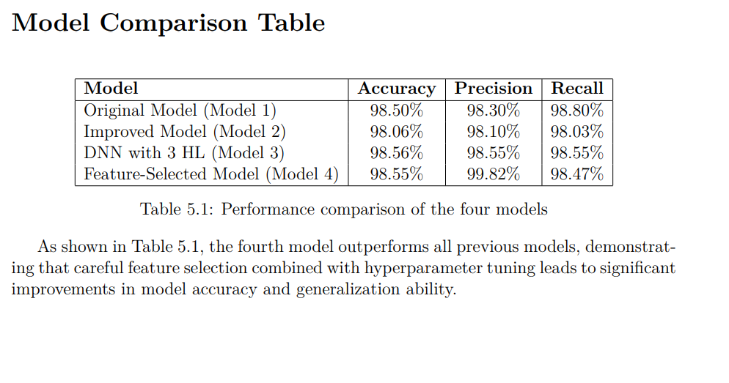

Slide 33
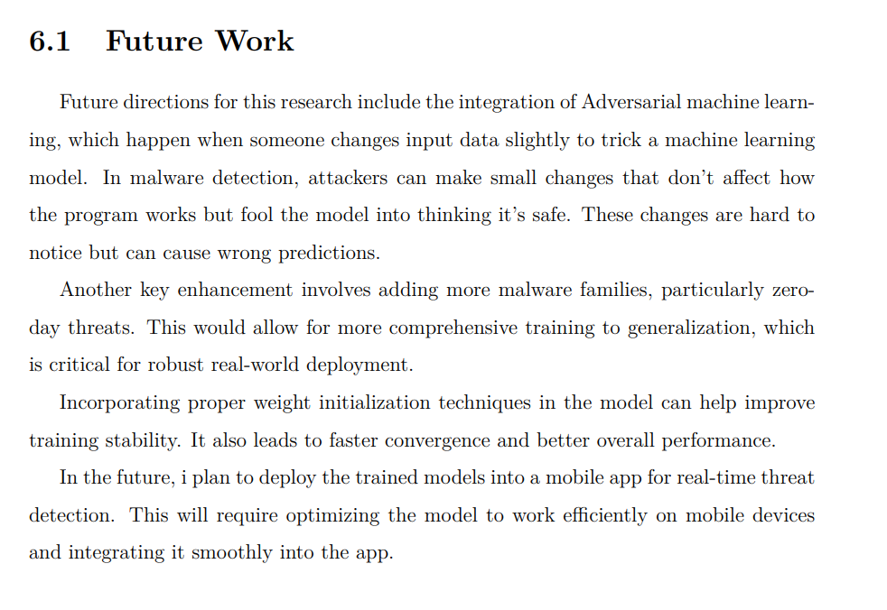

Slide 34
THANK YOU

