Slide 1

Every Customer Counts: TravelTide’s Path Forward
Customer Segmentation & Rewards Program
In today's competitive travel landscape, understanding our customers isn't just an advantage—it's essential for sustainable growth.
This presentation outlines TravelTide's strategic initiative to implement a robust customer segmentation and rewards program,
designed to elevate engagement, foster loyalty, and drive long-term value.
Abhinay Dornipati, 11.08.2025

Slide 2
CRISP-DM: Project Framework
Adopted the CRISP-DM (Cross-Industry Standard Process for Data Mining) framework, an industry-standard methodology ensuring a structured, iterative, and business-focused approach.
1
2
3
Proven & Business-Focused
Repeatable & Flexible
Iterative for Refinement
Works across diverse datasets and objectives.
Encourages continuous improvement at every stage.
Globally adopted, keeping the end goal at the core.
In short: CRISP-DM provides a clear roadmap, ensuring the segmentation project is both technically sound and business-ready.

Slide 3
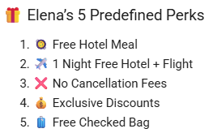
CRISP-DM Phase 1: Business Understanding
Project Context
Hypothesis
TravelTide aims to boost customer retention via a personalized rewards program.
Different customers value different perks (discounts, free cancellations, loyalty). Matching users to their most valued perk will drive customer engagement.
Business Goal
Success Criteria
Segment users by behavior.
Segments are actionable & interpretable.
Assign perks to boost reward program engagement.
Perks align with customer behaviors.
Outputs support personalized marketing.
Summary:
Segment users based on real booking behavior i.e, based on actual usage and spend behavior not assumptions
Confirm whether 5 predefined perks can be meaningfully assigned to real customer groups
Ensure segmentation is behaviorally justified and operationally actionable
Introduce new perks if data behavior supports it
Ensure outputs are usable for targeted marketing campaigns

Slide 4
CRISP-DM Phase 2: Data Understanding
Connected to PostgreSQL and loaded key tables, performing extensive Exploratory Data Analysis (EDA) to understand data structure, quality, and relationships.
Table
Records
Observations
users
1,020,926
No nulls, unique user IDs.
sessions
5,408,063
~43k inactive users, many null discount amounts.
flights
1,901,038
Some null return times (one-way trips).
hotels
1,918,617
Negative nights found.
Key Takeaways: Exclude inactive users, clean negative 'nights' values, remove duplicate session IDs, and handle nulls in discount and other columns. Data is consistent and ready for preprocessing.

Slide 5

CRISP-DM Phase 3: Data Preprocessing
Created a cohort-aligned, enriched session-level dataset, serving as the foundation for feature engineering and behavioral modeling. This ensures all relevant browsing and booking info is available.
Session-Level Cohort Table:
Each row represents a single session (browsing or booking) from a user who:
Had more than 7 sessions since January 4, 2023
Is a fully profiled user (demographic attributes available)
May or may not have booked a flight/hotel (via trip_id)
May have canceled the trip — this is retained for behavioral analysis
Session Features
User Demographics
Page clicks, booking actions, discount flags, cancellations.
Gender, birthdate, marital status, children, location.
Flight Details
Hotel Details
Route, schedule, airline, seats, checked bags, base fare.
Hotel name, nights, rooms, check-in/out times, price.
Data Cleaning Highlights:
Handled Negative Nights: Swapped check-in/out times and recalculated #Nights where check-in > check-out.
Discount Anomalies: Replaced NULL discount amounts with 0 when discount was flagged as True.
Handled Outliers: Capped features with outliers using Winsorization (lower → quantile (0.01), upper → (0.99))
Data Transformation:
Handled Skewed Features: Log Transformation and Robust Scaling.
Encoded Categorical Variables: One-hot encoding.

Slide 6

CRISP-DM Phase 4: Feature Engineering
Since users are segmented based on their behavior, data was aggregated at the user level. Additional metrics (features) were iteratively derived to assist the clustering algorithm in obtaining meaningful clusters.
User-Level Table Features:
Each row represents a single user with features for clustering TravelTide customers.
Session-level Metrics (all sessions): Cancellation rate, total page clicks, average session duration.
Trip-level Aggregation: Number of trips, flights, hotels, booking types (co-booked, flight-only, hotel-only), discount usage, spending, checked bags, nights, and rooms.
Monetary Spend: Total money spent on hotels and flights.
Derived Ratios: Rebooking ratio, co-booking ratio, flight-only ratio, hotel-only ratio.
The features (metrics) were derived iteratively to improve the clustering quality (Silhouette-Score) and business utility

Slide 7
CRISP-DM Phase 5: Modeling & Segmentation → Iterative Approach
Initial K-Means* model (Baseline) yielded a low silhouette score (~0.25 for 5 Clusters) due to high dimensionality, redundant features, and noisy data. We adopted an iterative approach to refine our clustering.
01
02
Iteration 1: Feature Pruning + PCA
Iteration 2: Feature Engineering
Removed demographic indicators and sparse/correlated binary flags. Applied PCA to reduce dimensions while retaining 95% variance.
Introduced `dollars_saved_per_km` to identify price-sensitive users, but later excluded due to low variance and noise.
03
04
Iteration 3: Refined Feature Set
Iteration 4: Monetary Spend Features
Dropped `dollars_saved_per_km` and re-modeled with PCA=4 and k=5, 6, and 7 clusters. Achieved best silhouette score (0.36) with 7 clusters.
Added `money_spent_hotel` and `money_spent_flight` to quantify user value, leading to improved interpretability.
Retained silhouette score (0.36) with 7 clusters.
*K-Means gives fast, interpretable, and business-ready segments, directly powering perks allocation strategy

Slide 8
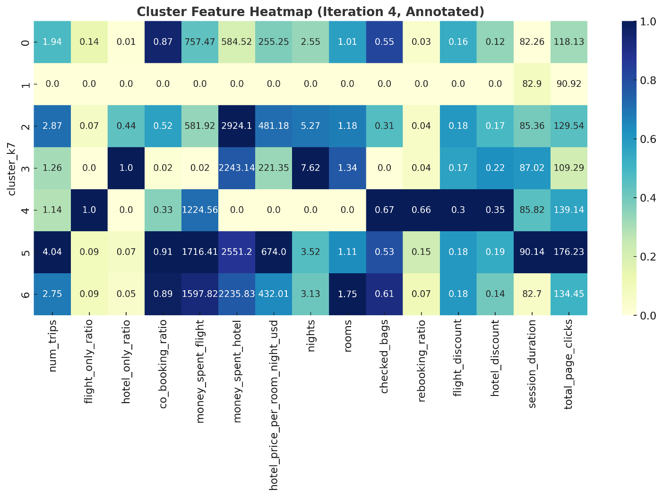
CRISP-DM Phase 5: Modeling & Segmentation→ Iteration 4
Cluster Profiling→ Understanding User Behavioral:
After clustering, we tried to understand the behavioral distribution across the clusters.
Purpose: Visual comparison of key behavioral metrics across all 7 customer clusters from Iteration 4.
Rows: Each cluster (0–6) as identified in K-Means clustering, showing average feature values.
Columns: Behavioral and spend-related metrics, including trip types, engagement, rebooking, and spending.
Color Scale: Darker blue indicates higher normalized values; lighter shades represent lower values.
Notable Insights:
• Cluster 3 shows 100% hotel-only bookings with long stays and multiple rooms.
• Cluster 4 is flight-only with high rebooking rates.
• Cluster 5 demonstrates high spend across both hotel and flights with strong co-booking.
• Cluster 6 shows high checked bag usage (0.61) with low rebooking.
Actionable Use: Supports perk assignments and persona definitions by visually confirming behavioral distinctions.

Slide 9
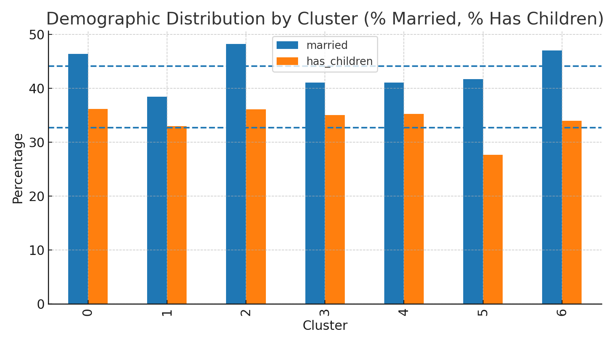
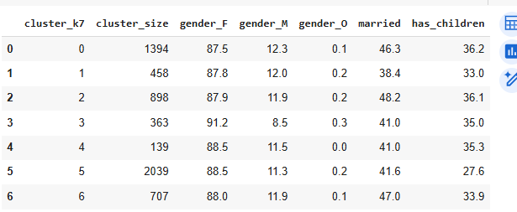
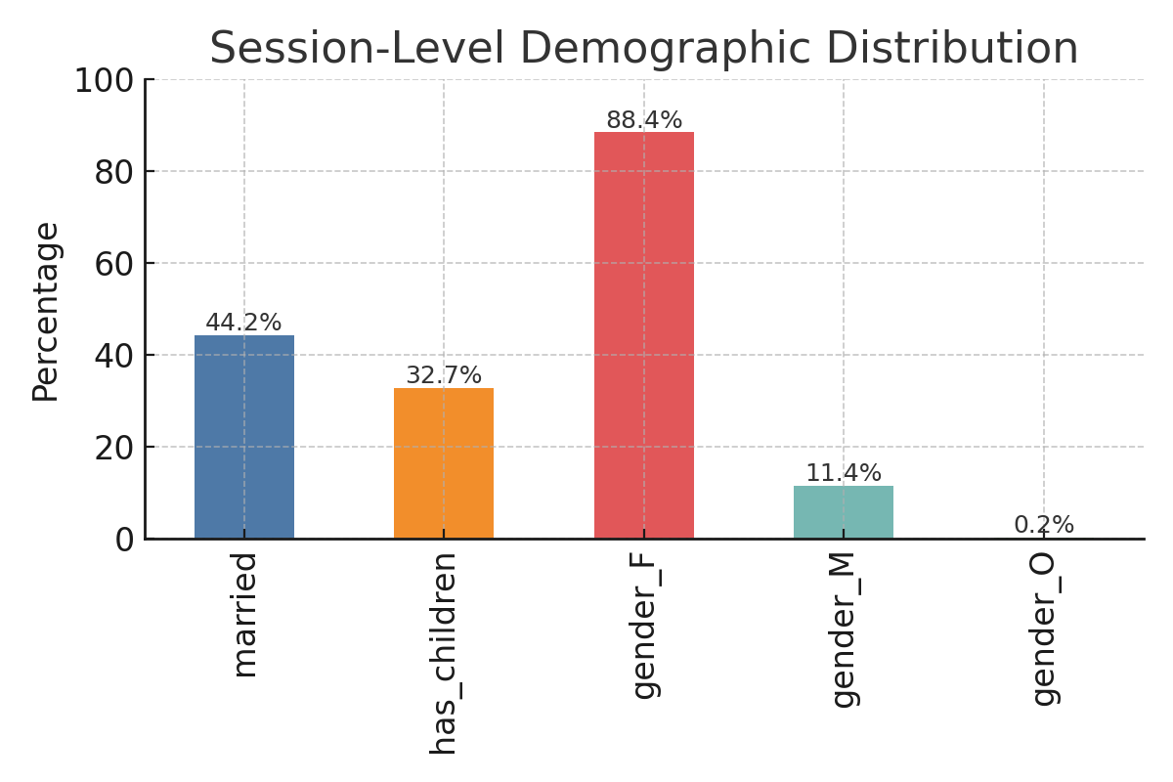
CRISP-DM Phase 5: Modeling & Segmentation→ Iteration 4
Cluster Profiling→ Understanding User Demographics:
After clustering, we tried to understand the demographics distribution across the clusters.
Key findings:
Married ranges 38.4%–48.2% (overall 44.0%).
Has children ranges 27.6%–36.1% (overall 32.6%).
Gender is consistently female-skewed (~88.2% F overall).
Conclusion: Demographics are not primary differentiators—segments are behavior-driven.
Key Findings:
Married: 44.2%
Has Children: 32.7%
Female: 88.4%, Male: 11.4%, Other: 0.18%
Demographic balance is inherent to the dataset not driven by clustering.

Slide 10

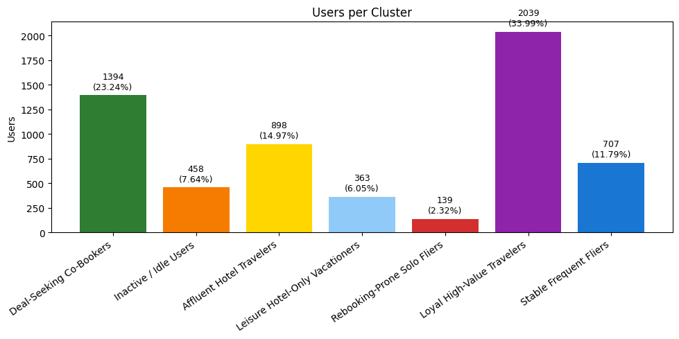
CRISP-DM Phase 5: Modeling & Segmentation→ Iteration 4
Cluster Profiling and Perk Mapping:
After clustering, we profiled each segment using original (true) feature values to understand user behavior and assign appropriate perks.
Deal-Seeking Co-Bookers
1
Engaged, price-conscious, high co-booking. Perk: Exclusive Discounts
Inactive / Idle Users
2
No trips, minimal engagement. Perk: Free Hotel Meal (reactivation)
Affluent Hotel Travelers
3
High hotel spend, mixed-mode bookers. Perk: Complimentary Daily Breakfast
4
Leisure Hotel-Only Vacationers
100% hotel-only, long stays, multiple rooms. Perk: Free Mid-Stay Housekeeping
5
Rebooking-Prone Fliers
100% flight-only, high rebooking rate. Perk: No Cancellation Fees
6
Loyal High-Value Travelers
High flight/hotel spend, frequent co-bookers. Perk: 1 Night Free Hotel + Flight
7
Stable Frequent Fliers
Low rebooking, consistent bookings, high checked bags. Perk: Free Checked Bag
#Users = 5998

Slide 11
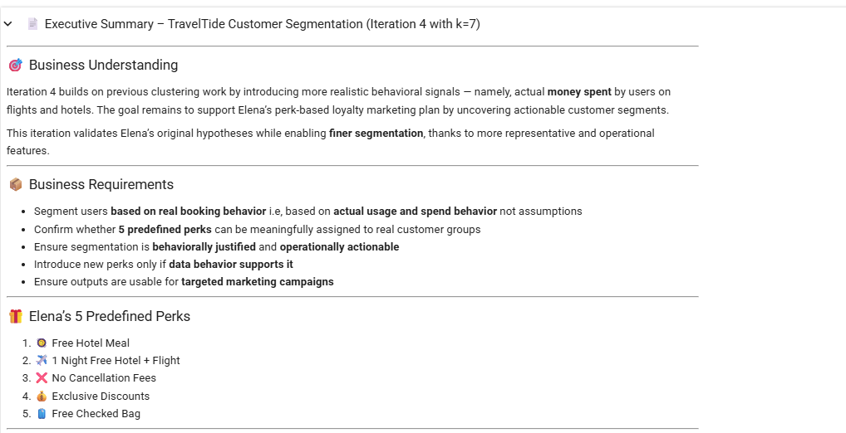
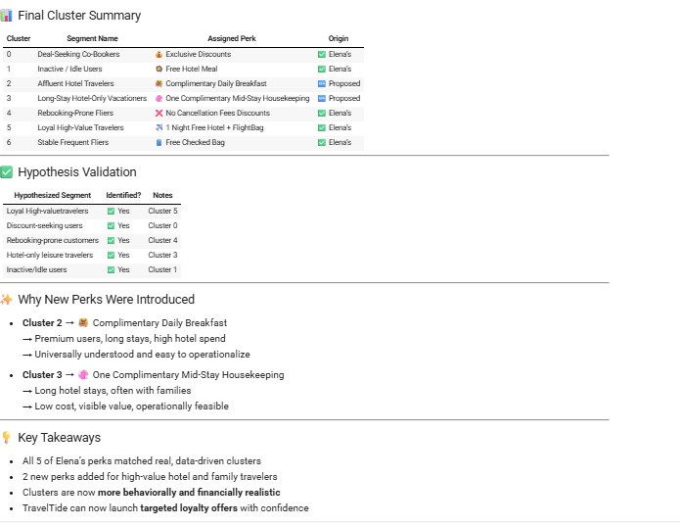
CRISP-DM Phase 5: Modeling & Segmentation→ Iteration 4
Executive Summary:

Slide 12
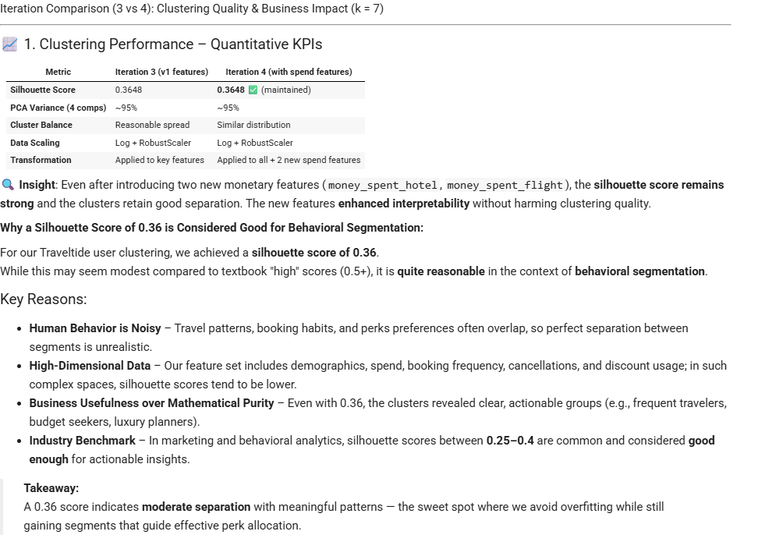
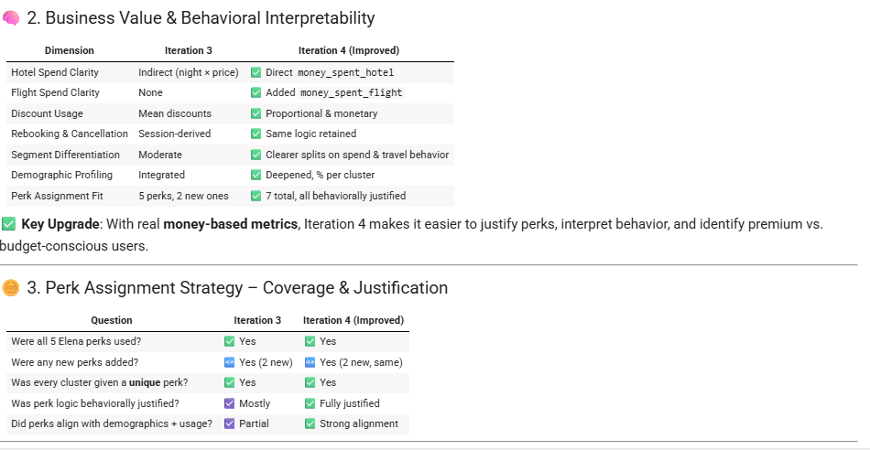
CRISP-DM Phase 6: Evaluation

Slide 13



CRISP-DM Phase 7: Deployment & Recommendations
We recommend Iteration 4 (k=7) for campaign rollout, based on its superior clustering quality, improved interpretability, and better justification of perks using user-level spend patterns.
Launch Precise A/B Tests
Target Effectively
Refine Loyalty Roadmap
Enable targeted perk tests to measure impact.
Focus on high spenders or idle users with tailored offers.
Build confidence in TravelTide's future loyalty strategies.
This approach will enable the Marketing Team to launch precise A/B perk tests, target high spenders or idle users effectively, and refine TravelTide's loyalty roadmap with confidence.

Slide 14
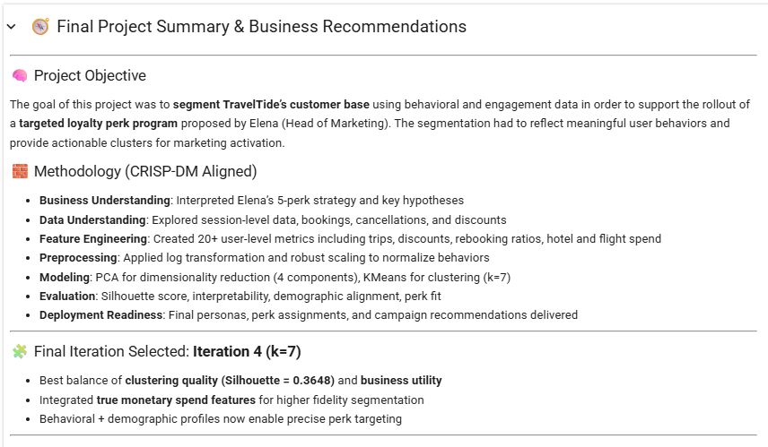
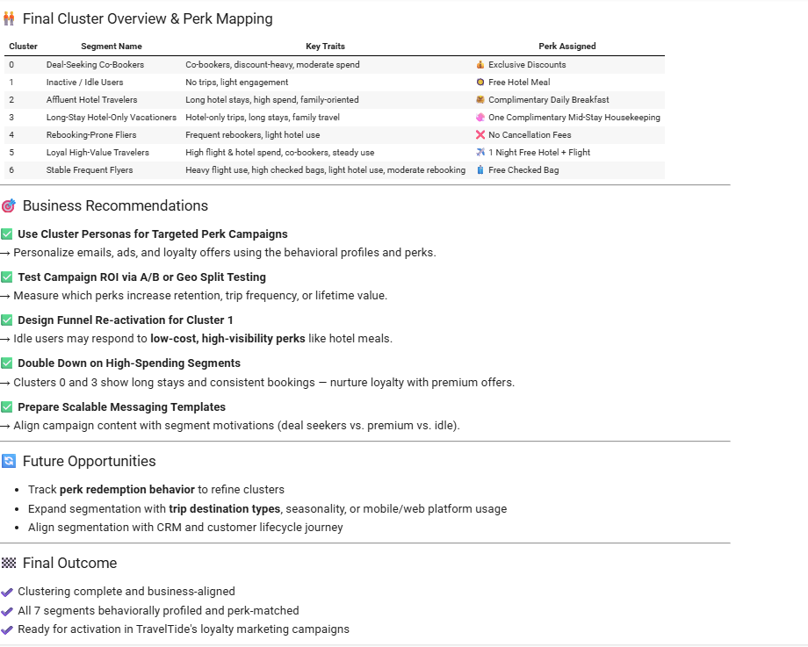
Final Project Summary & Business Recommendations

Slide 15
THANK YOU!

Slide 16
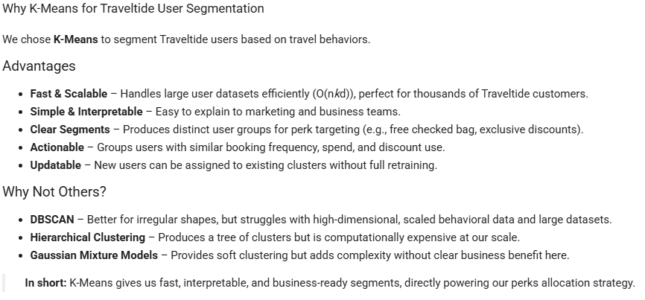
K-Means

Slide 17
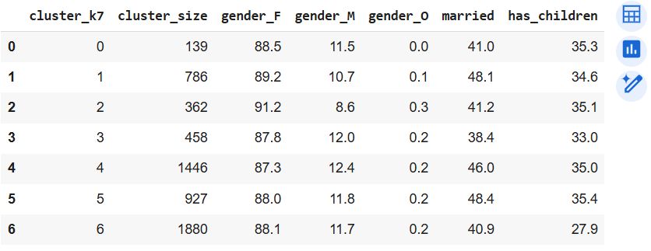
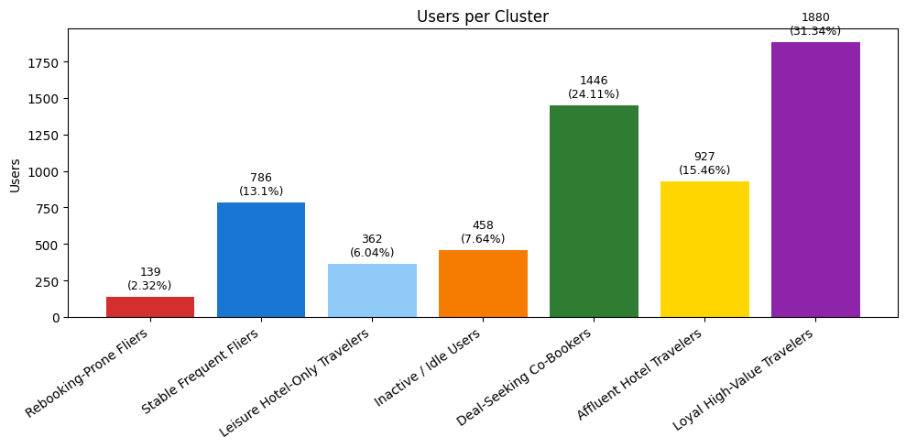
CRISP-DM Phase 5: Modeling & Segmentation→ Iteration 3
After clustering, we profiled each segment using original (true) feature values to understand user behavior and assign appropriate perks.
1
Rebooking-Prone Fliers
100% flight-only, high rebooking rate. Perk: No Cancellation Fees
2
Stable Frequent Fliers
Low rebooking, consistent flight/hotel stays. Perk: Free Checked Bag
3
Leisure Hotel-Only Travelers
100% hotel-only, long stays, multiple rooms. Perk: Free Mid-Stay Housekeeping
4
Inactive / Idle Users
No trips, minimal engagement. Perk: Free Hotel Meal (reactivation)
5
Deal-Seeking Co-Bookers
Engaged, price-conscious, high co-booking. Perk: Exclusive Discounts
6
Affluent Hotel Travelers
High hotel spend, mixed-mode bookers. Perk: Complimentary Daily Breakfast
7
Loyal High-Value Travelers
High flight/hotel spend, frequent co-bookers. Perk: 1 Night Free Hotel + Flight

Slide 18
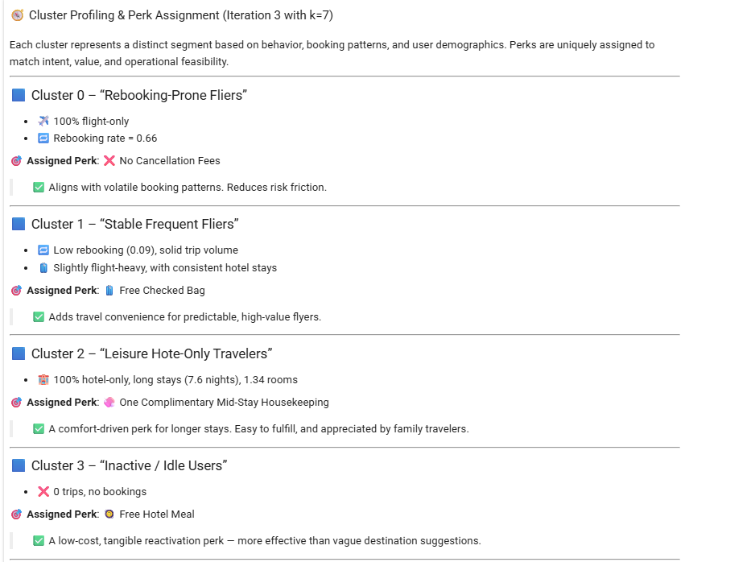
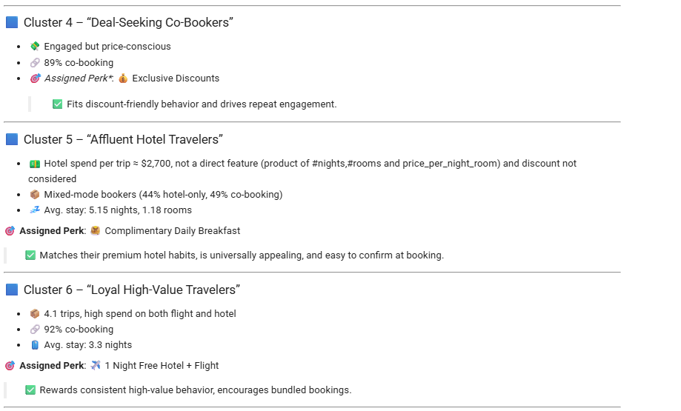
CRISP-DM Phase 5: Modeling & Segmentation→ Iteration 3
Demographic Enrichment, Cluster Profiling and Perk Mapping:
After clustering, we profiled each segment using original (true) feature values to understand user behavior and assign appropriate perks. User Demographics were also considered during the cluster profiling.

Slide 19
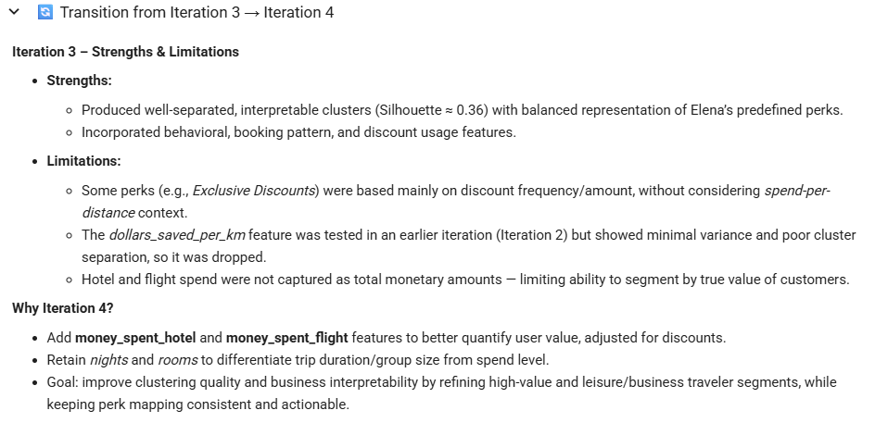
CRISP-DM Phase 5: Modeling & Segmentation

Slide 20
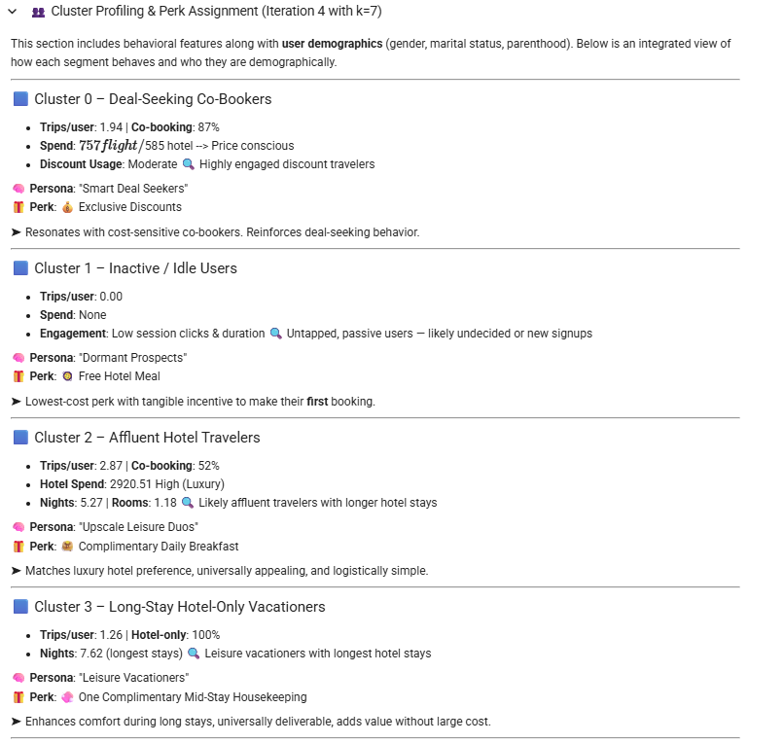
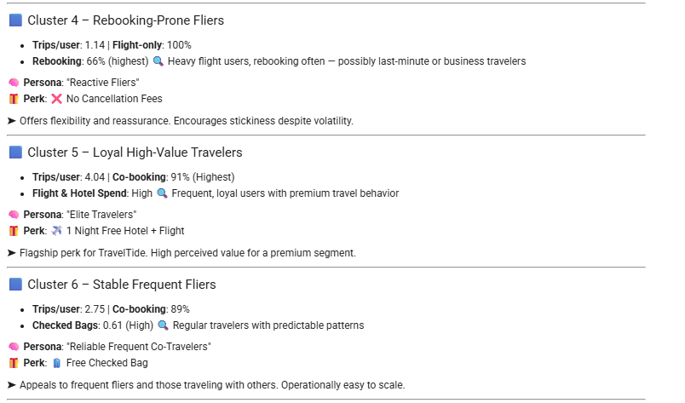
CRISP-DM Phase 5: Modeling & Segmentation→ Iteration 4
Cluster Profiling and Perk Mapping:

