Slide 1

CampusConnect
Alumni–Student Placement Portal
Presented by: Abhinay Chauhan
MCA, BIT Mesra (Noida)

Slide 2
Abstract
CampusConnect is a web-based placement portal that bridges the gap between alumni and current students. It enables alumni to share their placement experiences and interview insights, and allows students to communicate directly with them through a real-time chat system. The platform enhances career readiness and builds a strong alumni-student network.

Slide 3
Problem Statement
Students often struggle to access authentic placement experiences or direct mentorship from alumni. Traditional communication channels are fragmented and lack real-time interaction, making it hard to prepare effectively for interviews.

Slide 4
Objectives
1. To create a unified portal connecting alumni and students.
2. To enable alumni to share placement and interview experiences.
3. To provide real-time personal chat between alumni and students.
4. To store and manage data securely using a robust backend.

Slide 5
System Architecture
The system follows the MERN architecture:
- Frontend: React.js (UI rendering, routing, form handling)
- Backend: Node.js & Express.js (API services, authentication)
- Database: MongoDB (stores users, messages, posts)
- Real-time Communication: Socket.io (chat system)
The client and server communicate via RESTful APIs and WebSockets.

Slide 6
Technology Stack
- Frontend: React.js, Vite, Tailwind CSS
- Backend: Node.js, Express.js
- Database: MongoDB (Mongoose)
- Real-time Chat: Socket.io
- Authentication: JSON Web Tokens (JWT)
- Hosting: Vercel / Render / MongoDB Atlas

Slide 7
Modules Description
1. Authentication Module: Handles user registration and login using JWT.
2. Alumni Experience Module: Allows alumni to post placement stories.
3. Student Module: Lets students read posts and chat with alumni.
4. Chat Module: Real-time personal messaging powered by Socket.io.
5. Admin Module (future scope): Manages user verification and reports.

Slide 8
System Workflow
1. User registers and logs in based on their role (student or alumni).
2. Alumni share experiences that students can view.
3. Students can initiate chat with alumni.
4. Messages are sent in real-time using Socket.io.
5. Data is stored and retrieved securely from MongoDB.

Slide 9
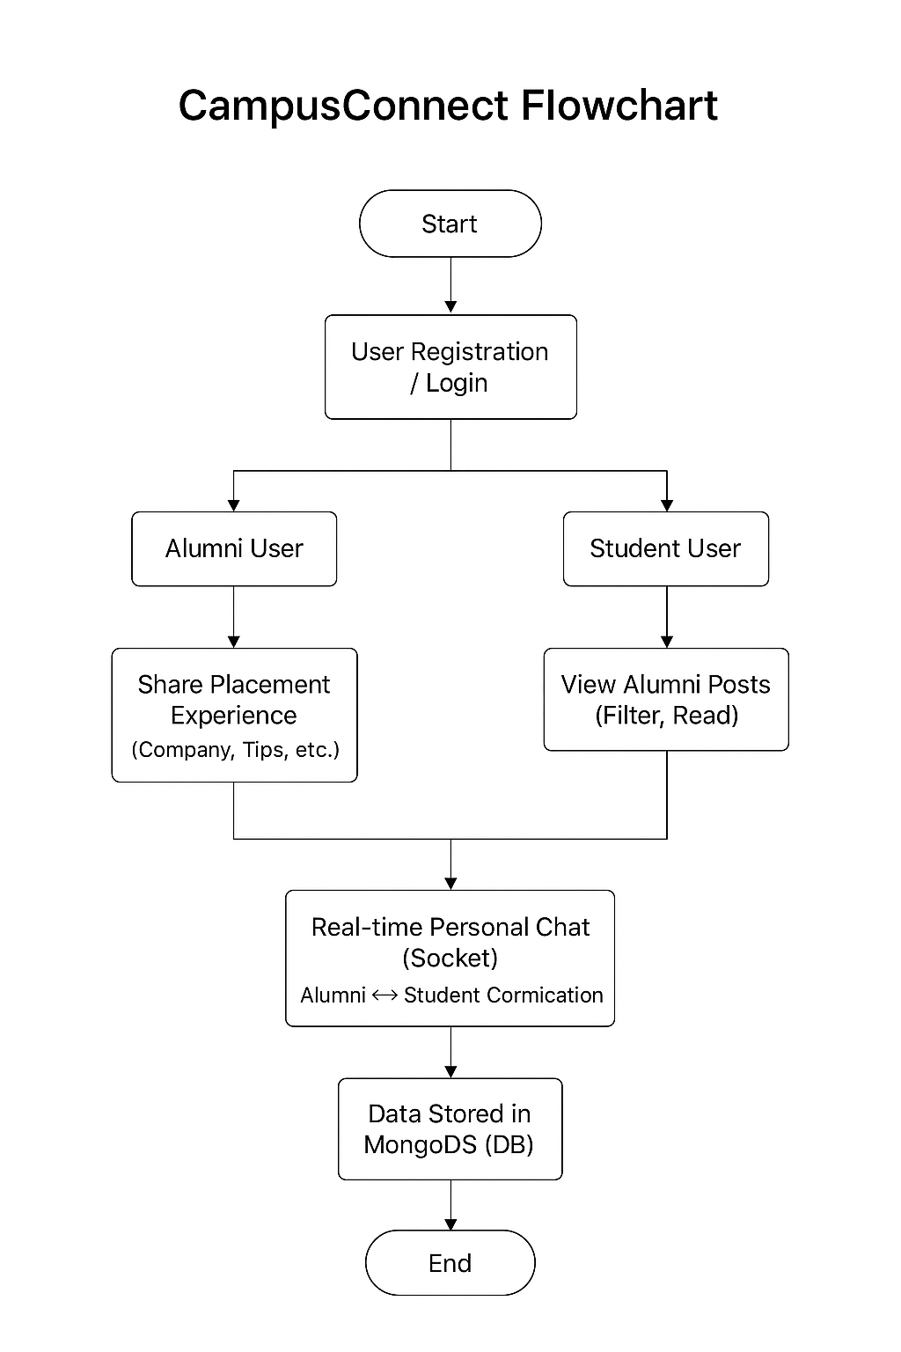

Slide 10
User interface

Slide 11
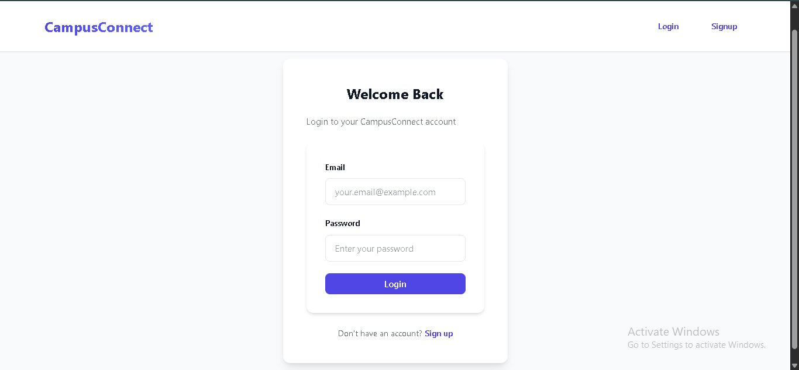

Slide 12
Alumni interface

Slide 13
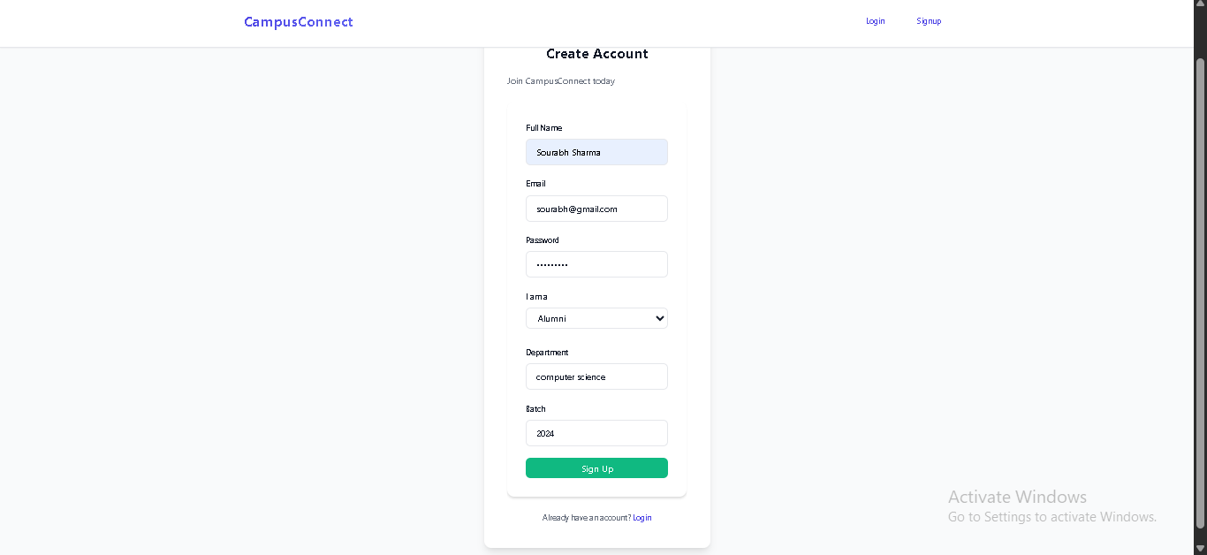

Slide 14
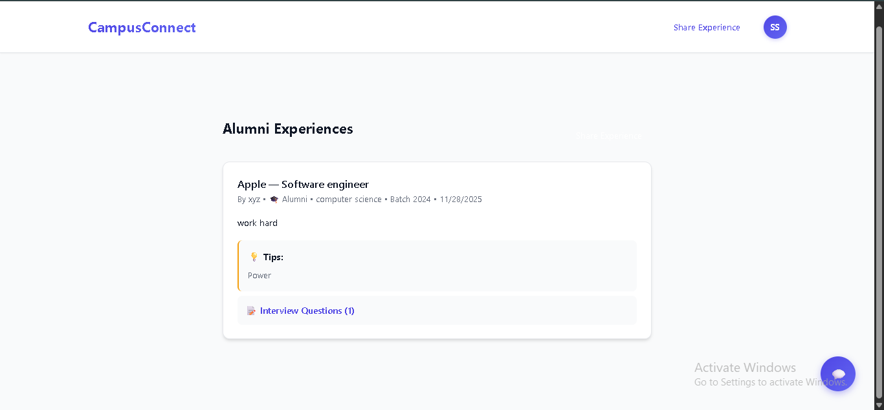

Slide 15
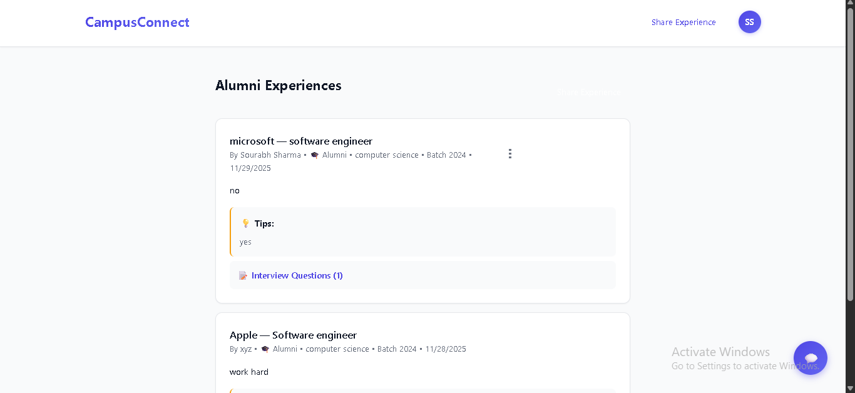

Slide 16
Student interface

Slide 17
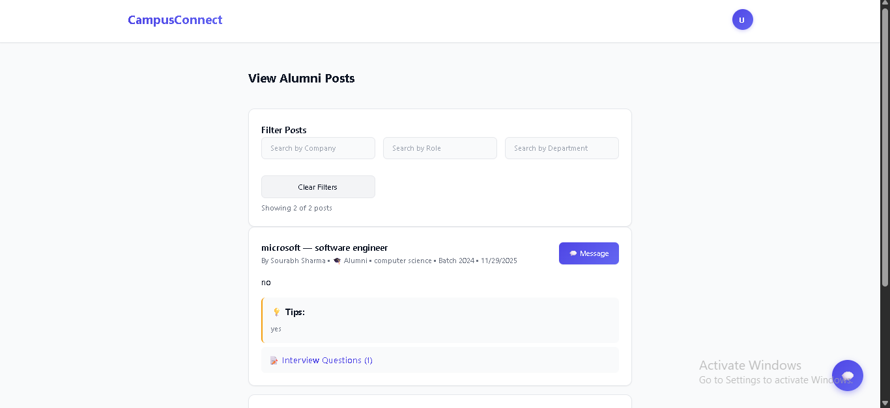

Slide 18
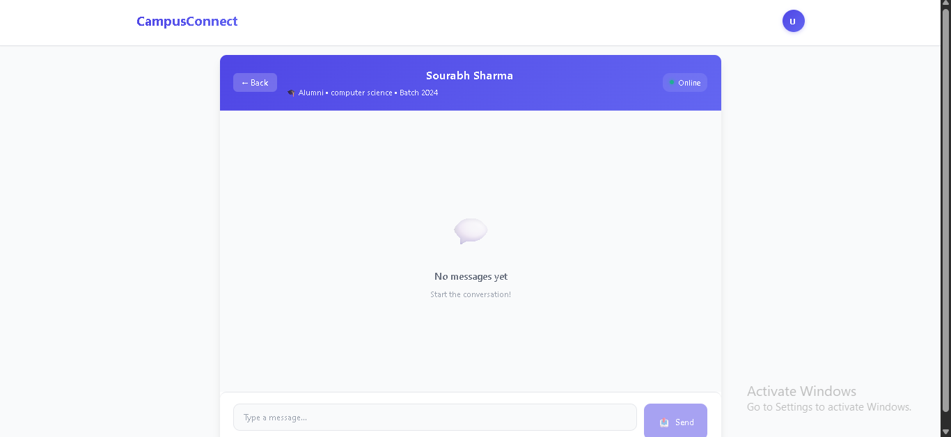

Slide 19
Key Features
✔ User-friendly interface for both alumni and students.
✔ Secure login and authentication.
✔ Real-time chat between users.
✔ Easy sharing and browsing of placement experiences.
✔ Scalable and cloud-hosted architecture.

Slide 20
Conclusion & Future Scope
CampusConnect successfully connects alumni and students through a unified placement portal. It encourages mentorship, career guidance, and transparency in placement preparation.
Future Enhancements:
- AI-based recommendation system for job guidance.
- Resume builder and mock interview integration.
- Admin dashboard for alumni verification.

Slide 21
Thank You

