Slide 1
COUNTERFEIT PRODUCT DETECTION USING KNUCT BLOCKCHAIN
STUDENTS:
1602-21-737-002 B ABHINAY
1602-21-737-302 M SAIRISHIK MENTOR:
HASEEBA YASEEN

Slide 2
OBJECTIVE
The main objective of this proposed system is to maintain the Genuity of the product by helping the customer track the supply chain history of the product. System gives customers the power to track the history of an entire product from manufacturer to customer using Knuct blockchain.

Slide 3
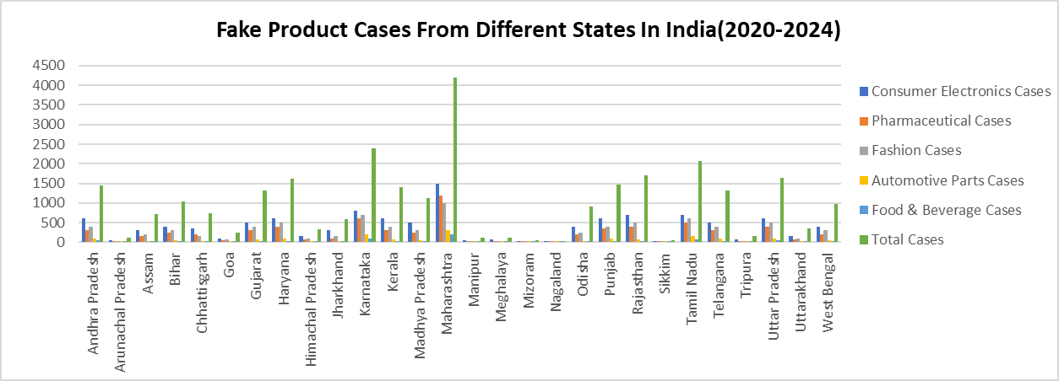
MOTIVATION

Slide 4
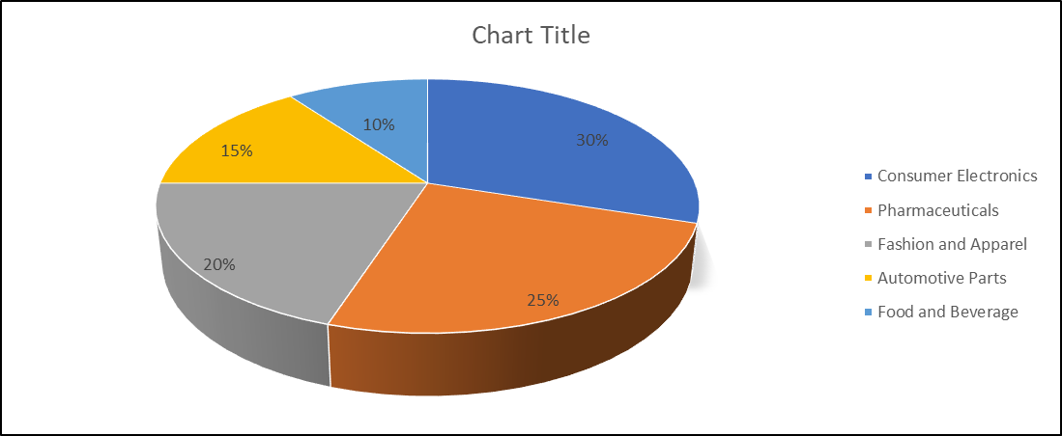
EFFECTS OF FAKE PRODUCTS IN DIFFERENT INDUSTRIES

Slide 5
LITERATURE SURVEY
Title of the paper and year | Methodology | Advantages | Disadvantages
Fake product identification for small and medium firms (FPISMF) using blockchain technology | Data Encryption Blockchain Verification Containerized Chaincode QR-Code Correction Algorithm | Enhanced Security Immutable Records Cost-Effective Solution Improved Customer Experience Scalability | Increased Processing Time Dependency on Technology Scalability Concerns Initial Setup Cost
Detection of Counterfeit Products using Blockchain | Blockchain Integration Data Traceability Multi-Party Access | Enhanced Transparency Improved Security Better Coordination | Initial Implementation Cost Technical Complexity Scalability Challenges
Blockchain-based fake news traceability and verification mechanism | Blockchain Integration Cloud Storage with Verification Polynomial Commitment Algorithm | Enhanced Authenticity Improved Traceability Increased Security | Complexity of Implementation Potential for High Costs Dependence on Technology

Slide 6
UNIQUENESS
EXISTING MODEL :
Advantages:
→ Transparency and Immutability
→ Decentralization
→ Enhanced Traceability
Disadvantages:
→ Complexity and Integration Challenges
→ High Energy and Resource Costs
→ Data Privacy Concerns
OUR MODEL:
Knuct Blockchain: Solves scale, cost, and privacy issues of traditional blockchains.

Slide 7
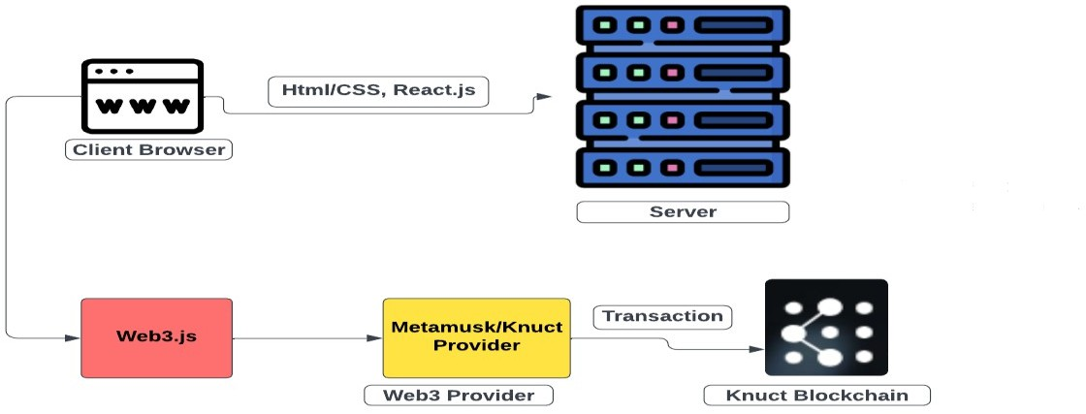
SYSTEM ARCHITECTURE/DESIGN

Slide 8
PAPER - I
TITLE: Fake product identification for small and medium firms (FPISMF) using blockchain technology
TITLE: Fake product identification for small and medium firms (FPISMF) using blockchain technology
DESCRIPTION
The Fake Product Identification for Small and Medium Firms (FPISMF) solution uses Hyperledger blockchain and AES encryption to help SMBs identify counterfeit products and protect their brands. Product details are securely encrypted and stored on the blockchain, and a chaincode system verifies authenticity in a secure, containerized environment. A specialized algorithm also corrects damaged QR codes, speeding up product validation for customers. This solution shows faster, more efficient anti-counterfeit verification, helping SMBs safeguard against fakes effectively
SOURCE
https://www.sciencedirect.com/science/article/pii/S2665917424001405?via%3Dihub

Slide 9
PAPER - II
TITLE: Detection of Counterfeit Products using Blockchain
DESCRIPTION
Supply chains often struggle with issues like poor coordination, service redundancy, and lack of transparency, making it hard to combat product counterfeiting. Traditional methods, such as RFID tags, QR codes, and AI-based systems, have limitations—QR codes can be easily duplicated, and AI models need heavy processing power. This project proposes a blockchain-based system to enhance counterfeit detection by tracking a product's supply chain history. Blockchain ensures secure, traceable data that multiple parties can access and is highly resistant to tampering, making it ideal for verifying product authenticity and improving transparency across the supply chain.
SOURCE
https://www.itm-conferences.org/articles/itmconf/abs/2022/04/itmconf_icacc2022_03015/itmconf_icacc2022_03015.html

Slide 10
PAPER - III
TITLE: Blockchain-based fake news traceability and verification mechanism
DESCRIPTION
The rise of the Internet and IoT has made fake news more prevalent, impacting daily life significantly. To help identify and trace fake news while ensuring the secure sharing of real news, this paper proposes a blockchain-based mechanism for news data storage. News data is stored in a cloud but verified on a blockchain for traceability, making it secure against tampering. Additionally, an updated polynomial commitment algorithm is used to ensure data consistency between the blockchain and cloud, enhancing the authenticity and traceability of news data while safeguarding real news from falsification.
SOURCE
https://www.cell.com/heliyon/fulltext/S2405-8440(23)04292-5?_returnURL=https%3A%2F%2Flinkinghub.elsevier.com%2Fretrieve%2Fpii%2FS2405844023042925%3Fshowall%3Dtrue

Slide 11

RESULTS
→ Growing Counterfeit Concerns
→ Increased Consumer Awareness
→ Supply Chain Transparency
→ E-commerce Growth
→ Regulatory Compliance
→ Global Market Size

Slide 12
CONCLUSION
The Fake product identification system developed with integration of QR codes and Knuct blockchain presents a lucrative opportunity for companies focused on brand protection, consumer safety, and supply chain integrity.

Slide 13
THANK YOU!

