Slide 1

CENTRALIZED ATM SECURITY SYSTEM
by 2111CS050068 - T.Abhinay
2111CS050113 - D.Nikhil 2111CS050112 - M.Nihanth 2111CS050082 - A.Goutham Under the Guidance of Mr.S Rajasekhar Reddy
Department of Internet of Things School of Engineering Malla Reddy University Hyderabad, Telangana, INDIA

Slide 2
ABSTRACT
In today's digital era, ensuring the security of Automated Teller Machines (ATMs) is of paramount importance to prevent unauthorized access and fraudulent activities. In response to this need, this project proposes an innovative IoT-based ATM security system that integrates various components, including sensors, a microcontroller, and Google Assistant, to offer comprehensive security control and monitoring.The system uses Hall-effect sensor, strategically placed within the ATM to detect unauthorized access and movement. This sensor monitors the status of the ATM door. This sensor continuously monitor the ATM environment and trigger alerts in case of security breaches. A microcontroller, such as Arduino or ESP8266, processes the data collected by the sensors and communicates with the internet via a Wi-Fi module. One of the unique features of the proposed system is its integration with Google Assistant, a virtual assistant developed by Google. This integration enables users to control and monitor the ATM security system using voice commands via the Google Home app or Assistant-enabled devices. Users can perform actions such as arming or disarming the system, checking the status of the ATM, or receiving real-time security alerts, all through simple voice commands. Real-time notifications are sent to the user's mobile device or email address in the event of a security breach, providing instant awareness and enabling prompt responses. This ensures that any unauthorized access or suspicious activity at the ATM is detected and addressed in a timely manner, reducing the risk of financial losses and enhancing overall security.

Slide 3
1.INTRODUCTION
1.1 Problem Definition & Description
Problem specification
The problem specification involves creating an IoT-based centralized ATM security alarm system controlled by Google Assistant using an Arduino board, where the system should be capable of detecting the state of an ATM door (open/closed) using a door sensor, activating a buzzer alarm when the door is open, and deactivating the alarm when the door is closed. Integration with Google Assistant should enable users to remotely control the alarm system via voice commands. Additionally, the system must ensure secure communication over the internet and robust error handling to maintain reliability and prevent unauthorized access.
Problem Description
The problem at hand entails the development of an Internet of Things (IoT) solution aimed at enhancing ATM security through the utilization of readily available hardware components and the integration of voice control functionalities via Google Assistant. The envisioned system centers around an esp8266 microcontroller board, tasked with monitoring the status of an ATM door using a sensor and activating an audible alarm in the event of unauthorized access. Crucially, this alarm system should be accessible remotely, allowing users to command its activation or deactivation using voice commands via Google Assistant.

Slide 4
1.2 Objectives of the Project
Aim of the project
The aim of this project is to create an efficient and user-friendly IoT-based centralized ATM security alarm system that integrates seamlessly with Google Assistant, allowing users to remotely monitor and control the security status of the ATM using voice commands. The system will prioritize security, reliability, and ease of use to deliver a comprehensive solution for enhancing home or office security.
Tasks and deliverables
Hardware Setup and Integration
Arduino Programming
Google Assistant Integration
Security Implementation
Testing and Validation
Deployment and Training

Slide 5
1.3 Scope of the project
Determining goals
The primary goal of the project is to develop an IoT-based ATM security alarm system that can be controlled via Google Assistant. This involves integrating hardware components such as an esp8266 board, door sensor, and buzzer, with software components for Wi-Fi connectivity and communication with Google Assistant. The system should accurately detect the state of the door, trigger the alarm when necessary, and provide remote control functionality through voice commands. Additionally, ensuring security and reliability in data transmission and system operation is crucial.
Data & Constrains
Data includes information related to the state of the ATM door (open/closed) sensed by the door sensor, as well as commands received from Google Assistant.
Constraints include hardware limitations of the esp8266 board, such as memory and processing power, as well as limitations imposed by the chosen communication protocols and platforms (e.g., Wi-Fi, Google Actions). Power consumption and scalability may also be considerations depending on the deployment environment and intended usage.

Slide 6
Workflow management strategies
Requirement Gathering and Planning
Hardware Setup
Software Development
Integration with Google Assistant
Testing and Debugging
Documentation and Deployment

Slide 7
2.SYSTEM ANALYSIS
2.1 Existing System
Background & Literature Survey
Nest x Yale Smart Lock: This system integrates with Google Assistant and allows users to remotely lock and unlock doors using voice commands. However, it requires proprietary hardware and may be expensive for some users.
August Smart Lock: Another popular smart lock system that supports voice control via Google Assistant. It offers features such as keyless entry and door activity monitoring but may lack flexibility for custom integrations.
Samsung SmartThings: This home automation platform supports various IoT devices, including door sensors and alarms. It offers integration with Google Assistant for voice control but may require additional setup and configuration.
Home Assistant: An open-source home automation platform that allows users to build custom IoT solutions. It supports integration with Google Assistant and offers flexibility for advanced configurations but may require more technical expertise to set up compared to commercial solutions.

Slide 8
Limitations of Existing System:
Platform Dependency: Many existing systems are platform-specific, limiting their compatibility and interoperability with other devices and services.
Complexity: Setting up and configuring existing systems can be complex and require significant technical expertise.
Limited Features: Some systems may lack advanced features such as secure communication protocols, remote access management, or integration with voice assistants.
Cost: Cost can be a limiting factor for some existing systems, especially those requiring proprietary hardware or subscription-based services.

Slide 9
2.2 Proposed System:
The proposed system entails the development of an Internet of Things (IoT) based ATM security alarm controlled by Google Assistant using an esp8266 board. The system incorporates a door sensor to detect the state of the ATM door (open or closed) and a buzzer alarm to alert users in case of unauthorized access. Integration with Google Assistant enables users to remotely control the alarm system via voice commands, enhancing convenience and accessibility. The esp8266 board facilitates communication between the door sensor, buzzer alarm, and Google Assistant via a Wi-Fi, ensuring seamless operation. Additionally, the system includes robust security measures to safeguard against unauthorized access, such as encryption of communication channels and authentication mechanisms.
Advantages of Proposed System:
Convenience
Accessibility
Remote Monitoring
Customization
Scalability
Cost-effectiveness

Slide 10
2.3 Software and Hardware Requirements
Software Requirements:
Arduino IDE
Libraries:
ESP8266WiFi: For connecting the Arduino board to a Wi-Fi network (if using ESP8266 module).
ESP8266WebServer: For setting up a web server on the Arduino board to handle HTTP requests.
SinricPro: For connecting to SinricPro,a cloud-based service designed for integrating IoT (Internet of Things) devices with Amazon Alexa and Google Assistant.
Google Actions Console
IFTTT (If This Then That)
Hardware Requirements:
Arduino board
Door sensor
Buzzer or alarm
Wi-Fi module
Power source
Internet connection

Slide 11
2.4 Feasibility Study
Technical Feasibility
The technical feasibility of the project hinges on the availability of required hardware components (esp8266 board, door sensor, buzzer, LEDs) and software tools (Arduino IDE, Google Home, SinricPro). These components are readily accessible and affordable, making the project technically feasible. Additionally, the required functionalities, such as connecting to Wi-Fi, detecting door status, and controlling the buzzer, can be implemented using well-documented libraries and programming techniques for Arduino. Integrating with Google Assistant via Google Home and SinricPro offers a feasible solution for voice control. Overall, the project's technical requirements are achievable with existing technology and resources.
Robustness & Reliability
Robustness and reliability are critical aspects of the project, particularly concerning security and system stability. Implementing secure communication protocols between the esp8266 board and Google Assistant, along with authentication mechanisms, enhances system security. Error handling routines in the Arduino code ensure graceful handling of unexpected events, contributing to system reliability. Thorough testing, including stress testing and validation against various scenarios, helps identify and mitigate potential vulnerabilities and weaknesses, thereby improving the system's robustness. Regular updates and maintenance practices further enhance reliability over time.

Slide 12
Economic Feasibility
Economically, the project is feasible as it involves relatively low-cost components and utilizes open-source development tools. esp8266 board, sensors, and other hardware components are affordable and widely available. Additionally, software tools such as Arduino IDE, Google Home, SinricPro offer free or low-cost access, minimizing upfront investment. The project's scalability allows for incremental expansion or customization based on budget constraints and specific requirements. Overall, the economic feasibility of the project is high, making it accessible to hobbyists, students, and small-scale deployments alike.

Slide 13
3.ARCHITECTURAL DESIGN
3.1 Modules Design
3.1.1 Microcontroller Board:
An ESP8266 board serves as the brain of this project. It controls the operation of the security system, communicates with the Hall Effect sensor, and interacts with the Google Assistant via Wi-Fi.
3.1.2 Hall Effect Sensor:
This sensor detects the opening and closing of the ATM door. It plays a crucial role in detecting unauthorized access and triggering the security alarm.
3.1.3 Alarm Buzzer or LED:
An alarm buzzer or LED provides visual or audible alerts when the security system is triggered. It signals to the user that the door has been opened without authorization.
3.1.4 Google Assistant-Compatible Device:
A device compatible with Google Assistant, such as a smartphone, Google Home speaker, or Raspberry Pi running Google Assistant SDK, enables voice control functionality. It allows users to arm or disarm the security system using voice commands.

Slide 14
3.2 Method & Algorithm design
Method Design:
3.2.1 Setup and Configuration:
Set up the ESP8266 or ESP32 development board and connect it to your Wi-Fi network.
Configure the Google Assistant integration using Sinric Pro or similar platform.
Establish connections for the Hall Effect sensor, alarm buzzer or LED, and any other components.
3.2.2 Initialization:
Initialize the microcontroller board and peripherals.
Initialize variables to track the security system's status (e.g., armed or disarmed).
3.2.3 Main Loop:
Continuously monitor the Hall Effect sensor to detect changes in the magnetic field (i.e., door openings).
If the door is opened and the security system is armed, trigger the alarm buzzer or LED.
Listen for commands from Google Assistant to arm or disarm the security system.
3.2.4 Communication with Google Assistant:
Use the Sinric Pro library or similar platform to handle communication between the microcontroller board and Google Assistant.
Define functions to handle commands such as "security system on" and "security system off" received from Google Assistant.

Slide 15
3.2 Method & Algorithm design
Algorithm Design:
3.2.5 Initialization:
Initialize Wi-Fi connection.
Initialize GPIO pins for the Hall Effect sensor, alarm buzzer or LED, and status LEDs.
3.2.6 Main Loop:
Read the state of the Hall Effect sensor.
If the door is opened and the security system is armed:
Trigger the alarm buzzer or LED.
Update the status LEDs to indicate the security breach.
3.2.7 Listen for commands from Google Assistant:
If the command is to arm the security system, set the system status to armed.
If the command is to disarm the security system, set the system status to disarmed.
3.2.8 Communication with Google Assistant:
Define functions to handle commands received from Google Assistant:
onSecuritySystemOn(): Arm the security system.
onSecuritySystemOff(): Disarm the security system.

Slide 16
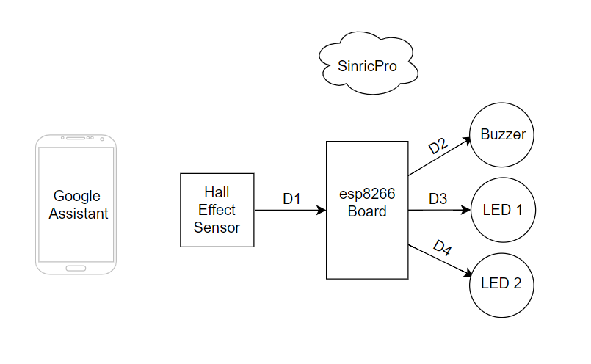
3.3 Project Architecture
3.3.1 Architectural Diagram:

Slide 17
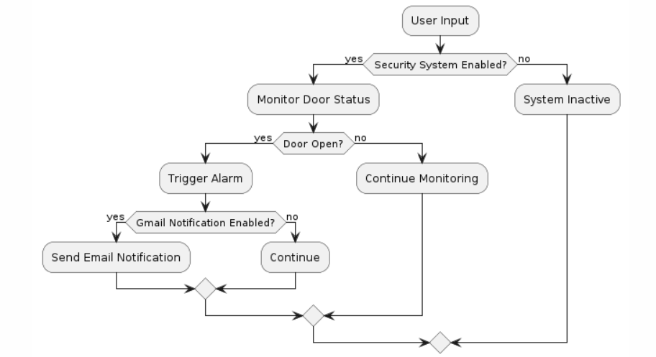
3.3 Project Architecture
3.3.2 Data Flow Diagram:

Slide 18
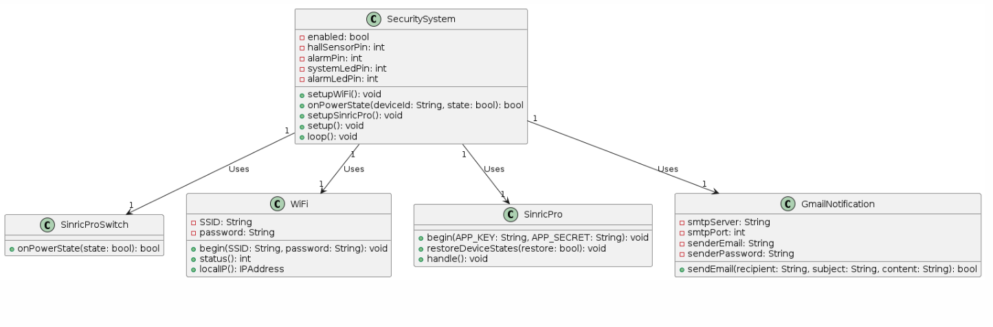
3.3 Project Architecture
3.3.3 Class Diagram:

Slide 19
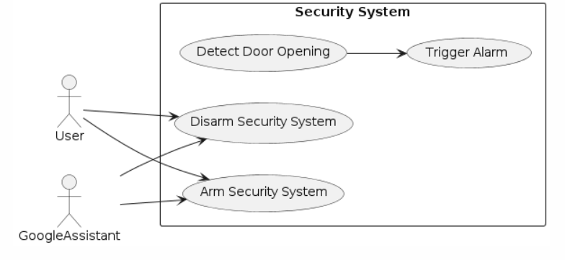
3.3 Project Architecture
3.3.4 Use Case Diagram:

Slide 20
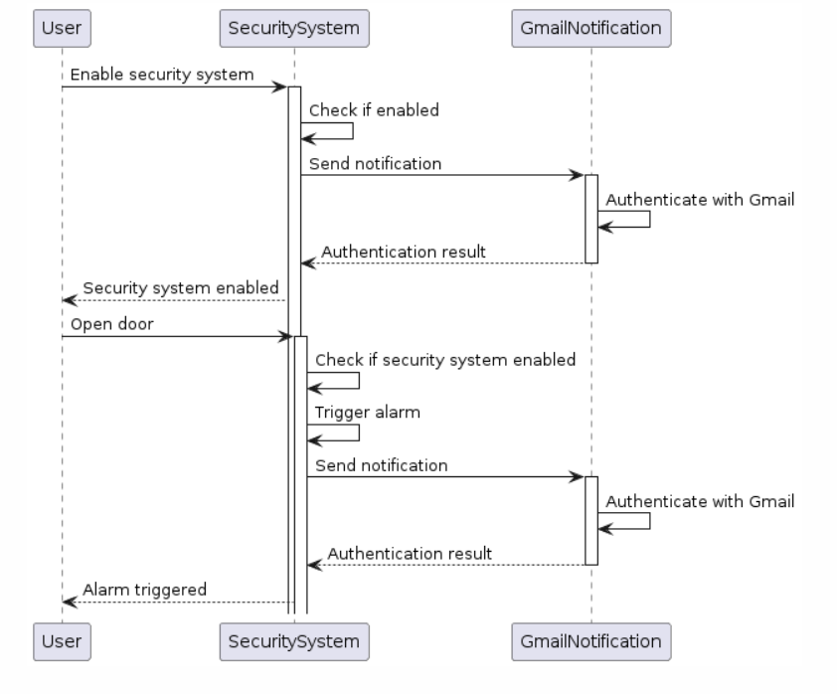
3.3 Project Architecture
3.3.5 Sequence Diagram:

Slide 21
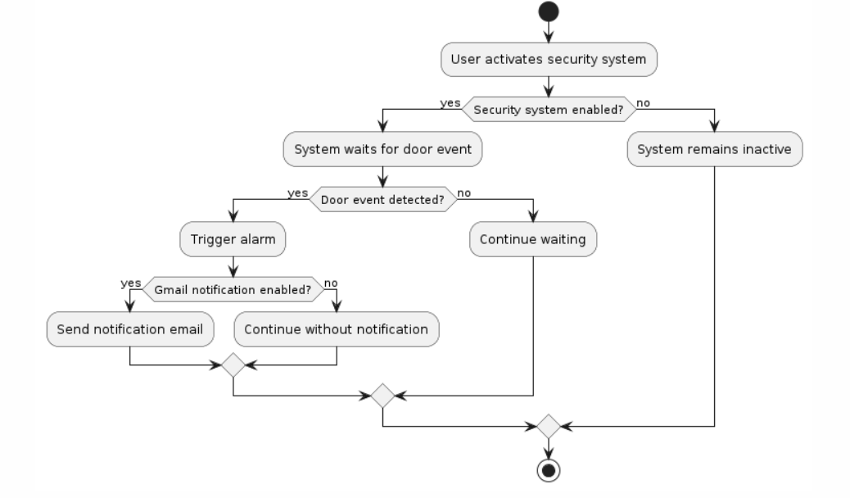
3.3 Project Architecture
3.3.6 Activity Diagram:

Slide 22
4.IMPLEMENTATION & TESTING
4.1 Coding Blocks
#include <Arduino.h>
#include <ESP8266WiFi.h>
#include "SinricPro.h"
#include "SinricProSwitch.h"
#define WIFI_SSID "12"
#define WIFI_PASS "12345678"
#define APP_KEY "4e8be083-d73d-4c55-9d22-610ed2bff8b8"
#define APP_SECRET "5feab028-ea77-4936-a37a-f4825415c4f4-f99fcd4c-0ba6-49be-9a83-b8a6785a37d7"
#define DEVICE_ID "660feef33019d22c418749b4“
#define HALL_SENSOR_PIN D1
#define ALARM_PIN D2
#define SYSTEM_LED_PIN D3
#define ALARM_LED_PIN D4

Slide 23
bool securitySystemEnabled = false;
void setupWiFi() {
Serial.println("\r\n[Wifi]: Connecting");
WiFi.begin(WIFI_SSID, WIFI_PASS);
while (WiFi.status() != WL_CONNECTED) {
Serial.print(".");
delay(250);
}
Serial.println("connected!");
}
bool onPowerState(String deviceId, bool &state) {
Serial.printf("%s: %s\r\n", deviceId.c_str(), state ? "on" : "off");
securitySystemEnabled = state;
digitalWrite(SYSTEM_LED_PIN, securitySystemEnabled ? HIGH : LOW);
return true;
}
void setupSinricPro() {
SinricProSwitch &mySwitch = SinricPro[DEVICE_ID];
mySwitch.onPowerState(onPowerState);
SinricPro.begin(APP_KEY, APP_SECRET);
SinricPro.restoreDeviceStates(true);
}

Slide 24
void setup() {
Serial.begin(9600);
pinMode(HALL_SENSOR_PIN, INPUT_PULLUP);
pinMode(ALARM_PIN, OUTPUT);
pinMode(SYSTEM_LED_PIN, OUTPUT);
pinMode(ALARM_LED_PIN, OUTPUT);
setupWiFi();
setupSinricPro();
}
void loop() {
SinricPro.handle();
if (digitalRead(HALL_SENSOR_PIN) == HIGH && securitySystemEnabled) {
digitalWrite(ALARM_PIN, HIGH);
digitalWrite(ALARM_LED_PIN, HIGH);
delay(1000);
digitalWrite(ALARM_PIN, LOW);
digitalWrite(ALARM_LED_PIN, LOW);
}
}

Slide 25
4.3 Execution Flow
Initialization Phase:
Initialize the microcontroller and peripherals, including Wi-Fi connectivity.
Connect to the Wi-Fi network and ensure a stable connection.
Set up GPIO pins for the Hall Effect sensor, alarm buzzer or LED, and status LEDs.
Main Loop:
Continuously loop through the main program logic.
Read the state of the Hall Effect sensor to detect any changes in the magnetic field (i.e., door openings).
Check the current status of the security system (armed or disarmed).
Door Status Monitoring:
If the door is opened and the security system is armed:
Trigger the alarm buzzer or LED to alert of a security breach.
Update the status LEDs to indicate the security breach.
Google Assistant Integration:
Listen for commands from Google Assistant to control the security system.
If a command is received to arm the security system:
Set the security system status to armed.
If a command is received to disarm the security system:
Set the security system status to disarmed.

Slide 26
Handling Events:
Handle any other events or actions triggered by external factors, such as system errors or network disruptions.
Take appropriate actions to maintain the integrity and functionality of the security system.
Continuous Monitoring:
Continue monitoring the Hall Effect sensor and listening for commands from Google Assistant indefinitely.
Ensure the system remains responsive and functional at all times.
Handle any unexpected errors or exceptions gracefully to prevent system failures.

Slide 27
4.4 Testing
Basic Functionality Testing:
Test Case 1: Ensure the system initializes correctly.
Test Case 2: Verify that the system can connect to the Wi-Fi network.
Test Case 3: Check if the system can arm and disarm the security system using Google Assistant commands.
Test Case 4: Confirm that the system responds appropriately to door openings when armed.
Test Case 5: Test the alarm functionality by triggering a security breach.
Wi-Fi Connectivity Testing:
Test Case 6: Verify the system's behavior when the Wi-Fi network is unavailable.
Test Case 7: Test reconnection behavior after a temporary Wi-Fi disconnection.
Google Assistant Integration Testing:
Test Case 8: Ensure the system correctly interprets and responds to Google Assistant commands.
Test Case 9: Verify the system's response when invalid commands are issued by Google Assistant.
Alarm Functionality Testing:
Test Case 10: Test the alarm functionality with different durations and patterns.
Test Case 11: Ensure the alarm stops when the security system is disarmed or after a set duration.
Error Handling Testing:
Test Case 12: Test the system's response to unexpected sensor readings or errors.
Test Case 13: Verify the system's behavior when encountering network or server errors during communication with Google Assistant.

Slide 28
Performance Testing:
Test Case 14: Measure the system's response time for arming and disarming.
Test Case 15: Test the system's responsiveness to door openings, ensuring timely detection and alarm triggering.
Robustness Testing:
Test Case 16: Test the system's behavior under various environmental conditions, such as changes in ambient light or temperature.
Test Case 17: Verify the system's reliability over extended periods of operation.
Integration Testing:
Test Case 18: Test the integration between hardware components (e.g., Hall Effect sensor, alarm buzzer) and the microcontroller.
Test Case 19: Validate the integration between software modules, ensuring seamless communication and data exchange.
Security Testing:
Test Case 20: Evaluate the system's security measures, such as encryption of communication channels and secure storage of sensitive information.

Slide 29
THANK YOU.

