Slide 1

BLOOD CELLS DETECTION

Slide 2
CONTENTS
Abstract
Introduction
Existing System in Detecting Blood Cells
Literature Survey
Requirements
Methodology
Proposed System
Dataset & Implementation
Results
Conclusion
References

Slide 3
ABSTRACT
This project automates the detection and labeling of white blood cells (WBCs) in medical images using Python's OpenCV library.
Techniques like morphological operations, adaptive thresholding, and the Hough Circle Transform are used to highlight and detect circular WBC structures in grayscale images. Each detected WBC is marked with a boundary and labeled "WBC," while details such as cell count and coordinates are stored.
This approach can improve the efficiency and accuracy of WBC detection, potentially aiding medical diagnostics by reducing manual cell counting errors.

Slide 4
INTRODUCTION
Blood Cell Detection and Its Importance
Blood cell detection identifies different cells in blood samples, such as RBCs, WBCs, and platelets. It’s essential for diagnosing conditions like anemia and leukemia, monitoring disease progression, and advancing research on new treatments.
Challenges in Blood Cell Detection
Blood cell detection faces challenges, including:
Sample Variability: Differences in cell density and size make detection inconsistent.
Noise and Artifacts: Background clutter and overlapping cells can hinder accuracy.

Slide 5
Cell Complexity: Diverse cell types with similar features make classification difficult.
Applications of Computer Vision in Hematology
Automated Counters: Speed up blood analysis and detect abnormalities.
Diagnostic Tools: Improve accuracy in diagnosing blood disorders.
Research: Aid in analyzing large datasets, promoting new discoveries.
Future Trends
AI Integration: Enhances real-time accuracy.
Wearable Devices: Enables continuous blood monitoring.
Telemedicine: Supports remote blood analysis for better healthcare access.

Slide 6
EXISTING SYSTEM
Several methodologies are currently employed for blood cell analysis, each with its strengths and limitations:
Manual Microscopy: Traditionally, blood cell detection has relied on manual microscopy, where trained professionals visually identify and count cells. This method, while accurate, is time-consuming and prone to human error.
Deep Learning: Deep learning models, especially convolutional neural networks (CNNs), have shown great promise in enhancing accuracy and speed in cell detection and classification, often outperforming traditional methods.

Slide 7
LITERATURE SURVEY
Image processing techniques, particularly for medical image analysis, have been a critical research area for several decades. The identification and analysis of cells, such as white blood cells (WBCs), are vital in medical diagnostics and disease detection. Over time, researchers have explored numerous methodologies to improve the accuracy, efficiency, and automation of such tasks. The code presented is a modern application of these techniques, leveraging image processing methods like “morphological operations”, “thresholding”, and “Hough Circle Transformation” to detect and label WBCs in images.

Slide 8
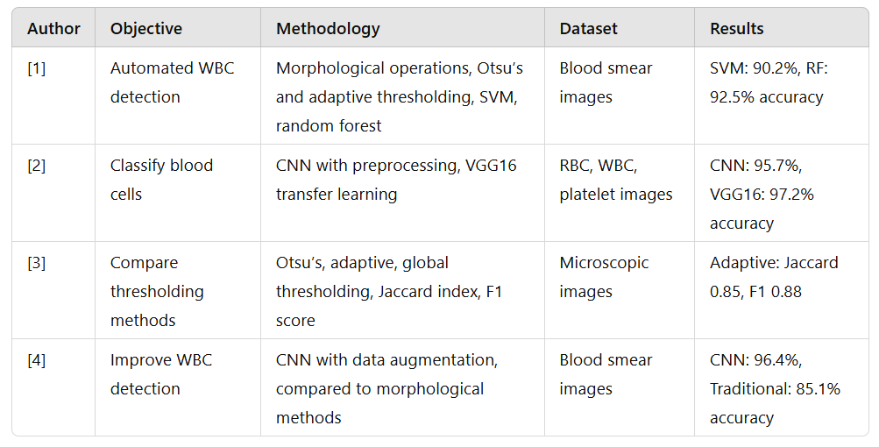

Slide 9
REQUIREMENTS
Software Requirements
Operating system : Windows 7 or later..
Coding Language : Python
Tools : Google collab
Dataset : Collected from Kaggle.
Hardware Requirements
Processor : IntelPentium
RAM : 4.00 GB or more

Slide 10
METHODOLOGY
Data PreparationDefine Dataset Path: The path to the dataset is set to a specific folder where the cell images are stored.List Image Files: Using the os library, the code lists all images in the dataset directory that have .png or .jpg extensions.Select Random Image: One image is randomly chosen from the dataset for analysis.
Ground Truth DataMock Ground Truth Count: A placeholder function, get_ground_truth_count, is defined to simulate ground truth data by returning a random cell count between 0 and 10. This function should ideally be replaced with actual ground truth values if available.

Slide 11
METHODOLOGY
3. Image ProcessingImage Reading: The selected image is read in grayscale mode for easier processing.Morphological Operations:Kernel Definition: A 5x5 matrix of ones is created as a structuring element for morphological operations.Dilation: The image undergoes dilation to enhance cell-like features.Closing: Morphological closing is applied to reduce noise by filling small holes in detected regions.
4. ThresholdingAdaptive Thresholding: Two adaptive thresholding techniques are applied to binarize the image based on local pixel intensities:Mean Thresholding: Binarization based on the local mean intensity.Gaussian Thresholding: Binarization with Gaussian-weighted intensity around each pixel.Otsu’s Thresholding: A global thresholding technique that calculates an optimal threshold value to separate foreground (cells) and background.

Slide 12
METHODOLOGY
5. Circle Detection Using Hough TransformHough Circle Transform: This algorithm detects circular shapes in the image:Adjusted parameters control the minimum distance between detected centers, thresholds for edge and center detection, and circle size range.Circle Extraction and Annotation:If circles are detected, each circle’s parameters (center and radius) are stored and annotated on the image with:Circle Outline: Drawn around each detected cell.Center Marker: A small rectangle indicating the circle’s center.Label: Adds the label "WBC" next to each detected circle.
6. Display of Detected CellsRGB Conversion: Converts the image from BGR to RGB to display correctly with Matplotlib.Plotting with Matplotlib: Displays the annotated image with detected cells, suppressing axis labels and adding a title with the image filename.

Slide 13
METHODOLOGY
7. Accuracy CalculationCalculate Ground Truth and Detected Count: The number of detected cells is compared with the ground truth count for the selected image.Accuracy Formula: A simple accuracy calculation based on the difference between detected and ground truth counts is performed, accounting for cases where the ground truth is zero.
8. Visualization of AccuracyPlotting Accuracy: A bar chart shows the accuracy metric for the image, providing a visual summary of the detection performance.
9. Result ReportingPrint Detected Information: The code outputs the detected cell count, as well as the x-coordinates, y-coordinates, and radii of all detected cells, providing detailed data on each detection.

Slide 14
PROPOSED SYSTEM
The proposed system leverages image processing techniques to automate the detection of white blood cells (WBCs) from medical images. The system is designed to process grayscale images, enhancing the accuracy of detecting cells using various methods such as morphological operations, adaptive thresholding, and circle detection with the Hough Circle Transform.
1. Input Dataset
The system begins by loading the dataset of medical images, which are stored in formats such as .png and .jpg. The images contain medical samples where the white blood cells need to be identified and counted. A random image is selected from the dataset for analysis.

Slide 15
PROPOSED SYSTEM
2. Image Preprocessing
The system applies morphological operations to enhance the features of the image, such as the boundaries of the cells. Operations like dilation and closing help in removing noise and refining the shape of the cells for more accurate detection.
3. Thresholding Techniques
Adaptive thresholding methods, specifically mean and Gaussian adaptive thresholding, are applied to convert the grayscale image into a binary format, where the white blood cells stand out against the background. The system also uses Otsu's thresholding to dynamically choose an optimal threshold value for separating the cells from the background.

Slide 16
PROPOSED SYSTEM
4. Circle Detection
To detect the white blood cells, the system employs the Hough Circle Transform, which is particularly effective in identifying circular shapes in images. The system identifies the circular regions, representing the cells, and labels them by drawing circles around the detected cells and marking the centers.
5. Display and Results
Finally, the processed image is displayed using Matplotlib, showing the detected cells labeled with circles and their centers marked. Additionally, the total number of detected cells, along with their radii and coordinates, is printed for further analysis.

Slide 17
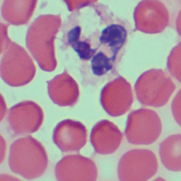
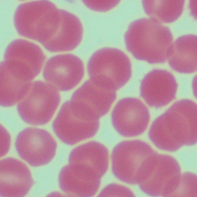
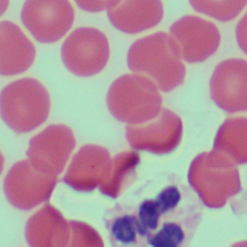
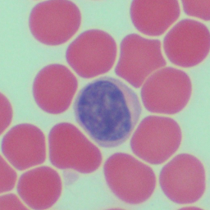
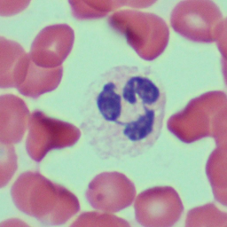
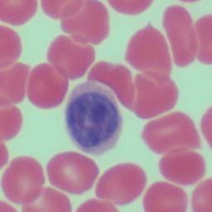
DATASET(BLOOD CELL IMAGES)

Slide 18
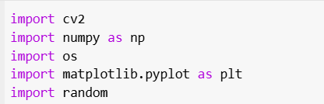
IMPLEMENTAION
1. Import Libraries:
cv2: For image processing tasks.
numpy: For numerical operations.
os: For handling file paths and directories.
matplotlib.pyplot: For plotting.
random: For random number generation.

Slide 19
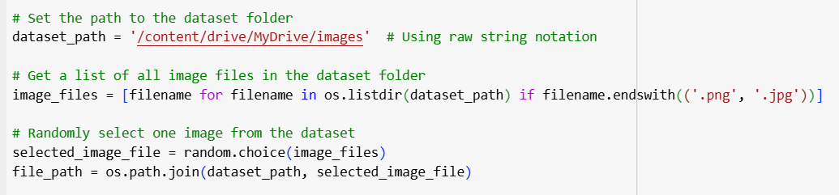
2. Dataset Path and Image Selection:
The dataset path is set to the specified folder containing images.
It retrieves all image files with .png and .jpg extensions.
A random image is selected from this list for processing.

Slide 20
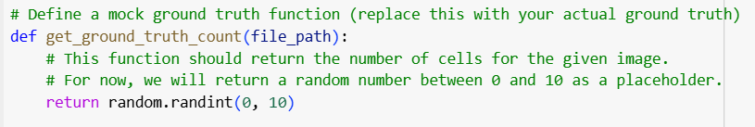
3.Ground Truth Placeholder:
A function get_ground_truth_count generates a random number (0-10) as a mock cell count for the selected image. This is a placeholder for actual ground truth data.

Slide 21
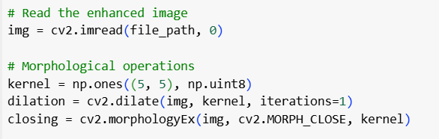
4. Read and Preprocess Image:
The image is loaded in grayscale using cv2.imread.
Morphological Operations:
A kernel of size 5x5 is created.
Dilation and Closing operations are applied to enhance features.

Slide 22
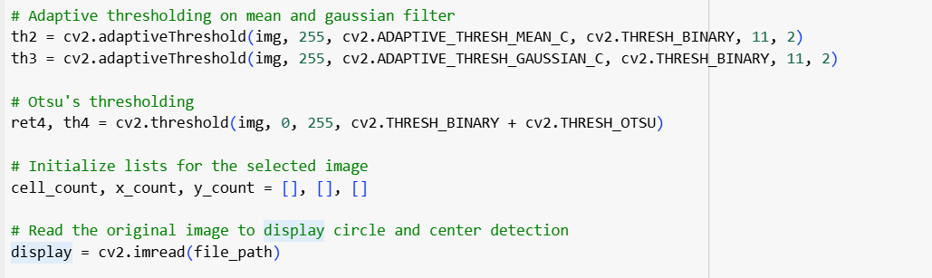
5. Thresholding:
Adaptive thresholding methods (mean and Gaussian) and Otsu’s thresholding are applied for binarization. These techniques help distinguish cells from the background.

Slide 23
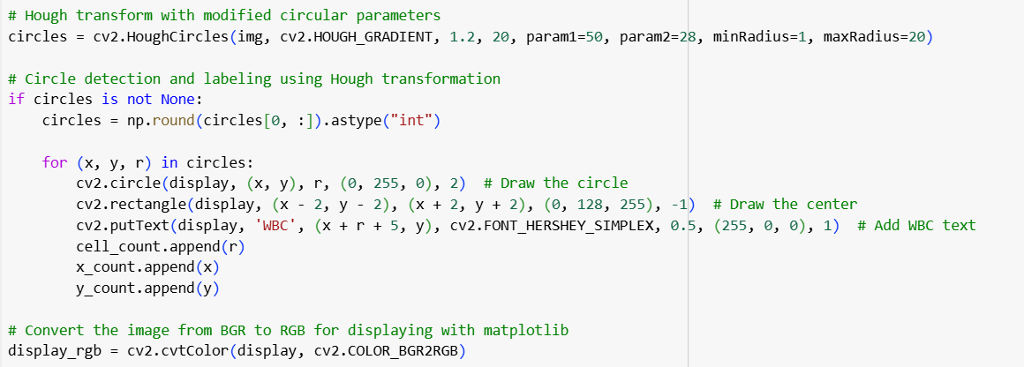
6. Circle Detection with Hough Transform:
The Hough Circle Transform detects circles that likely represent cells.
Circles are drawn on the image, with a rectangle for each center, and labeled "WBC".
Each detected circle's radius and coordinates are stored in cell_count, x_count, and y_count lists.

Slide 24
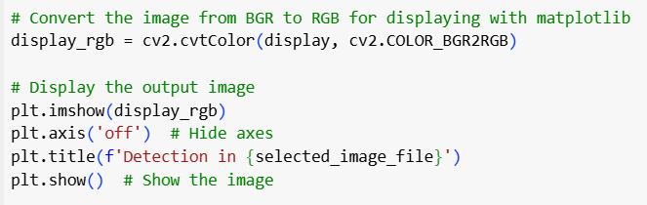
7. Display Image with Detected Circles:
The display image is converted to RGB for display in matplotlib.
The result is shown using plt.imshow.

Slide 25
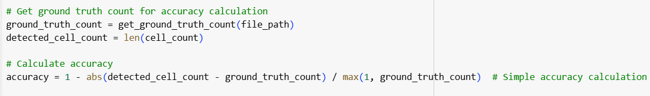
8. Accuracy Calculation:
get_ground_truth_count provides a mock count of cells for comparison.The difference between detected and ground truth counts is used to calculate a simple accuracy metric.

Slide 26
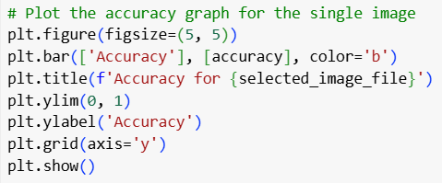
9. Plotting Accuracy:
A bar chart displays the calculated accuracy for the image.

Slide 27
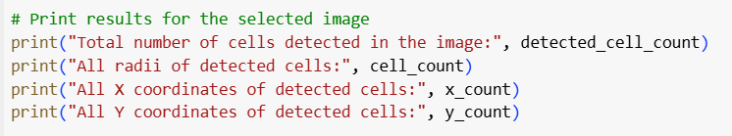
10. Printing Results:
It outputs the total detected cells, radii, and coordinates for each detected cell.

Slide 28
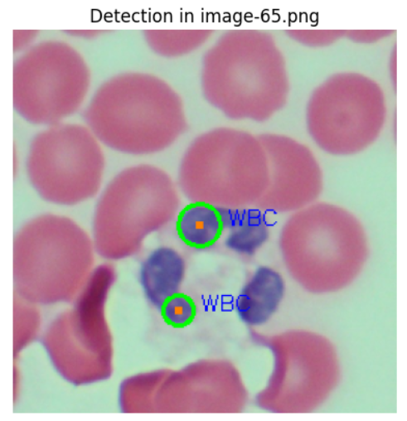
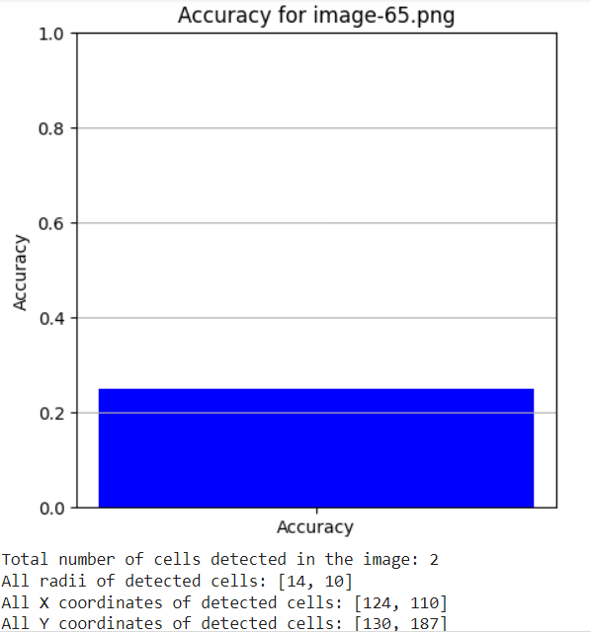
RESULTS

Slide 29
CONCLUSION
This project successfully demonstrates an automated white blood cell (WBC) detection system using image processing techniques such as morphological operations and Hough Circle Transform. The code processes blood smear images by applying dilation, closing, adaptive thresholding, and Otsu’s thresholding to enhance the quality of the images for more accurate segmentation. The key technique used for cell detection was the Hough Circle Transform, which effectively identified circular shapes representing WBCs in the images.
The system displayed promising results by accurately detecting and labeling white blood cells in a randomly selected image from the dataset. The detected cells were highlighted with circles, and their centers were marked for clarity.

Slide 30
The number of detected cells, as well as their radii and coordinates, were printed as output for further analysis. The adaptive thresholding techniques (mean and Gaussian) were utilized to enhance contrast, contributing to better segmentation results, while Otsu's thresholding was also employed to binarize the image for easier detection.
This method is an efficient way to detect WBCs in blood smear images and can be further enhanced by integrating deep learning models for higher accuracy and robustness. Future improvements could include optimizing parameters, handling varying illumination conditions more effectively, and evaluating performance on larger, more diverse datasets.

Slide 31
REFERENCES
[1] Abbas S, “Microscopic images dataset for automation of RBCs counting”, DatainBrief 5 2015., pp. 35-40.
[2] Ahasan R, Ratul A.U, A.S.M. Bakibillah, “White blood cells nucleus segmentationfrom microscopic images of strained peripheral blood filmduring leukemiaandnormal condition”, 2016 5th International Conference on Informatics, ElectronicsandVision, ICIEV 2016, pp. 361-366.
[3] Adagale S.S, Pawar S.S, “Image Segmentation using PCNNand TemplateMatching for”, IEEE 2013.
[4] Gautam, Anjali, Bhadauria, Harvindra, “Classification of White Blood CellsBasedon Morphological Features”, 2014 International Conference on AdvancesinComputing,Communications and Informatics (ICACCI), pp. 2363 2368.
[5] Hari J, Prasad A.S, Rao S.K, “Separation and counting of blood cellsusinggeometrical features and distance transformed watershed”, Proceedings of theIEEEInternational Caracas Conference on Devices, Circuits and Systems, ICCDCS2014pp. 1-5.

Slide 32
[6] Jha K.K, Das B.K, Dutta H.S, “Detection of abnormal blood cells on thebasisofnucleus shape and counting of WBC”, Proceeding of the IEEE International Conference on Green Computing, Communication and Electrical Engineering, ICGCCEE 2014.
[7] Kaur P, Sharma V, N. Garg, “Platelet Count using Image Processing”, 2016International Conference on Computing for Sustainable Global Development, 2016, pp. 2574-2577. 57
[8] Manik S, Lalit, M. Saini, N. Vadera, “Counting and Classification of WhiteBloodCell using Artificial Neural Network (ANN)”, 1st IEEE International ConferenceonPower Electronics. Intelligent Control and Energy Systems (ICPEICES-2016, pp. 1-5.
[9] Loddo, Andrea, Putzu, Lorenzo, Ruberto, Cecilia DI, Fenu, Gianni, “AComputer- Aided System for Differential Count from Peripheral Blood Cell Images”, Proceedings- 12th International Conference on Signal Image Technology and Internet-BasedSystems, SITIS 2016, pp. 112-118.
[10] Lou J, M. Zhou, Q. Li, C. Yuan, H. Liu, “An automatic red blood cell countingmethod based on spectral images”, 2016 9th International Congress on ImageandSignal Processing, BioMedical Engineering and Informatics (CISP BMEI), pp. 1391- 1396

