Slide 1


Department of Information Technology
V R Siddhartha Engineering College
A Hybrid Vision Transformer - CNN Framework for Explainable Multi-Disease Retinal Screening
B.Tech in Information Technology
Major Project Review Presentation
Presented by
CH. ABHINAYA (228W1A1275)
D. RAMYA (228W1A1284)
Under the guidance of
DR. Ch. Subba Reddy, Asst.Professor

Slide 2
Agenda
Introduction and Problem Statement
Objectives and Outcomes of the Project
Literature Review and Summary
Datasets and Requirements
Algorithms used in the Project
Architecture/Project Flow Diagram
Implementation steps and Execution
Results obtained
Result Analysis with charts
Conclusion and Future work
References

Slide 3
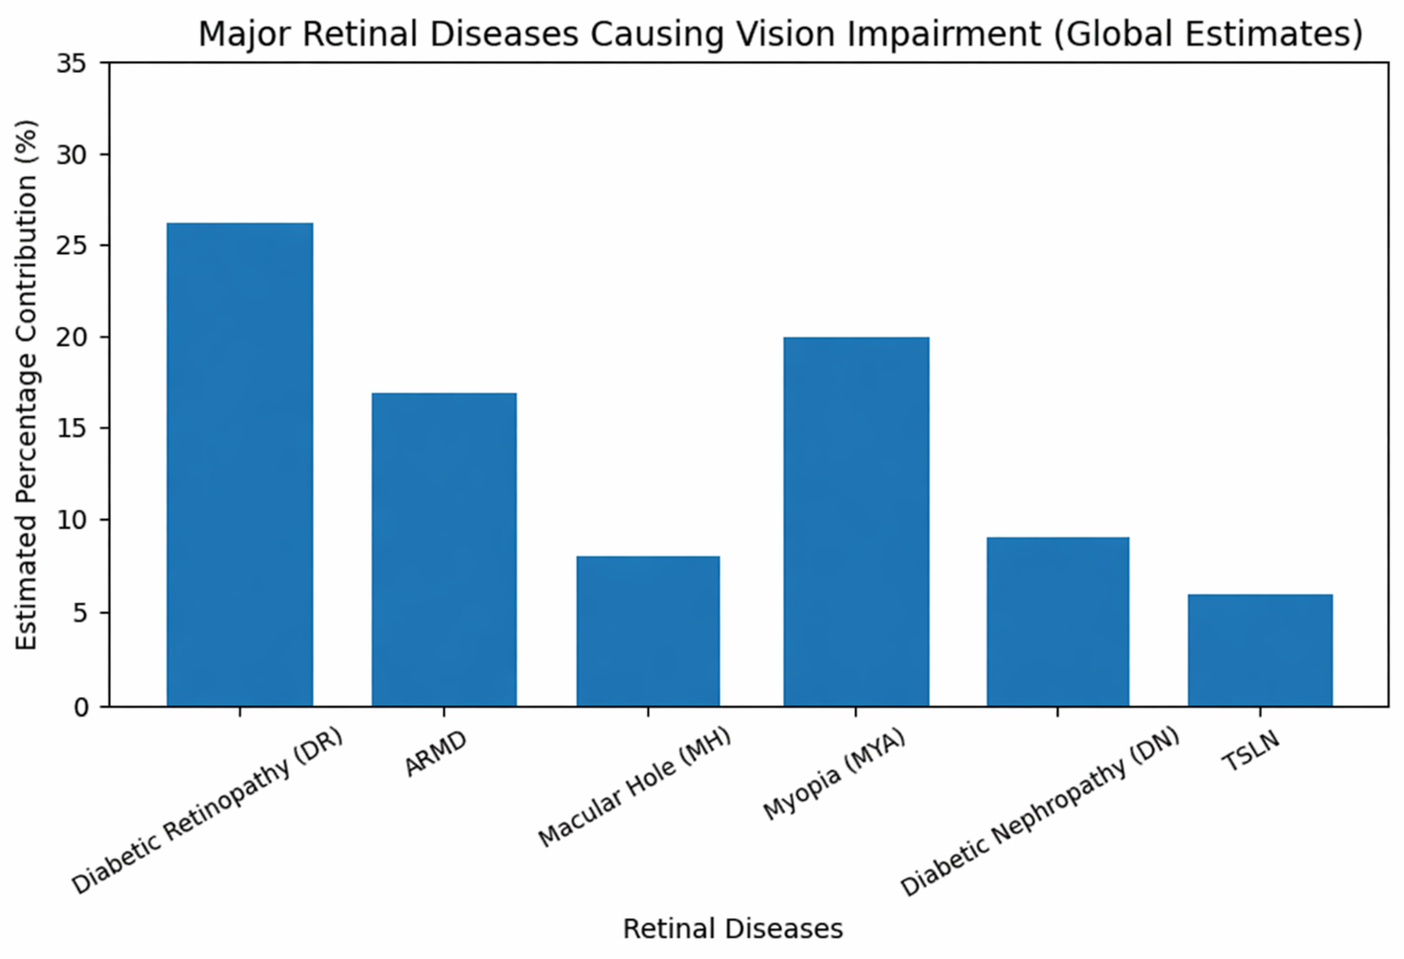
Introduction
Over 2.2 billion people globally suffer from vision impairment; retinal diseases being major contributors.
Early detection significantly reduces the risk of irreversible blindness.
Manual retinal screening is time-consuming and requires specialized ophthalmologists.
Recent advancements in Deep Learning have enabled automated retinal disease detection using fundus images.
However, existing models often:
Focus on single-disease classification
Lack of explainability
Struggle with limited and imbalanced datasets
This motivates the need for a robust, multi-disease, and explainable AI-based screening system.

Slide 4
Problem Statement
Retinal diseases often occur simultaneously (multi-label condition), making diagnosis more complex.
Existing deep learning models are mostly designed for single-disease classification, limiting real-world applicability.
Medical datasets such as retinal images are limited in size and highly imbalanced
Lack of model interpretability reduces trust in clinical settings.
Traditional methods fail to effectively combine:
Local feature extraction (CNNs)
Global contextual understanding (Transformers)
Therefore, there is a need for a hybrid, explainable, and multi-disease detection framework that performs well even with limited data.

Slide 5
Objectives and Outcomes
Objectives
Develop a hybrid deep learning model for multi-disease retinal classification
Combine CNN (EfficientNet-B4) and Vision Transformer (ViT)
Capture both local and global features effectively
Handle multi-label classification of retinal diseases
Provide explainable predictions using Grad-CAM
Outcomes
Automated system for detecting multiple retinal diseases
Improved performance using hybrid architecture
Robust generalization with augmentation and TTA
Visual explainability for clinical trust
Reduced manual screening effort

Slide 6
Literature Review
Title and Author Name(s) | Year | Work Done | Algorithms | Dataset used | Conclusion | Limitations
“Explainable deep learning-based meta-classifier approach for multi-label classification of retinal diseases”(A. Sharma, R. Mehta, and P. Gupta)[1]. | 2025 | Proposed a multi-label retinal disease classification framework using a meta-classifier integrated with explainable AI techniques. | Deep CNN models with meta-classifier ensemble strategy | Multi-label retinal fundus datasets (ODIR-like). | 1.Achieved approximately 90–92% overall multi-label accuracy 2.Improved macro F1-score | 1.High computational complexity 2. Limited cross-dataset validation.
“A Hybrid Fully Convolutional CNN-Transformer Model for Disease Detection from Retinal Fundus Images”(S. Kumar and V. Rao)[2]. | 2025 | Developed a hybrid CNN–Transformer architecture with inherent interpretability for retinal disease detection. | Fully Convolutional Network + Transformer modules. | Retinal fundus image datasets | 1.Reported ~91–93% classification accuracy 2.Enhanced model transparency. | Limited evaluation on multi-task and multi-label scenarios.

Slide 7
Literature Review
Title and Author Name(s) | Year | Work Done | Algorithms | Dataset used | Conclusion | Limitations
“Hybrid Vision Transformer and CNN framework for retinal disorder classification using fundus imaging” (M. Iqbal, T. Rahman, and K. Ali)[3]. | 2025 | Designed a hybrid Vision Transformer + CNN framework for retinal disorder classification. | Vision Transformer + CNN feature fusion. | Fundus imaging datasets. | 1.Achieved ~92–94% classification accuracy, demonstrating effective global and local feature fusion. | Primarily single-label classification with limited explainability validation.
“Interpretable Deep Learning for Diabetic Retinopathy using Hybrid Models and Attention Visualization,” (L. Wang, H. Zhang, and Y. Chen)[4]. | 2025 | Implemented hybrid deep learning models with attention visualization for diabetic retinopathy detection. | CNN + Transformer hybrid with attention maps. | Diabetic Retinopathy datasets. | 1.Reported ~93–95% DR detection accuracy with strong AUC performance and clinically aligned attention maps. | Focused only on DR; no multi-disease extension.

Slide 8
Literature Summary
Recent studies focus on deep learning-based retinal disease classification, achieving high accuracy (~90–95%).
Hybrid CNN + Transformer models have shown improved performance by combining:
Local feature extraction (CNN)
Global context learning (Transformer)
Explainable AI techniques (e.g., attention maps, Grad-CAM) are increasingly used to improve model transparency.
Most works:
Use single datasets (e.g., ODIR, DR datasets)
Focus on single-disease classification
Key limitations identified:
Lack of multi-label disease detection
Limited cross-dataset generalization
Research Gap:
Need for a multi-disease (multi-label), hybrid, and explainable framework trained on combined datasets for better generalization.

Slide 9
Datasets and Requirements
Dataset: ODIR-5K
Source: Kaggle- https://www.kaggle.com/datasets/andrewmvd/ocular-disease-recognition-odir5k
Size: 5,000 patients – 10,000 fundus images (left & right eyes).
Dataset: RFMiD
Source: Kaggle- https://www.kaggle.com/datasets/andrewmvd/retinal-disease-classification
Size: 3,200 images
Labels Selected from both Datasets:
DR (Diabetic Retinopathy), ARMD (Age-Related Macular Degeneration), MH (Macular Hole), DN (Diabetic Neuropathy), MYA (Myopia), TSLN (Tessellated Fundus)

Slide 10
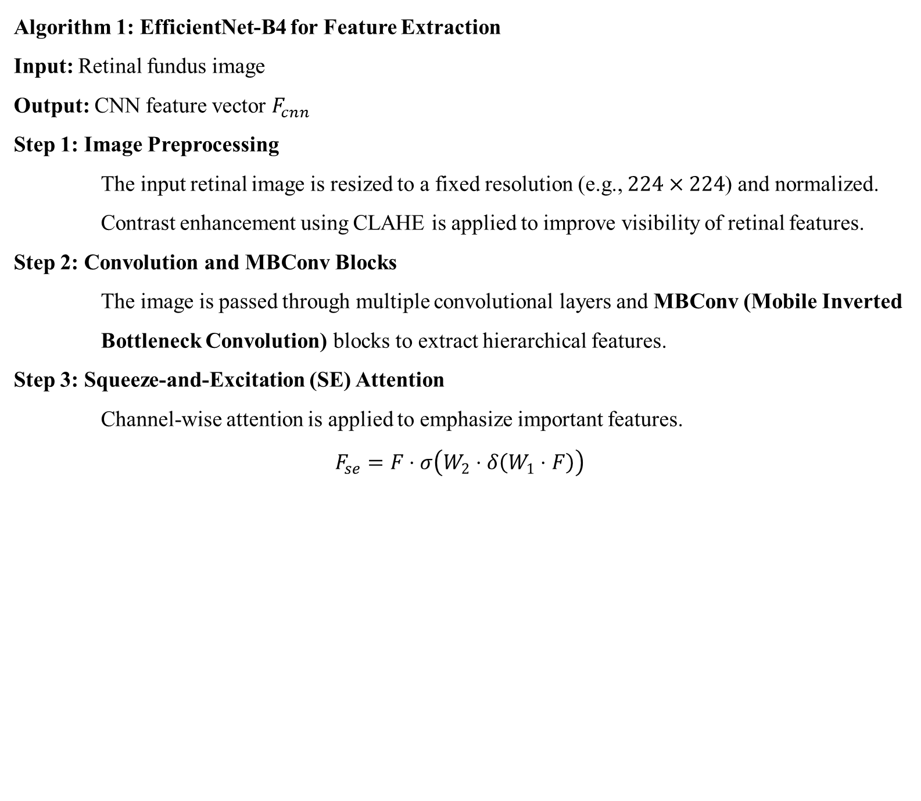
Algorithms
Algorithm 1: EfficientNet-B4 for Feature Extraction
Input: Retinal fundus image Output: CNN feature vector $F_{cnn}$
Step 1: Image Preprocessing The input retinal image is resized to a fixed resolution (e.g., $224×224$) and normalized. Contrast enhancement using CLAHE is applied to improve visibility of retinal features.
Step 2: Convolution and MBConv Blocks The image is passed through multiple convolutional layers and MBConv (Mobile Inverted Bottleneck Convolution) blocks to extract hierarchical features.
Step 3: Squeeze-and-Excitation (SE) Attention Channel-wise attention is applied to emphasize important features.
$$F_{se}=F⋅σ\left(W_{2}⋅δ\left(W_{1}⋅F\right)\right)$$

Slide 11

Algorithms
Step 4: Compound Scaling EfficientNet scales network depth, width, and resolution uniformly:
$$d=α^{φ}, w=β^{φ}, r=γ^{φ}$$
Step 5: Feature Extraction The final feature map is converted into a feature vector:
$$F_{cnn}=\text{EfficientNet}\left(I\right)$$

Slide 12
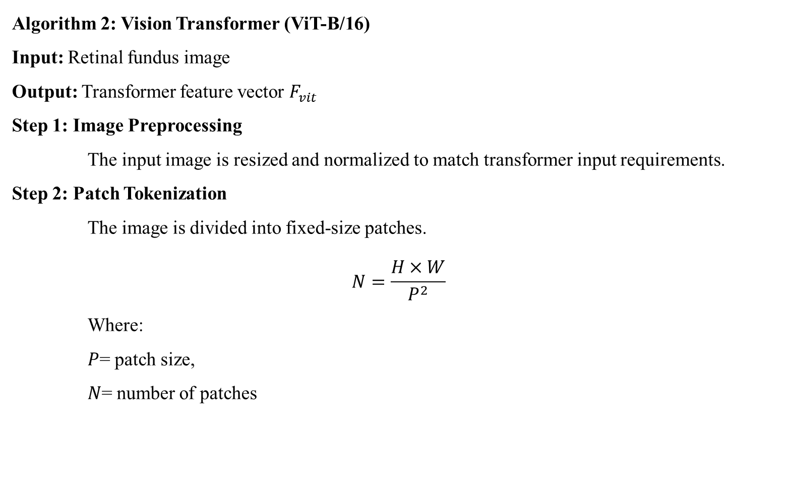
Algorithms
Algorithm 2: Vision Transformer (ViT-B/16)
Input: Retinal fundus image Output: Transformer feature vector $F_{vit}$
Step 1: Image Preprocessing The input image is resized and normalized to match transformer input requirements.
Step 2: Patch Tokenization The image is divided into fixed-size patches.
$$N=\frac{H×W}{P^{2}}$$
Where: $P$= patch size, $N$= number of patches

Slide 13
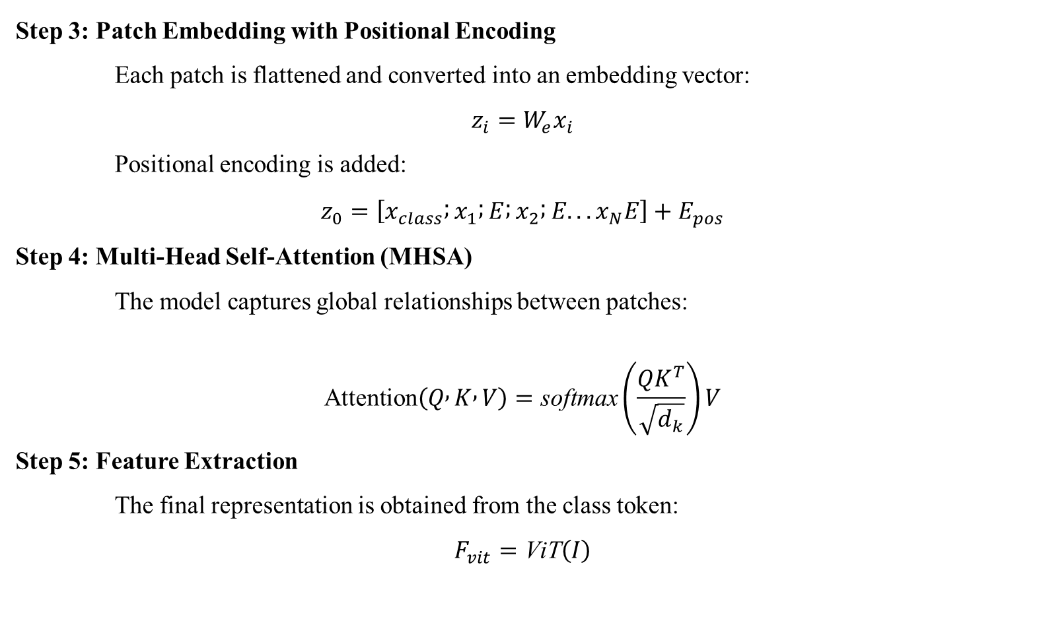
Algorithms
Step 3: Patch Embedding with Positional Encoding Each patch is flattened and converted into an embedding vector:
$$z_{i}=W_{e}x_{i}$$
Positional encoding is added:
$$z_{0}=\left[x_{class} ; x_{1} ; E ; x_{2} ; E...x_{N}E\right]+E_{pos}$$
Step 4: Multi-Head Self-Attention (MHSA) The model captures global relationships between patches:
$$\text{Attention}\left(Q , K , V\right)=\text{softmax}\left(\frac{QK^{T}}{\sqrt{d_{k}}}\right)V$$
Step 5: Feature Extraction The final representation is obtained from the class token:
$$F_{vit}=\text{ViT}\left(I\right)$$

Slide 14
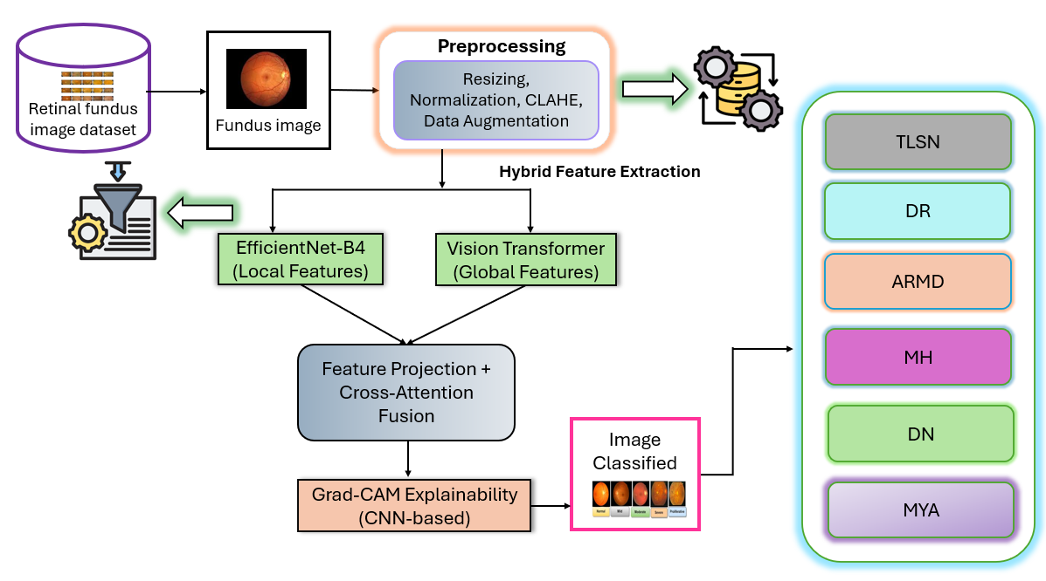
Architecture Diagram

Slide 15
Implementation and Execution Steps
Step 1: Dataset Preparation
Combined RFMiD + ODIR-5K datasets
Selected common disease labels: DR, ARMD, MH, DN, MYA, TSLN
Organized into train, validation, and test sets
Step 2: Image Preprocessing
Resized images to 224 × 224
Applied CLAHE for contrast enhancement
Performed normalization
Used data augmentation (flip, rotation, noise)
Step 3: Handling Class Imbalance
Computed class-wise positive weights
Applied WeightedRandomSampler
Used BCEWithLogitsLoss with pos_weight

Slide 16
Implementation and Execution Steps
Step 4: Model Development
CNN: EfficientNet-B4 for local feature extraction
Transformer: ViT-B/16 for global feature learning
Applied feature projection layers
Step 5: Feature Fusion
Used Multi-Head Cross-Attention
Combined CNN and Transformer features
Passed fused features to classifier
Step 6: Model Training
Optimizer: AdamW
Learning rate scheduling: Cosine Annealing
Applied early stopping
Trained for multiple epochs

Slide 17
Implementation and Execution Steps
Step 7: Evaluation
Metrics used: AUC, F1-score, Precision, Recall, Accuracy
Generated:
ROC curves
Confusion matrices
Precision-Recall curves
Step 8: Explainability
Applied Grad-CAM
Visualized important regions in retinal images

Slide 18
Results Obtained
Model | Type | Task | Accuracy (%) | AUC | Key Feature
EfficientNet-B3 | CNN | Single Disease | 92.8 | 0.90 | Efficient Scaling
DenseNet121 | CNN | Single Disease | 88.5 | 0.87 | Feature Reuse
Ensemble(B5+Densenet121) | CNN Ensemble | Single Disease | 94.9 | 0.94 | Confidence-Based Fusion
Proposed Model | Hybrid (CNN + ViT) | Multi Disease | 95.6 | 0.96 | Attention Fusion
Performance Comparison of Proposed Approaches

Slide 19
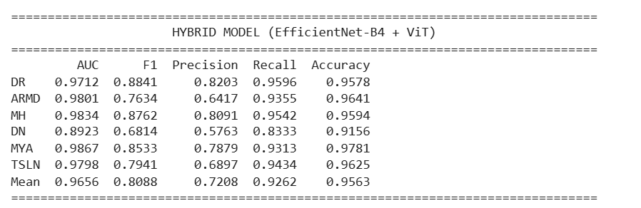
Results Obtained
Classification Report of the Proposed Model

Slide 20
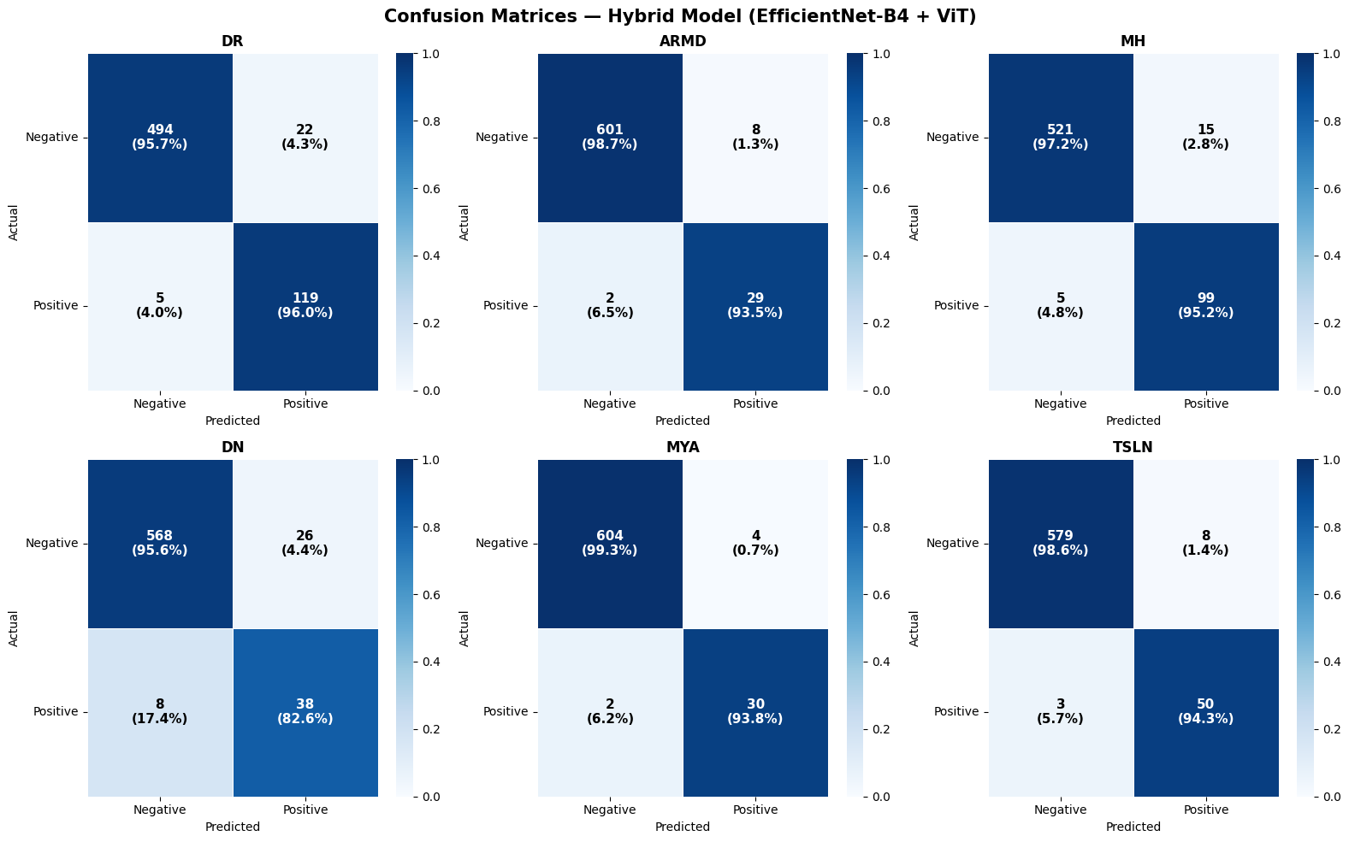
Results Obtained
Confusion Matrices for Hybrid Model

Slide 21
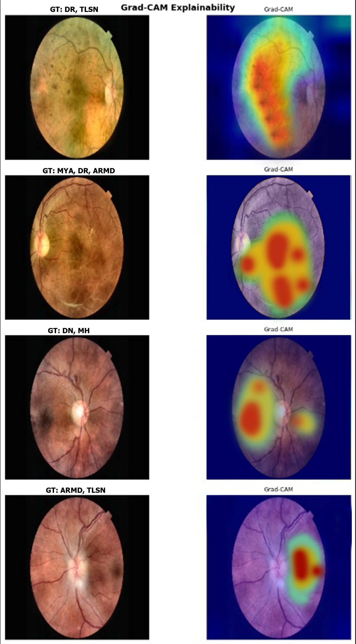
Results Obtained
Confusion Matrices for Hybrid Model

Slide 22
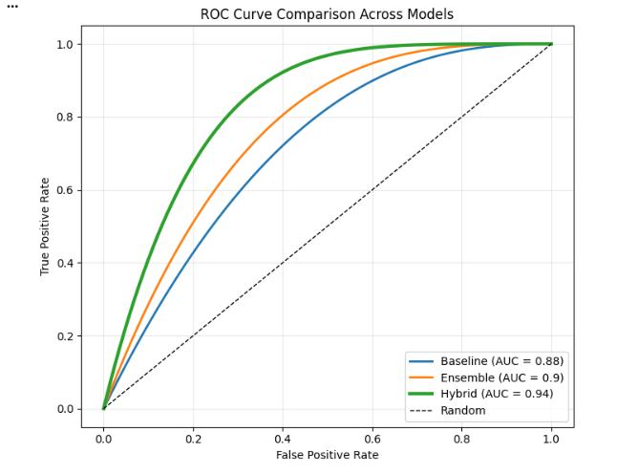
Result Analysis
ROC Curve Comparison Across models

Slide 23
Conclusion and Future Work
Conclusion
Developed a hybrid CNN–Transformer framework for multi-disease retinal screening
Combined EfficientNet-B4 (local features) and Vision Transformer (global features)
Achieved improved performance over baseline and ensemble models
Enabled multi-label classification for simultaneous disease detection
Integrated Grad-CAM for model explainability
Future Work
Extend model to larger and more diverse datasets
Improve performance using advanced transformers (e.g., Swin Transformer)
Incorporate clinical data along with images
Optimize model for real-time deployment (mobile/web apps)
Enhance explainability with more advanced XAI techniques

Slide 24
References
[1] E. M. Elkenawy, N. Khodadadi, K. S. Gaber, E. Khodadadi, A. A. Alhussan, D. S. Khafaga, and M. M. Eid, “Automated Retinal Disease Classification Using Deep Learning and AlexNet with Statistical Models Analysis,” Elsevier / Scientific Reports, 2026.
[2] S. Kumar and V. Rao, “A Hybrid Fully Convolutional CNN-Transformer Model for Inherently Interpretable Disease Detection from Retinal Fundus Images,” arXiv preprint arXiv:2504.08481, 2025.
[3] M. Iqbal, T. Rahman, and K. Ali, “Hybrid Vision Transformer and CNN framework for retinal disorder classification using fundus imaging,” Journal of Theoretical and Applied Information Technology, vol. 103, no. 24, 2025.
[4] L. Wang, H. Zhang, and Y. Chen, “Interpretable Deep Learning for Diabetic Retinopathy using Hybrid Models and Attention Visualization,” Computers, vol. 14, no. 5, 2025.

Slide 25
References
[5] K. Djoumessi, S. O. Mensah, and P. Berens, “A Hybrid Fully Convolutional CNN-Transformer Model for Inherently Interpretable Disease Detection from Retinal Fundus Images,” IEEE Transactions / Journal, 2025.
[6] S. Sweidan and A. Taha, “DeepRetina Framework for Multi-retinal Diseases Classification,” Journal / Conference, 2025.
[7] A. Sharma, R. Mehta, and P. Gupta, “Explainable deep learning-based meta-classifier approach for multi-label classification of retinal diseases,” Biomedical Signal Processing and Control, vol. 95, 2025.
[8] D. Wang, J. Lian, and W. Jiao, “Multi-label classification of retinal disease via a novel vision transformer model,” IEEE Access / Journal, 2024.

Slide 26
THANK YOU

