Slide 1
ADVANCED SECURITY SYSTEM FOR AUTOMOBILES
DONE BY:
R.ABHINAYA[111713104001]
B.ABIRAMI[111713104003]
G.ABIRAMI[111713104004]

Slide 2

WHAT IS SECURITY?
Security is the degree of resistance to, or protection from, harm. It applies to any vulnerable and valuable asset, such as a person, dwelling, community, item, nation, or organization.
Security has two dialogues. Negative dialogue is about danger, risk, threat and etc. Positive dialogue is about opportunities, Interests, profits etc. Negative dialogue needs military equipment, armies, police. Positive dialogue needs social capital, Education, social interaction.

Slide 3
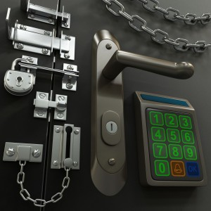
IMPORTANCE OF SECURITY
Designing secure vehicles is becoming increasingly important as a result of recent advances in potential cyber-attacks against vehicles. This security needs to be considered over the course of the product lifecycle and includes a consideration of requirements definitions, design, development, testing, and maintenance.
TYPES OF SECURITY
Monitoring
Installation
Home Automation

Slide 4


WHY SECURITY?
Cars are expensive ,security is needed to prevent them from being theft . Lot of times people think that they are immune to theft or “It won’t happen to me”. This is absolutely untrue .Once the car is theft , it is very difficult to find the culprit. Police compliant takes many years to find the culprit Since it is a tough job for policeman.
Don’t leave yourself, your information or your vehicle vulnerable to an intruder by not having a car security system installed on your vehicle.

Slide 5

Mobile phone is having IMEI number and Credit card is having a number to recover from theft but for CAR?
OUR IDEA:
A barcode is embedded in a car during the manufacturing stage

Slide 6


TECHNOLOGY USED
BARCODE :
Barcode is the small image of lines (bars) and spaces that is affixed to car's number plate ,identification cards to identify a particular car's owner or location. The code uses a sequence of vertical bars and spaces to represent numbers and other symbols.
DATABASE:
A database is a collection of information that is organized so that it can easily be accessed, managed, and updated.

Slide 7
ADVANTAGES OF BARCODE READER
Eliminate the possibility of human error.
Reliable
User Friendly
Reduces employee training time
Inexpensive to design and print
Data obtained through barcodes is available rapidly

Slide 8

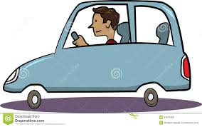
PRINCIPLE

Slide 9
WORKING
APPLICATION
DATABASE
[QUERY,RETRIEVE]
DISPLAY

Slide 10
ADVANTAGE OF SECURITY SYSTEM
They prevent unauthorized access
Bumping up car's resale value
Ease of identifying the car's owner
Helping with insurance
Avoiding the high cost of car theft
Like mobile

Slide 11

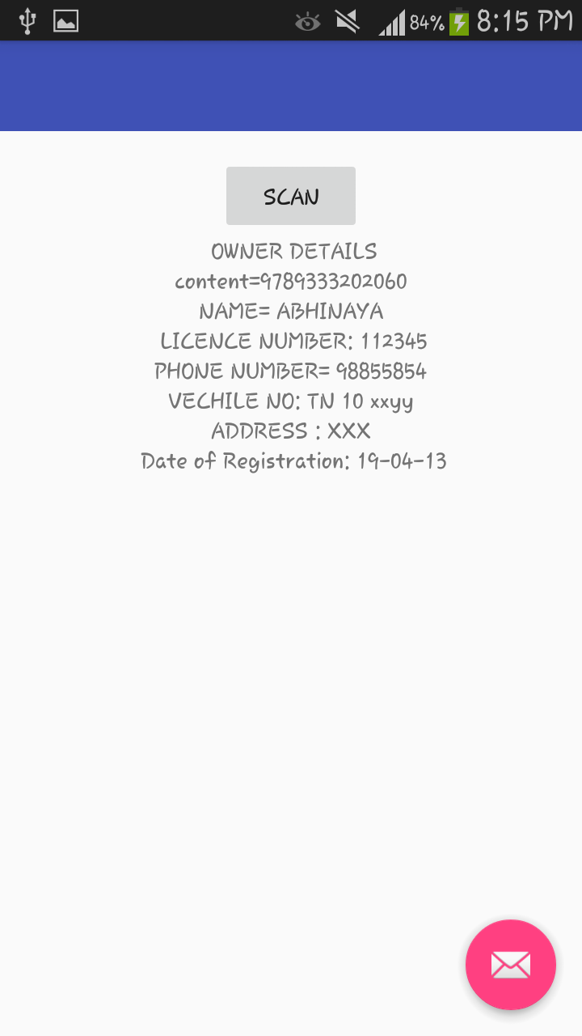
Result:

Slide 12


