Slide 1

Health care services
We are here to help you……..

Slide 2
contents
Introduction
How this website helpful?
Services
Banks
Contact us
Register
feedback

Slide 3
INTRODUCTION
Organ donation is the process when a person allows an organ of their own to be removed and transplanted to another person, legally, either by consent while the donor is alive or dead with the assent of the next of kin.
In this website we can know about the person who is in need of organ , blood ,tissue to survive in life.
Also we can know about the donor's through this website.
This website will help to know about the donor to save the person who is in danger.
By this website we can save many lives.

Slide 4
about us
Organ transplantation saves a large number of lives and improves the quality of life of many more. But there is a major shortfall in the availability of organs. This leads to potentially preventable death and morbidity in a large number of people. Yet the resources needed to meet the demand for organs are potentially available. Every day there are a large number of patients, who die in controlled circumstances in hospital, whose organs could potentially save the lives of others. But the vast majority of these organs are buried or burned.

Slide 5

services
Any person can access to the bank tab for services related to blood , organ, tissue donation.
This website is created to save lives of people who are in urgency of organ transplantation , blood and tissue which are related to health.
This can be done with your co-operation by creating your account in this website.

Slide 6
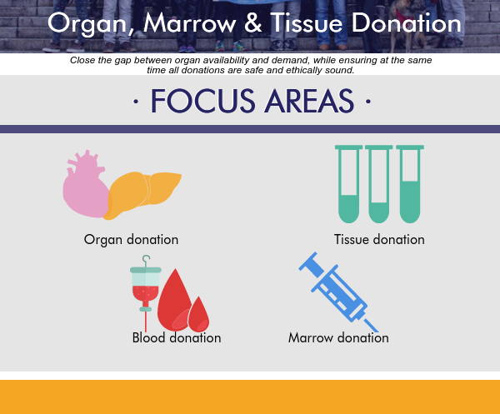
banks
it consists of three sections
Blood section
Organ section
Tissue section

Slide 7
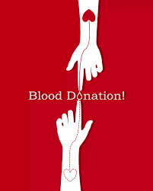
Blood section
It consists of the blood donor details
Contact the person from whom you need the blood from the available information.

Slide 8
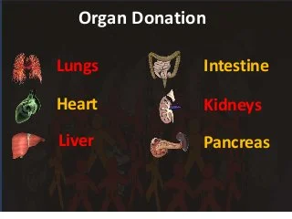
ORGAN SECTION
Organ donation is the process when a person allows an organ of their own to be removed and transplanted to another person, legally, either by consent while the donor is alive or dead with the assent of the next of kin.
It consists of the organ donor details include kidney,liver,eyes…

Slide 9
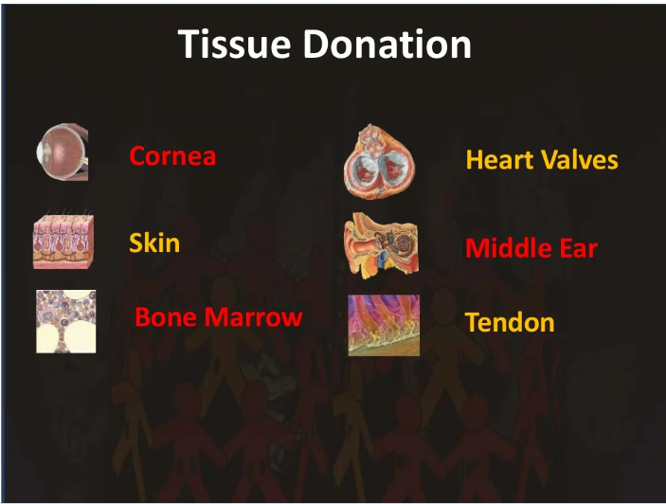
TISSUE SECTION
Donated human tissues can be used in many surgical applications, saving and healing lives on a daily basis. Tissue donation can benefit patients in a number of serious or life-threatening medical situations, including saving patients with severe burns, allowing athletes with torn ligaments or tendons to heal and regain strength
It consists of tissue donor details

Slide 10
contact us
CONTACT US HealthCareServices Mob : +91 96366 20000/+91 63120 20000 Email : healthcare@service.com visit us

Slide 11
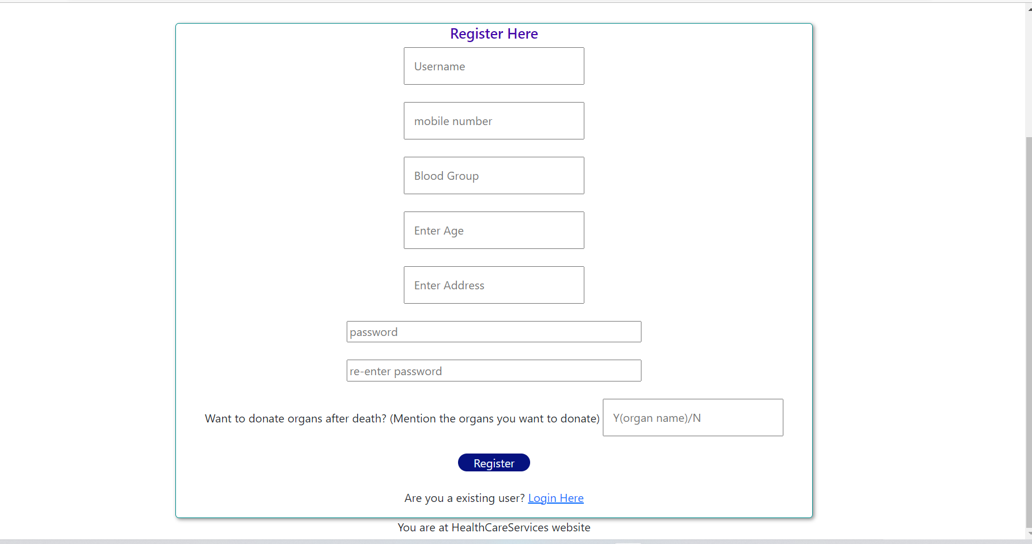
Registration form

Slide 12
