Slide 1
Methods for Evaluating(assessing) the Accuracy of a Classifier
Holdout method
Random Subsampling
Cross Validation
Bootstrap method
1
Notes:
1

Slide 2
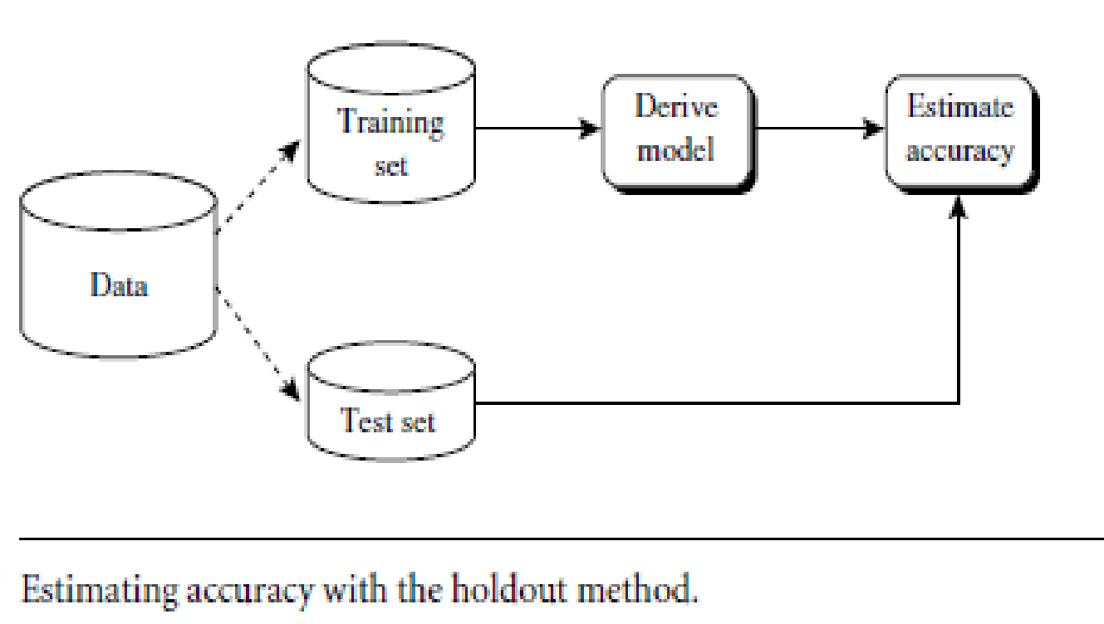
Evaluating(assessing) the Accuracy of a Classifier
Holdout method
Given data is randomly partitioned into two independent sets
Training set (e.g., 2/3) for model construction
Test set (e.g., 1/3) for accuracy estimation ---Pessimistic estimate
Random subsampling: a variation of holdout
Repeat holdout method k times, accuracy = avg. of the accuracies obtained from each iteration
2
Notes:
2

Slide 3
Evaluating the Accuracy of a Classifier
Cross-validation (k-fold, where k = 10 is most popular)
Randomly partition the initial data into k mutually exclusive subsets or folds,D1 to Dk, each of approximately equal size.
Perform training and testing k times.
At i-th iteration, use D_{i} as test set and others collectively as training set
Unlike the holdout and random subsampling methods, here each sample is used the same number of times for training and once for testing.
The results of each iteration are averaged, to find accuracy which is used as a performance metric to compare the efficiency of different models.
The k-fold cross-validation technique generally produces less biased models as every data point from the original dataset will appear in both the training and testing set.
This method is optimal if you have a limited amount of data.
Leave-one-out: A special case of k folds where k is set to number of initial tuples i.e only one sample is left out at a time for test set.
Stratified cross-validation: folds are stratified so that class dist. in each fold is approx. the same as that in the initial data.
3
Notes:
3

Slide 4
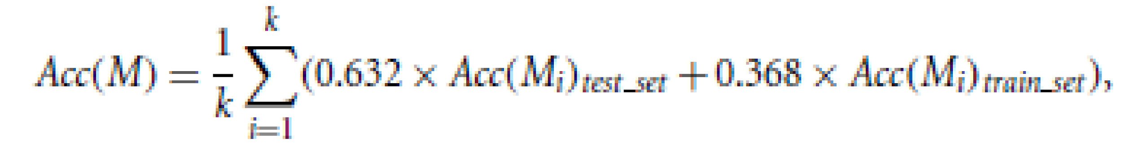

Evaluating the Accuracy of a Classifier
Bootstrap
Works well with small data sets
Samples the given training tuples uniformly with replacement
i.e., each time a tuple is selected, it is equally likely to be selected again and re-added to the training set
Several bootstrap methods, and a common one is .632 bootstrap
Suppose we are given a data set of d tuples. The data set is sampled d times, with replacement, resulting in a training set of d samples. The data tuples that did not make it into the training set end up forming the test set. On an average 63.2% of the original data will end up in the bootstrap sample, and the remaining 36.8% will form the test set (since (1 – 1/d)^{d} ≈ e⁻¹ = 0.368)
Repeat the sampling procedue k times, overall accuracy of the model:
4
Notes:
4

Slide 5
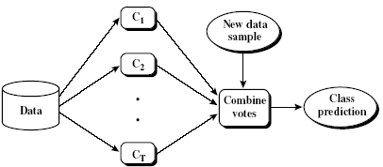







Ensemble Methods: Improving the Accuracy
Ensemble methods
Use a combination of models to increase accuracy
Combine a series of k learned models, M₁, M₂, …, M_{k}, with the aim of creating an improved model M*
A given data set, D, is used to create k training sets, D1, D2, : : : , Dk, where Di(1<=i<=k-1) is used to generate classifier Mi .
Given a new data tuple to classify, the base classifiers each vote by returning a class prediction. The ensemble returns a class prediction based on the votes of the base classifiers.
Ensembles yield better results when there is significant diversity among the models.
Examples are Bagging, boosting, and random forest
5

Slide 6




Bagging: Bootstrap Aggregation
Analogy: Diagnosis based on multiple doctors’ majority vote
Training
Given a set D of d tuples, at each iteration i, a training set D_{i} of d tuples is sampled with replacement from D (i.e., bootstrap)
A classifier model M_{i} is learned for each training set D_{i}
To classify an unknown sample X ,
Each classifier M_{i} returns its class prediction which counts as one vote.
The bagged classifier M*, counts the votes and assigns the class with the most votes to X
Bagging can be applied to the prediction of continuous values by taking the average value of each prediction for a given test tuple
Accuracy
Often significant accuracy than a single classifier derived from D
It will not be considerably worse and is more robust to the effects of noisy data and overfitting.
The increased accuracy occurs because the composite model reduces the variance of the individual classifiers
6

Slide 7



Bagging: Boostrap Aggregation
Figure: Increasing classifier accuracy: Ensemble methods generate a set of classification models, M1, M2, : : : , Mk. Given a new data tuple to classify, each classifier “votes” for the class label of that tuple. The ensemble combines the votes to return a class prediction.

Slide 8
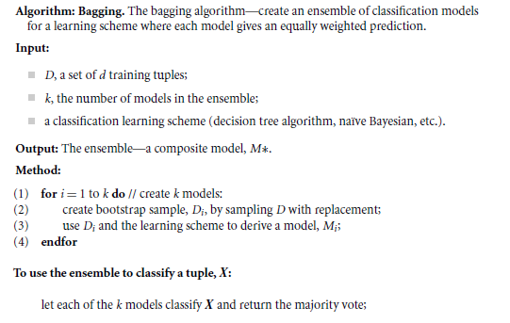
Bagging Algorithm

Slide 9




Boosting
How boosting works?
Weights are assigned to each training tuple
A series of k classifiers is iteratively learned
After a classifier M_{i} is learned, the weights are updated to allow the subsequent classifier, M_{i+1}, to pay more attention to the training tuples that were misclassified by M_{i}
The final boosted classifier M* combines the votes of each individual classifier, where the weight of each classifier's vote is a function of its accuracy
9

Slide 10


Adaboost (Adaptive Boosting)
Given a set of d class-labeled tuples, (X₁, y₁), …, (X_{d}, y_{d})
Initially, AdaBoost assigns each training tuple an equal weight of (1/d)
Generate k classifiers in k rounds. At round i,
Tuples from D are sampled (with replacement) to form a training set D_{i} of the same size d.
Each tuple’s chance of being selected is based on its weight
A classification model M_{i} is derived from D_{i}
Its error rate is calculated using D_{i} as a test set
The weights of the training tuples are then adjusted according to how they were classified.
If a tuple is misclassified, its weight is increased, o.w. it is decreased
These weights will be used to generate the training samples for the classifier of the next round.
The basic idea is that when we build a classifier, we want it to focus more on the misclassified tuples of the previous round.
We build a series of classifiers that complement each other.
10

Slide 11
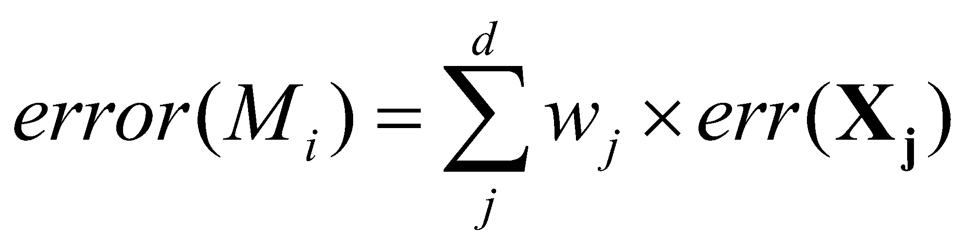
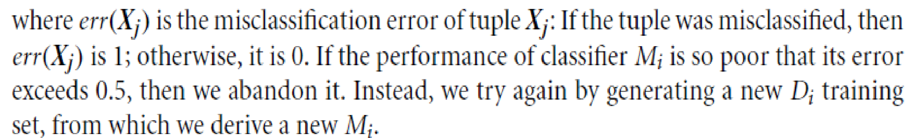
Adaboost (Adaptive Boosting)
To compute the error rate of model Mi , we sum the weights of each of the tuples in Di that Mi misclassified.
The error rate of Mi affects how the weights of the training tuples are updated.
If a tuple in round i was correctly classified, its weight is multiplied by error(Mi)/(1-error(Mi). Once the weights of all the correctly classified tuples are updated, the weights for all tuples (including the misclassified ones) are normalized so that their sum remains the same as it was before.
To normalize a weight, we multiply it by the sum of the old weights, divided by the sum of the new weights. As a result, the weights of misclassified tuples are increased and the weights of correctly classified tuples are decreased
11

Slide 12
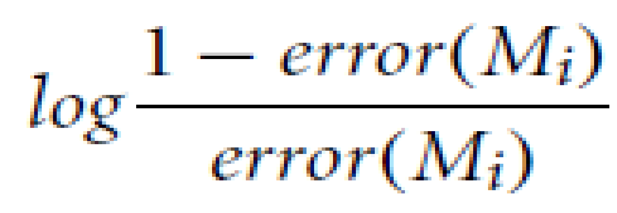


Once boosting is complete, how is the ensemble of classifiers used to predict the class label of a tuple, X?”
The boosting assigns a weight to each classifier’s vote, based on how well the classifier performed.
The lower a classifier’s error rate, the more accurate it is, and therefore, the higher its weight for voting should be. The weight of classifier Mi ’s vote is
For each class, c, we sum the weights of each classifier that assigned class c to X. The class with the highest sum is the “winner” and is returned as the class prediction for tuple X.
Boosting Vs Bagging
Boosting focuses on the misclassified tuples, it risks overfitting the resulting composite model to such data. Therefore, sometimes the resulting “boosted” model may be less accurate than a single model derived from the same data.
Bagging is less susceptible to model overfitting.
While both can significantly improve accuracy in comparison to a single model, boosting tends to achieve greater accuracy.
12

