Slide 1



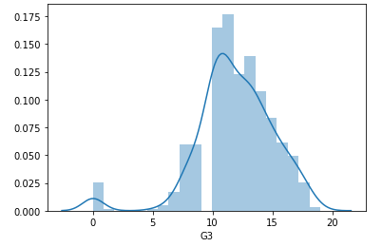
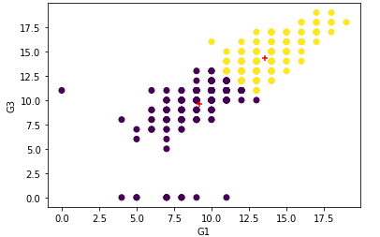
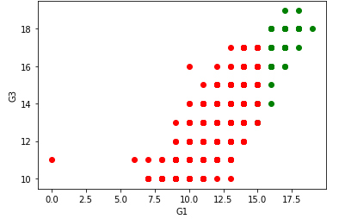

Predicting Final grade of the student
School of Computer Science and Information Systems, Northwest Missouri State University
Abhinay Reddy Kaitha
Introduction
Results
Conclusions
The main aim is to predict the final grade of the student based on various attributes which include the student grades, demographic, social and school related features
Evaluating the final grade of the student based on the other grades G1 and G2
The data I have chosen is continuous so I performed linear regression to predict the final grade with an accuracy of 86%
I have classified the grades of the students into 4 groups and performed decision tree classifier to determine if a student grade belongs to a particular group or not
I have performed clustering to determine if the student gets a good grade based on the other grade
Using SVC
Using the above classifier, the accuracy is 86% ,the precision is 86% and the sensitivity is 86%
Materials/Methods
Features:
First subject Grade
Second subject Grade
Mother’s education
Father’s education
Performed data cleaning
Performed Linear regression to train the model.
Used Decision Tree Classifier to implicitly perform feature selection.
Evaluate
Based on the clustering I would say that the student gets higher grade whose G1(first subject grade) is closer to the top of the centroid of the top cluster rather than the bottom cluster
From the above graph it is clear that the student who gets a grade greater than 15 have a higher chance of getting a grade higher than 15
Additional Resources
Acknowledgements
Poster Repository
https://archive.ics.uci.edu/ml/datasets/Student+Performance
https://scikit-learn.org/stable/modules/generated/sklearn.tree.DecisionTreeClassifier.html
Mentor: Dr. Charles Hoot
https://github.com/44-599-MachineLearning-F19/machine-learning-f19-final-project-Abhinaykaitha/blob/master/Poster.pptx

