Slide 1
Investor portal
FM recommended changes

Slide 2
Brief
The ability to add more documents under any heading without over writing the first document. As an example there is an existing investor who has bought more shares. The share certificate and agreements need to be added without over writing the old one.

Slide 3
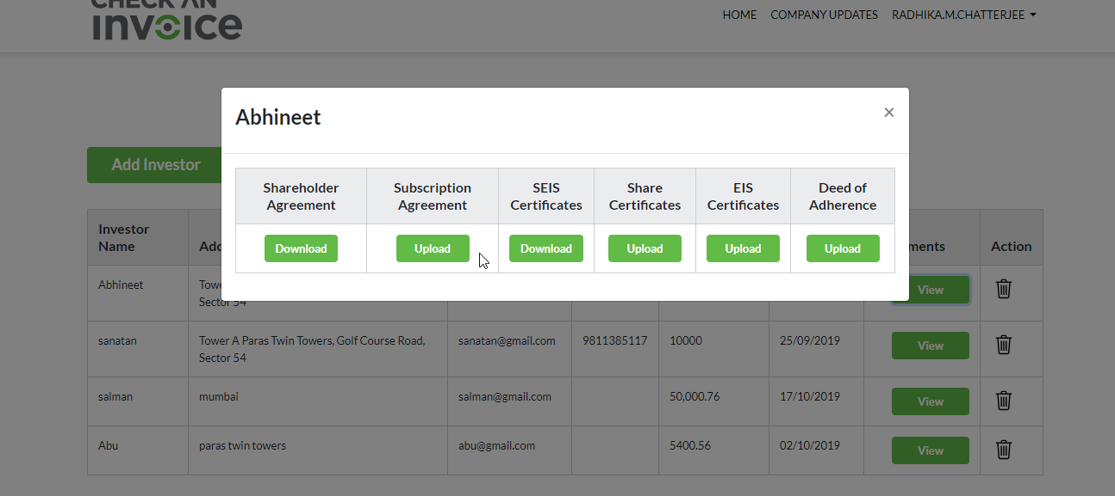

Slide 4
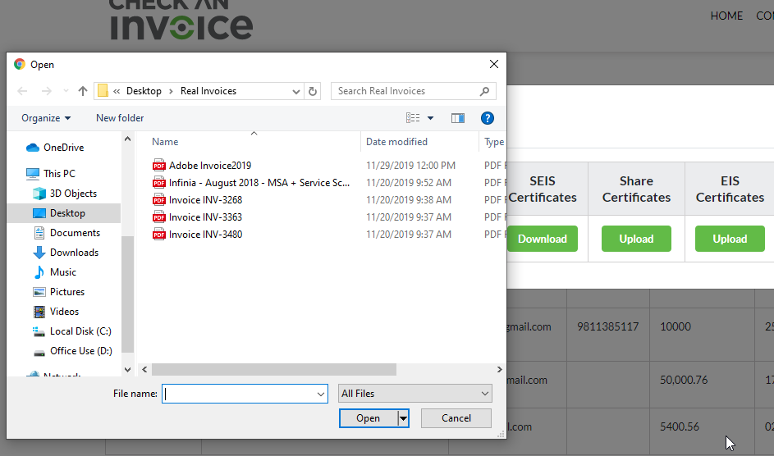

Slide 5
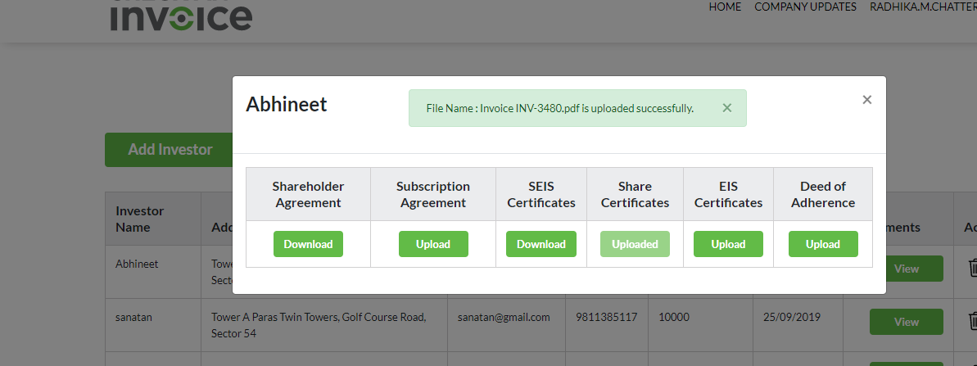
Upload
Inv_123
Inv_1234

Slide 6
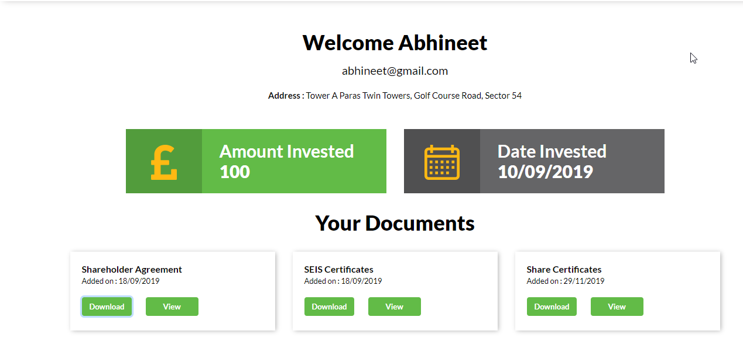
Share holder agreement
SEIS Certificates
Share Certificates
Inv_123
Inv_1234
Inv_123
Inv_1234
Inv_123
Inv_1234
Download
View
Download
View
Download
View
Download
View
Download
View
Download
View

Slide 7
