Slide 1
Greyatom Test
Flight Price Prediction
presented by - Abhineet

Slide 2
Problem Statement
You have been hired by advertising company to assess the revenue that can be generated by a proposed ad. Based on the demographic information provided, you need to predict whether the revenue generated will cover costs to produce and air the ad(Whether there will be a net gain from an ad or not)
Data can be used to gain business insights, make decisions, behaviour and ways to optimize ads, guiding marketing initiatives, implementation of innovative additional services,boost the advertising firm’s reputation and much more.
Lets build Machine leaning model to predict Advertisement Success.

Slide 3
Business Insights:
1. Find if any particular Flights showing higher price.
2. Find out if price of Flight is related to Price of the flight.
3. Find out if particluar room types showing higher price of the property.
4. Check skewness in the data and handle it.
5. Detect outliers in the data and handle them.
6. Do analysis to detect correleation among the columns and handle it.
Evaluation Metric:
Evaluation metric for this problem is root-mean-squared error (RMSE)

Slide 4
Data : Dataset Information: data contains 8012 bookings of the flight, 10 predictors and 1 target column(price). Features and target variable:
Variable | Description
Airline | The name of the airline
source | The date of the journey
Destination | The destination where the service ends
Route | The route taken by the flight to reach the destination
Dep_Time | The time when the journey starts from the source
Arrival_Time | Time of arrival at the destination.
Duration | Total duration of the flight.
Total_Stops | Total stops between the source and destination.
Additional_Info | Additional information about the flight
Price | Target, The price of the ticket()

Slide 5
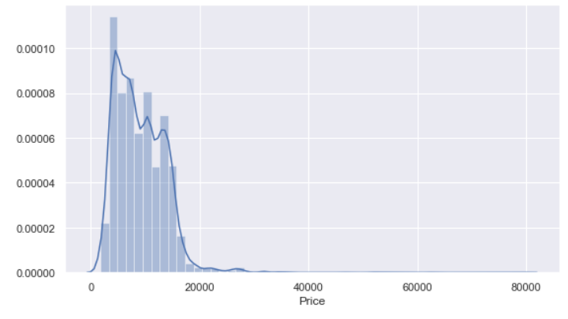
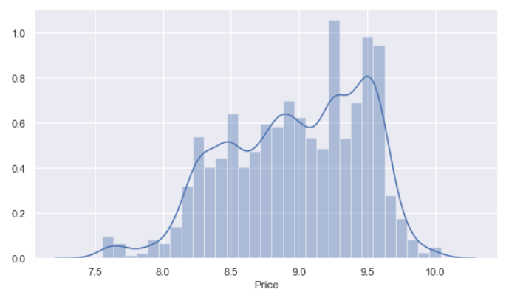
EDA:
1. Dropped Route column.
2. Total_Stops has one null value which was dropped.
3 Price column:
- Dependant column 'price' is positively skewed, so outliers present in price column.
- To handle outliers we have scaled the column values using log.
- Min value for price is '1759', maximum price of flight it 79512 which can be treated as a outlier and hence it was dropped. Avergae flight cost if around Rs. 9000.
Price Before normalization
Price After normalising

Slide 6
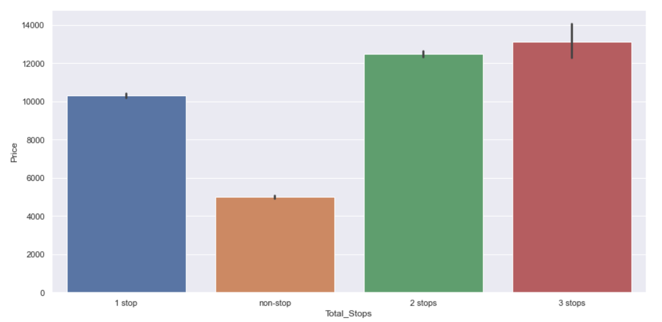
Bivaraite analysis of total_stops vs price
neighbourhood_group vs price
Insight:
1. flights with 2 and 3 stops costs more
2. non-stop flights cost cheapest

Slide 7
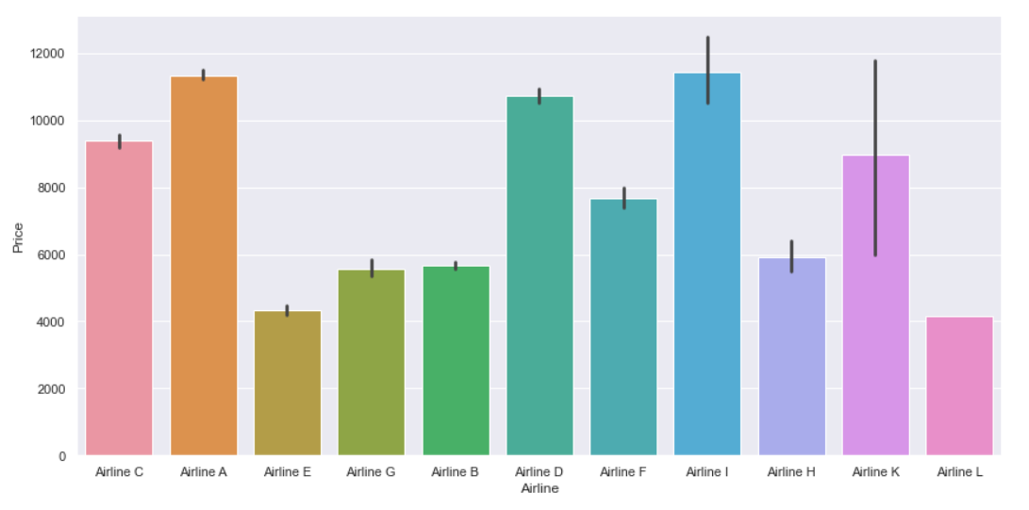
Bivariate Analysis of Airline and Price
Insight:
Airline A and Airline I are having most expensive ticket cost

Slide 8
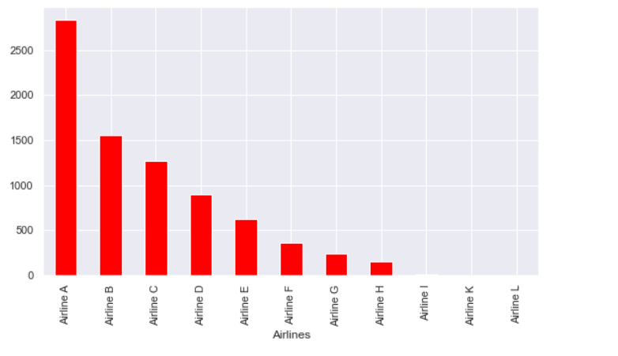
-
Frequency distribution of Flights
Insight:
Airline A has most number of flights

Slide 9
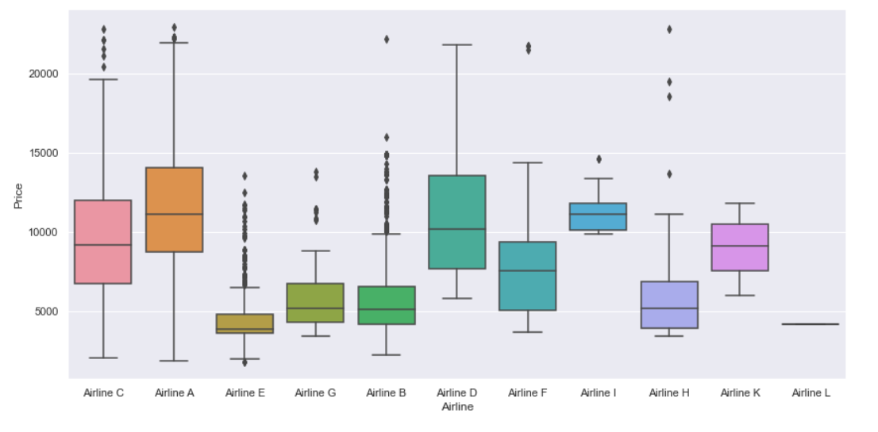
Bivariate analysis of Airline and Price
Insight:
Airline A and C are showing wide range of variaton in price.

Slide 10
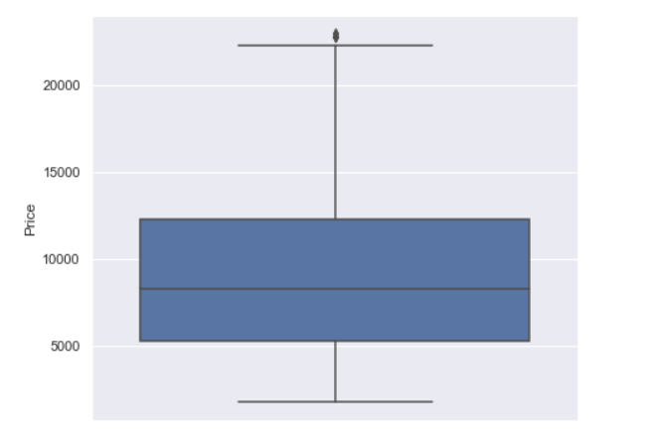
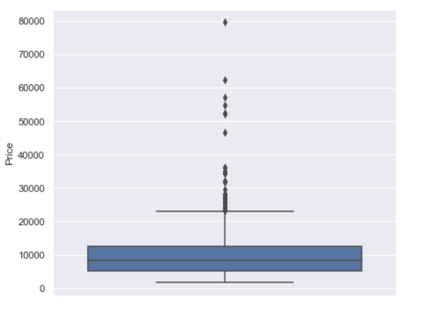
Outliers in Price column
Outlier in price column were dropped.

Slide 11
Missing Values and treating Categorical values
1. One Missing values in Total_Stops was dropped.
2. Route column was dropped as value could not be added from it.
3. All Categorical columns were converted in Int values using OneHotEncoding.
Feature engineering
1. A new feature 'Days_bfr_journey' was added to get the no of days ticket was booked before flight.
2. 'Arrival_Time' feature was cleaned to get only time and removing any dates present in the column.
3. 'Hours' feature was converted into minutes format.
4. Price column was treated to reduce skewness in the data.

Slide 12
Models and Approaches
Various Vanilla models were assessed and also hyperparameter tuning were tried on the models. The models were:
- BaggingRegressor
- RandomForestRegressor
- GradientBoostingRegressor
- GradientBoostingRegressor(hyperparameter)
- XGBRegressor

Slide 13
Results of the Models:
Finally from the observations above GradientBoostingRegressor was selected as the best model for the price prediction. we avoided XGBRegressor although it gave a better result as we are still unaware on how XGB really works.
Model | RMSE | Accuracy
BaggingRegressor | 0.1218 | 0.939
RandomForestRegressor | 0.3052 | 0.619
GradientBoostingRegressor | 0.1943 | 0.845
GradientBoostingRegressor | 0.1271 | 0.934
XGBRegressor | 0.1254 | 0.935

Slide 14
Next Steps
If time permitted, could have tried the following :
1. Do some research on the Route Column and extract meaningful words by using NLP.
2. Also do some further analysis on the data and obtain some more insights valuable for business.

