Slide 1

DRIVESHARE MANAGEMENT SYSTEM
Under the guidance of Manuel D. Montrond
Group No.: 2
Group Members:
Abhinav Chandrakant Gangurde
Akshay Veerabhadraiah
Neha Suresh
Om Shailesh Raut
Venkata Sai Poojith Kotipalli

Slide 2
Project Overview
The DriveShare Database System is designed to support a comprehensive ride-sharing platform that connects riders, drivers, and car owners through a centralized and efficient database. The system streamlines trip requests, car assignments, payments, and dispute resolution while maintaining secure role-based access and data integrity.
Objective: To develop a scalable and structured database that enhances the functionality and user experience of a ride-sharing service by managing user roles, vehicle data, ride transactions, and financial reporting.
Scope:
Registration and role assignment for users (Rider, Driver, Renter)
Management of cars, trip requests, and assignments
Handling of multiple payment methods including Card, Wallet, and Cash
Automated invoice generation and dispute management
Admin-level reporting and auditing features
Purpose: The primary goal is to improve operational efficiency and data accuracy for cab service providers, while ensuring affordability, accessibility, and income opportunities for all users in the DriveShare ecosystem.

Slide 3
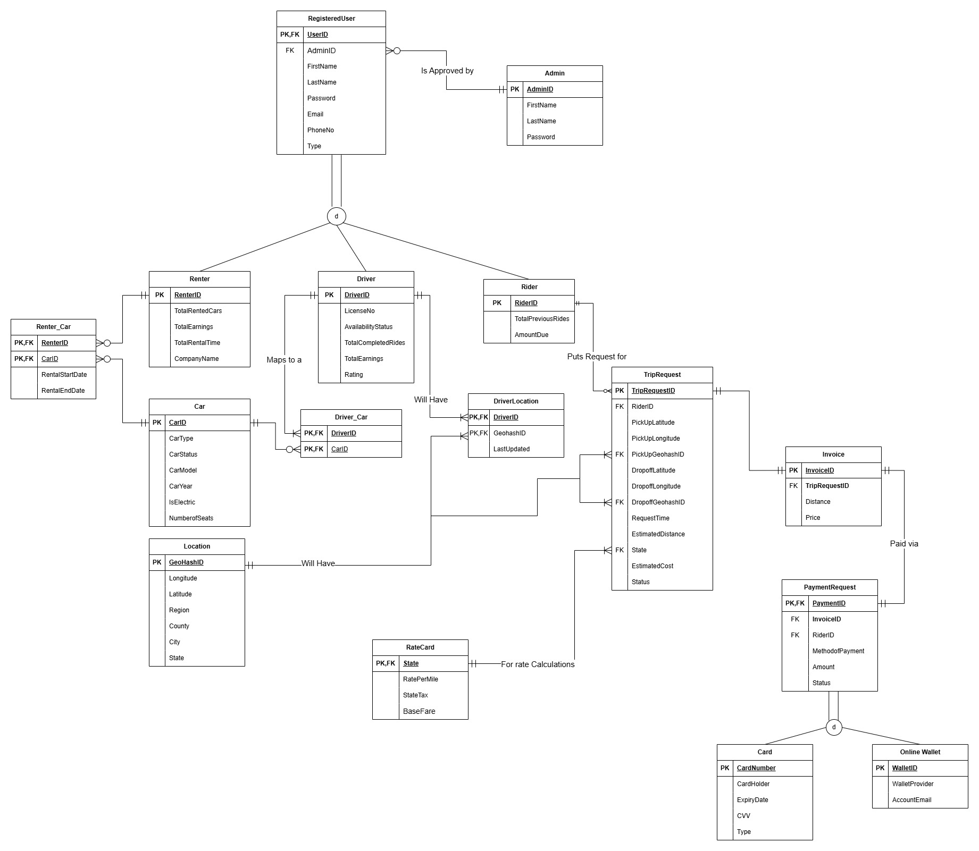
E-R DIAGRAM

Slide 4
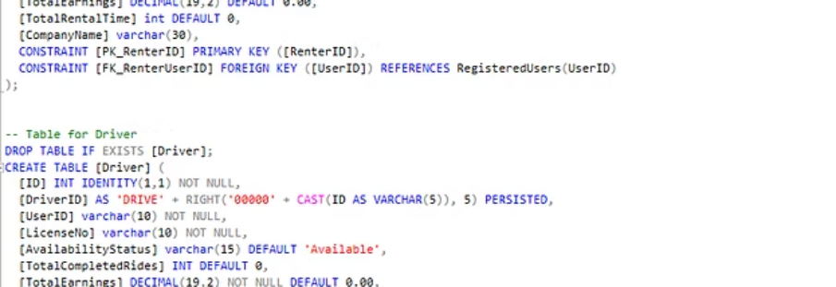
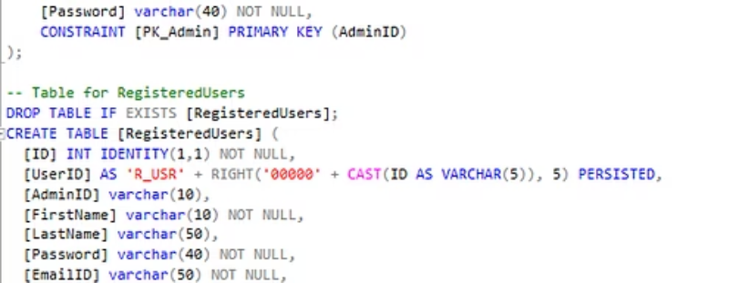
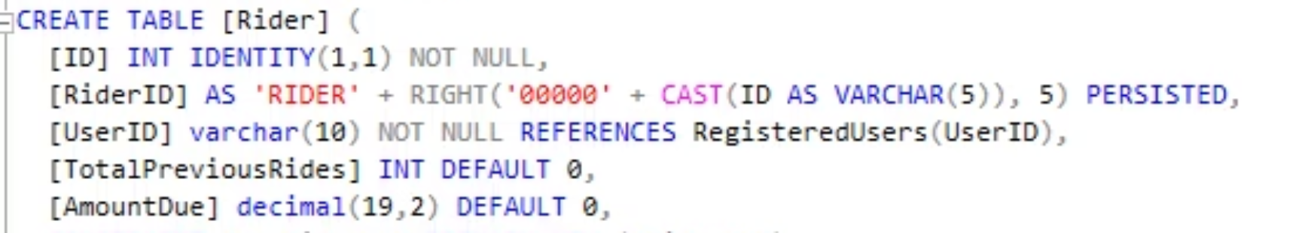
DATA DEFINITION
Foundation / Base Tables for Managing DriveShare System.

Slide 5
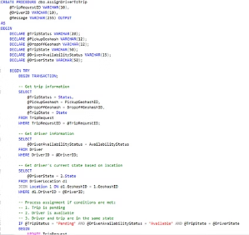
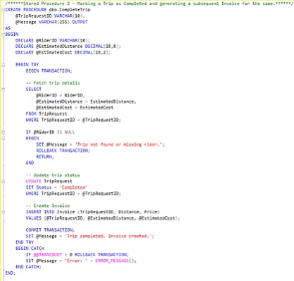
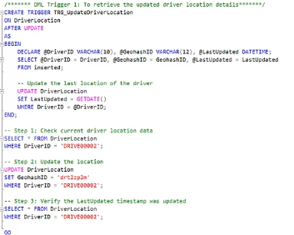
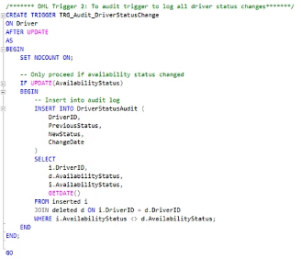
Persistent Stored Modules
STORED PROCEDURES
TRIGGERS
AssignDriverToTrip: Assigns an available driver to a pending trip if they're in the same state, updating both trip status and driver availability.
TRG_UpdateDriverLocation: Automatically updates the timestamp whenever a driver's location changes.
CompleteTrip: Marks a trip as completed and automatically generates an invoice with the trip's estimated distance and cost.
TRG_Audit_DriverStatusChange: Creates audit records whenever a driver's availability status changes, tracking the history of status updates.

Slide 6
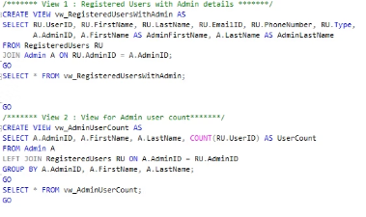
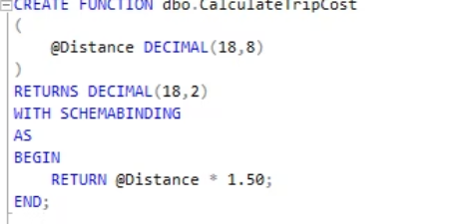
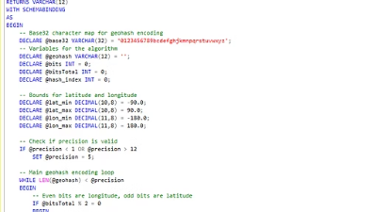
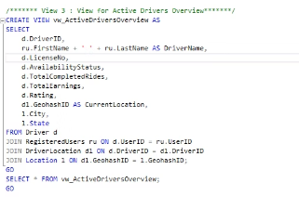
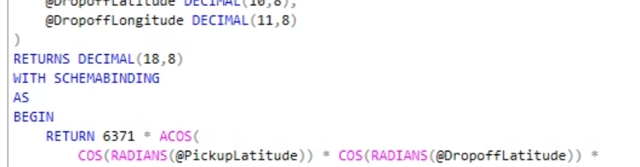
Views and UDFs
Views
User Defined Functions
vw_RegisteredUsersWithAdmin: Shows all registered users along with their assigned admin's details.
CalculateGeohash: Converts latitude and longitude coordinates into a geohash string (a compact location code) by repeatedly dividing the coordinate space and encoding the result using a base32 character set.
vw_AdminUserCount: Displays each admin and how many users they manage.
CalculateDistance: Uses the Haversine formula to calculate the distance in kilometers between two geographic points (pickup and dropoff locations) based on their latitude and longitude coordinates.
vw_ActiveDriversOverview: Provides a summary of active drivers with their status, ratings, and current location.
CalculateTripCost: A simple function that calculates the cost of a trip by multiplying the distance by a fixed rate of $1.50 per kilometer.

Slide 7
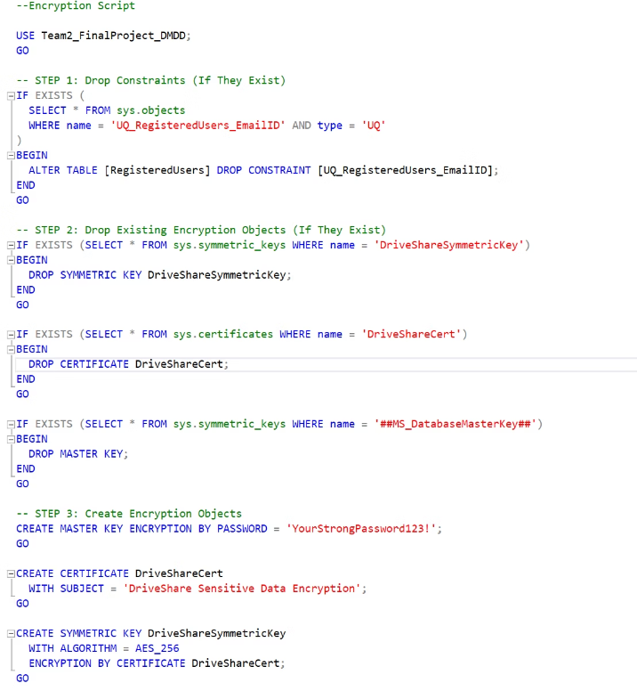
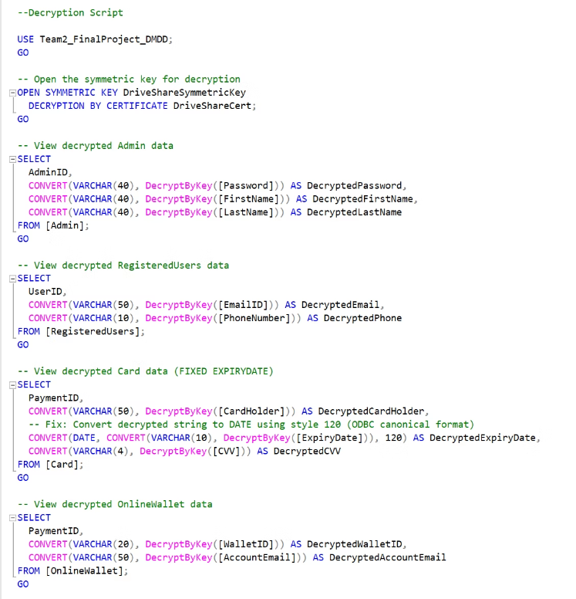
DATA ENCRYPTION
This script encrypts sensitive data (like passwords, emails, card details) in various tables using a symmetric key (DriveShareSymmetricKey) and a certificate (DriveShareCert) with AES_256 encryption. It replaces original columns with encrypted ones and renames them to keep schema consistent. The decryption script uses DecryptByKey() to retrieve readable values securely for admin or audit views.

Slide 8
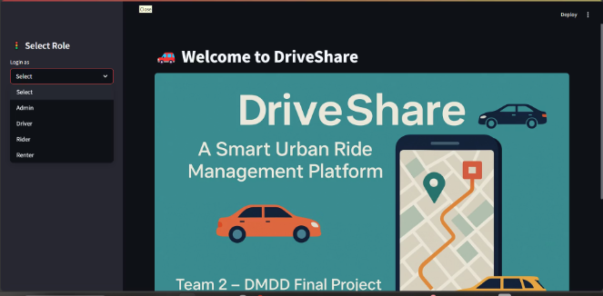
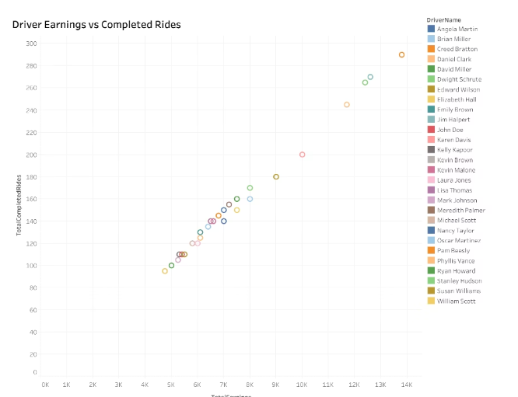
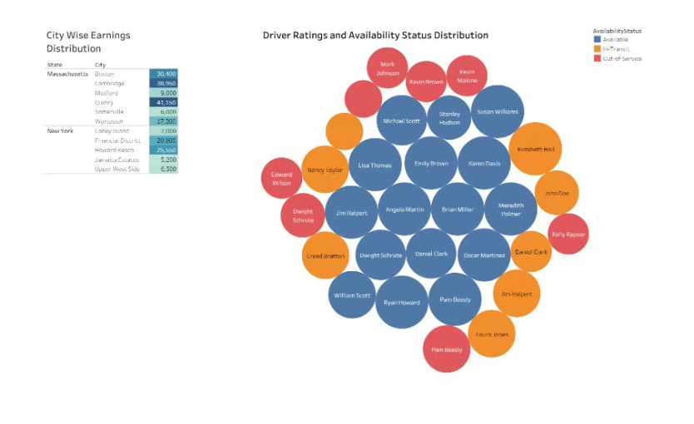
Visualization

