Slide 1

Social Media Analysis
- Abhinandan Tiwary

Slide 2
AGENDA
Problem Statement
Data Description
Objective Key Metrics and Visualizations
Insights and Recommendations

Slide 3
Problem Statement
Instagram generates large volumes of user interaction data such as posts, likes, comments, follows, and tags. However, understanding user behavior, engagement patterns, and identifying valuable users requires structured analysis. The challenge is to analyze this data to derive actionable insights that can support marketing strategies, user retention, influencer identification, and content optimization.

Slide 4
Data description
The dataset consists of multiple relational tables capturing different aspects of user activity:
Users: Stores user profile information and account creation time
Photos: Contains user-generated posts with timestamps
Likes: Records user likes on photos
Comments: Stores user comments on posts
Follows: Represents follower–following relationships
Tags & Photo_Tags: Capture hashtag usage on posts

Slide 5
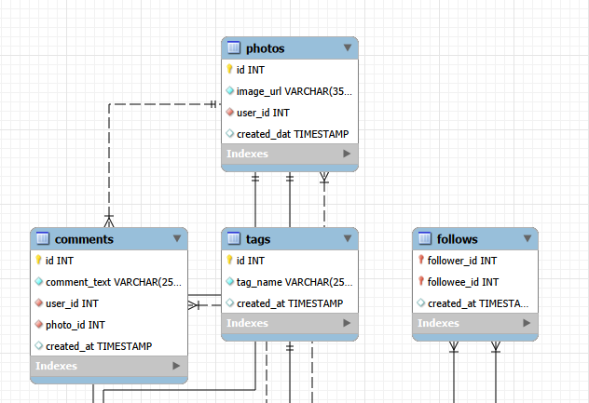
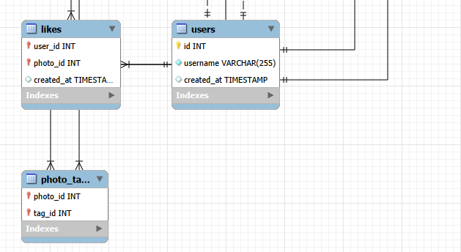
Schema
The image displays a database schema for social media application like instagram.

Slide 6
Objectives, Key Metrics & Approach
The main objective is to understand how users interact with content and how engagement varies across users and time.
Key metrics include posts per user, likes and comments per post, engagement rate, follower count, and posting time.
A data-driven exploratory approach was followed, where patterns were first identified through visualizations and then translated into insights and business recommendations.

Slide 7
Overall User Activity Overview
Across most users, total likes consistently exceed total comments, indicating that liking content is the primary mode of engagement compared to commenting.
A few users show significantly higher spikes in both likes and comments, highlighting a small group of highly influential or active users driving overall engagement.

Slide 8
Posting Time & Engagement Trend
User engagement is highly concentrated during a specific time window. Most posts, likes, and comments occur around 6 PM, indicating that users are most active during evening hours. This reflects real-world behavior where users engage with social media after work or study hours.

Slide 9
High-Value and Loyal Users
A small group of users consistently drives high engagement through both likes and comments. These users demonstrate strong loyalty and significantly contribute to overall platform activity and community growth.

Slide 10
Impact of User-Generated Content on Targeted Advertising
User-generated content like posts, hashtags, and photo tags reveals user interests, preferences, and trending topics. Leveraging this data helps create targeted and personalized ad campaigns, increasing engagement and conversion rates.

Slide 11
User Segmentation
Based on behavior and engagement, users can be segmented into Active Creators, Engaged Users. This segmentation helps understand different user personas and enables personalized strategies instead of a one-size-fits-all approach.

Slide 12
Inactive User Analysis
A segment of users shows little to no posting or engagement activity.
These inactive users represent a growth opportunity. With the right re-engagement strategies, such as personalized notifications or incentives, they can be encouraged to return and participate more actively.

Slide 13
Campaign Timing / Proxy Ad Effectiveness
Since direct ad campaign data is unavailable, engagement metrics were used as proxy indicators of campaign effectiveness. The strong engagement observed during peak posting hours suggests that timing plays a crucial role in content visibility and campaign success.

Slide 14
Conclusion & Future Scope
This analysis demonstrates how user activity and engagement data can be transformed into actionable business insights.
Future analysis can be enhanced by incorporating demographic data, ad campaign metrics, and long-term user retention tracking to further improve personalization and marketing effectiveness.

Slide 15
Recommendations
Prioritize high-engagement content themes by promoting posts and hashtags that consistently receive higher likes and comments, as they drive stronger user interaction.
Re-engage inactive users through personalized notifications, content recommendations, and limited-time incentives to increase platform activity.
Leverage top-performing users as influencers or brand advocates by collaborating with accounts that show high engagement rates and strong follower growth.

Slide 16
THANK YOU

