Slide 1

Starbucks coffee
Starbucks coffee is famous in world.

Slide 2
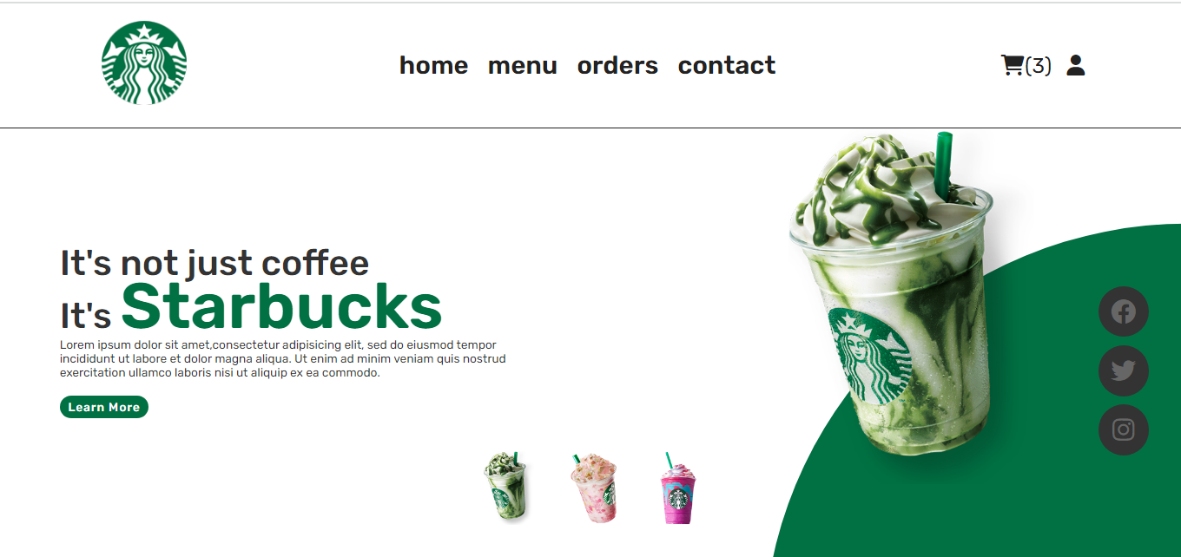
HOME PAGE
.This is my website home page.
.My website in any coffee order is online.

Slide 3
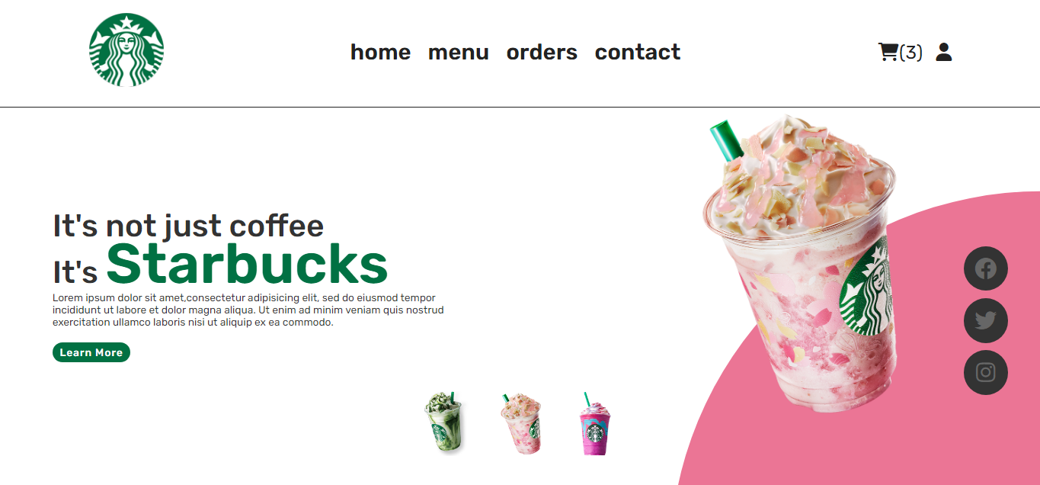
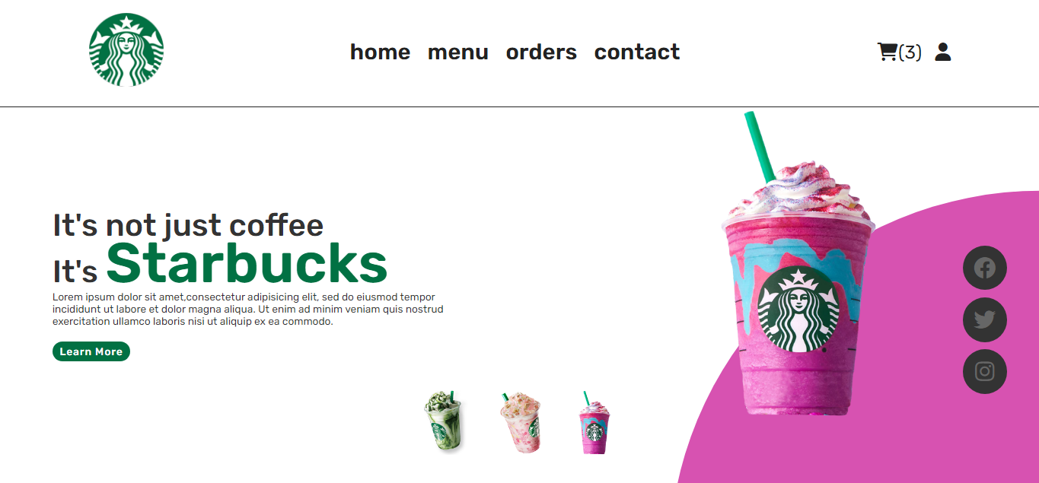
1
2
3
.
.
This is a quary selector.
.
1
Onclick and change image,circle color
2
.
.
.

Slide 4

Loding Effect
This is a uniqe loding effect in my website

Slide 5
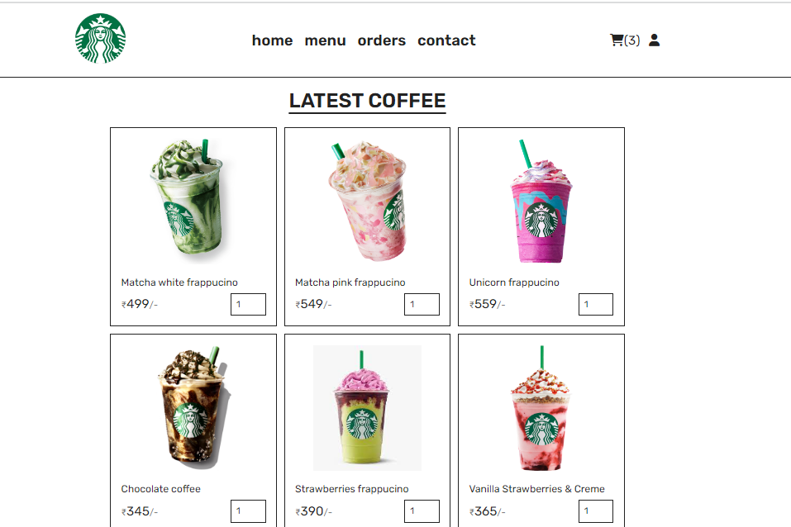
Menu section
.
.
This is menu section in starbuck website.menu section in any coffee is avilable.
.
.

Slide 6
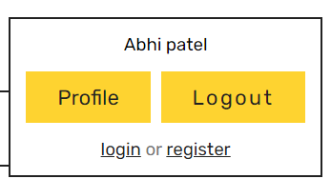
User id
1
This is user id.In this user profile and logout option

Slide 7
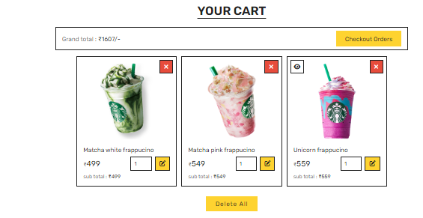
Cart section
This is my website cart option.Cart in any coffee add and order online.

Slide 8
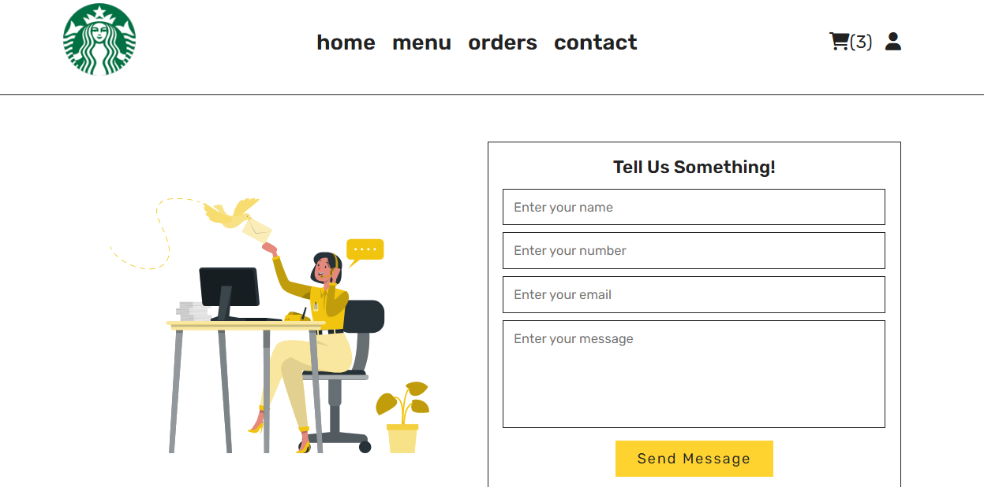
Contect section
This is the contect section in website.Any problme to contect starbuck
.
.
.
.
.

Slide 9
Thank you
Contact
Phone:+1860-266-0010
Email:info@starbucks.com

