Slide 1
.
Internship projectories
Satapara Abhi Vipulbhai
.
Hearty Welcome You

Slide 2

Starbucks coffee
Starbucks coffee is famous in world.

Slide 3
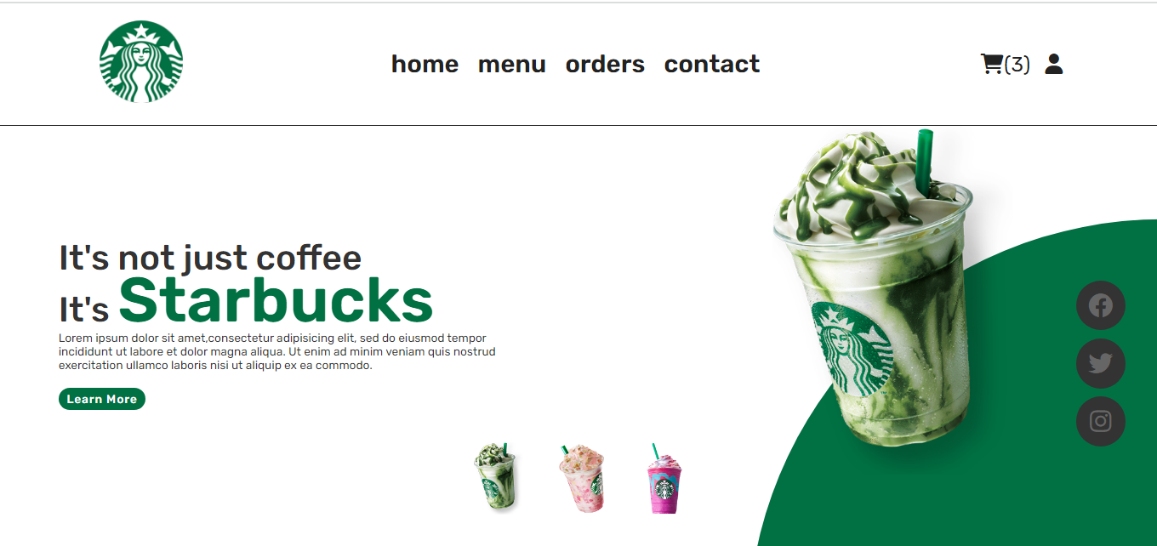
HOME PAGE
.This is my website’s home page.
.In My website in any coffee order is online.
Use this make:
Html css javascript

Slide 4
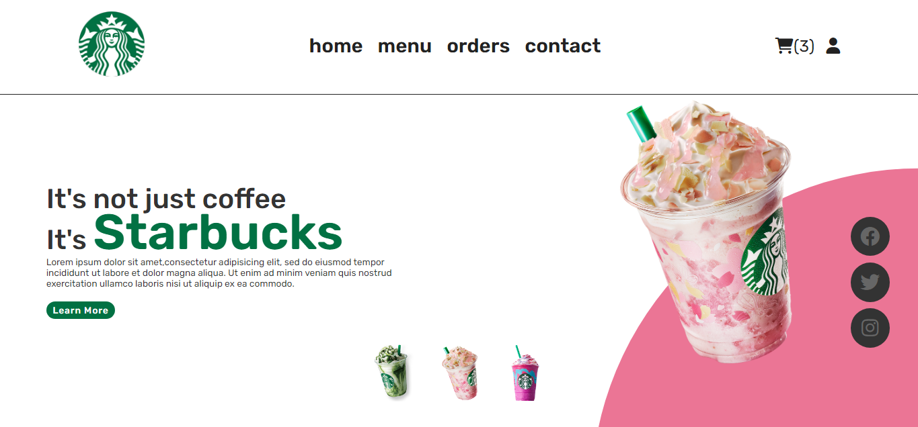
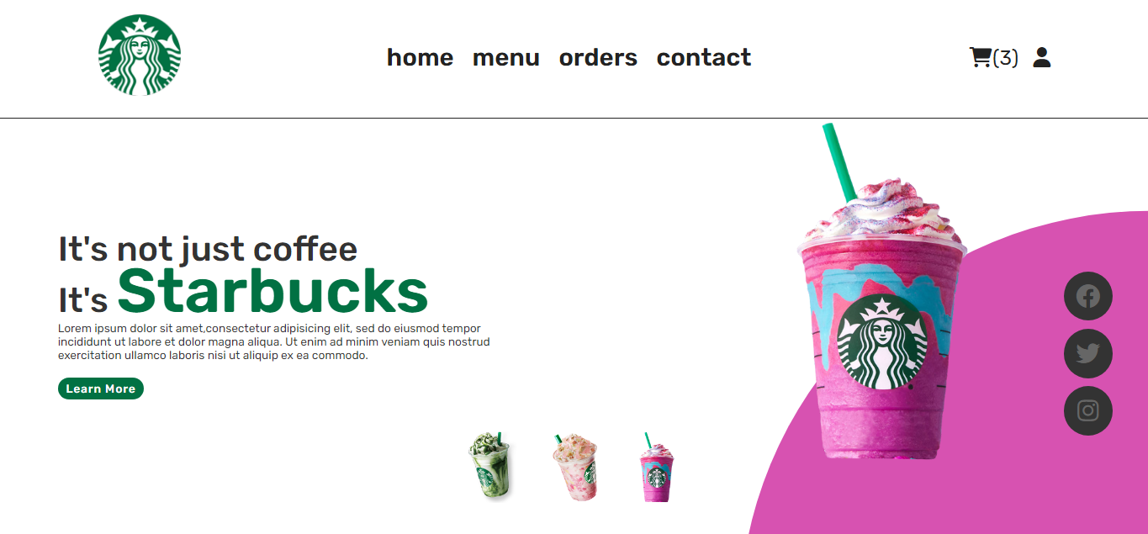
1
2
3
.
.
This is a quary selector.
.
1
Onclick and change image,circle color
2
.
.
Use this make:
Javascript
.

Slide 5

Loding Effect
This is a uniqe loding effect in my website
Use this make:
loading image and css

Slide 6
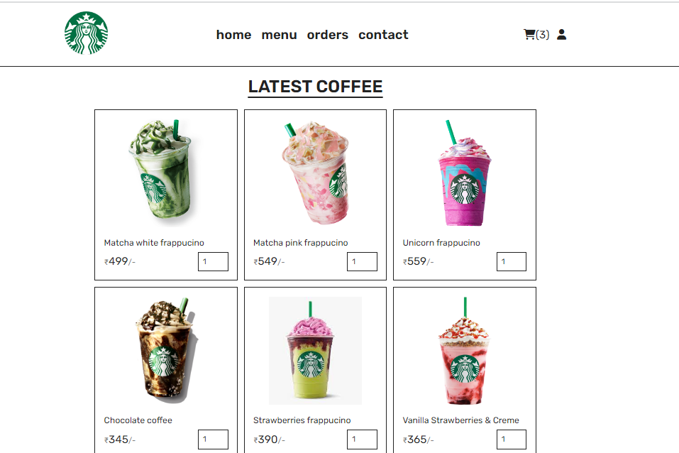
Menu section
.
.
This is menu section in starbuck website.menu section in any coffee is avilable.
.
Use this make:
Html css

Slide 7
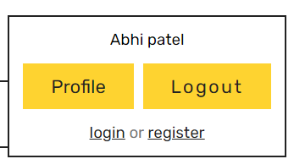
User id
1
This is user id.In this user profile and logout option

Slide 8
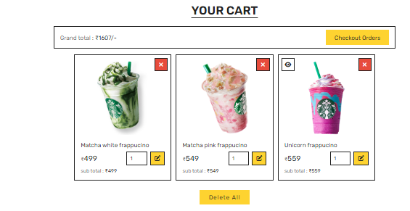
Cart section
This is my website cart option.Cart in any coffee add and order online.
Use this make:
Html css javascript

Slide 9
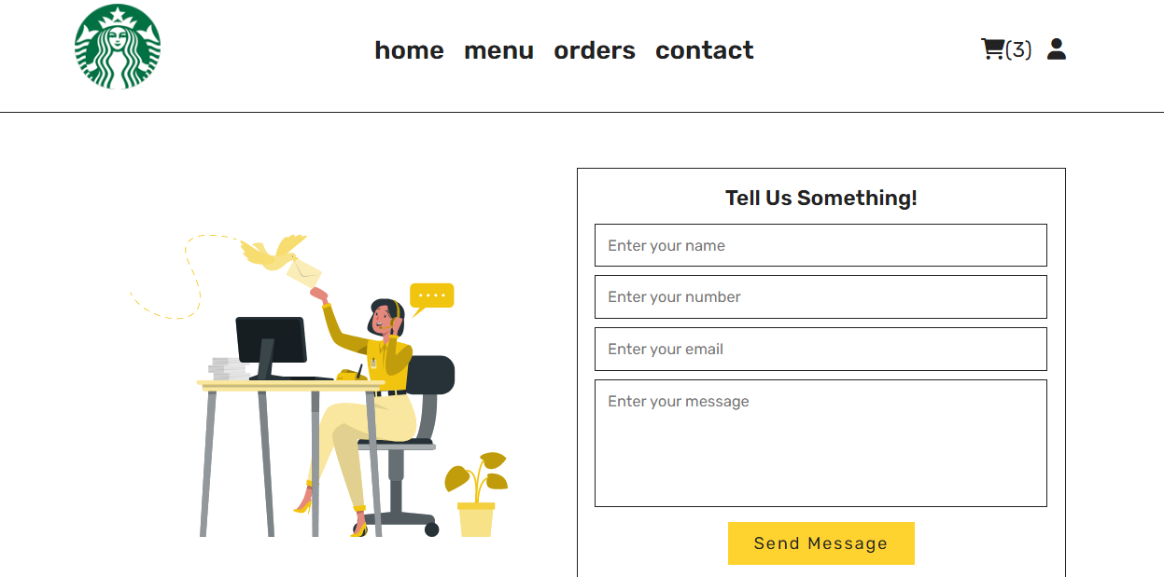
Contect section
This is the contect section in website.Any problme to contect starbuck
.
.
.
.
.

Slide 10
Thank you
Contact
Phone:+1860-266-0010
Email:info@starbucks.com

