Slide 1

Personalized Health Recommendation System
AI-Based Design for Preventive Wellness
Case Study 19 — Applied AI (22AI741)
Author: Abhinand Prameesh · USN: 1DS23AI002

Slide 2

Problem statement — Why generic recommendations fail
1
Generic approach
Everyone receives the same exercise and nutrition advice — low relevance, low adherence.
2
Personalized approach
Recommendations adapt to goals, preferences and activity patterns — higher relevance and safer guidance.
Users differ by fitness goals, lifestyle, food preferences, activity levels and available time — a one-size-fits-all model reduces effectiveness and engagement.

Slide 3




Data inputs — three categories
Users control consent and sharing. Each category is explicit, segmented, and minimised to what's necessary.
User preferences
Activity data
Health information
Age
Fitness goals
Food & exercise preferences
Available time, lifestyle
Daily steps, workout history
Exercise duration, sleep
Heart rate
Height, weight, BMI
Allergies, self-reported conditions
Important: Users explicitly control what they share via consent and privacy settings.

Slide 4


Proposed system architecture — design overview
1
2
3
USER
CONSENT & PRIVACY LAYER
DATA PROCESSING
Profile, preferences, activity (consented)
Granular opt-in, data minimization, anonymization
Normalization, feature extraction, secure storage
4
5
6
AI RECOMMENDATION ENGINE
RAG / KNOWLEDGE GROUNDING
SAFETY & VALIDATION LAYER
Exercise · Nutrition · Preventive-wellness (specialized agents)
Retrieve trusted guidelines to ground suggestions
Rule checks, diagnostic-detection, escalation
7
PERSONALIZED OUTPUT → USER
Explainability, confidence, next steps
Inside the AI engine: three specialist components (Exercise, Nutrition, Preventive Wellness) optionally orchestrated via LangGraph/agent layer for modularity.

Slide 5
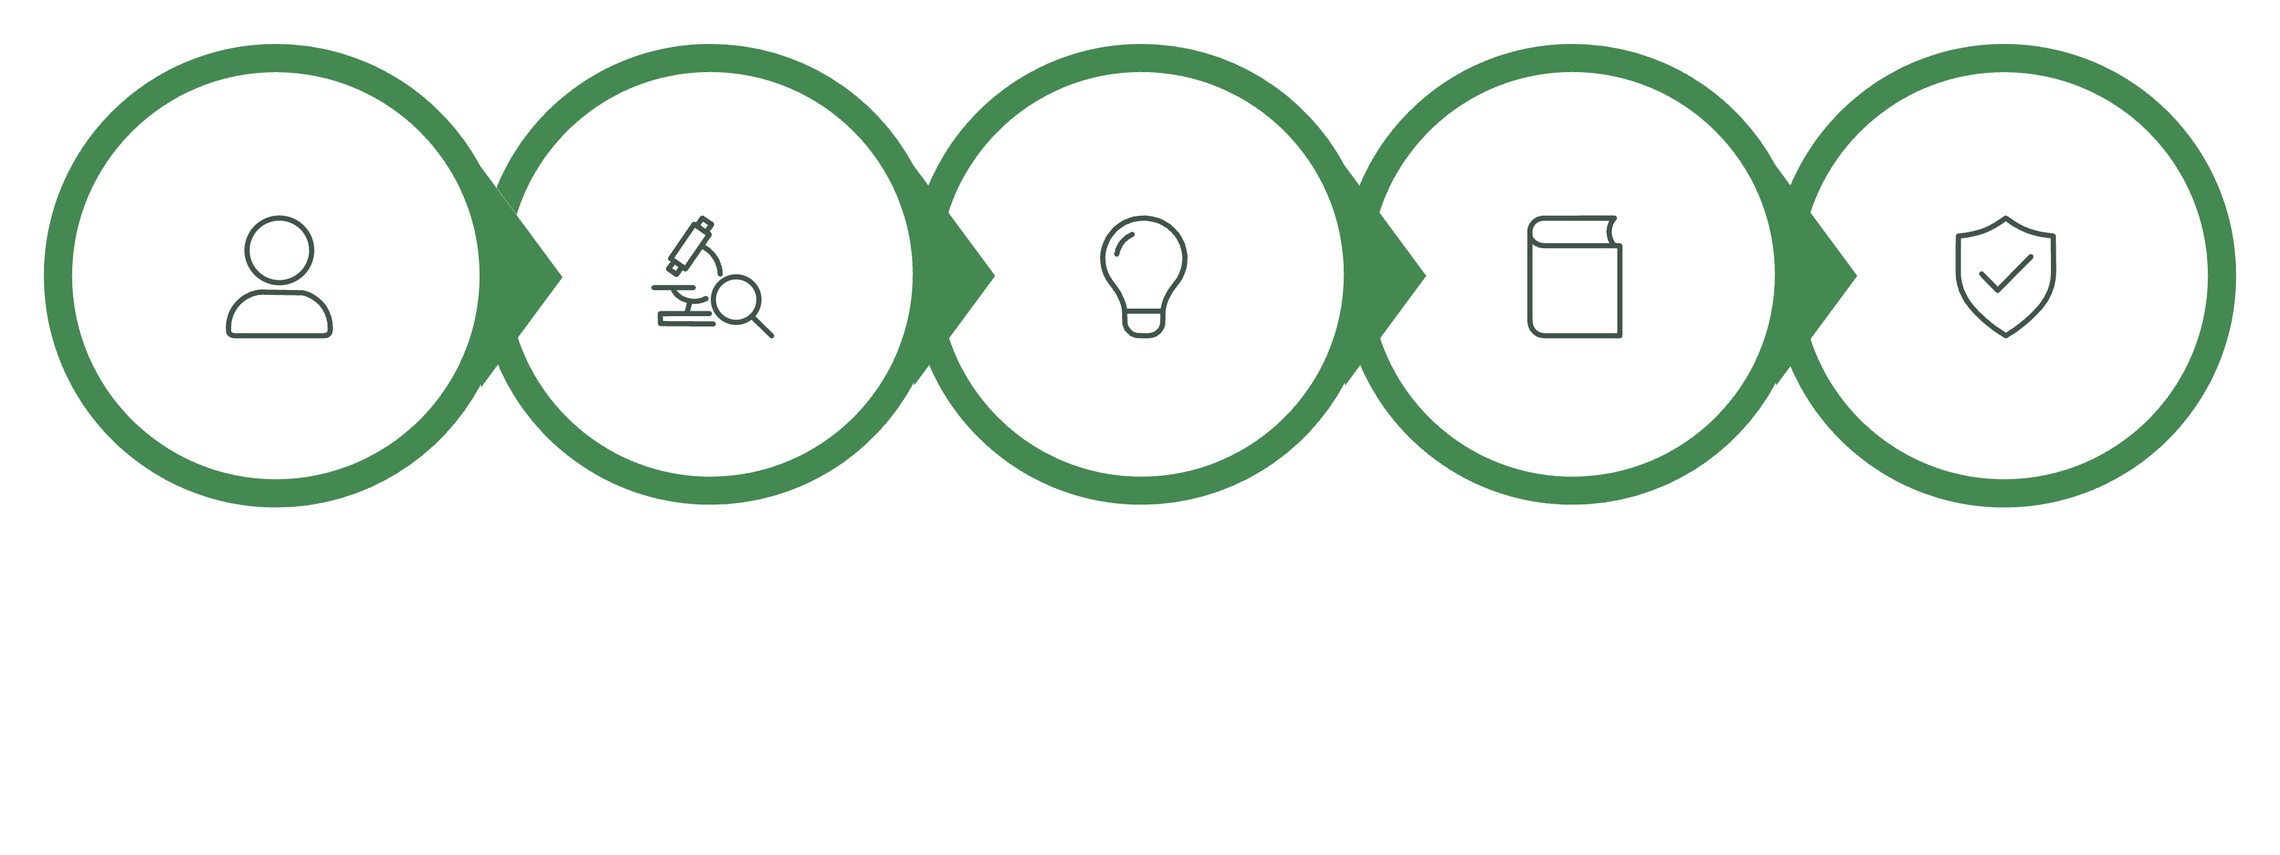
How the AI generates recommendations — 5-step pipeline
Build Profile
Analyze Activity
Generate Candidates
Ground with RAG
Validate & Present
Example flow: (User goal + activity + preferences) → candidate recommendation → guideline grounding → safety check → final personalised recommendation with confidence and explanation.

Slide 6


Personalization in action — two user examples
User A — Age 21 (Low activity)
User B — Age 45 (Moderate activity)
Recommendations
Recommendations
Start: 30-min brisk walking (5x/week)
Progression: add interval walks after 2 weeks
Vegetarian meal templates focused on protein & iron
Sleep & routine nudges for consistency
Moderate cycling routine (40–60 min, 3–4x/week)
Endurance progression plan with recovery days
Vegetarian nutrition emphasizing balanced macronutrients
Maintain activity with targeted strength micro-sessions
The outputs differ because the engine weights age, baseline activity, preferences and available time to produce safe, achievable plans.

Slide 7




Privacy & user consent — responsible data handling
Explicit consent
Encryption & access control
Clear prompts for each data type; reversible choices.
End-to-end encryption in transit & at rest; role-based access.
Data minimization & deletion
Anonymization & pseudonymization
Store only required features; user-triggered deletion & retention policies.
Use anonymized datasets for model improvement where permitted.
Consent example: "Allow the application to access your activity data?" [Allow] [Deny] [Change later] — users can granularly control each permission.

Slide 8

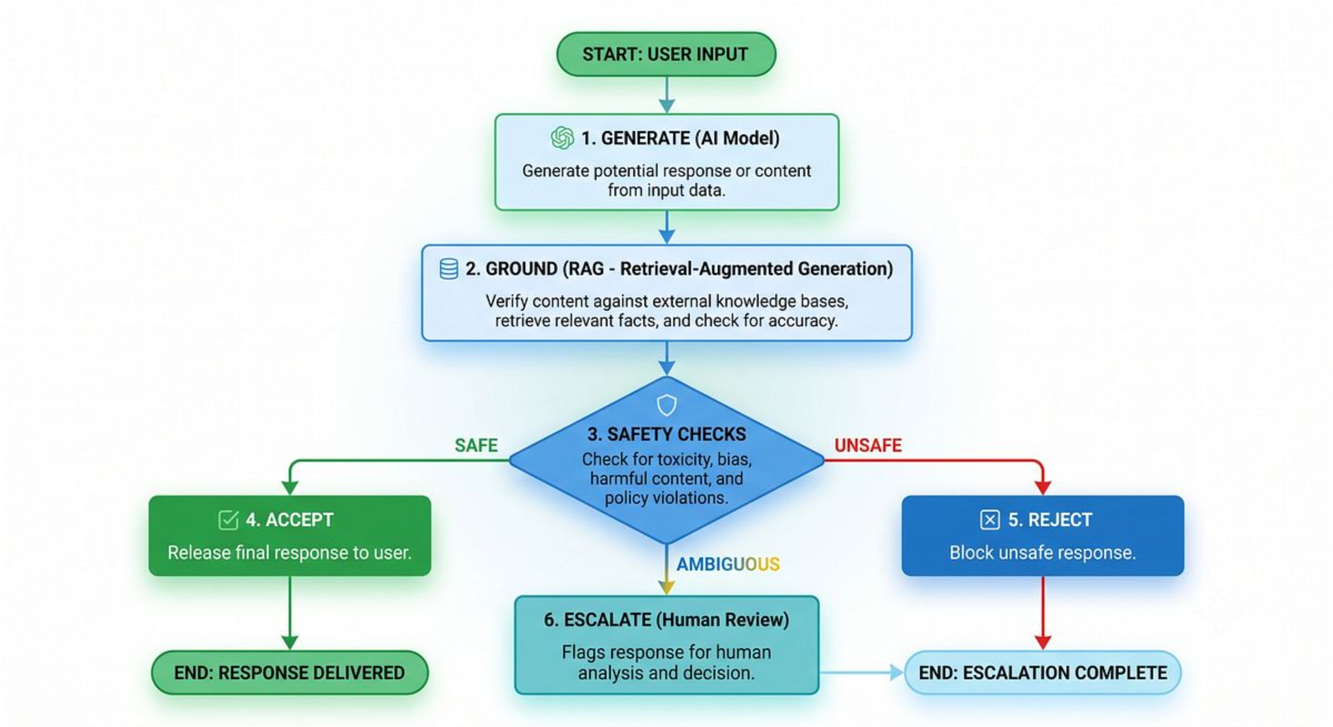

Preventing AI misinformation — detection & mitigation
01
Ground outputs
RAG retrieves authoritative guidelines to reduce unsupported claims.
02
Apply safety rules
Detect diagnostic language, medication instructions, or prescriptive claims.
03
Reject / modify / escalate
Unsafe or diagnostic content is blocked or routed to human review.
04
Communicate uncertainty
Include confidence scores, citations and plain-language caveats.
RAG reduces hallucination risk but does not eliminate it. Design for conservative failure modes and human escalation.

Slide 9

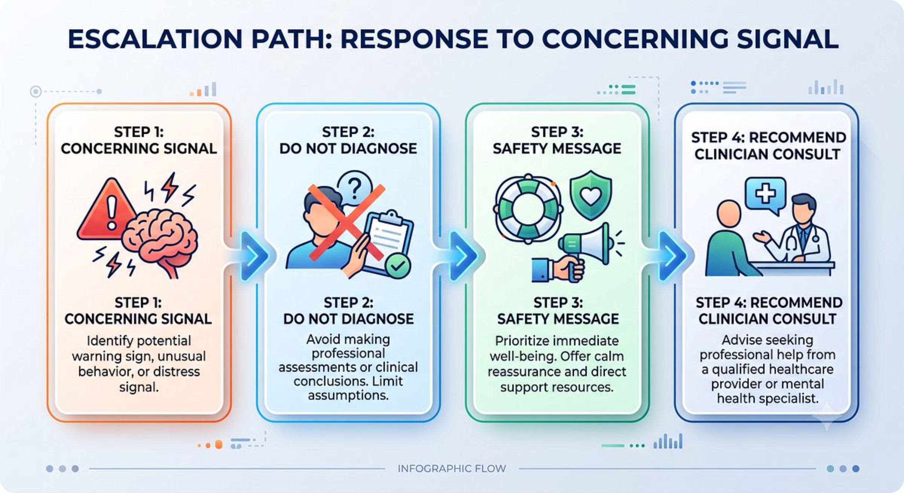
Wellness vs medical advice — clear boundary & escalation
General wellness guidance (OK)
Medical advice (NOT PROVIDED)
Try increasing daily physical activity.
Consider more vegetables & protein-rich foods.
Maintain consistent sleep to support wellbeing.
"You have diabetes." — Diagnostic claims are disallowed
"Take this medication." — Prescriptions are disallowed
"Stop your prescribed medication." — Never advise stopping treatment
For potentially concerning inputs the system shows a safety message and recommends consultation with qualified healthcare professionals; it may offer to share a summary for clinician review with user permission.

Slide 10

Conclusion & proposed technology stack
1
2
Architecture summary
Technology stack
User Data → Consent & Privacy → AI Engine → RAG Grounding → Safety Validation → Personalised Recommendations
Frontend: React / Streamlit · Backend: Python + FastAPI · AI/ML: PyTorch, scikit-learn · Agents: LangChain / LangGraph · Vector store: ChromaDB / Pinecone · DB: PostgreSQL · Security: Encryption & Auth
Key takeaway
Main limitations
Personalized AI should be useful, safe, transparent, and user‑controlled.
Quality depends on user-provided data
AI recommendations can still err; conservative escalation necessary
Not a clinical diagnostic system — does not replace clinicians
Next steps (design): prototype agent orchestration, define trusted guideline sources for RAG, build safety-rule set, and run user studies focused on consent UX and recommendation safety.

