Slide 1
Robust gesture recognition using microphone
Stanford Spring 2020 EE292D
Abhipray Sahoo (abhipray@stanford.edu)

Slide 2

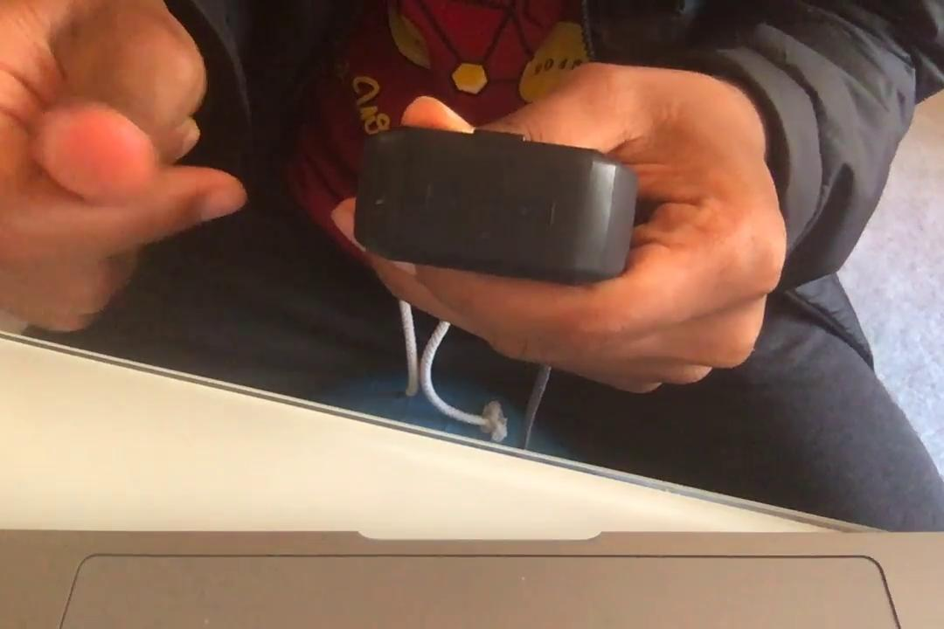
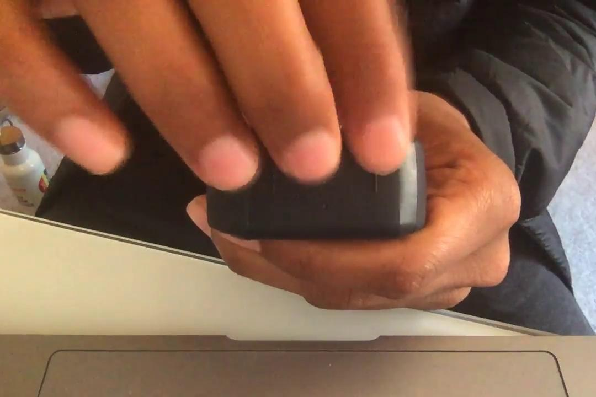
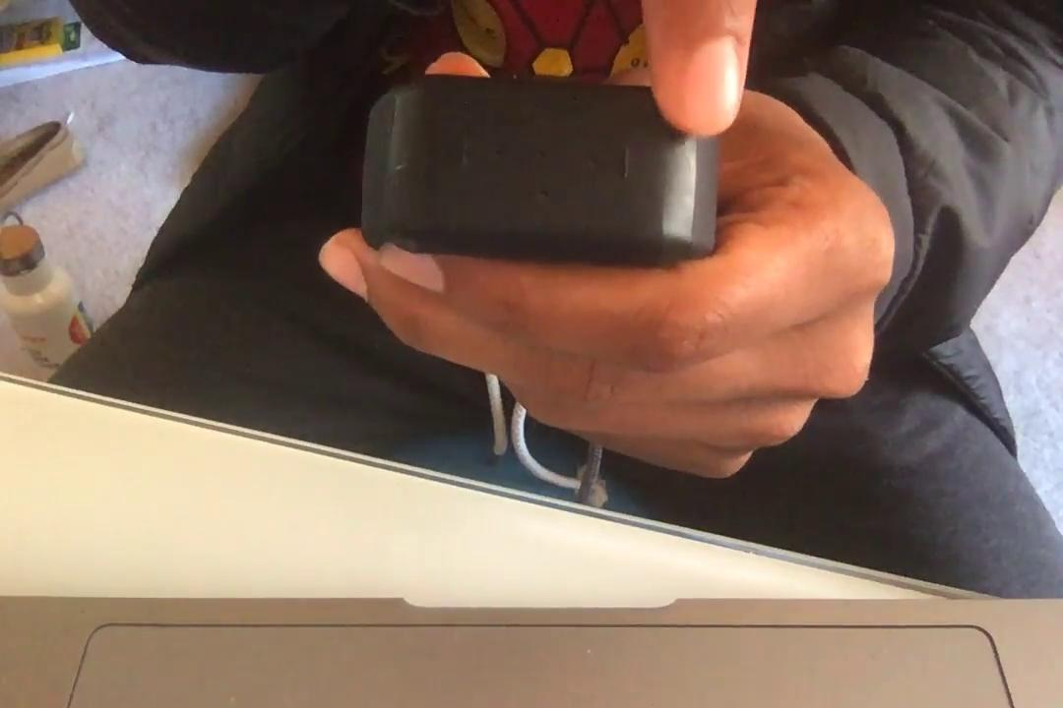
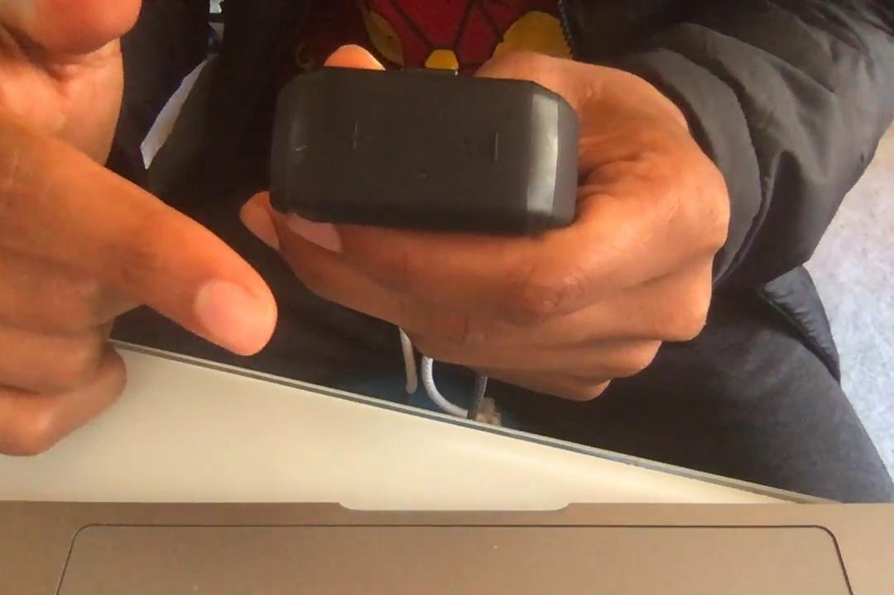
Problem introduction
Detect five gestures performed on Neosensory Buzz in real-time with low latency.
The gestures will be used for user input. For eg. display battery level on double tap.
1. Double tap
2. Finger snap
3. Drumming
4. Slide minus
5. Slide plus

Slide 3
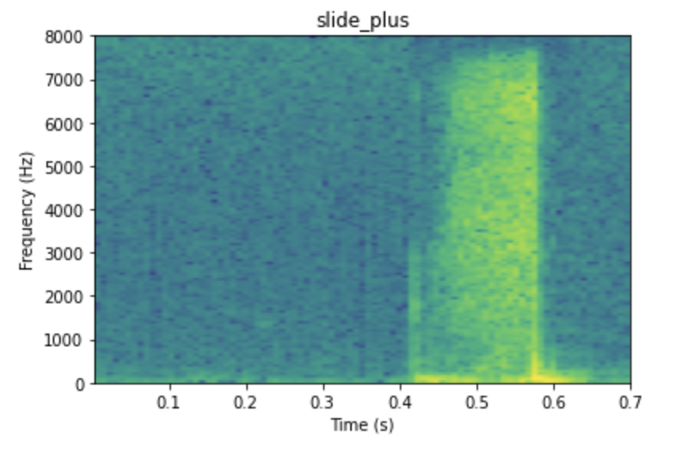
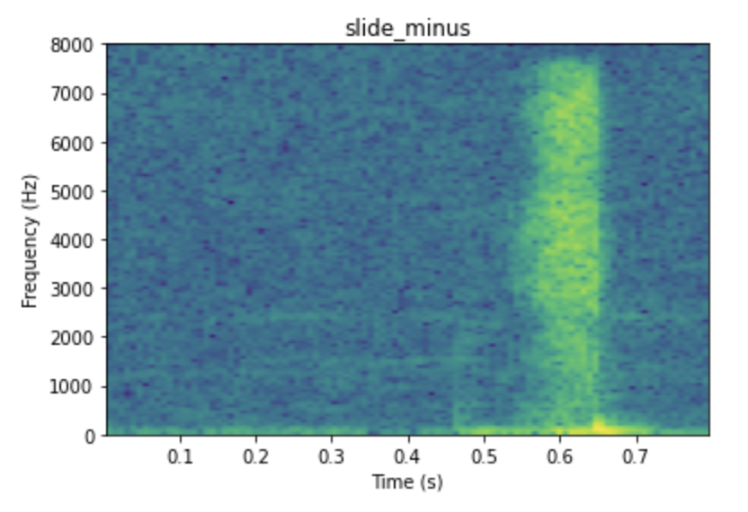
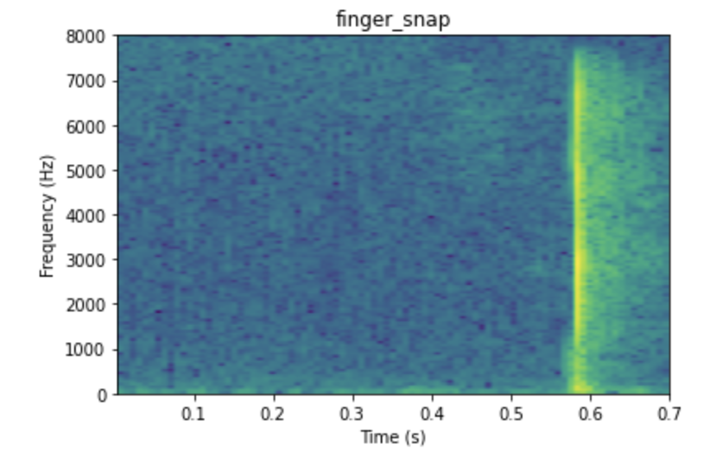
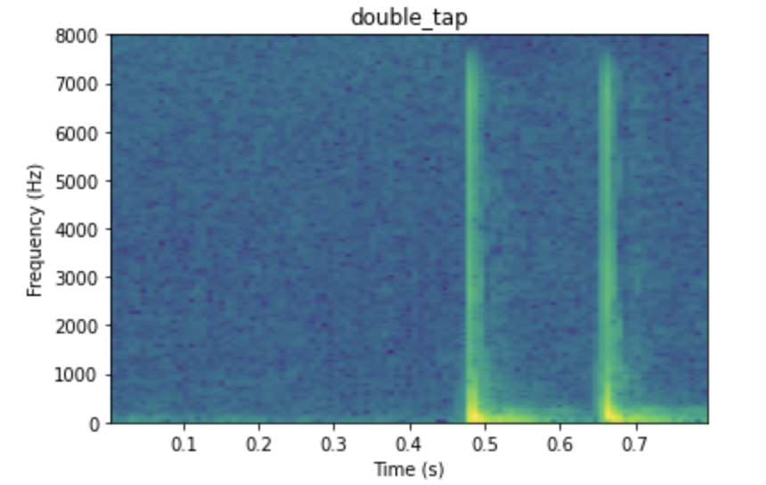
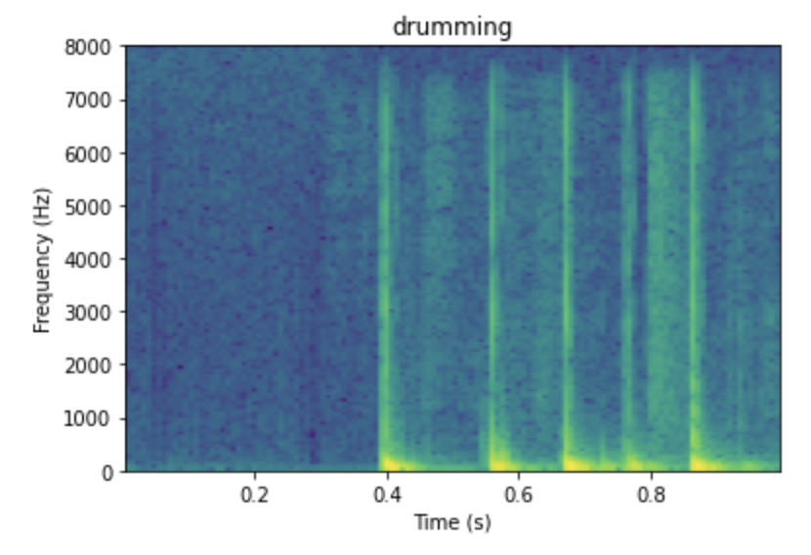
Dataset collection
Modify Pete Warden’s open speech recording (Demo)
Collected 10 examples per gesture from 4 different people
Collected 360+ examples per gesture myself
Collected 100 one-second clips of negative examples

Slide 4
First experiments
Use micro speech tf lite micro example with tiny_conv model
Data prep:
Trim to 1 second by extracting loudest segment for each gesture
Manually inspect every single example and remove bad examples
Train set accuracy | Validation set accuracy | Test Set accuracy | Confusion matrix
76% | 92.6% (N=149) | 95.4% (N=151) | [[11 0 0 0 4 0 2] [ 0 17 0 0 0 0 0] [ 0 0 25 0 0 0 0] [ 0 0 0 30 0 0 0] [ 0 0 0 0 18 1 0] [ 0 0 0 0 0 20 0] [ 0 0 0 0 0 0 23]]

Slide 5
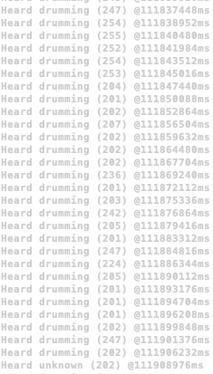
Tiny conv streaming
Detects drumming constantly
Streaming accuracy test 71.5% matched, 26.0% correct, 45.5% wrong, 8.0% false positive
Speculations:
Model’s front-end optimized for speech. Maybe not well-suited for this application with impulse-type audio

Slide 6
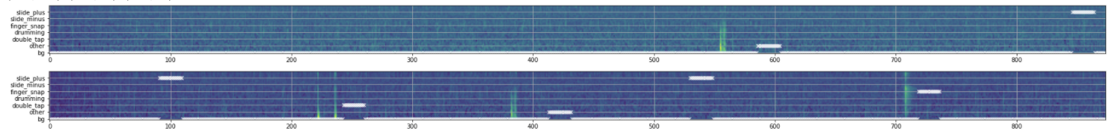
RNN experiments using synthesized data
Dataprep:
14 seconds background track overlaid randomly with gesture clips and negative sample clips (between 1-5 clips)
Extract 40 mel-filterbank energies
2 seconds exponential smoothing and drop first 2 seconds
32768 training examples, 4096 validation and test each with different underlying gesture clips and negative clips

Slide 7
RNN experiments using synthesized data
Output Dense (softmax)
Input: 40 mel-filterbank
Dense(10)
BatchNorm
GRU(16, tanh)
BatchNorm
x3
Total number of params: 5,369
Float model: 33,444 bytes

Slide 8
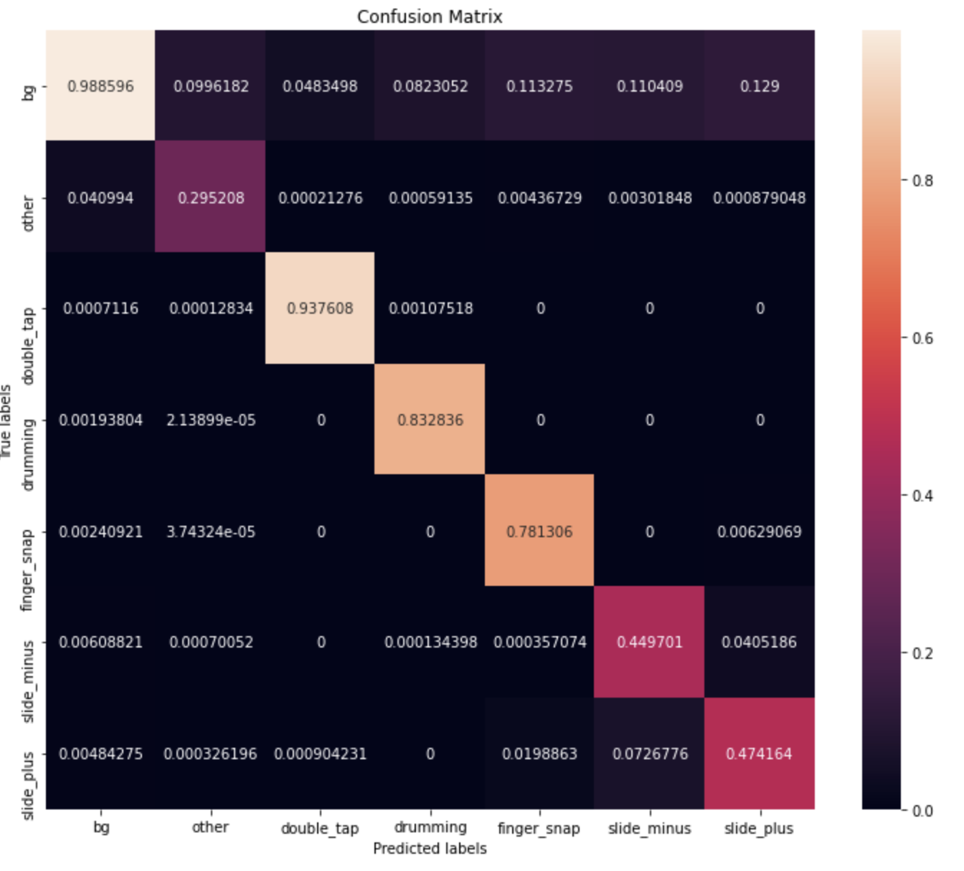
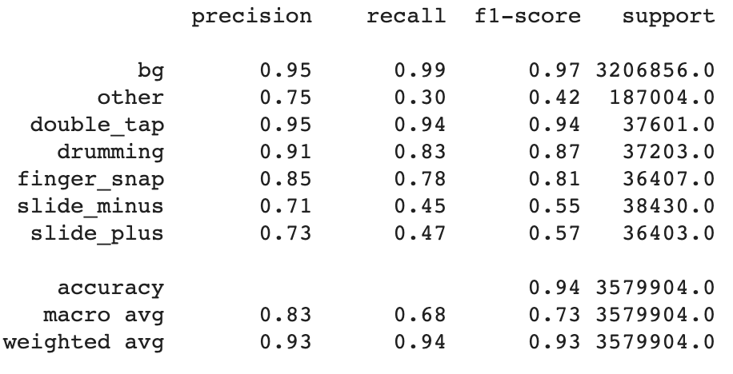
Training results

Slide 9
Streaming performance & demo
A gesture is recognized when:
- Softmax output probability for gesture exceeds a threshold - Model predicts same gesture for 10 consecutive frames (160ms) - After a gesture is recognized, output is suppressed for 20 frames of 300ms

Slide 10
Next steps
Collect more training data
Train with motor noise added into the mix

Slide 11
Questions?
Thank you Pete, Zain and Keyi.

