Slide 1



C^{A}lass^{x}icºca^{n}rs
Axon Classic Cars
SQL Case Study

Slide 2


Contents
Introduction
Problem Statement
Dataset
Entity Relationship Diagram
Suggestions
Insight’s
Recommendation

Slide 3



C^{A}lass^{x}icºca^{n}rs
Introduction
In This project, I
Company's data,
have worked on Axon
which is a classic car
retailer company. The sales team lacks a centralized system to effectively manage and analyze sales data, which is affecting the decision-making process. The aim is to use Microsoft Power BI and SQL to create a Business Intelligence (BI) solution, that offers insights and helps them make better decisions for the future.

Slide 4

C^{A}lass^{x}icºca^{n}rs
Problem Statement
Axon's sales data is disorganized and lacks a centralized system, leading to
inaccuracies and making it challenging to make informed decisions.
The absence of a BI tool hampers data analysis, preventing the sales team from
deriving meaningful insights and understanding market trends.
Management struggles to access timely and accurate sales reports, which hinders their ability to make decisions based on up-to-date information.
The company is unsure whether to choose Microsoft Power BI or SQL as the BI
tool, leading to uncertainty about tool compatibility and capabilities.

Slide 5
C^{A}lass^{x}icºca^{n}rs
Dataset
Customers: stores customer’s data.
Products: stores a list of scale model cars.
ProductLines: stores a list of product line categories.
Orders: stores sales orders placed by customers.
OrderDetails: stores sales order line items for each sales order.
Payments: stores payments made by customers based on their accounts.
Employees: stores all employee information as well as the organization structure
such as who reports to whom.
Offices: stores sales office data

Slide 6
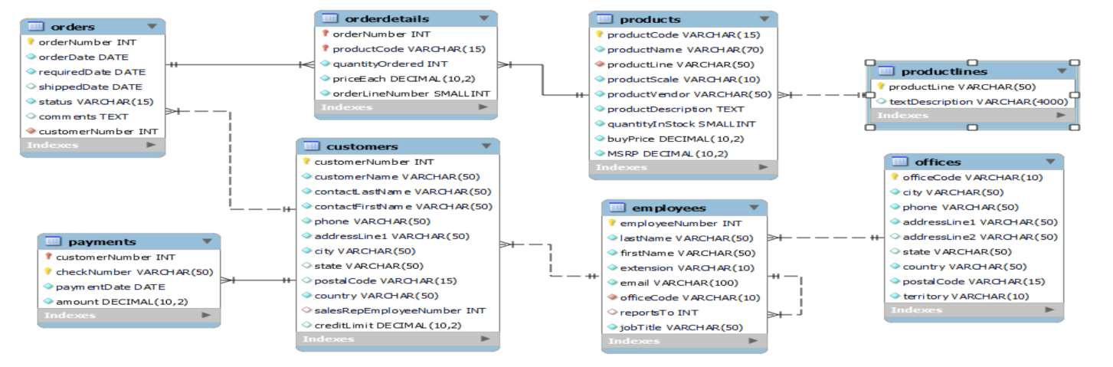
C^{A}lass^{x}icºca^{n}rs
Entity Relationship Diagram

Slide 7
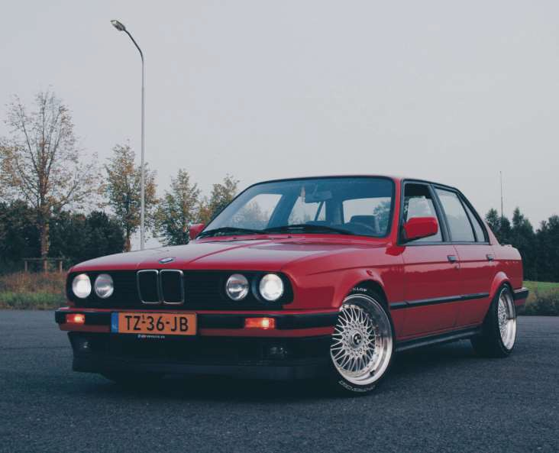

C^{A}lass^{x}icºca^{n}rs
Uncovering Insights
RDBMS Used:- MySQL

Slide 8
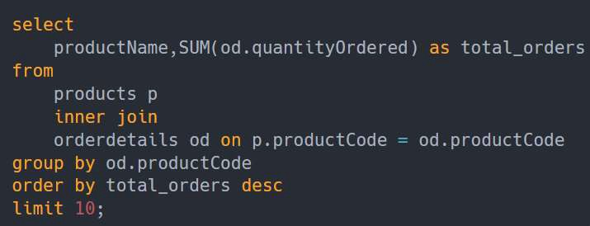
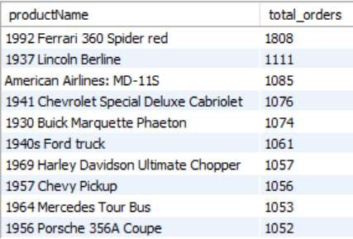
Which are the top 10 products by order
Suggestion: Promote the top 10 best-selling scale model cars and Ensure they are always in stock. Analyze why these products are popular for future product development.

Slide 9
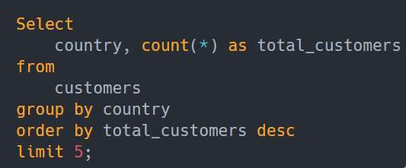
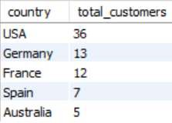
Which countries has highest number of customer
Suggestion: Focus on strengthening the market in the USA, consider expansion in Germany and France, and implement targeted marketing in smaller markets like Spain and Australia

Slide 10
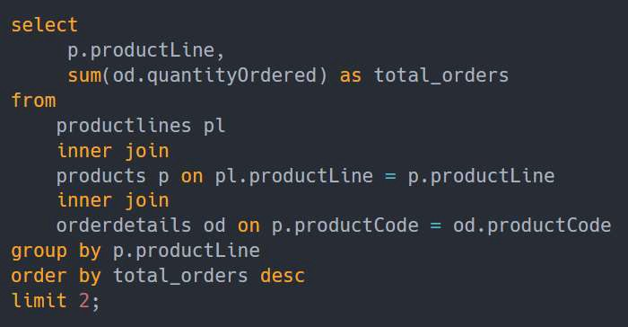

Find the top 2 product line by order
Suggestion: Focus on Classic Cars and Vintage Cars as they are the top-performing
product lines. Analyze and improve the performance of lower-selling product lines.
Explore customer segmentation for more targeted marketing and product development.

Slide 11
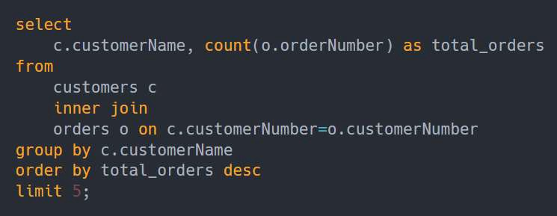
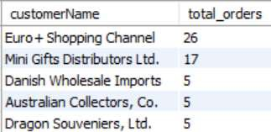
Which are the top 5 customers with the highest number of orders products by order
Suggestion: Concentrate efforts on maintaining a strong relationship with "Euro+ Shopping Channel, "Mini Gifts Distributors Ltd.“ your top customer. Understand the preferences of top customers to tailor marketing strategies, and consider expanding product lines to attract a wider audience for sustained growth.

Slide 12
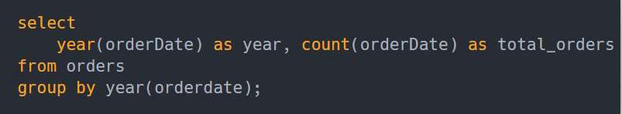
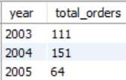
find each year how many orders are placed
Suggestion: Analyze yearly order counts to replicate successful strategies from peak years like 2004. Develop plans to boost sales during weaker years, customize marketing based on insights from successful years, and evaluate the impact of customer engagement on order counts.

Slide 13
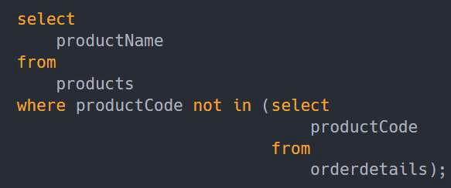

Find the product which is not ordered by any customer.
Suggestion: Look into the "1985 Toyota Supra" due to its lack of sales and determine its future in the product lineup. Collect customer feedback and market data to understand why the product is not selling and make informed decisions.

Slide 14
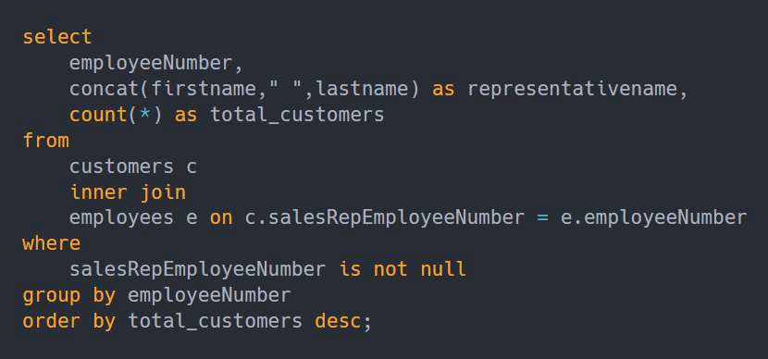
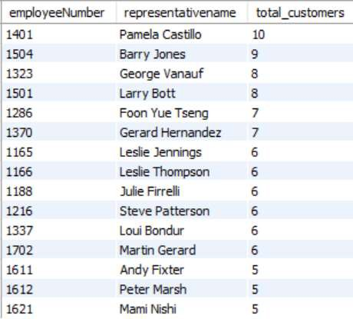
Find The Number Of Customers For Each Sales Representative
Suggestion: Acknowledge and reward high-performing employees like Pamela Castillo and Barry Jones for their substantial customer base. Encourage other employees to enhance customer engagement.

Slide 15
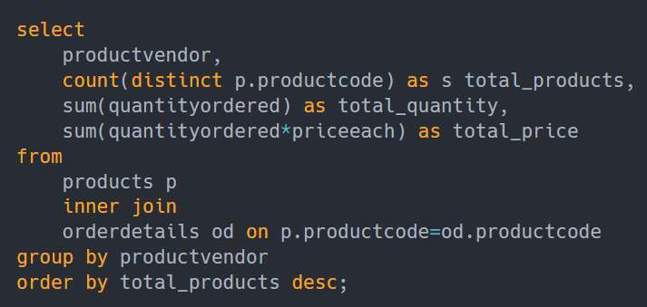
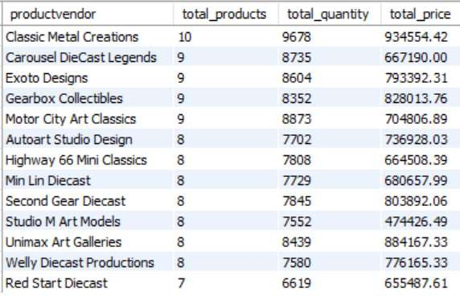
find number of products ordered, total quantity and total price by each vendor
Suggestion: Enhance relationships with top vendors, consider product expansion with
selected vendors, and align product offerings with market and customer preferences.

Slide 16
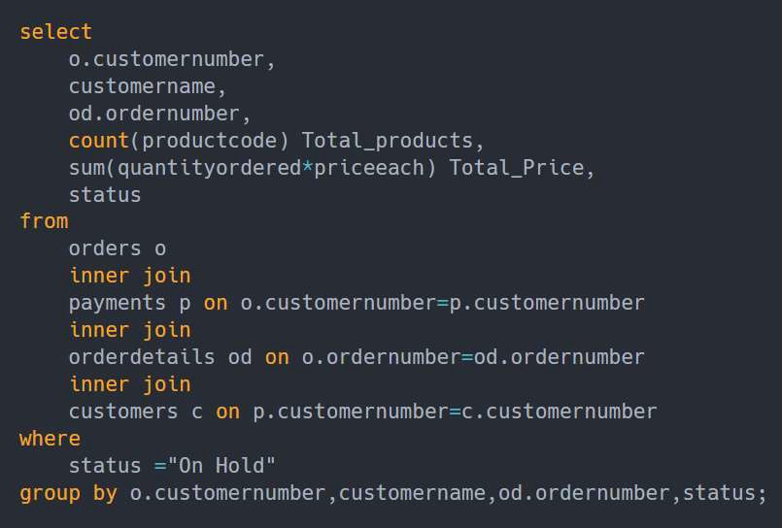
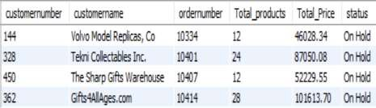
find customers, orders, total products of "On Hold" products
Reach out to customers with orders
"On Hold" promptly to resolve their
concerns and experience.
ensure a positive Check product
availability to fulfil orders promptly.
Ensure
procedures
smooth payment
to prevent order
delays. Keep customers informed about order status and estimated delivery times for better customer satisfaction.

Slide 17
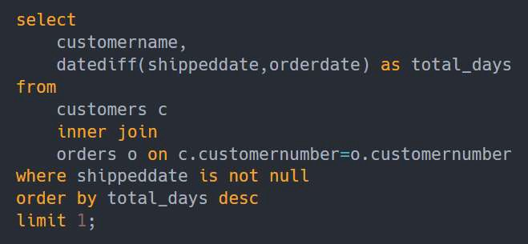

Find the customer who taken more days to ship the order
Suggestion: Improve order processing and reduce the time from order placement to shipment. , optimizing inventory to meet demand more efficiently, maintaining transparent customer order status updates, streamlining the supply chain, and continuously benchmarking against competitors for competitiveness.

Slide 18
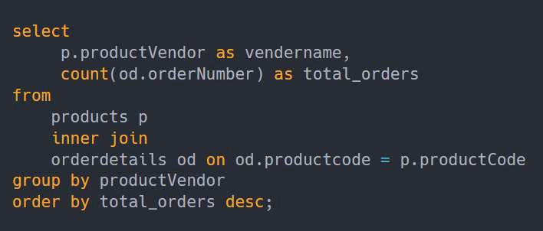
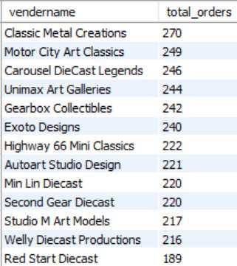
Find Number Of Products Ordered By Each Vendor
Suggestion: Prioritize top-performing vendors with high order counts. Ensure efficient supply chain management, particularly for vendors with high order volumes.

Slide 19
C^{A}lass^{x}icºca^{n}rs
Insights
Customer Distribution: Most of our customers are located in the USA, with Germany following closely.
Popular Product Lines: Among our product lines, "Classic Cars" stands out as the most
frequently ordered, closely followed by "Vintage Cars."
Top-Selling Product: The product that has seen the highest number of orders from our customers is the "1992 Ferrari 360 Spider Red," with the "1937 Lincoln Berline" as the runner- up.
Top Customers: The "Euro+ Shopping Channel, "Mini Gifts Distributors Ltd.“ your top
customer.
Top-Performing Employee: Gerard Hernandez from our Paris office has demonstrated
exceptional promise as our most prolific employee, generating the highest number of orders.

Slide 20
C^{A}lass^{x}icºca^{n}rs
Recommendation
Market Expansion: While the USA is a significant market, consider leveraging the success in Germany as a stepping-stone to further expand into European markets. Invest in marketing and customer engagement strategies specifically tailored to European audiences to tap into this growth potential.
Product Line Expansion: Capitalize on the popularity of "Classic Cars" and "Vintage Cars" by expanding these product lines. Introduce new models, variations, or related accessories to cater to the existing customer interest and potentially attract new customers with similar preferences
Promote Best-selling Products Focus marketing efforts on promoting the "1992 Ferrari 360 Spider Red" and the "1937 Lincoln Berline" as top-selling products to maximize sales and customer engagement.
Team Up with Vendors: Improve Partnerships with Successful Vendors such as 'Classic Metal
Creations,' 'Motor City Art Classics,' and 'Carousel DieCast Legends' to Increase Sales.
Employee Recognition and Development: Implement an employee recognition program to celebrate and reward outstanding performance. This can boost morale and motivate all employees to excel. Offer career development paths and opportunities for growth within the organization to retain top talent and allow them to advance their careers.

Slide 21



THANK YOU

