Slide 1
Vision:
A standardized “tool set” of data structures based on sketch technology could enable simplified implementation and sharing of various data and models of user behavior across many different organizations.

Slide 2
Core Theta Sketch Technology
Effective Sampling Rate Determined by the Sketch
Theta Sketch: k = 4
k: Trade-off of size / accuracy
θ
Analysis Using Set Expressions Across Multiple Theta Sketches
Raw Stream of Uniques
h1
h2
h3
h4
Internal Hashed Identifiers represents a uniform random sample of uniques
Est() = k /θ
Core Sketches have Built-in Capabilities
Ideal for counting and Set Operations of Unique Identifiers
Simple sketch size vs. accuracy trade-offs
Retained sample of hashed identifiers has uniform random properties
Well understood error properties, backed by mathematical proofs.
High Performance. Suitable for both real-time steaming and batch operations.
Notes:
This is the base technology that is stable and used by many platforms across Yahoo.

Slide 3
Associative Behavior Analysis Using Tuple Sketches
Tuple Sketch: k= 4
Analysis using Set Expressions Across
Multiple Tuple Sketches &
Arbitrary Select Operations within a Tuple Sketch
Summary Objects
θ
h1 | •
h2 | •
h3 | •
h4 | •
x | …
Raw Stream of Uniques with Additive Attributes
ID | x | …
Est() = k /θ
Summary Objects can be treated as a uniform random sample of the uniques with attributes
Est(attr x) = Σ(x) /θ
Tuple Sketches have Extended Capabilities
Ideal for collecting a uniform sample of identifiers with additive attributes (e.g., counters).
The Summary Objects are defined by the user developer by extending base Tuple Sketch classes and can have multiple columns.
The user developer defines the rules for updating Summary Objects, and the rules for set operations.
High Performance. Suitable for both real-time steaming and batch operations.
Notes:
This is the base technology that is stable and used by many platforms across Yahoo.

Slide 4
Why Not Joins And Other DB Operations
θ_{A}
h1 | x1
h2 | x2
h3 | x3
h4 | x4
θ_{B}
θ_{min}
h3 | y3
h4 | y4
h5 | y5
h6 | y6
h3 | x3 | y3
h4 | x4 | y4
Inner Join on hash columns
Tuple Sketches have Extended Capabilities
Ideal for collecting a uniform sample of identifiers with additive attributes (e.g., counters).
The Summary Objects are defined by the user developer by extending base Tuple Sketch classes and can have multiple columns.
The user developer defines the rules for updating Summary Objects, and the rules for set operations.
High Performance. Suitable for both real-time steaming and batch operations.
Notes:
This is the base technology that is stable and used by many platforms across Yahoo.

Slide 5
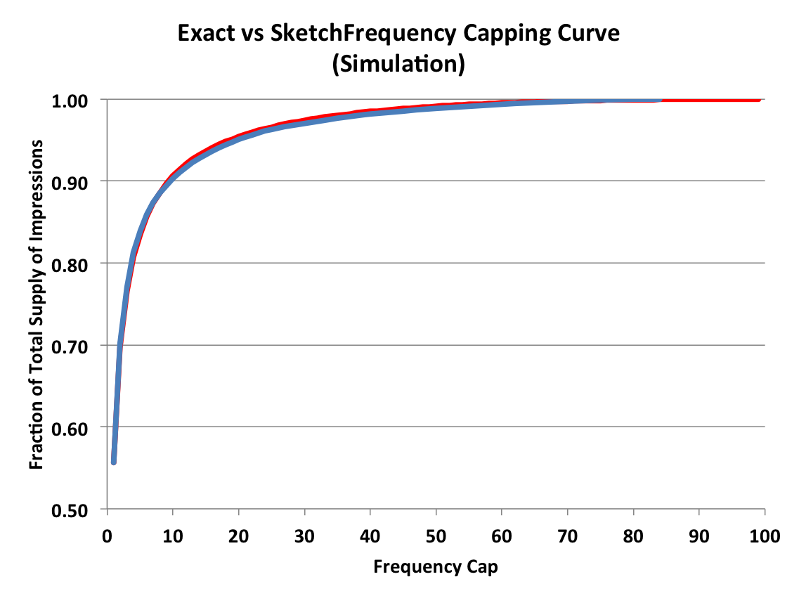
Example: Simple Frequency Cap Distributions Using Sketch Technology
Extend Base Class Using Counters or Histograms
TupleSketch:
k = 3
θ
Raw Impression Data: {B}
b1 | •
b2 | •
b3 | •
Imp Count
Imp Count
Imp Count
Simple Algorithm
Est(B) = k /θ
Dimensional Merging
Online or Offline processing
Notes:
A simple example of behavior analysis is computing the Frequency Cap Distribution for a single interval of time. This can be done by attaching a simple counter to each identifier retained in the sketch.
Each time a duplicate impression is seen by the sketch, it increments the counter.
At the end of the sketching period, a straightforward algorithm transforms this array of counters into our well-known Frequency Cap Curve.

Slide 6
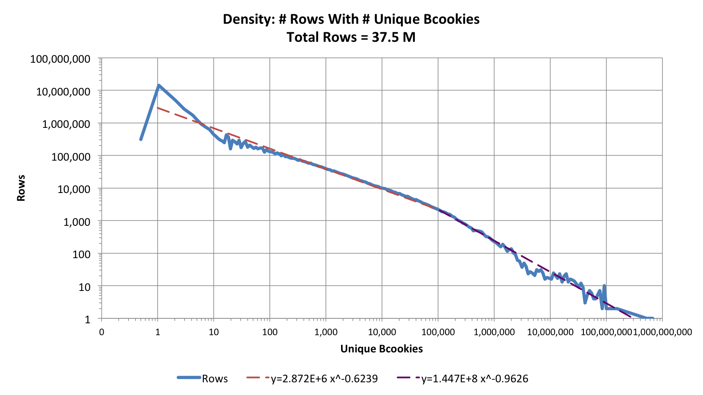
Our Raw Data is Quite Skewed
Notes:
Almost every analysis team at Yahoo is impacted by the simple fact that our incoming raw data is highly skewed. Our big sites, such as Front Page, Sports, and Finance dominate our traffic.
A uniform sampling of this raw data also produces sample sets that are similarly skewed. Which means attempting to analyze behavior of users from small or emerging properties (e.g., phone applicatons) is difficult because the sampled data has too few representative samples.
The above curve was a simple analysis of one intermediate table from Digits 2. Curves like this occur all over Yahoo.

Slide 7
Stratified Sampling & Queries Using Sketch Technology
Phase 1
Phase 2
Query Types
e := Event
B := Bcookie
b := hash(B)
P := Base Profile
D_{n} := n Dim columns
S := θ (KMV) Sketch(k)
R := Reservoir Sketch(k),
or priority, or VarOpt
TS := Tuple Sketch(k)
H := Histogram(e)
LCS := Long Comb of S
R^{K}_{P1}({e, N₁/k})
List{e, N_{i}/k}
|e| <= mK
Spray e by P
Arbitrary, Event Count Query:
a posteriori {e}-matching
Unbiased, Known Good Error & Bounds
R^{K}_{Pm}({e, N_{m}/k})
TS^{K}_{Dn-comb1}({b,H})
Freq Cap Query:
a priori {D_{n}-comb}-matching
Unbiased, (Error to be validated)
Spray e by D_{n}-comb₁
TS^{K}_{Dn-combm}({b,H})
Phase 1
Phase 2
Pass 1
Raw Events e: {B,D_{n},P, ...}
S^{K}_{P1}({b},θ₁)
Hash Table
LCS({b, 1/θ_{max}})
|b| <= mK
Spray b by P
Arbitrary, Unique B-Count Query:
a posteriori {B}-matching
Unbiased, Known Good Error & Bounds
S^{K}_{Pm}({b},θ_{m})
Arbitrary, Unique B-Count,
or Freq Cap Query:
a posteriori {e}-matching
Unbiased, Known Error & Bounds
Pass 2
Raw Events e: {B, …}
Hash Table
LCS({b, 1/θ_{max}, {e}})
|b|<=mK
Arbitrary, Event Count Query:
a posteriori {e}-matching
Unbiased, Unknown Error
Phase 3
Notes:
A different kind of extension of the base Tuple Sketch enables fast and efficient sampling of our raw data that enables leveling-of-the-playing-field across many different “strata” (dimensions) of Yahoo data.
This provides a standardized, simpler, faster and more accurate way to perform this “leveling” than what we are doing now.
And it could be leveraged across many different platforms and groups.

Slide 8

Example: Achieving Stratified Sampling Using Sketch Technology
Raw Data: {B,D_{n}}
N = Unique B = 9 (unknown)
C_{T} = #Imp = 12 (unknown)
Worked Example
Stratified Sampling Sketch (SSS) of Base Profile 1
b = hash(B)
Assume b1 < b2 < b3 < b4 … b9
Summary A₁: C_{R,1}=3
B₁, I₁
B₁, I₂
B₁, I₃
B₂, I₄
B₂, I₅
B₃, I₆
B₄, I₇
B₅, I₈
B₆, I₉
B₇, I₁₀
B₈, I₁₁
B₉, I₁₂
D_{n} | B | b | C_{D} | W | θ
… | B₁ | b₁ | C₁ | 2 | 1/3
… | B₁ | b₁ | C₂ | 2 | 1/3
… | B₁ | b₁ | C₃ | 2 | 1/3
TupleSketch:
k = 3
θ ≈ k/N = 1/3
b1 | •
b2 | •
b3 | •
Summary A₂: C_{R,2}=2
D_{n} | B | b | C_{D} | W | θ
… | B₂ | b₂ | C₁ | 2 | 1/3
… | B₂ | b₂ | C₂ | 2 | 1/3
Query on matching rows of {B,D_{n}}
Est(B) = 3 /θ = 9
Summary A₃: C_{R,3}=1
C_{T} = 12 (total)
C_{R} = 6 (retained)
W = C_{T} / C_{R} = 2
D_{n} | B | b | C_{D} | W | θ
… | B₃ | b₃ | C₁ | 2 | 1/3
Translating Back to Raw Data from a query:
Raw Data Unique B = Σ(Row_{i}/θ_{i})
Raw Data Impressions = Σ(Row_{i}*W_{i}*C_{D,i})
Counts impressions with same {B, D_{n}}
Note: W and θ are computed when sketch is completed
Notes:
A different kind of extension of the base Tuple Sketch enables fast and efficient sampling of our raw data that enables leveling-of-the-playing-field across many different “strata” (dimensions) of Yahoo data.
This provides a standardized, simpler, faster and more accurate way to perform this “leveling” than what we are doing now.
And it could be leveraged across many different platforms and groups.

Slide 9
Many Base Profiles
k
SSS of BP 1
B | D_{n} | W | θ
Raw Data
Impressions
R={B,D_{n}}
Base Profile
Switch
Concatenate Rows
k
Query on matching rows of {B,D_{n}}
SSS of BP n
B | D_{n} | W | θ
Notes:
This is the larger picture where all of Yahoo data would be partitioned among n Base Profiles. The dimension information used to define the profiles could be defined by each group or be shared across groups.

Slide 10
The opportunities to extend this base “Tuple Sketch” into other types of User behavior analysis are huge.
We are seeing only the tip of the iceberg.

Slide 11
The Frequency Cap Model
Given a Stream, A, of Events (e: {B, ts, D_{n}}) ε A
Based on the long integration interval T, what is the fraction of all events
where the B experience no more than f impressions
within the selected D_{n} and
within a time period t.
e := Event
ts := Time stamp
T := Long Integration Interval
t := Short Estimation Interval
B := Bcookie

Slide 12
Options to Reservior Sampling
Simple Reservior, Flat Sampling of Raw Events (Edo’s proposal)
No Agg
Partitioned by Base Profiles
Aggregate across chosen Dimensions
Much smaller, potentially Exact
May require Joins
Aggregate with Weighted Sampling
VarOpt
Priority Sampling
Edith’s WS : Steaming, but 2-pass

