Slide 1
BLUEMIND SOLUTIONS · AI & ML INTERNSHIP · CAPSTONE PROJECT
Customer Churn
Intelligence System
Predicting the quiet goodbyes before they happen
Abhishek Rai A · Intern ID 21INT58 · Day 20 Capstone Presentation

Slide 2
THE PROBLEM
1 in 4
customers on this dataset walked away, and most
of them never said a word before they left.
No complaint ticket. No angry call. Just a cancelled subscription.
CUSTOMER CHURN INTELLIGENCE SYSTEM
02

Slide 3
WHY IT MATTERS
By the time someone cancels, it's already too late to ask why
1
2
3
Retention beats
acquisition
Silence is
the warning
Early beats
accurate
Keeping a customer
costs far less than
winning a new one.
Most churn happens
quietly, with no
complaint at all.
A good guess today
beats a perfect
explanation later.
CUSTOMER CHURN INTELLIGENCE SYSTEM
03

Slide 4
THE MISSION
What if we could see it coming?
Flag the customers most likely to leave, early enough for a retention
team to actually do something about it, and explain why each one
was flagged so the outreach is targeted instead of a guess.
CUSTOMER CHURN INTELLIGENCE SYSTEM
04

Slide 5
THE DATA
7,043 customers,
one story to find
7,043
21
The IBM Telco Customer Churn dataset. Real account, service and billing details for a telecom provider's customer base, pulled straight from source with no manual downloading.
customers
attributes each
3
26.5%
data groups: account,
services, billing
already churned
CUSTOMER CHURN INTELLIGENCE SYSTEM
05

Slide 6
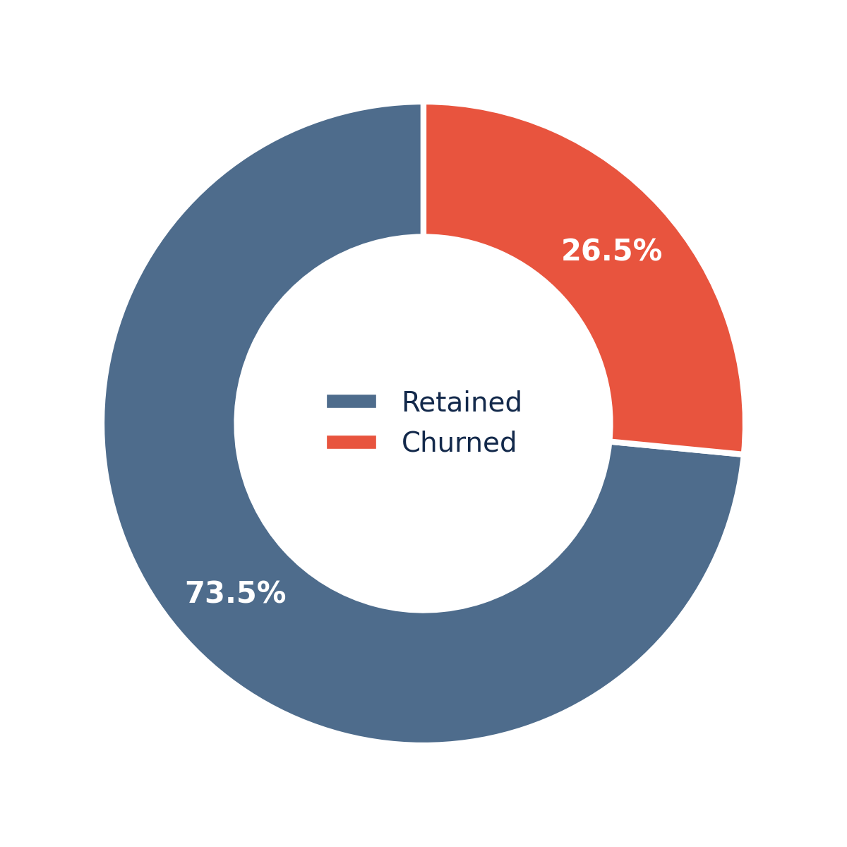
THE BIG PICTURE
Where we're
starting from
Just over a quarter of customers in this dataset have already churned. The other three quarters is where the answer to why is hiding.
CUSTOMER CHURN INTELLIGENCE SYSTEM
06

Slide 7
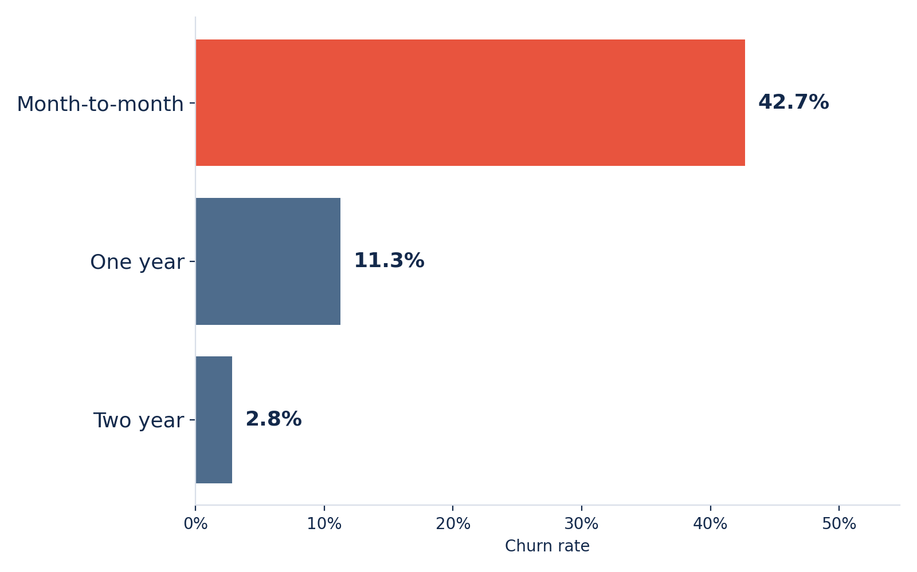
INSIGHT 01
The contract trap
Month-to-month customers churn at 42.7%. Two-year customers churn at 2.8%. Commitment, it turns out, is one of the strongest retention tools there is.
CUSTOMER CHURN INTELLIGENCE SYSTEM
07

Slide 8
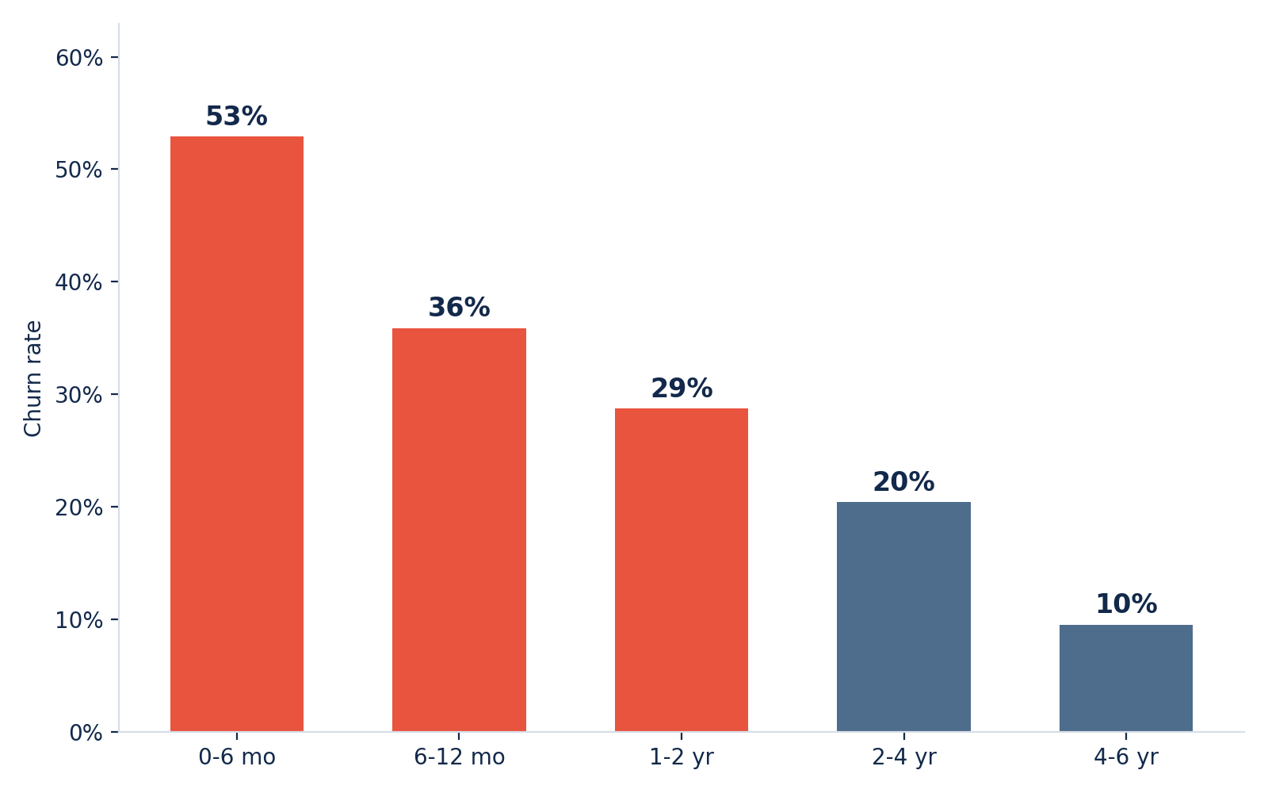
INSIGHT 02
The first
six months
Over half of customers in their first six months churn. That risk falls steadily the longer someone stays, tenure itself is protective.
CUSTOMER CHURN INTELLIGENCE SYSTEM
08

Slide 9
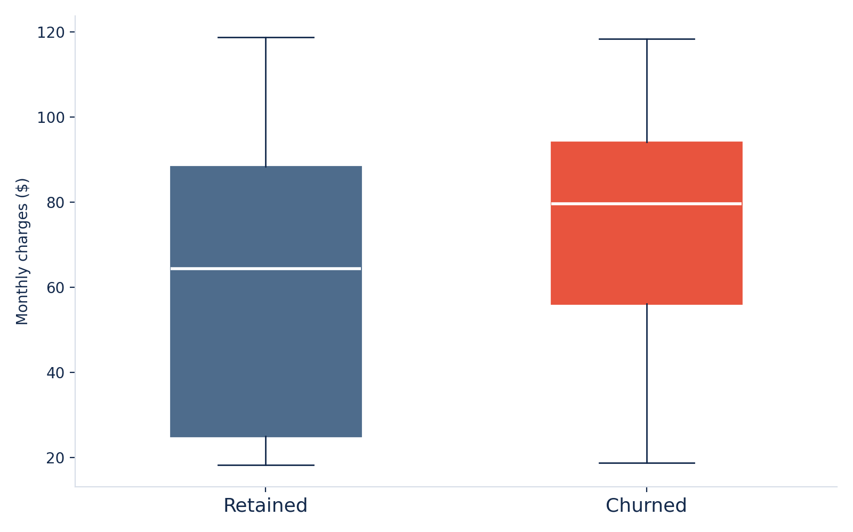
INSIGHT 03
Paying more,
staying less
Customers who leave tend to pay noticeably more each month than those who stay. Price and perceived value are not always lining up.
CUSTOMER CHURN INTELLIGENCE SYSTEM
09

Slide 10
THE PIPELINE
A pipeline that
doesn't cheat
The train and test split happens before any scaling, encoding or fitting. Nothing the model learns has ever seen the test data. That discipline is what separates a real result from a leaked one.
Raw data
Clean
Split
Preprocess
Train
7,043 rows
from source
→
Fix billing
gaps
→
Train and test,
before anything
→
Scale and
encode
→
Fit the
models
Split happens here, before scaling or encoding ever sees the test set
CUSTOMER CHURN INTELLIGENCE SYSTEM
10

Slide 11
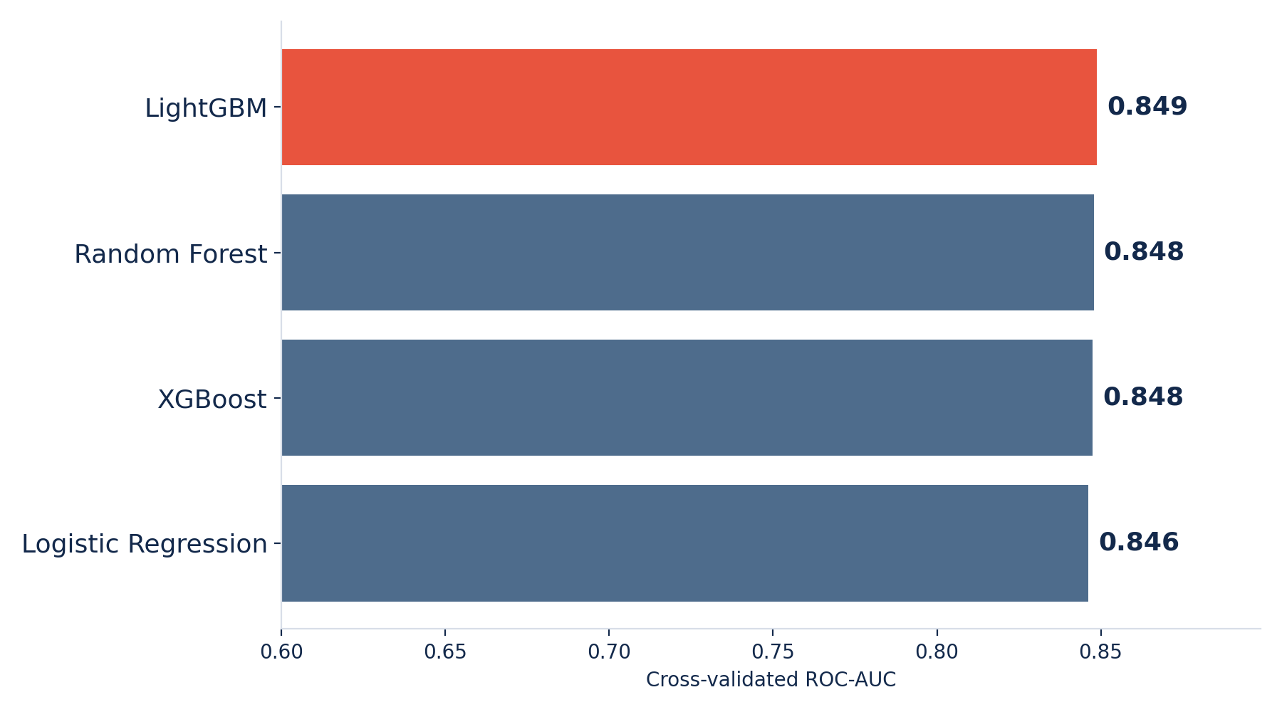
THE BAKE-OFF
Four models,
one winner
Logistic Regression, Random Forest, XGBoost and LightGBM, each tuned with RandomizedSearchCV over five-fold cross-validation, ranked on ROC-AUC.
LightGBM
wins at 0.849 cross-validated ROC-AUC
CUSTOMER CHURN INTELLIGENCE SYSTEM
11

Slide 12
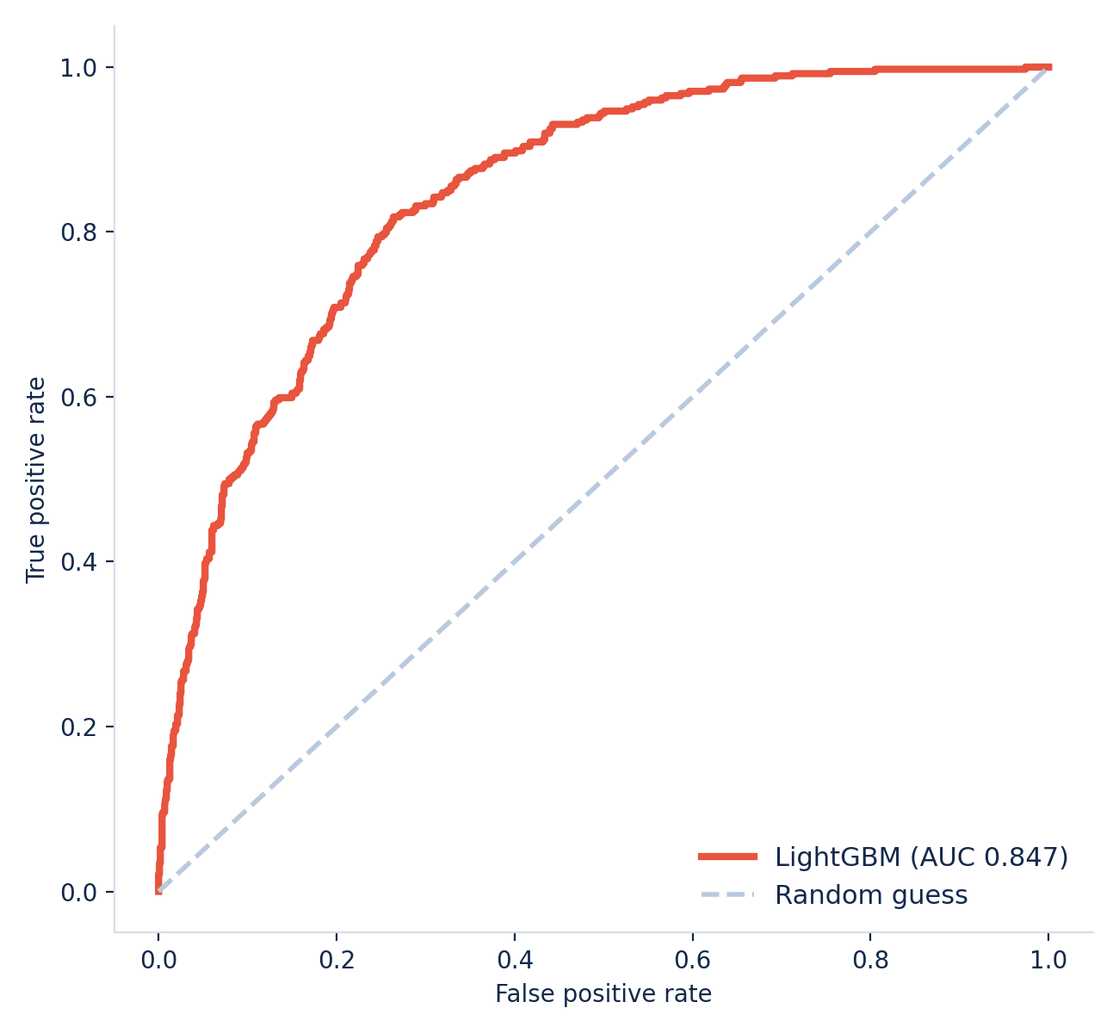
THE WINNER
Holds up on
unseen data
The real test isn't cross-validation, it's data the model has never touched. On the held-out test set, the curve barely moves.
0.847
ROC-AUC on the test set
CUSTOMER CHURN INTELLIGENCE SYSTEM
12

Slide 13
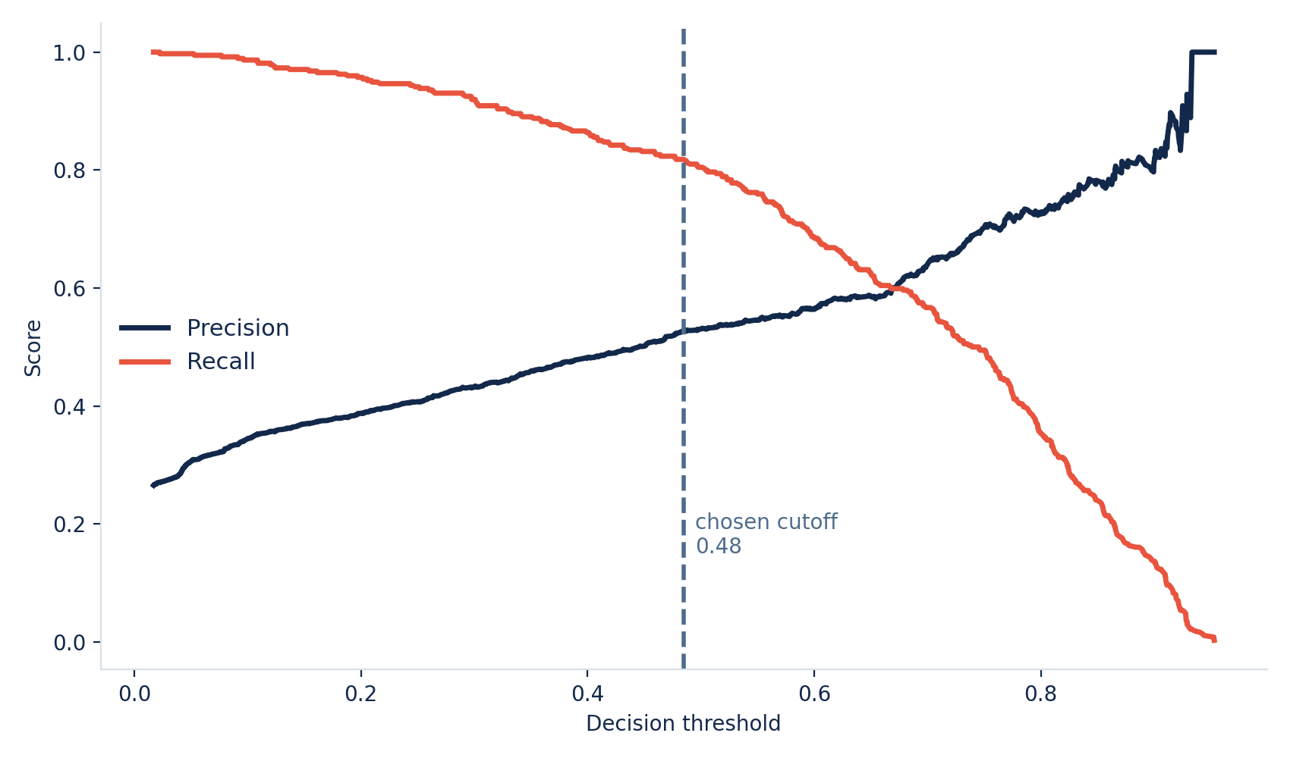
THE TRADEOFF
0.5 is not a
business decision
Missing a real churner costs far more than one wasted retention offer. The cutoff was moved from the default to reflect that, favouring recall over blind precision.
CUSTOMER CHURN INTELLIGENCE SYSTEM
13

Slide 14
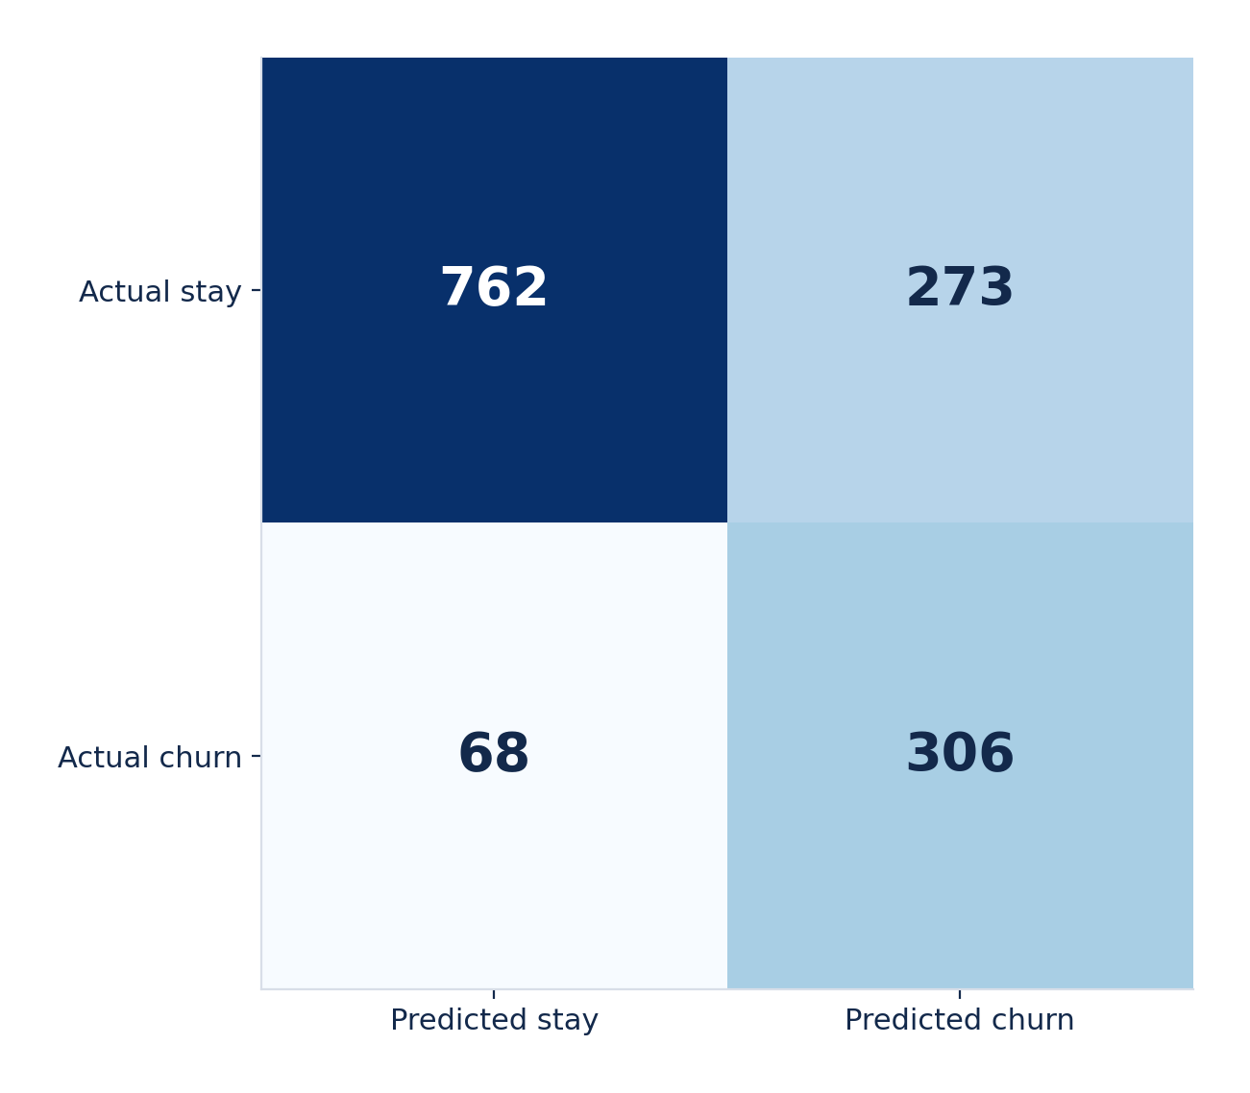
IN PRACTICE
1,409 customers,
one call each
306 flagged correctly before they left. 68 missed. 273 false alarms, each one only costing the price of an offer to someone who was staying anyway.
CUSTOMER CHURN INTELLIGENCE SYSTEM
14

Slide 15
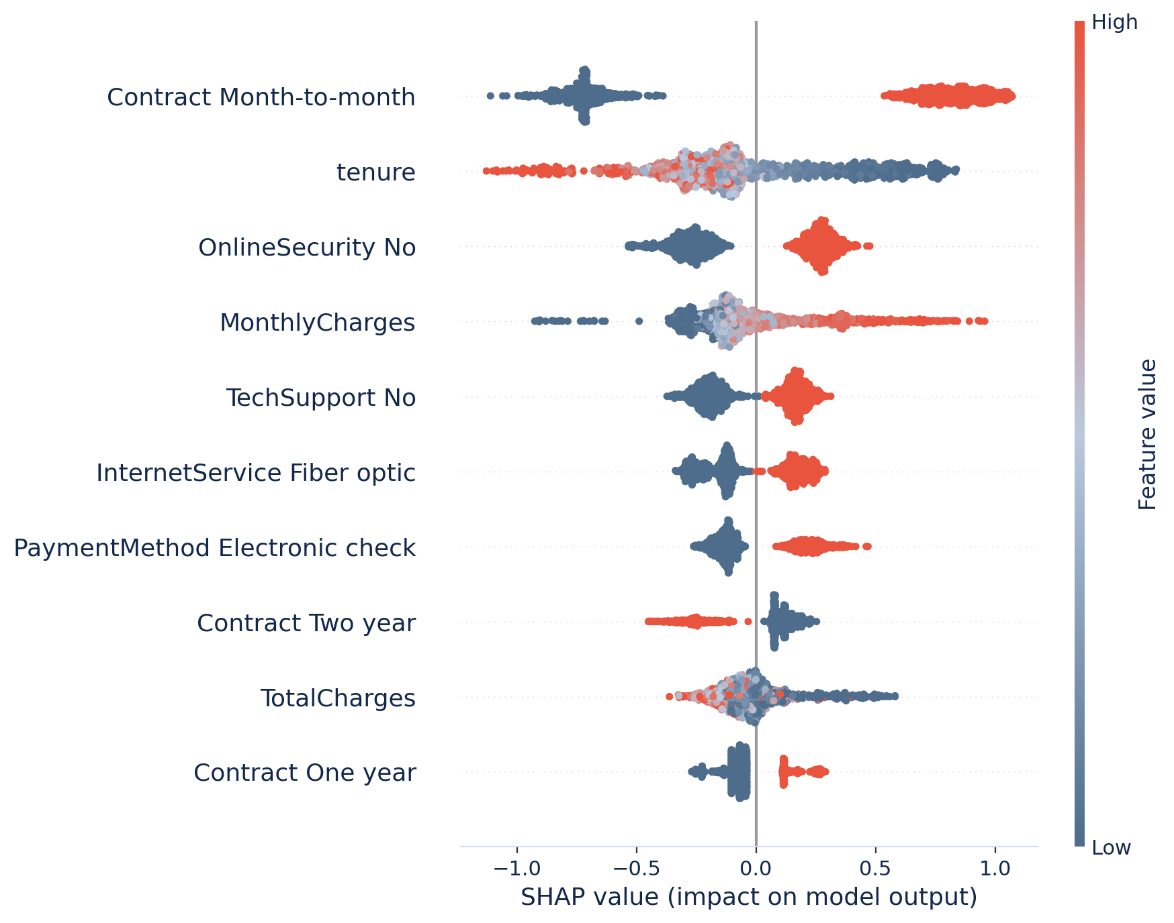
EXPLAINABILITY
Every prediction
has a reason
Month-to-month contracts, short tenure, and missing security or tech support all push risk up, exactly what the EDA hinted at, now confirmed by the model itself.
CUSTOMER CHURN INTELLIGENCE SYSTEM
15

Slide 16
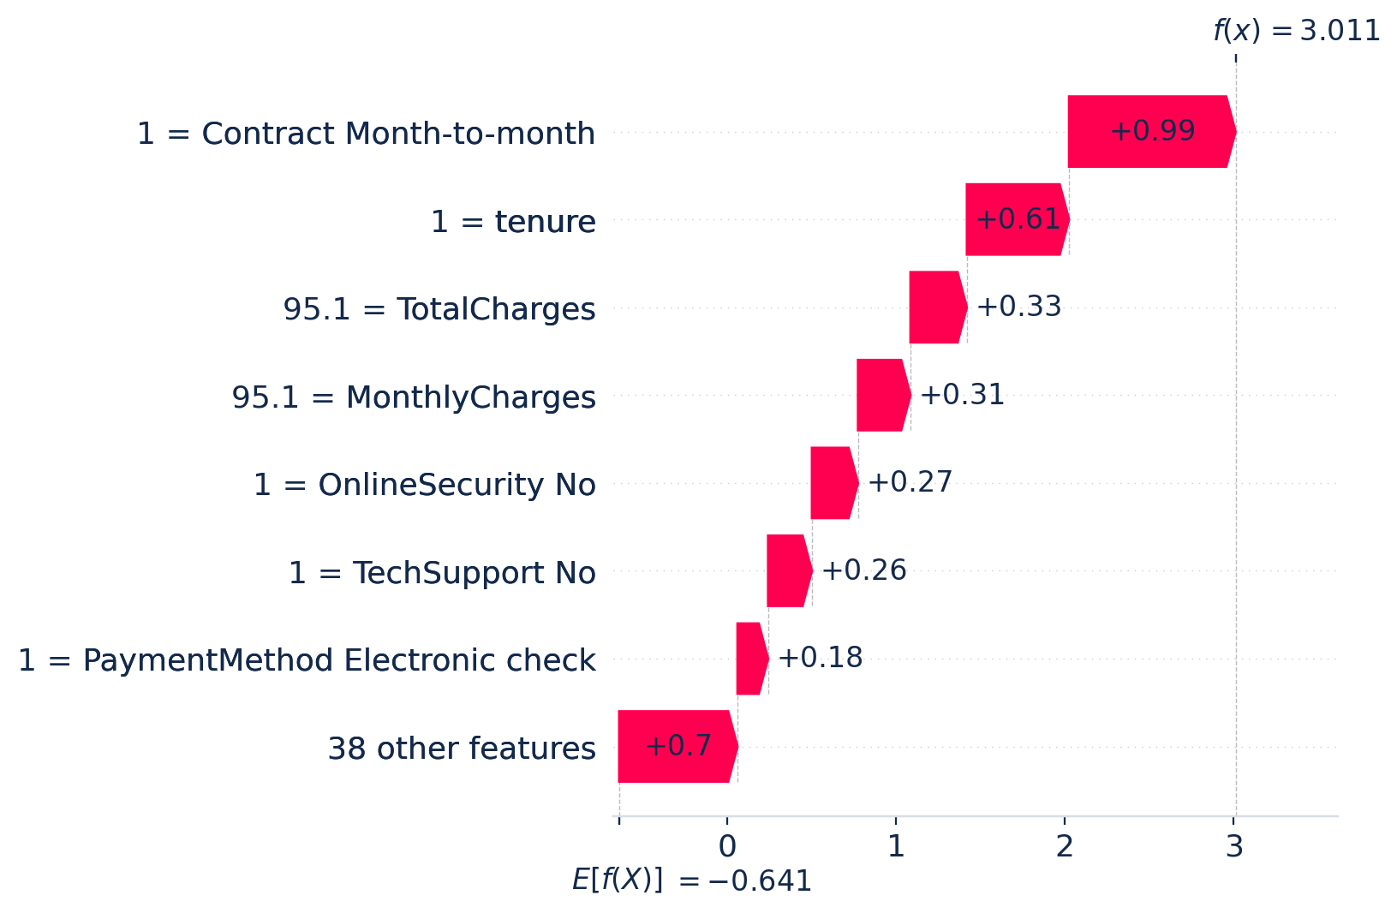
ONE CUSTOMER
The riskiest
customer in the
test set
One month in. Month-to-month. No online security, no tech support, paying by electronic check. The model puts their churn risk at 95%, and shows exactly why.
CUSTOMER CHURN INTELLIGENCE SYSTEM
16

Slide 17
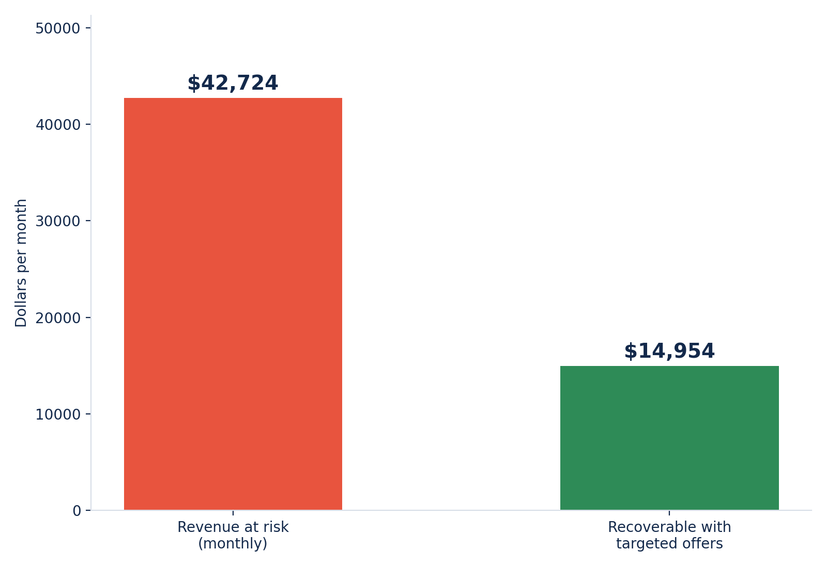
WHAT IT'S WORTH
Turning predictions
into dollars
579 customers flagged high risk in the test set alone. At a conservative 35% retention success rate, that's real recoverable revenue.
$179K
estimated recoverable per year, from this test set alone
CUSTOMER CHURN INTELLIGENCE SYSTEM
17

Slide 18
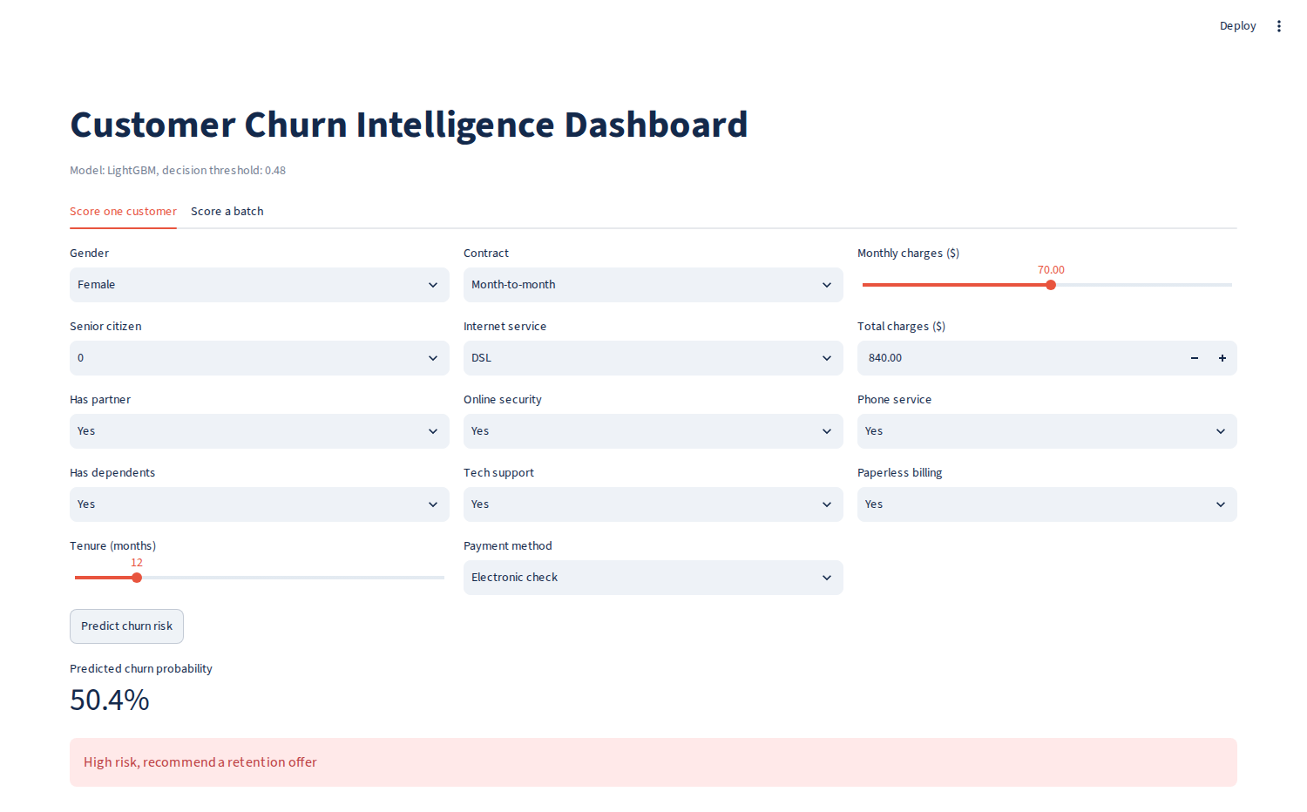
THE PRODUCT
A dashboard the
team can actually
use
Enter one customer's details or upload a batch. Every score comes with a threshold-based flag, so the retention team knows exactly who to call first.
CUSTOMER CHURN INTELLIGENCE SYSTEM
18

Slide 19
WHAT'S NEXT
Where this goes
from here
Time-aware validation
1
Replace the random split with a time-based one, churn is a time dependent problem and a random split can quietly leak the future into training.
Three honest next steps, if there were two more weeks on this instead of two more days.
Predict when, not just if
2
Move from a yes-or-no flag to a survival style model that estimates how soon a customer is likely to leave.
Straight into the CRM
3
Turn this into a scheduled weekly batch job that pushes the high risk list directly to the retention team's tools, no manual CSV uploads.
CUSTOMER CHURN INTELLIGENCE SYSTEM
19

Slide 20
THANK YOU
Questions, pushback and edge cases welcome
0.847
82%
$179K
4
test ROC-AUC
churners caught
recoverable a year
models compared
Abhishek Rai A · Bluemind Solutions AI & ML Internship

