Slide 1


52
MAJOR PROJECT · 23ONMCR-753
REPORT PAGES
MindAgent
6
AWS LAMBDAS
Intelligent Document Q&A System
14
A serverless, confidence-driven Retrieval-Augmented Generation (RAG) platform — built entirely on pay-per-use cloud infrastructure.
STEP RAG PIPELINE
100%
Abhiraj Ghosh
Roll No: O24MCA110969 · MCA (4th Sem) · Batch 2024–2026
TESTS PASSING

Slide 2






THE PROBLEM
Why existing document Q&A falls short
Latency vs. timeout
Retrieval quality
Rate-limit fragility
Multi-user leakage
Deep RAG pipelines take 8–15 s, but API Gateway enforces a hard 29 s HTTP timeout — almost no margin, failures under load.
Pure vector search misses exact keywords; pure BM25 misses paraphrases. Neither alone is production-grade.
LLM APIs enforce strict rate limits. A system that fails on exhaustion is unreliable for real workloads.
Shared embedding stores without isolation can expose one user's documents to another's queries.
MindAgent · Problem

Slide 3






PROJECT OBJECTIVES
What MindAgent set out to build
Fully serverless RAG
Async submit-poll
Complete PDF→answer lifecycle on AWS Lambda — no persistent servers.
SQS-backed pattern that defeats the 29 s API Gateway timeout entirely.
Hybrid retrieval
Conditional HyDE
HNSW vectors + BM25 keyword search fused via Reciprocal Rank Fusion.
Hypothetical Document Embeddings, triggered only when RRF < 0.02.
MMR reranking
Multi-tenant isolation
λ=0.7 diversity-aware selection of non-redundant context chunks.
Supabase Row-Level Security + user-scoped cache keys.
MindAgent · Objectives

Slide 4
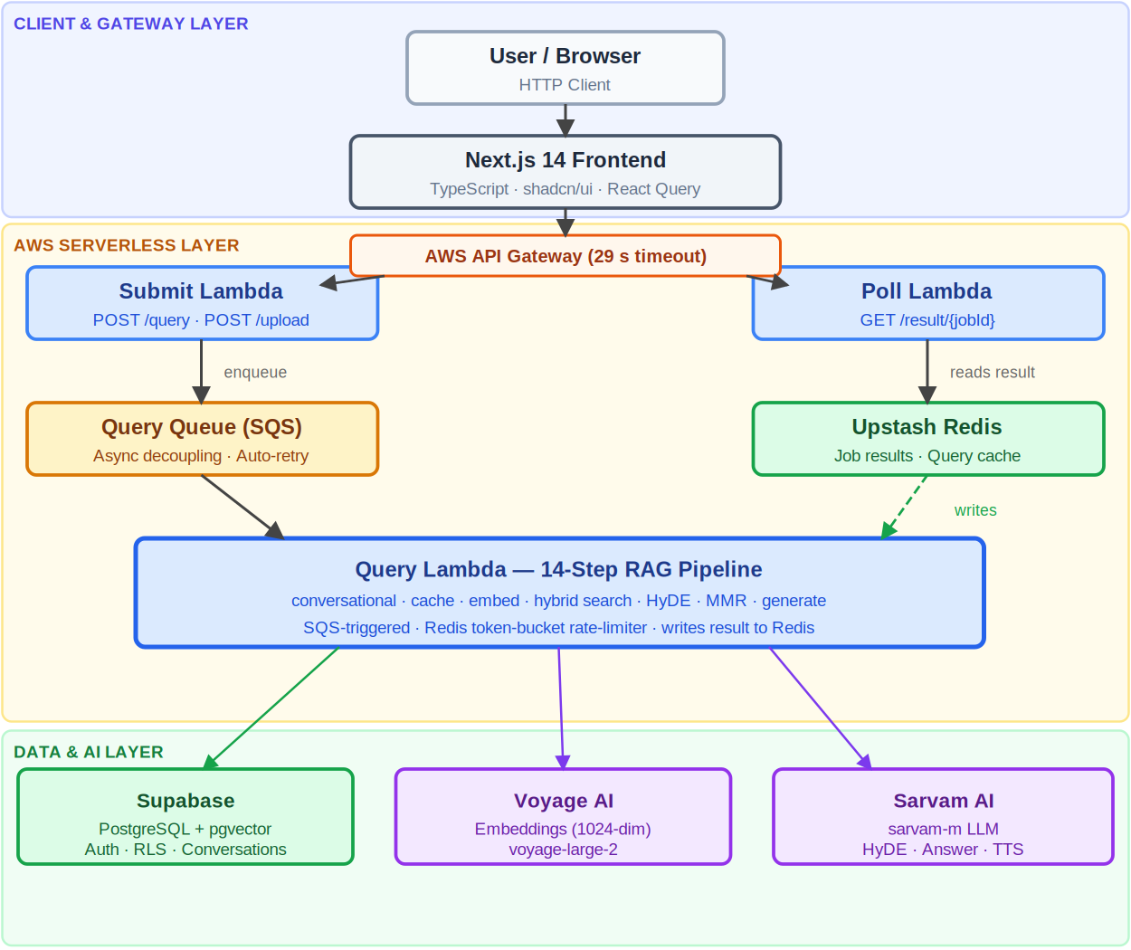
DESIGN · 3.1
System Architecture
Two independent async pipelines — query and ingestion — decoupled via SQS, sharing a Supabase + Redis data layer. Entirely serverless.
MindAgent · Architecture

Slide 5
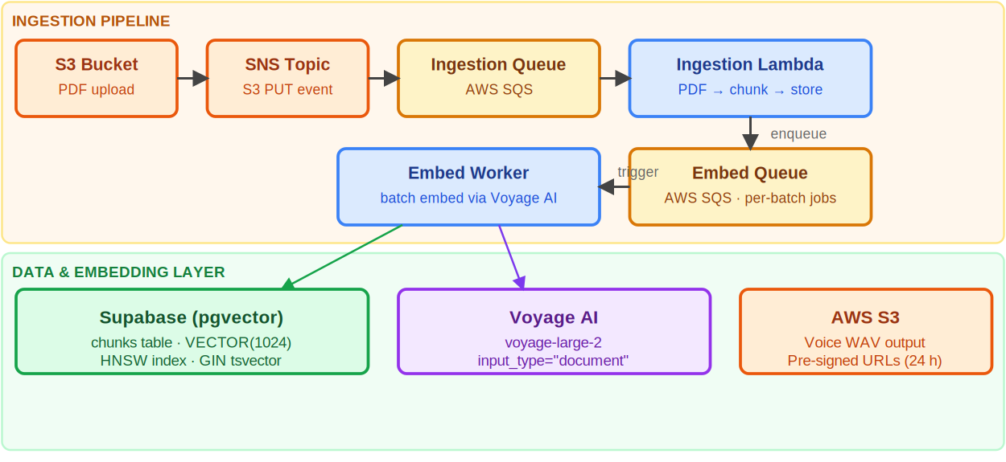



DESIGN · 3.1.2
Document Ingestion Pipeline
Windowed chunking
50-page windows · 3-page overlap → ~500-char segments
Async embedding
Voyage AI voyage-large-2 → 1,024-dim dense vectors
Status lifecycle
pending → processing → indexing → ready
MindAgent · Ingestion

Slide 6
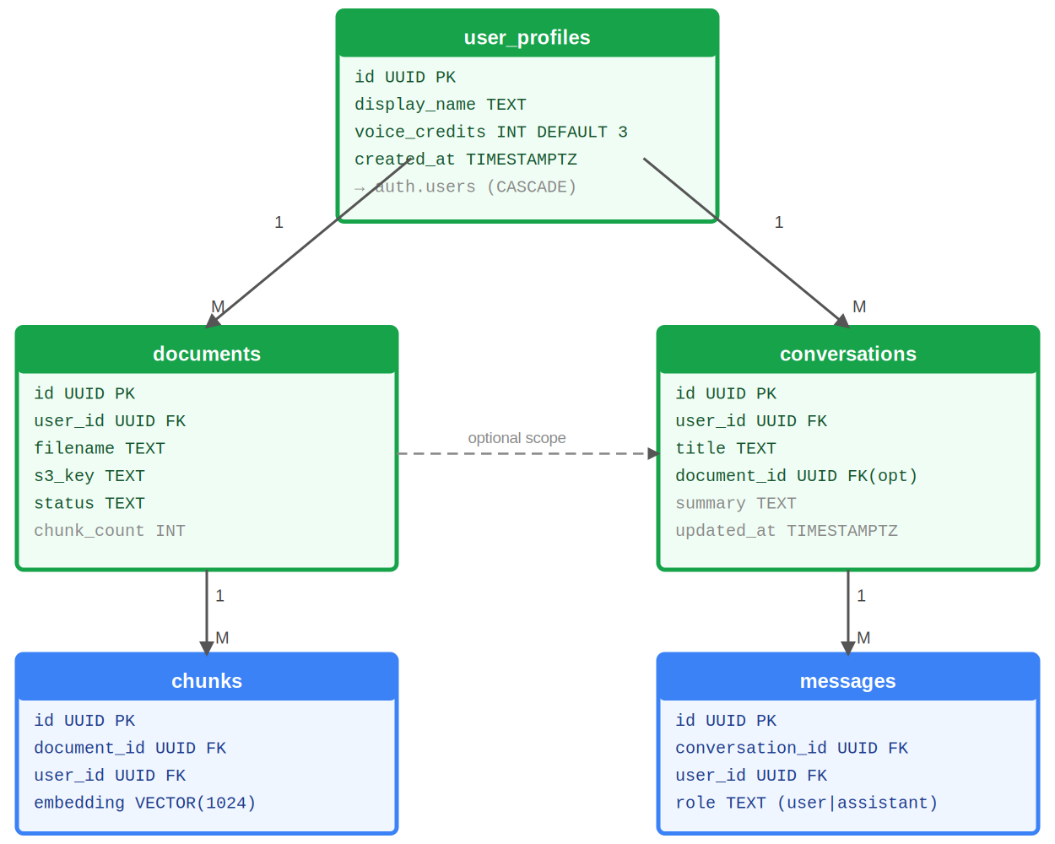
DESIGN · 3.4
Entity Relationship Model
Five-table schema in the rag schema (Supabase PostgreSQL 15).
chunks VECTOR(1024) embedding + generated tsvector for BM25
documents S3 key, status, chunk_count — owned per user
conversations Optional document scope, rolling summary
RLS Every table filtered by JWT subject = user_id
MindAgent · Data Model

Slide 7




CORE LOGIC · 14 STEPS
The Confidence-Driven Query Pipeline
STEP 1
STEP 2
STEP 3
STEP 4
STEP 5
Submit
Retrieve
Enhance
Rerank
Generate
POST /query →
SQS job_id, 200 OK
Embed → hybrid
HNSW + BM25 (RRF)
RRF < 0.02 ?
conditional HyDE
MMR λ=0.7 →
top-5 diverse chunks
Sarvam AI →
answer + sources
Rate-limit resilience: A Redis sliding-window token bucket enforces Sarvam's 60 calls/60 s limit. On exhaustion the job is re-queued via SQS visibility timeout — never a failed query, never a degraded answer.
MindAgent · Query Pipeline

Slide 8
IMPLEMENTATION · 4.1
Technology Stack
COMPUTE
API
ASYNC
EVENTS
AWS Lambda · Python 3.11
API Gateway (HTTP)
SQS (Standard + FIFO)
SNS fan-out
STORAGE
DATABASE
CACHE / RATE-LIMIT
EMBEDDINGS
AWS S3
Supabase · PostgreSQL 15 + pgvector
Upstash Redis
Voyage AI · voyage-large-2
LLM / TTS
AUTH
FRONTEND
SECRETS
Sarvam AI · sarvam-m
Supabase Auth · JWT HS256
Next.js 14 · TypeScript · shadcn/ui
AWS Secrets Manager
MindAgent · Tech Stack

Slide 9

CORE LOGIC · RATE_LIMITER.PY
Redis Sliding-Window Token Bucket
shared_lambda/rate_limiter.py
Sorted-set window
BUCKET_CAPACITY = 60 # max tokens per 60-second window
WINDOW_SECONDS = 60
def acquire_tokens(r, bucket_key, cost, timeout_s):
start, wait_time = time.time(), 1.0
while time.time() - start < timeout_s:
now_ms = int(time.time() * 1000)
window_start = now_ms - (WINDOW_SECONDS * 1000)
r.zremrangebyscore(bucket_key, 0, window_start) # prune expired
used = r.zcard(bucket_key)
available = max(0, BUCKET_CAPACITY - used)
if available >= cost:
for _ in range(cost):
r.zadd(bucket_key, {f'token:{uuid4()}': now_ms})
return True
time.sleep(wait_time)
wait_time = min(wait_time * 1.5, 10.0) # backoff
return False # timeout → caller raises RATE_LIMIT_WAIT → SQS requeue
Each token = member scored by timestamp; expired members pruned per call.
Two buckets
router (cost 1) and rag (HyDE 1 + generate 2) tracked independently.
Graceful backoff
1s → 1.5s → 2.25s … capped at 10s before SQS re-queue.
MindAgent · Rate Limiter

Slide 10
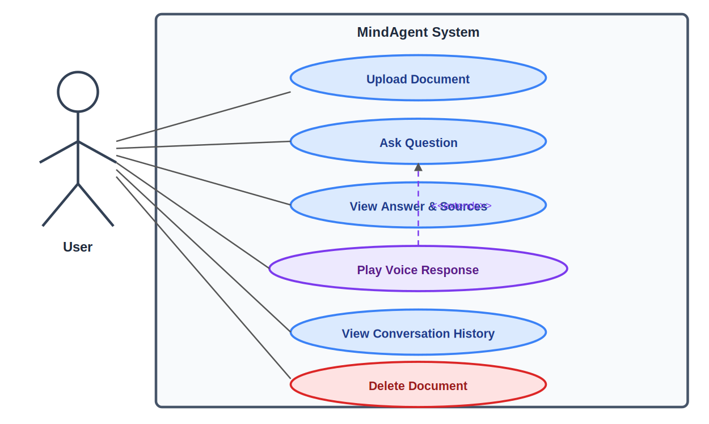
IMPLEMENTATION · 4.3
Query Lifecycle — Sequence
1
Cache check
user:sha256(query) in Redis
2
Async starts
SQS triggers Query Lambda
3
Embed + search
Voyage AI → HNSW+BM25
4
Persist
SETEX job:{id} 3600 {answer}
5
Client polls
GET /result/{jobId} → done
MindAgent · Sequence

Slide 11
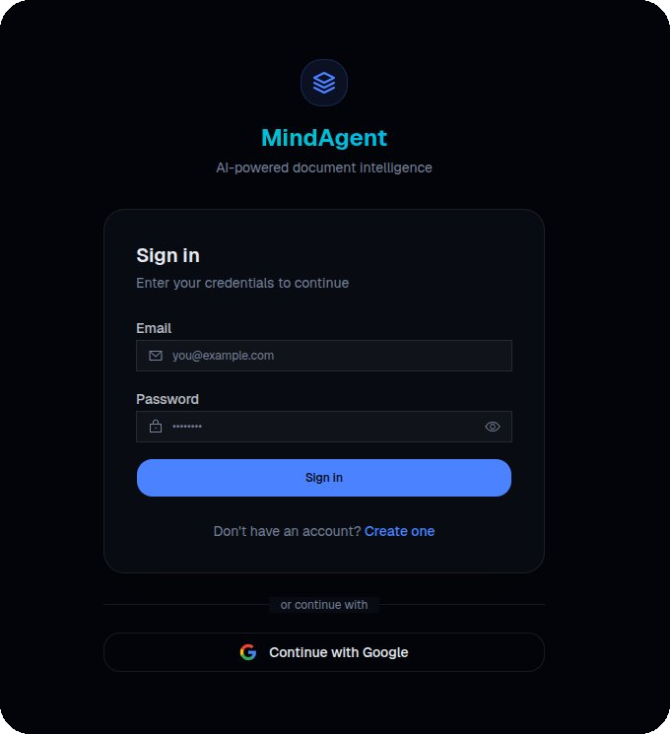
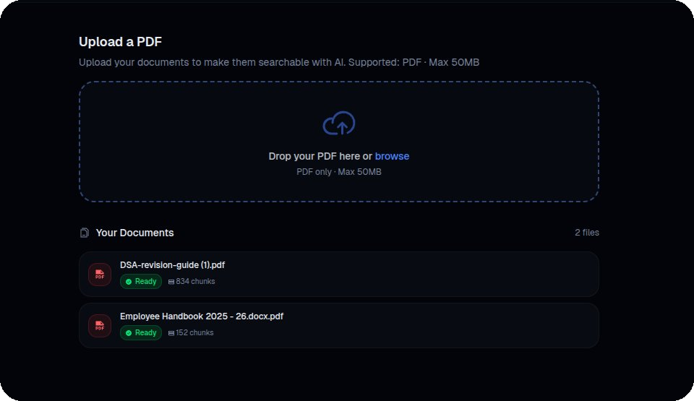
APPLICATION · 6.3
The Application — Auth & Upload
Figure 6.1 — Sign-in via Supabase Auth (JWT HS256)
Figure 6.2 — PDF upload via pre-signed S3 URL
MindAgent · UI · Auth

Slide 12
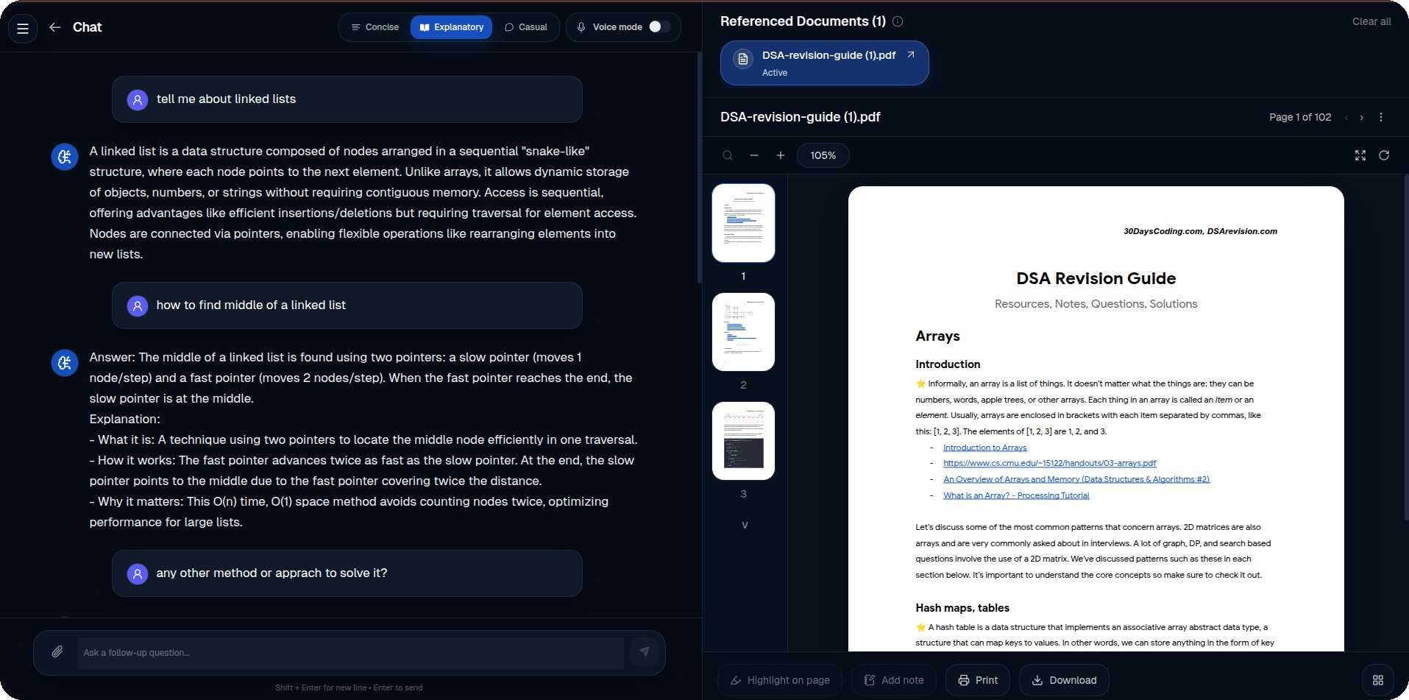

APPLICATION · 6.3.3
Conversational Q&A Interface
Grounded answers
Every response cites source chunks with page numbers.
Live PDF pane
Referenced document rendered beside the chat.
Style control
Concise · Explanatory · Casual + voice.
MindAgent · UI · Q&A

Slide 13
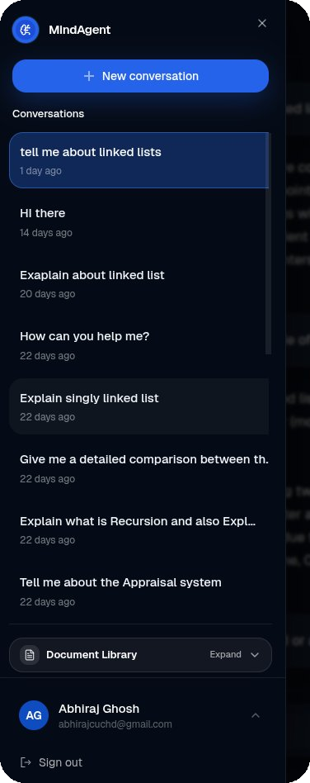
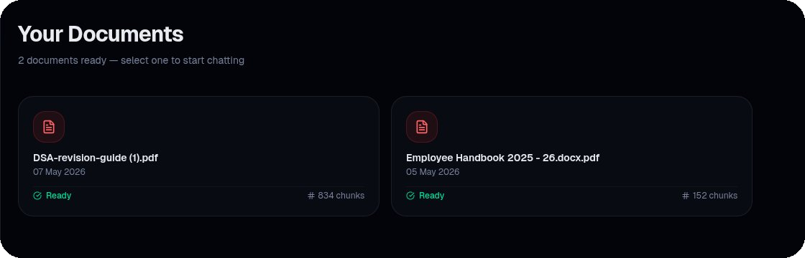
APPLICATION · 6.3.6–6.3.7
Conversations & Document Management
Figure 6.7 — Deletion cascades through S3 → Supabase → query cache
Multi-document scope
Named conversations
Cascade delete
Cache eviction
Figure 6.6 — Conversation sidebar; last 3 Q&A pairs feed follow-up context
MindAgent · UI · History

Slide 14
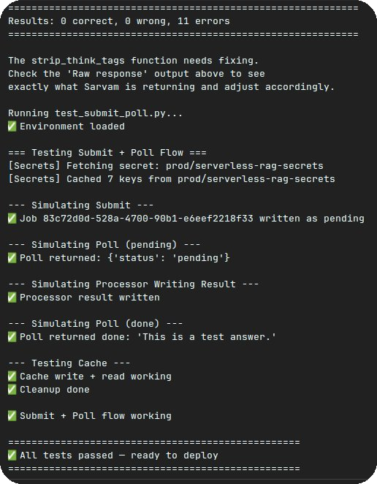
TESTING · 5.5
Testing & Validation
Three-tier strategy
10
Unit tests
Mocked deps — auth, Redis, secrets, router
10
Integration
Live Supabase + Redis, real Lambda handlers
3
End-to-end
Full pipeline against deployed API
23 / 23 tests passed · 100% pass rate
Figure 5.1 — Submit + poll flow; all tests passing
MindAgent · Testing

Slide 15

CHAPTER 7
Conclusion & Future Scope
KEY ACHIEVEMENTS
FUTURE SCOPE
Async submit-poll fully defeats the 29 s timeout
Hybrid search beats vector- or keyword-only retrieval
Confidence-gated HyDE adds quality without wasted tokens
MMR λ=0.7 keeps context diverse, cuts hallucination
SQS re-queue means no query ever fails on rate limits
RLS + scoped cache keys guarantee tenant isolation
Multi-format ingestion (DOCX, HTML, OCR)
Streaming responses via SSE / WebSocket
Agentic tool use — search, calc, code
Cross-encoder reranking (Cohere Rerank)
Multilingual BM25 + usage analytics
MindAgent · Conclusion

Slide 16


Thank You
MindAgent — production-grade document intelligence, built entirely serverless.
github.com/Abhiraj-cuchd/docmind
mindagent.abhirajghosh.tech
Abhiraj Ghosh
O24MCA110969 · MCA 4th Sem · CU Online · 2024–2026

