Slide 1

SWASTIK
An AI Chatbot for Guru Gobind Singh Public School
School Exhibition

Slide 2
The Challenge: Why build Swastik?
Parents, students, and staff have common, recurring questions:
"When are the exams?"
"What is the fee submission deadline?"
"Where is the new syllabus?"
"What are the school timings today?"
Finding specific, up-to-date answers quickly can be difficult.

Slide 3

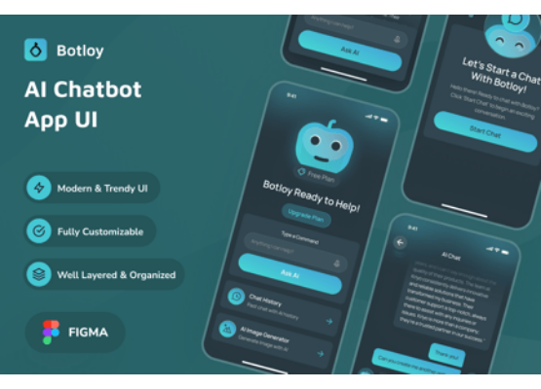
Our Solution: SWASTIK
An AI Assistant for Our School
We built 'Swastik', a 24/7 AI-powered chatbot designed specifically for our school community.
It provides instant, accurate, and friendly answers to all school-related queries, embodying our school's motto:
"Knowledge is Power"

Slide 4


Meet the Team (Core)
Abhi Raj Singh
Binod Soren
Core Developer, Debugger, & Designer
Debugger
Responsible for the full-stack development, AI integration, and overall project design.
Focused on testing, identifying bugs, and ensuring the chatbot's responses are stable and accurate.

Slide 5






Meet the Team (Content & Comms)
Pragati Agarwal
Lovely Kumari
Ananya
Decorator/Designer
Speaker
Speaker
Designed the Flow chart, Q.R. Frame structure, Heading, Titles etc.
Ready to present our project and answer your questions at the exhibition.
Sharing our project's journey and demonstrating its features to all our visitors.

Slide 6
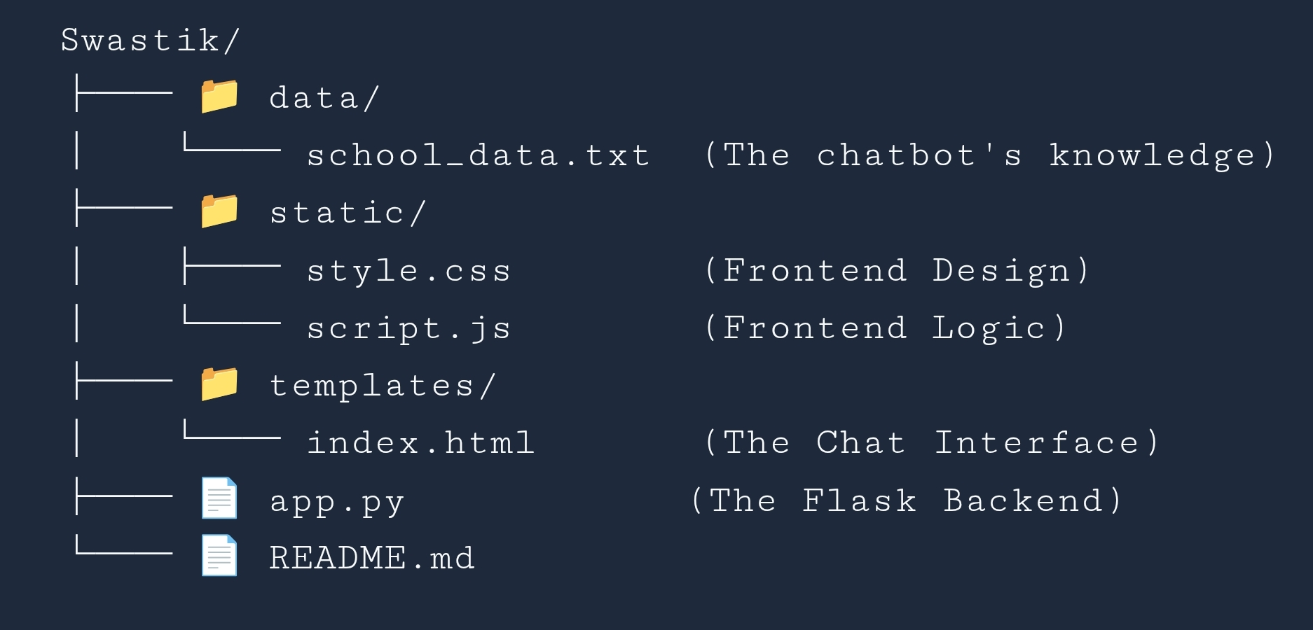
Project Architecture
A clean structure, separating the backend, frontend, and data.

Slide 7








Our Technology Stack
Frontend
Backend
The "Brain"
API Provider
HTML, CSS, & JS
To create a responsive and user-friendly chat interface.
Python & Flask
A powerful and lightweight server to handle requests and logic.
Meta Llama 3 70B
A state-of-the-art AI model for understanding and generating answers.
OpenRouter
Provides us with free and reliable access to the Llama 3 AI model.

Slide 8


The AI "Brain"
Meta Llama 3 (70B)
We are using the powerful Meta Llama 3 70B Instruct model. It's one of the most advanced open-source AI models available.
It's "instruction-tuned," which means it's excellent at following our prompts and providing safe, accurate answers based on our school's data.

Slide 9



How We Went Live: Deployment
Frontend: GitHub Pages
Backend: Render.com
Our user interface (HTML, CSS, JS) is hosted on GitHub Pages.
Our Flask app (Python) runs on Render.com.
It keeps our backend server running 24/7 and securely manages our AI API keys.
It's fast, free, and automatically updates when we push code to our repository.

Slide 10


See It in Action!
Scan the QR Code!
Try the chatbot live on your Desktop/Tablet.
abhiraj1121.github.io/ai/
See the code:
github.com/Abhiraj1121/ai

Slide 11

See It in Action!
Scan the QR Code!
For mobile only!
Try the chatbot live on your Mobile Phone.
abhiraj1121.github.io/aimobile/
See the code:
github.com/Abhiraj1121/aimobile

Slide 12
Thank You
Questions?

