Slide 1
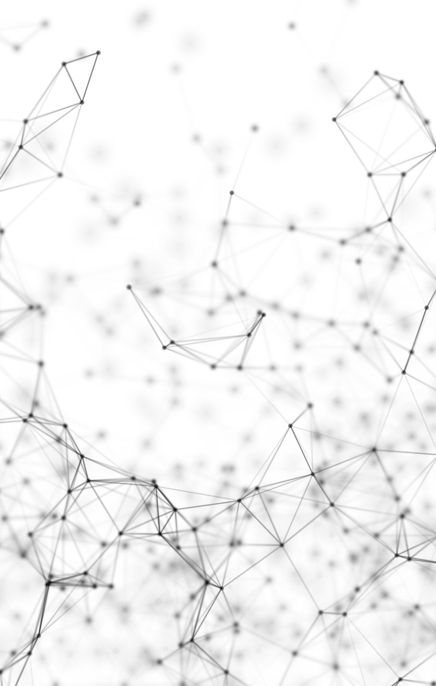
Learning Prosthesis
Abhiraj Abhaykumar Eksambekar
PSU ID: 932343978
abhiraj@pdx.edu

Slide 2
Goal
With computer vision and machine learning, I tried to replicate 10 different hand gestures on a prosthetic robotic arm.
This project deals with understanding neural network models, understanding and generating dataset required for training a neural network model and using the trained model to detect real time gestures and replicate it on to the arm.
This project is a first simple step in understanding of the mechanical aspects of arm and to have a better structure and better control interfacing with human in order to develop good reliable prosthetic limbs.

Slide 3
Generating dataset
I created a simple python script to generate dataset.
This script was given to my friends, family and classmates to help me with generation of dataset. They simply have to run the script according to instructions, place their hand in the blue square and replicate the hand gesture as shown in top left corner of the screen.
The script automatically starts saving images for each gesture.
Thanks to my parents, Ramprakash, Noah Page, Keerthan, Kaustubh and Aayush in helping me generate the dataset.
Variety in dataset helps to generalize the model so that it should be able to detect gestures shown by anyone else not in the above list.

Slide 4
Generating dataset
There are 10 gestures to be gathered.
The python script generates 200 images of each gesture. Therefore generating 2000 images in total for one person.
The dataset was checked, and any wrong images were deleted.
This dataset was divided into 3 different sets- Training set, testing set and validation set.

Slide 5
CNN Model
Convolutional Neural Networks consists of different layers of convolutional layer, pooling layer, zero padding layer.
In this project I am using MobileNet CNN available in keras applications.
It has 0.704 top-1 accuracy and 0.895 top-5 accuracy.
It has 88 layers which are later changed to 83 according to this project requirement.
Main reason for selecting this model is MobileNet consumes less disk space-15MB which can run faster in mobile devices.
Since I am using Raspberry Pi, bigger models can pose huge latency in classification of image.

Slide 6
Training model
I use the gathered dataset to train the CNN model.
There are 15,957 images in total. 12,757 images were used as training set, 3,000 images were used for validation set and 200 were used as testing set.
To train the model, all the dataset is grouped in batches of 32 images. All batches trained the model for single epoch.
After each epoch, the trainer gives information of accuracy and loss for training set and validation set.
With the help of validation set we can check for overfitting condition.
Overfitting occurs when the model trains so perfectly that it classifies the training set with 100% accuracy but has huge loss when classifying image which is not present in the training set.

Slide 7
Testing model
To test the model, I created 4 different test sets.
First set consist of images split from original gathered dataset.
The second test set has images with no much rotation or translation of hand gesture.
The third test set has images with high rotation and translation of the gesture.
And the final test set has images also with high rotation and translation, but with a very noisy background.
Confusion matrix is crated for each type of test set.

Slide 8
Hardware used
Raspberry Pi 4b with 4GB ram
RPI Camera V2
Sunflower PCA 9685 module for servo motor control
Futaba S3003- servo
Laptop with 16GB RAM and 6GB GPU used for training the model.

Slide 9
Controlling servo
Futaba S3003 has a voltage range of 4.8V to 6V
According to datasheet, the duty-cycle range to control the motor angle is 2% to 7.5%.
This duty-cycle is tested and corrected in the final code.
I use the python package available in official documentation of PCA9685 module.
Simple calculations are done to find duty-cycle which corresponding to the required angle.

Slide 10
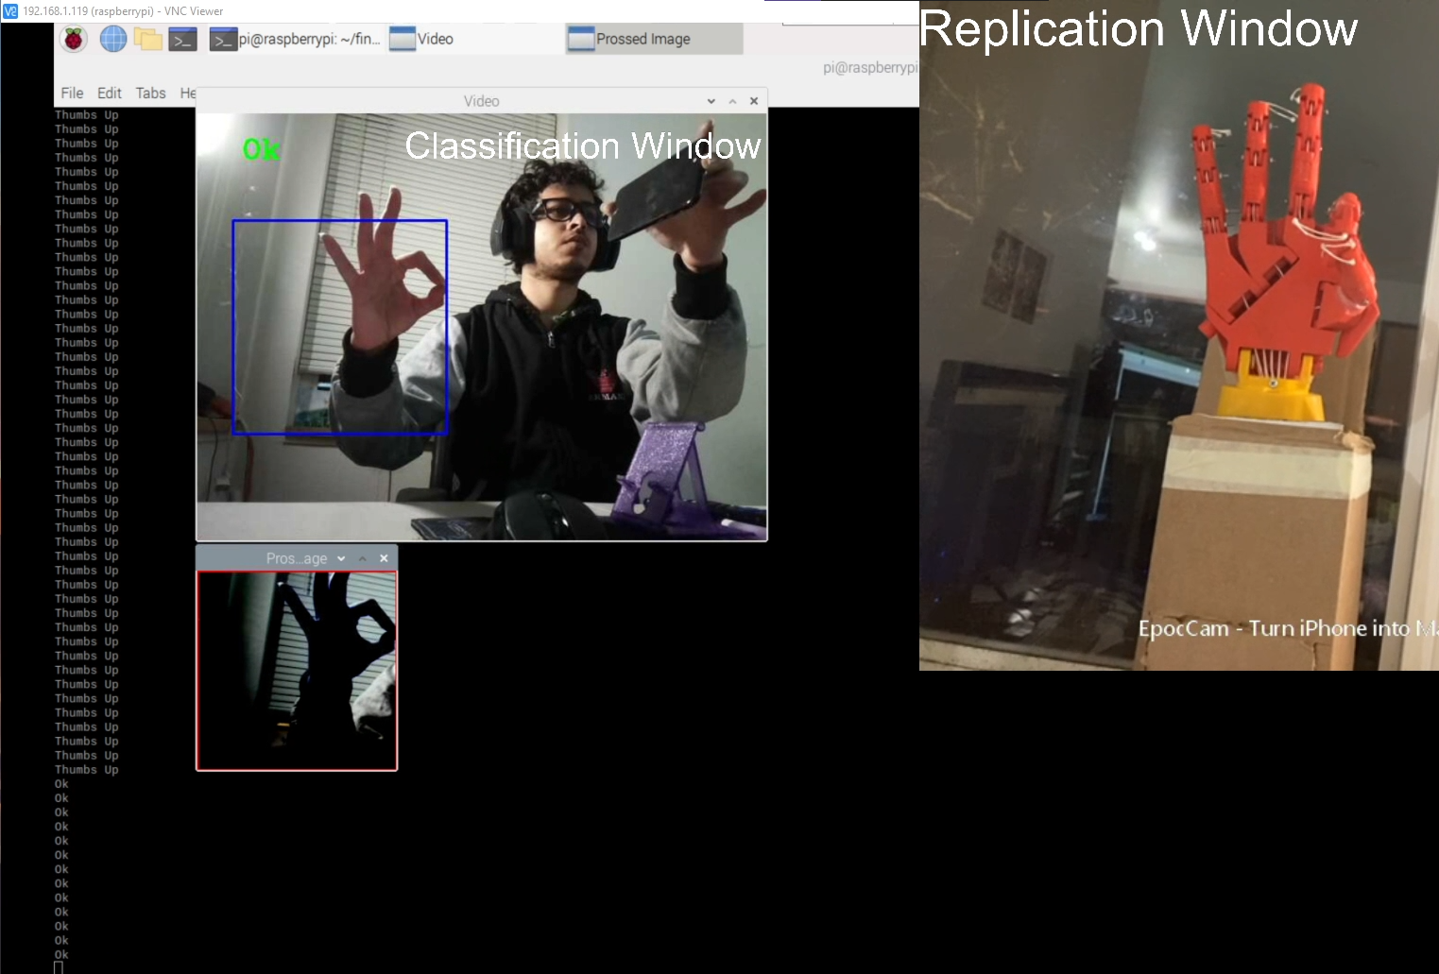
Detection and replication

Slide 11
Mechanical defects
Long screws in fingers sometime restrict adjacent finger movements.
Threads wrapping around the servo motor which control the finger movement slips from its rings and therefore setting the tension in strings loose.
Threads not strong to hold any heavy objects in hand.

Slide 12

Possible mechanical improvements

Slide 13
Relation to paper reading
As previously presented, my paper presentation deals with brain response to stimuli where stimuli being emotions, gestures shown be human and a robot.
It deals with understanding areas of brain affecting response to the gestures.
By testing and finding areas of brain which are responsible for movement and motions of hand, this information can be useful to control the prosthetic arm by identifying corresponding changes in brain.

Slide 14

Thank you

